Slide 1
CDAO-STORE:
A New Vision for Data Integration
Brandon Chisham, Trung Le, Enrico Pontelli,
Tran Son, Ben Wright
IEvoBio 2010
Portland, OR

Slide 2
CDAO
Comparative Data Analysis Ontology
  provide semantics to the descriptions of data and transformations commonly found in the domain of phylogenetic inference.
  enables the description of phylogenetic trees and associated character data matrices

Slide 3
What We Did
CDAO-Store
  a repository providing a rich set of API's for querying and visualizing phyloinformatics data.

Slide 4
CDAO-Store Repository?
What's in it?
  TreeBASE dump dated January 2009
  Also allows the importation of CDAO formatted files.
    To get your files into CDAO, we can translate NEXUS, PHYLIP, and MEGA into CDAO format.
  Files can be exported in RDF/XML using CDAO terms

Slide 5
Querying CDAO-Store
PhyloWS
  retrieve data sets via name, tree identifier, taxon, algorithm, method, or size.
  supports computing the minimum spanning clade or the nearest common ancestor of a set of taxa.
Web-Based
  Search for data sets by author or study
  View data sets online by tree, taxon, algorithm, method, or size.

Slide 6
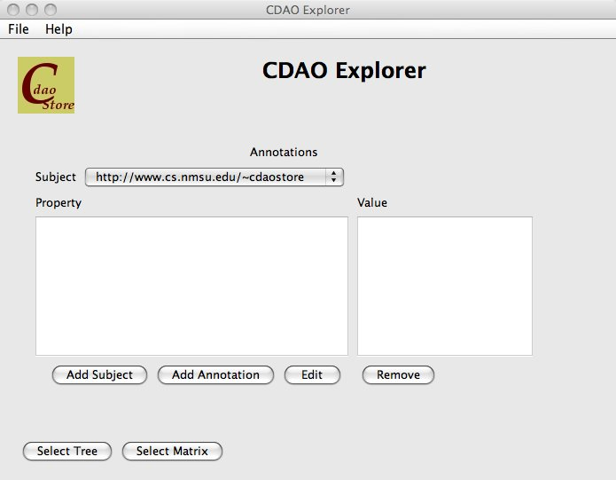
Visualization
CDAO-Explorer
  Tree Viewer
  Matrix Viewer

Slide 7
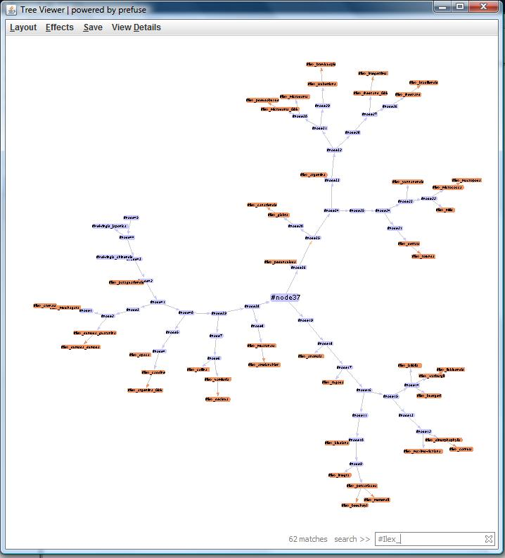
Tree Viewer
Uses the Prefuse framework
2 Layouts, “Force Layout” and “Node Layout”
Can search by node/edge name
View details of nodes or edges
Can save as jpg or png

Slide 8
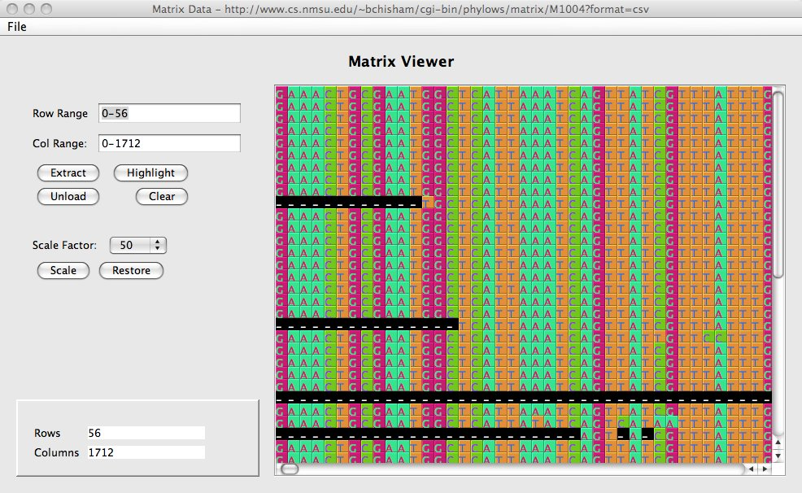
Matrix Viewer
Custom built
Color-coded cells
Extract or 'crop' parts of the Matrix for closer views
Zoom in and out of the matrix
Annotation support in development.

Slide 9
Conclusion
The CDAO-store tool set provides a robust foundation for a semantically aware, phylogeny resource
The CDAO-Explorer portion of the store has achieved a good base-line functionality and provides a set of useful features to advance the current state of visualization of large data sets in this field.

Slide 10
Future
Annotations / MIAPA / OBI
User-defined SPARQL Queries
Better Tree / Matrix integration
Ambiguous Name Resolution (at taxon, tree, and study levels)
Intergrating other stores besides TreeBASE

Slide 11




Questions?
Find us at:
  http://www.cs.nmsu.edu/~cdaostore
  http://cdaotools.sourceforge.net
  http://www.twitter.com/cdaotools
Funding for this project provided by:
  NSF CREST grant HRD-0420407
  NSF IGERT grant DGE-0504304
Additional Support provided by:
  NESCent
  NMSU
  CDAO Development Team

