Slide 1
Phylogeny

Slide 2
Trees and their terms

Slide 3
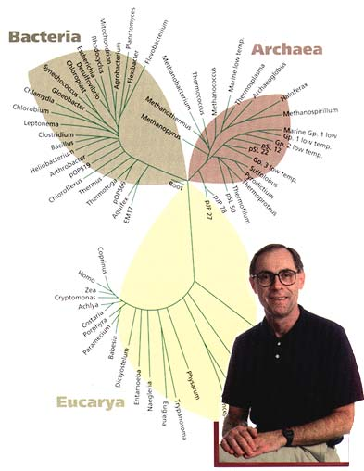
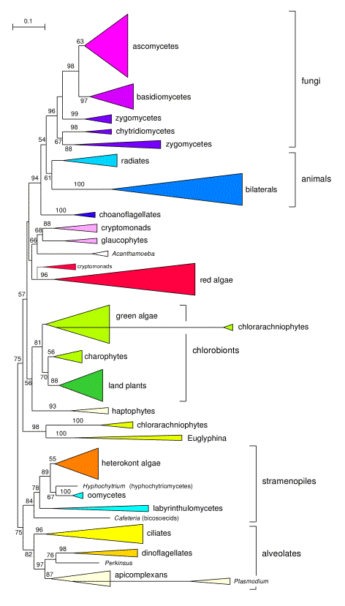

Slide 4
Tree terminology
leaf (terminal node)
internal node
(hypothetical ancestor)
edge (branch)
root

Slide 5
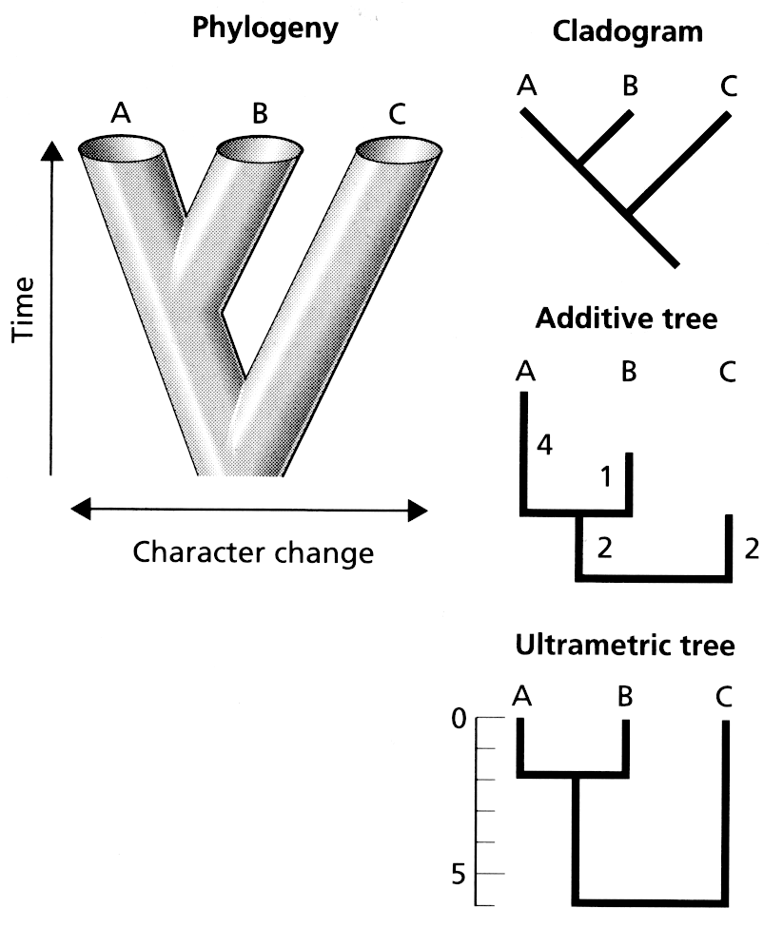

Slide 6
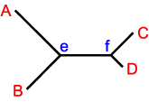
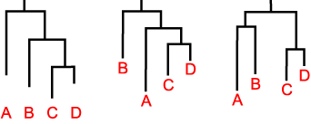
Rooting a tree

Slide 7
Order doesn’t matter
(trees are like mobiles)
A
B
C
D
D
C
B
A
B
C
D
A
=
=

Slide 8
Tree description
A
B
C
,
(
)
,
(
)
,
)
(
(
A
B
,
C
)

Slide 9
Building trees
Maximum parsimony
(which tree can explain data with least amount of evolutionary change)
Maximum likelihood
(which tree has highest probability of generating observed data)
Bayesian analysis
(probability distribution of trees based on prior knowledge and current data)

Slide 10
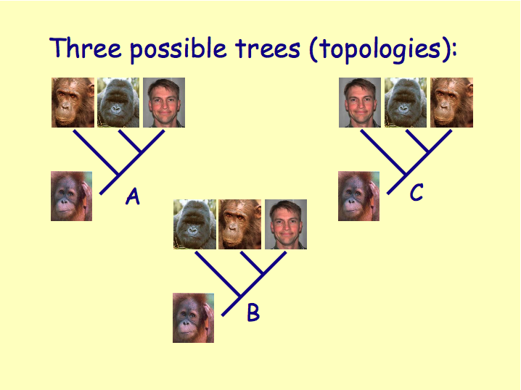
Notes:
Parsimony and likelihood pick “best” tree

Slide 11
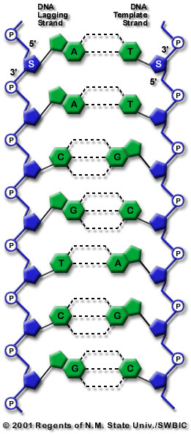
Types of substitution
A
G
transitions
transversions
C
T
transitions

Slide 12
Likelihood
Observed
human
More parameters = better fit
but, don’t want too many
parameters
A
C
G
T
A
C
chimp
G
T
Predicted by models
Jukes-Cantor
Kimura 2 parameter
Hasegawa et al.
A
C
G
T
A
C
G
T
A
C
G
T
A
A
A
C
C
C
G
G
G
T
T
T

Slide 13
Probability is different from likelihood

Slide 14
You hear a noise in the ceiling…

Slide 15
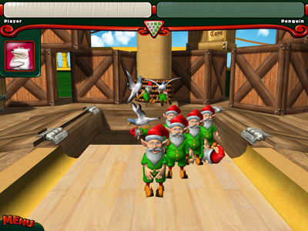
Could be elves bowling in the attic

Slide 16
The probability that you have bowling elves is very low…

Slide 17
…but if you did have them, the probability that you would hear them is very high (=likelihood)

Slide 18
Bayesian methods

Slide 19
Probability of having bowling elves is low (prior probability)
If you have bowling elves, probability that they would make a noise is high (likelihood)
Bayesian methods combine prior probability with likelihood to get posterior probability

Slide 20
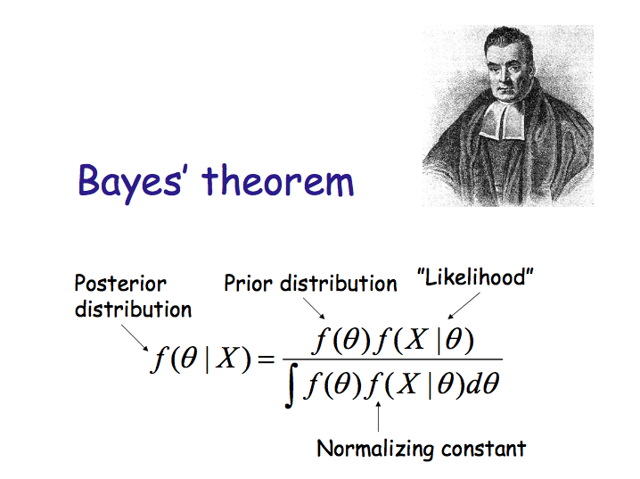

Slide 21
Notes:
Parsimony and likelihood pick “best” tree

Slide 22
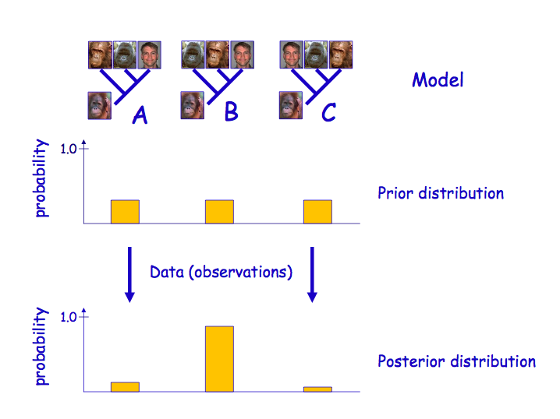
Notes:
Instead of a single best tree we have a probability distribution. Don’t pick the single best tree.

Slide 23
Bayesian posterior probabilities
A
B
1.0
C
0.8
D
0.5
E

Slide 24
Open problems

Slide 25
Visualisation

Slide 26
There are few constraints on how we can draw trees

Slide 27
A
B
Y
C
D
X

Slide 28
We can reorder Y
B
A
Y
D
C
X

Slide 29

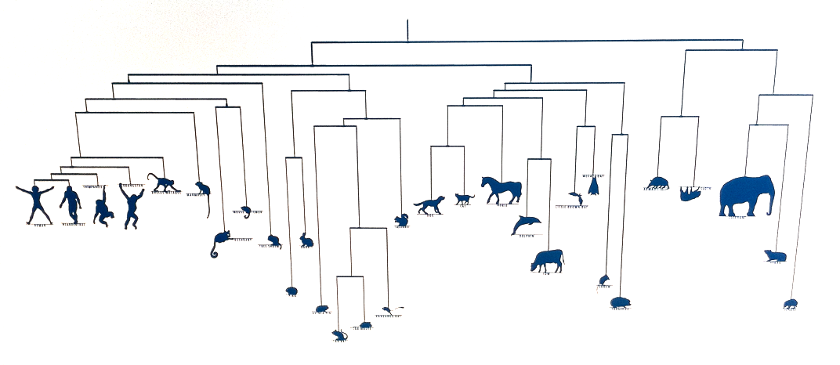
@broadinstitute

Slide 30
X is a partial order
B
A
Y
D
C
X

Slide 31
X is a partial order
B
A
Y
D
C
X

Slide 32
B
A
Y
D
C
X: evolutionary distance

Slide 33
B
A
Y
D
C
X: time

Slide 34
What would third dimension represent?
Y
Z?
X

Slide 35
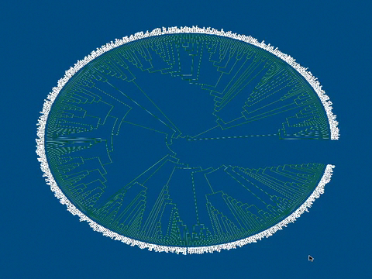
Paloverde
Notes:
http://loco.biosci.arizona.edu/paloverde/paloverde.html

Slide 36

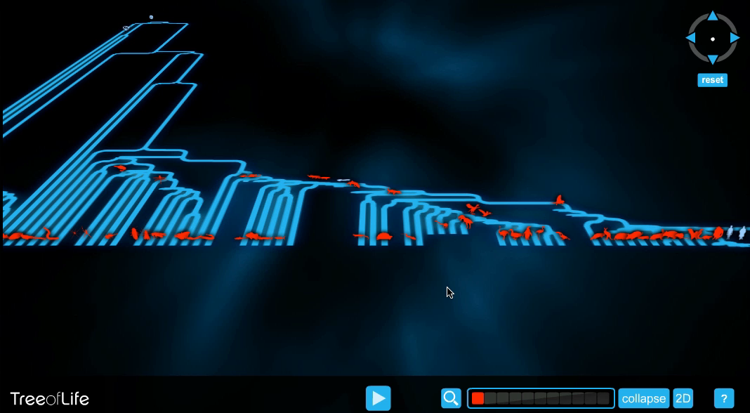
@wellcometrust
Notes:
http://www.wellcometreeoflife.org/

Slide 37
Touching the tree

Slide 38

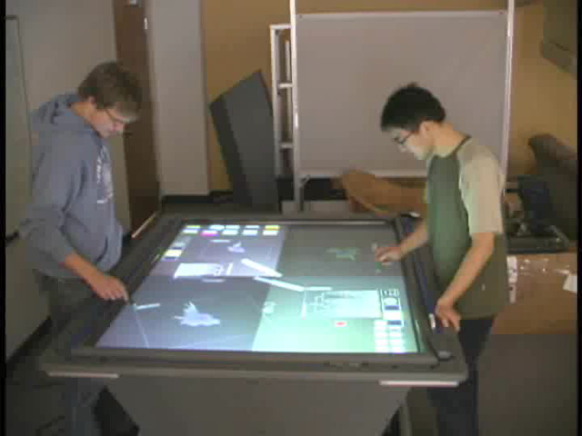
@dr_pi
Notes:
Petra Isenberg, see “Interactive tree comparison for co-located collaborative information visualization” http://www.ncbi.nlm.nih.gov/pubmed/17968069 and http://innovis.cpsc.ucalgary.ca/Research/CollaborativeTreeComparison

Slide 39
Big trees

Slide 40
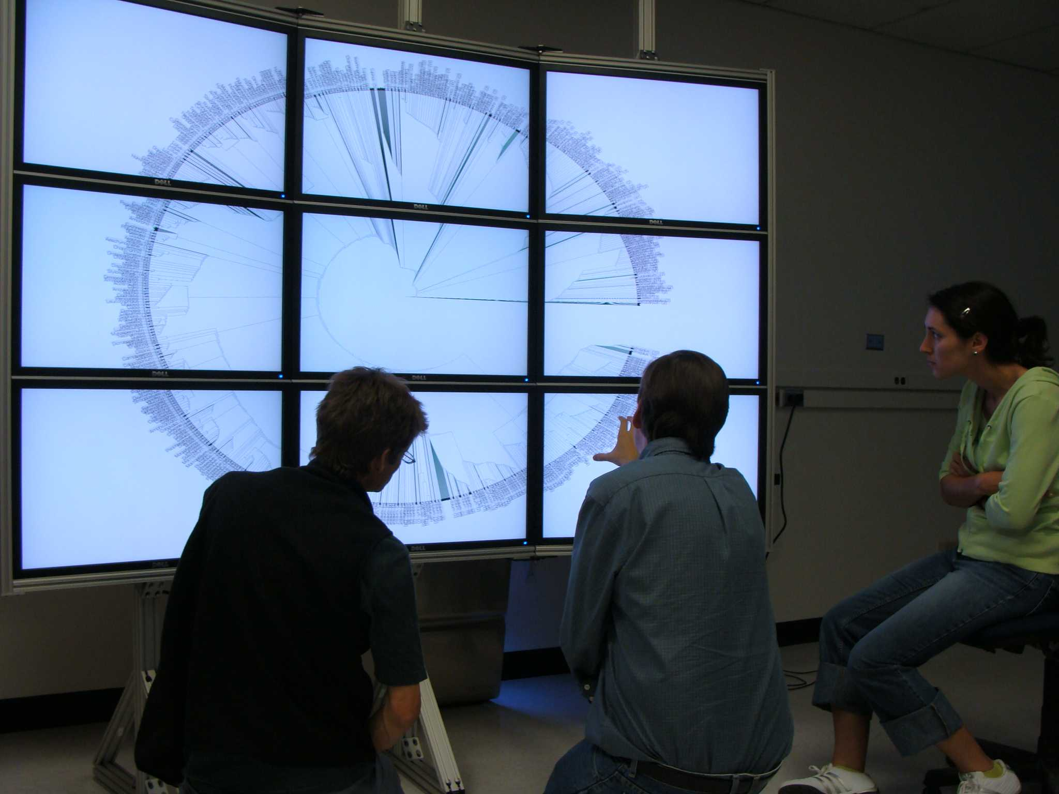
add
Notes:
Image from Mike Sanderson’s Lab (http://loco.biosci.arizona.edu/)

Slide 41
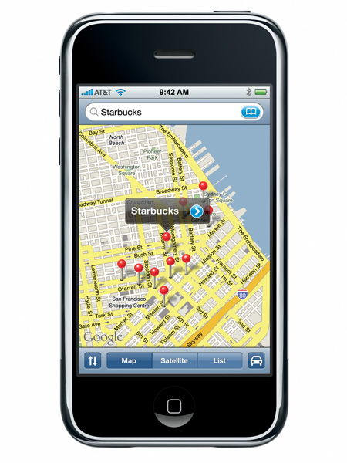

Slide 42
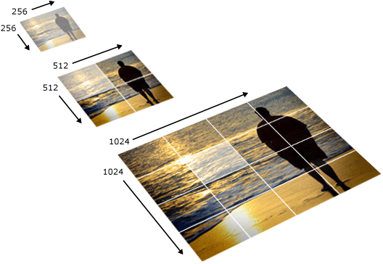
Notes:
http://msdn.microsoft.com/en-us/library/cc645050(v=vs.95).aspx

Slide 43

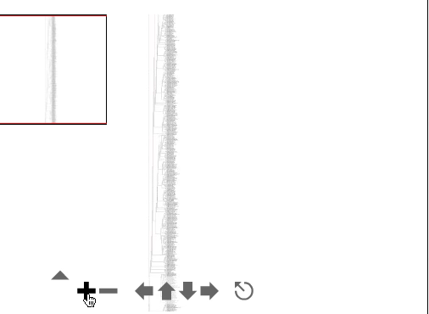
@rdmpage
Notes:
http://iphylo.blogspot.com/2007/08/visualising-very-big-trees-part-iv.html

Slide 44
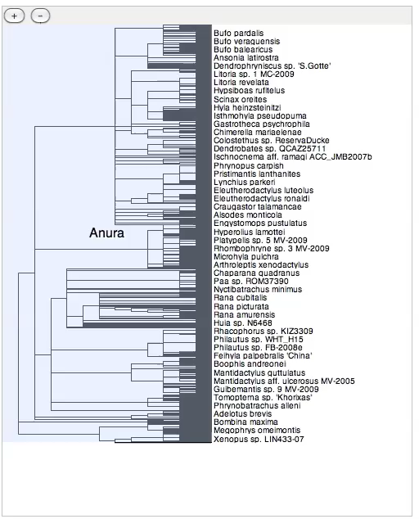
@rdmpage

Slide 45
Where are the trees?

Slide 46

http://www.treebase.org/

Slide 47
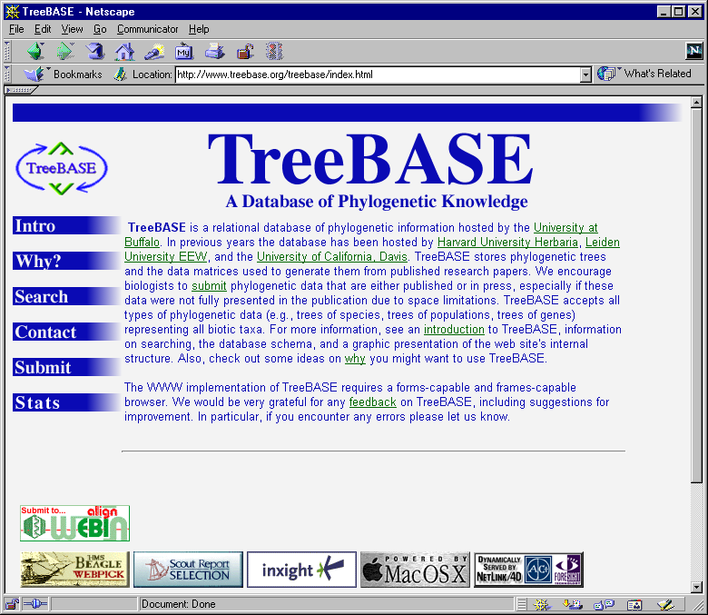
Rate of growth of phylogenetic knowledge
Number of papers with “molecular” and “phylogeny” in Web of Science
Number of studies in TreeBASE

Slide 48
Why aren’t we archiving these trees?

Slide 49
How can we find the trees that we have?

Slide 50
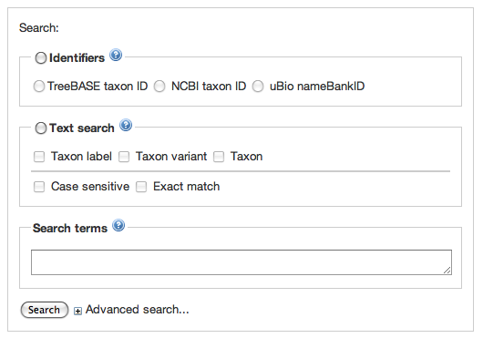
TreeBASE interface

Slide 51
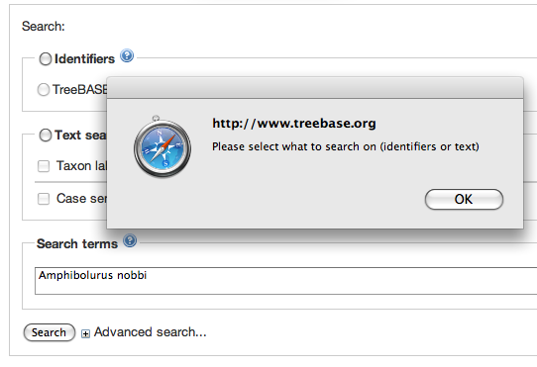
TreeBASE interface

Slide 52
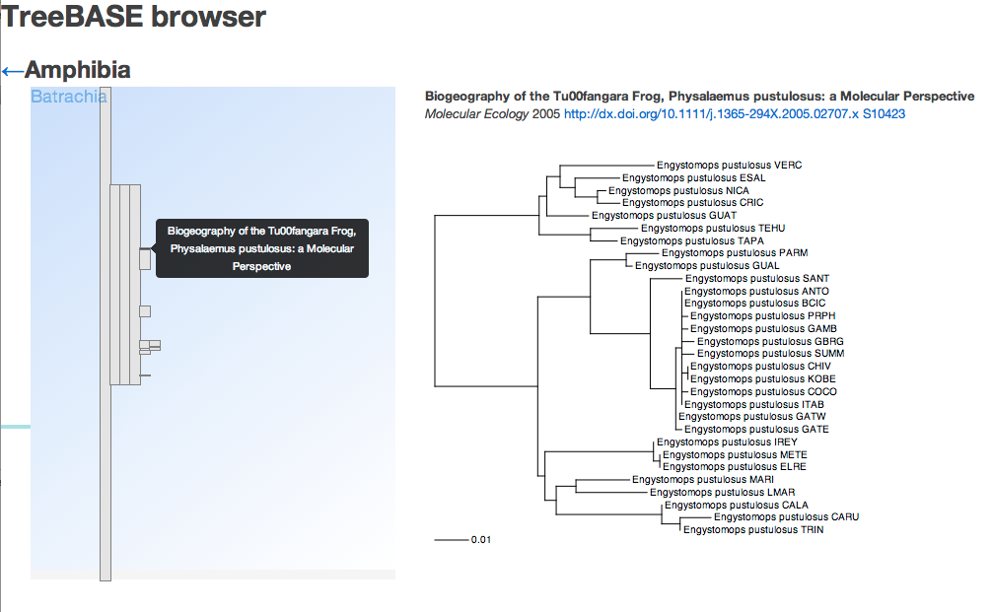
Browser

Slide 53
The End

