Slide 1
Phylogeny

Slide 2
Trees and their terms

Slide 3
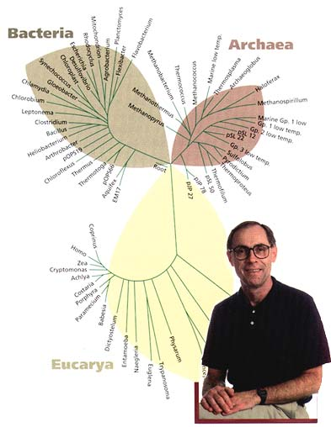
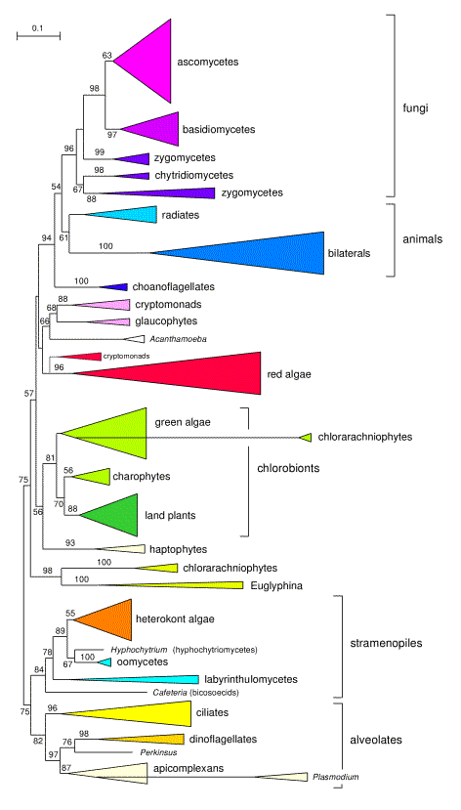

Slide 4
Tree terminology
leaf (terminal node)
internal node
(hypothetical ancestor)
edge (branch)
root

Slide 5
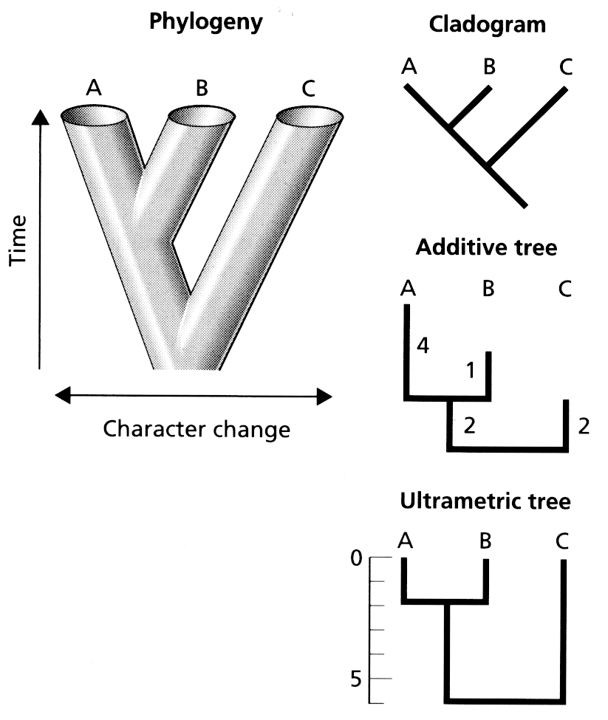

Slide 6
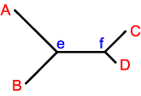
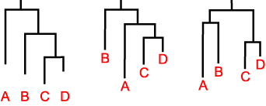
Rooting a tree

Slide 7
Order doesn’t matter (trees are like mobiles)
A
B
C
D
D
C
B
A
B
C
D
A
=
=

Slide 8
Tree description
A
B
C
,
(
)
,
(
)
,
)
)
(
(
A
B
,
C

Slide 9
How do we get trees?

Slide 10
Tree building methods
Neighbour joining
Parsimony
Likelihood
Bayesian

Slide 11
Neighbour joining

Slide 12
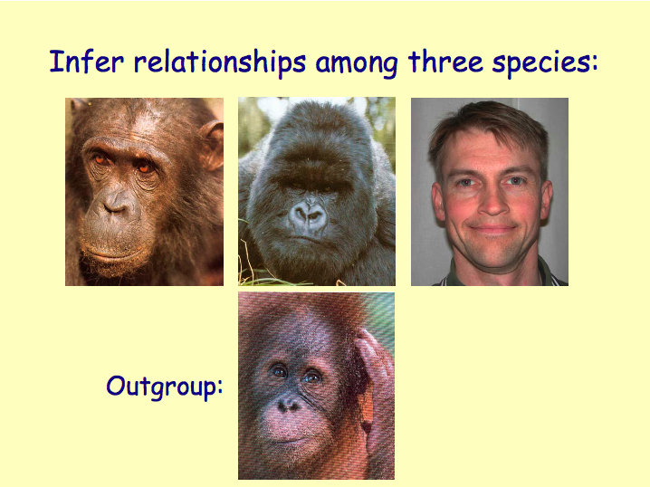

Slide 13
Distance matrix
TCCCGGGTGACACACCTCA
|||| | ||||||
CCCCGTGCAGTACACCTTG
gibbon human chimp gorilla orang
1 gibbon -
2 human 0.17877 -
3 chimp 0.18761 0.08717 -
4 gorilla 0.18762 0.10169 0.10610 -
5 orang 0.18668 0.15884 0.17104 0.16657 -

Slide 14
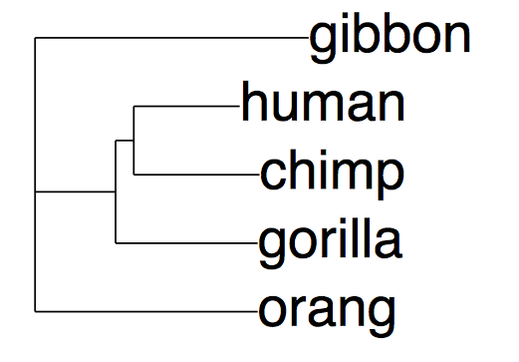
The single neighbour joining tree for the DNA sequences

Slide 15
Parsimony

Slide 17
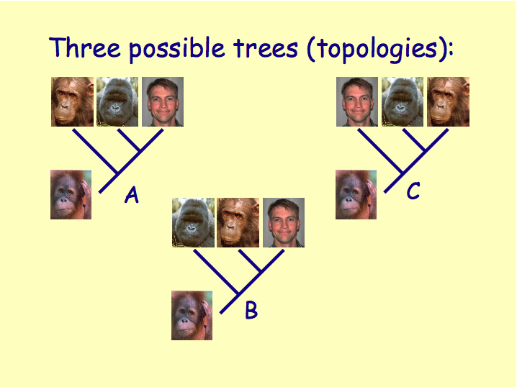

Slide 18
Choose tree that requires the least amount of evolutionary change

Slide 19
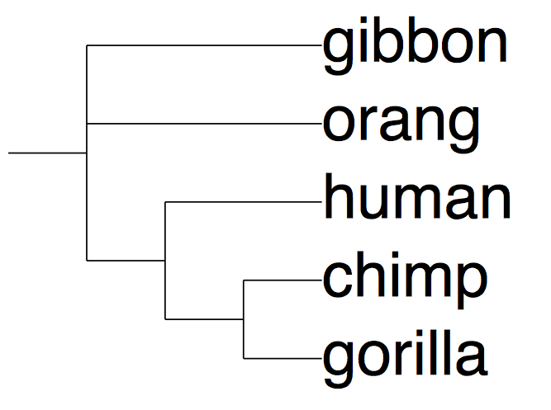
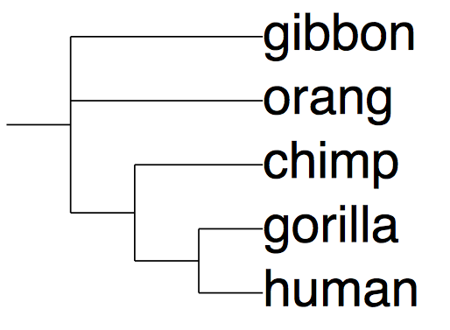
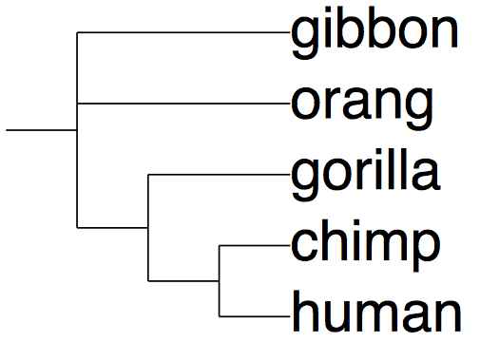
The number of DNA substitutions required to fit the DNA data onto each tree (= tree “length”)
353
356
355

Slide 20
What can go wrong?

Slide 21
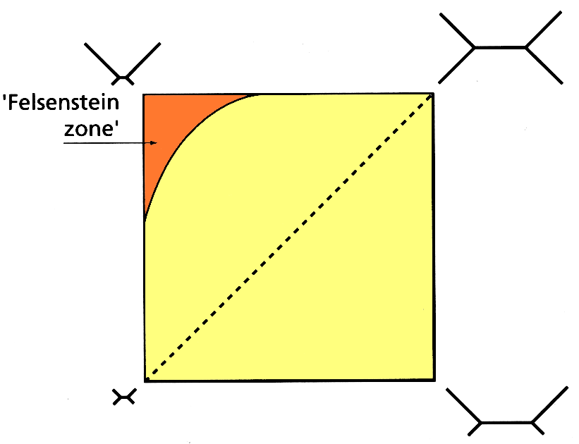

Slide 22
0
0
0
A
B
C

Slide 23
1
0
0
A
B
C

Slide 24
1
1
0
A
B
C

Slide 25
1
0
1
A
B
C

Slide 26
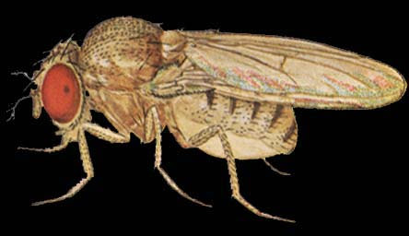
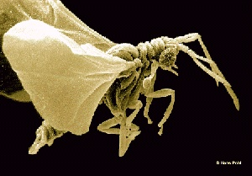
Aedes
Drosophila
Strepsipte
Halteres
Polistes
Flea
Scorpionfl
Sawfly
Meloe
Tenebrio
Lacewing
18S rRNA sequences
Parsimony groups Strepsiptera and flies
Antlion
OUU06478
PSU06480
0.1

Slide 27
Sawfly
Strepsipte
Meloe
Tenebrio
Polistes
Aedes
Drosophila
Lacewing
Antlion
Flea
18S rRNA sequences
Maximum likelihood suggests a different tree
Scorpionfl
OUU06478
PSU06480

Slide 28
Likelihood

Slide 29
Likelihood = probability of the data given a model and some observations
In other words, what are the chances of us getting the data we got?

Slide 31
Probability of observed data given a tree and a model of how characters evolve

Slide 32
Need a model for how characters evolve

Slide 33
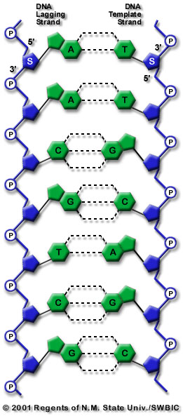
Types of substitution
A
G
transitions
transversions
C
T
transitions

Slide 34
Likelihood
Observed
human
More parameters = better fit
but, don’t want too many
parameters
A
C
G
T
A
C
chimp
G
T
Predicted by models
A
C
G
T
A
C
G
T
A
C
G
T
A
A
A
C
C
C
G
G
G
T
T
T

Slide 36
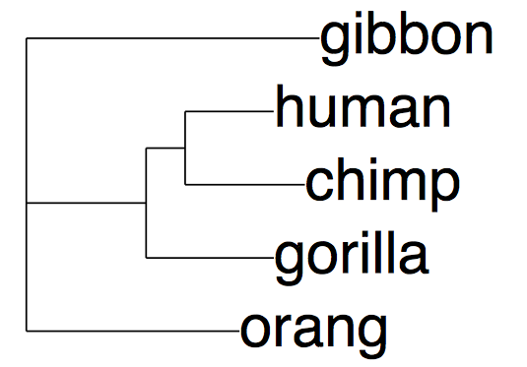
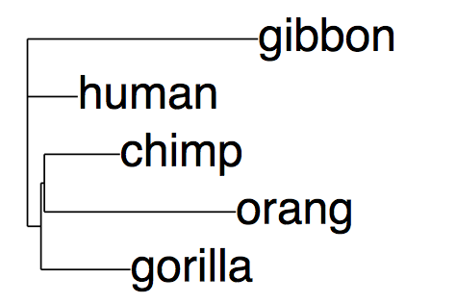
2683.70217
(-log probability that this tree
would give observed data)
2729.50352

Slide 37
Bayesian

Slide 38
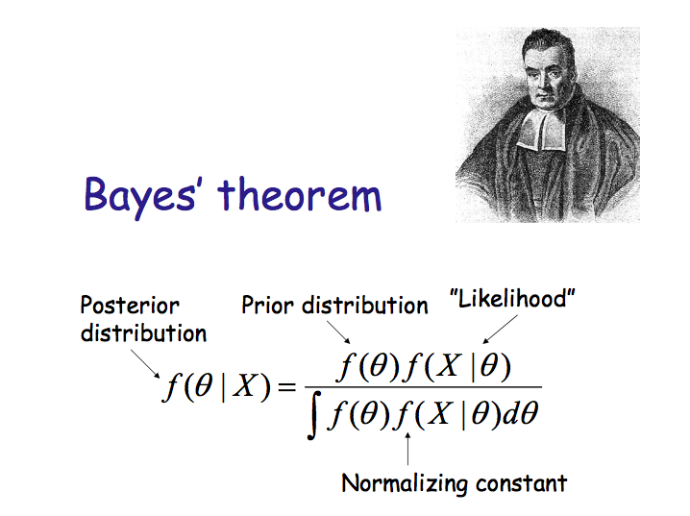

Slide 40
Notes:
Parsimony and likelihood pick “best” tree

Slide 41
https://www.menti.com/1u6eurfeqk

Slide 42
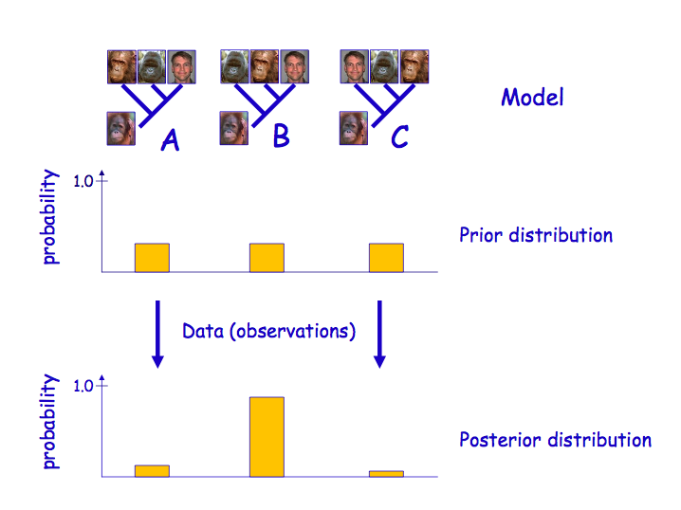
Notes:
Instead of a single best tree we have a probability distribution. Don’t pick the single best tree.

Slide 43
Bayesian methods
Many trees may have similar likelihoods
Any one tree might itself have a low probability
Summarise over a (large) set of trees

Slide 44
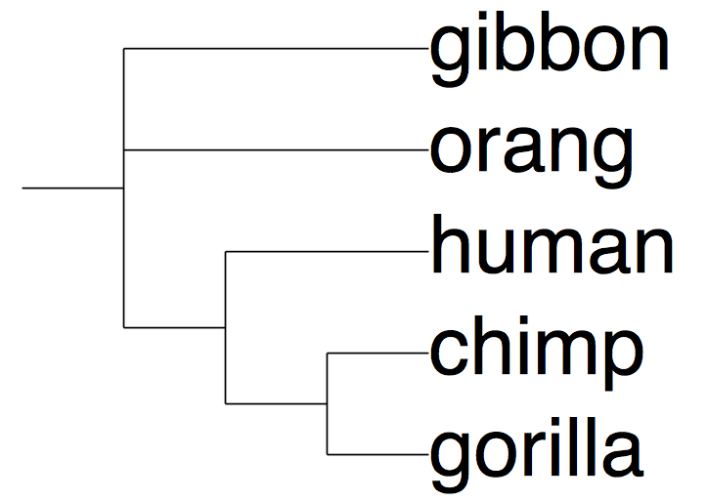
1.0
Numbers on internal nodes are posterior probabilities that node is correct
0.6

Slide 45
Open problems

Slide 46
Visualisation

Slide 47
There are few constraints on how we can draw trees

Slide 48
A
B
Y
C
D
X

Slide 49
We can reorder Y
B
A
Y
D
C
X

Slide 50

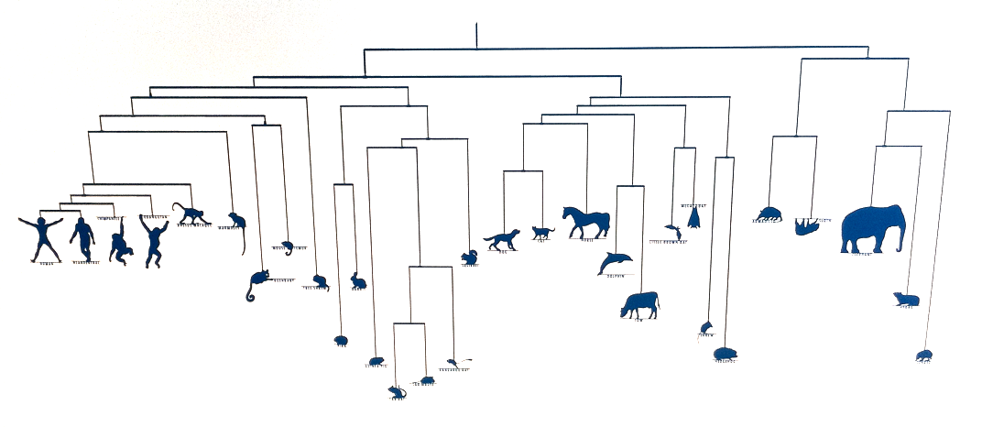
@broadinstitute

Slide 51
X is a partial order
B
A
Y
D
C
X

Slide 52
X is a partial order
B
A
Y
D
C
X

Slide 53
B
A
Y
D
C
X: evolutionary distance

Slide 54
B
A
Y
D
C
X: time

Slide 55
What would third dimension represent?
Y
Z?
X

Slide 56
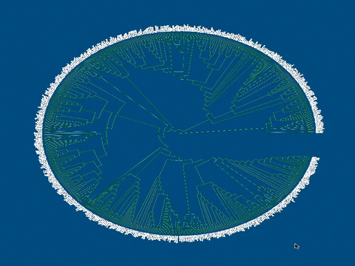
Paloverde
Notes:
http://loco.biosci.arizona.edu/paloverde/paloverde.html

Slide 57

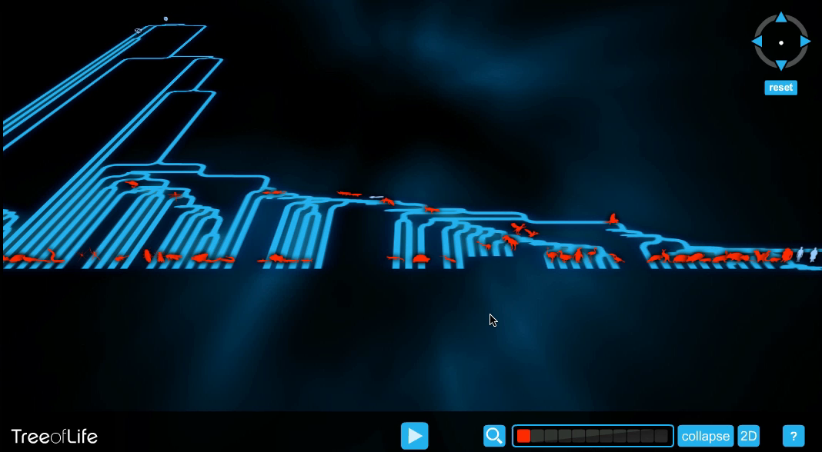
@wellcometrust
Notes:
http://www.wellcometreeoflife.org/

Slide 58
Touching the tree

Slide 59

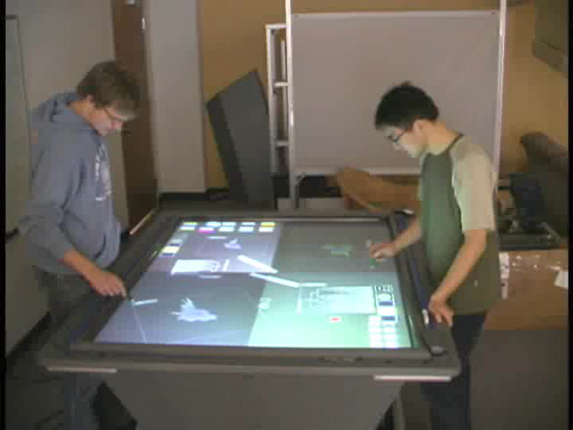
@dr_pi
Notes:
Petra Isenberg, see “Interactive tree comparison for co-located collaborative information visualization” http://www.ncbi.nlm.nih.gov/pubmed/17968069 and http://innovis.cpsc.ucalgary.ca/Research/CollaborativeTreeComparison

Slide 60
Big trees

Slide 61
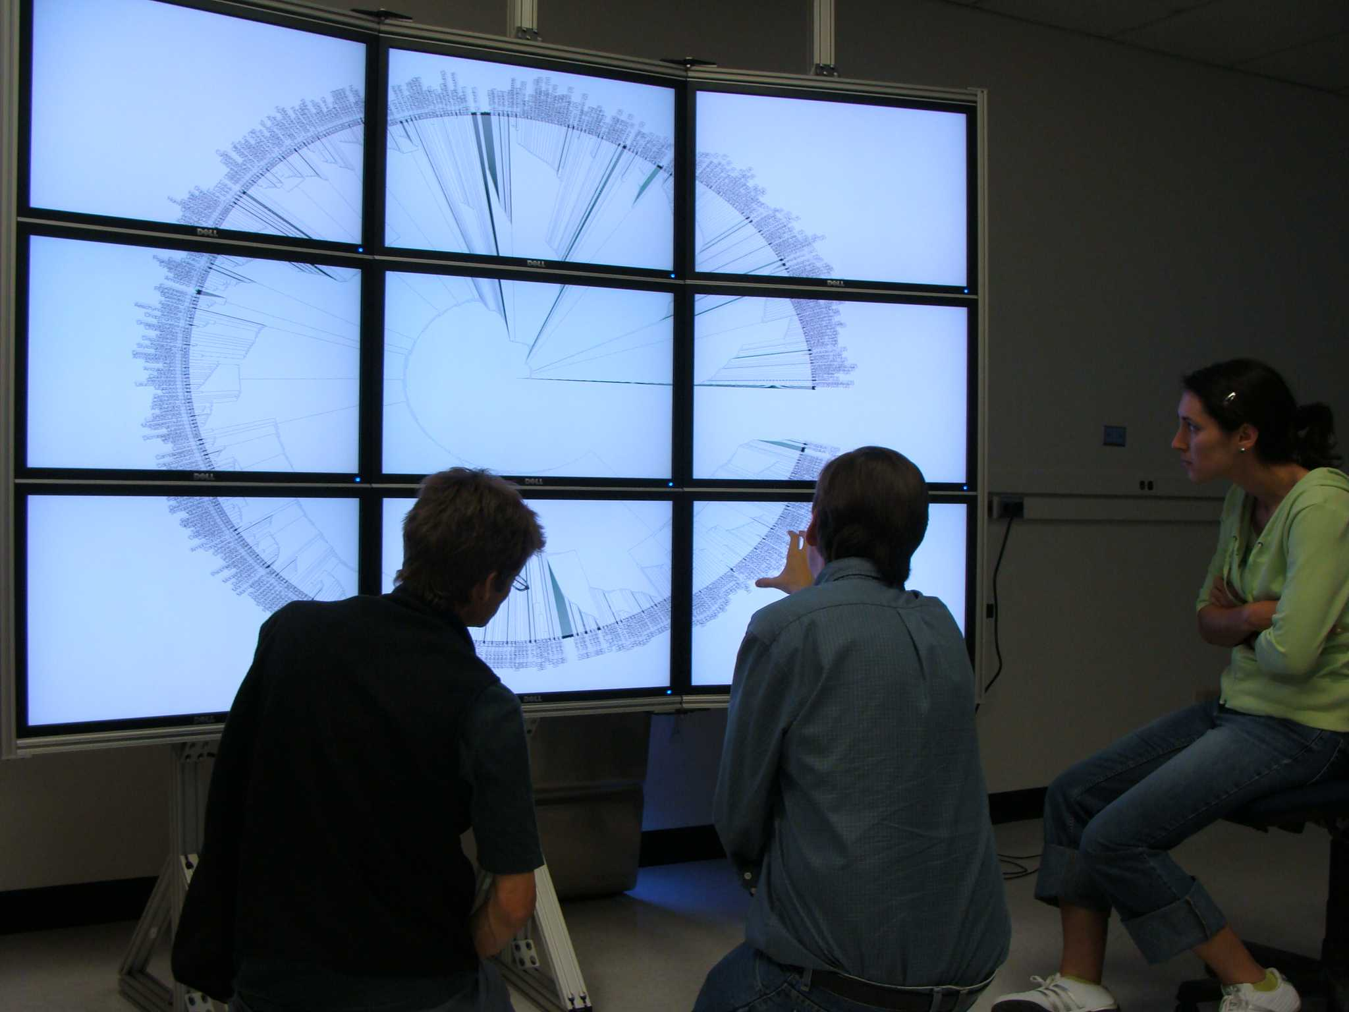
add
Notes:
Image from Mike Sanderson’s Lab (http://loco.biosci.arizona.edu/)

Slide 62
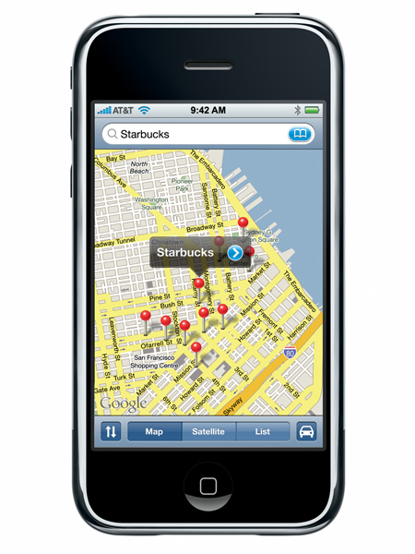

Slide 63
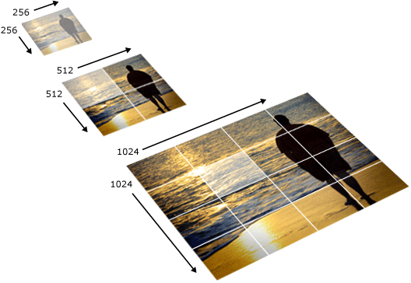
Notes:
http://msdn.microsoft.com/en-us/library/cc645050(v=vs.95).aspx

Slide 64

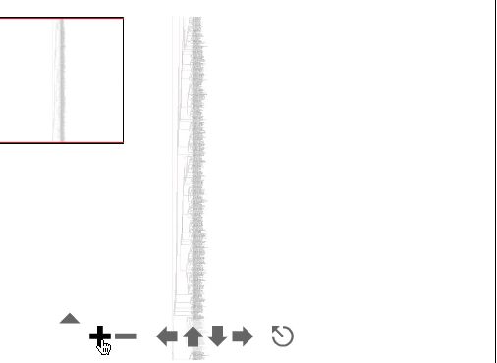
@rdmpage
Notes:
http://iphylo.blogspot.com/2007/08/visualising-very-big-trees-part-iv.html

Slide 65
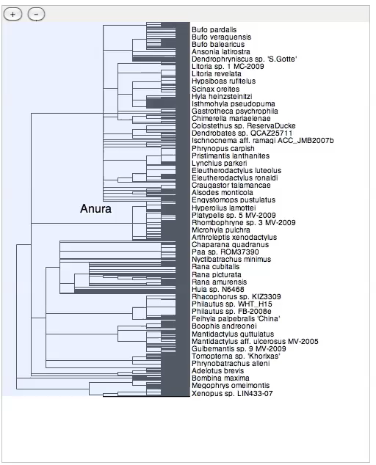
@rdmpage

Slide 66
Where are the trees?

Slide 67

http://www.treebase.org/

Slide 68
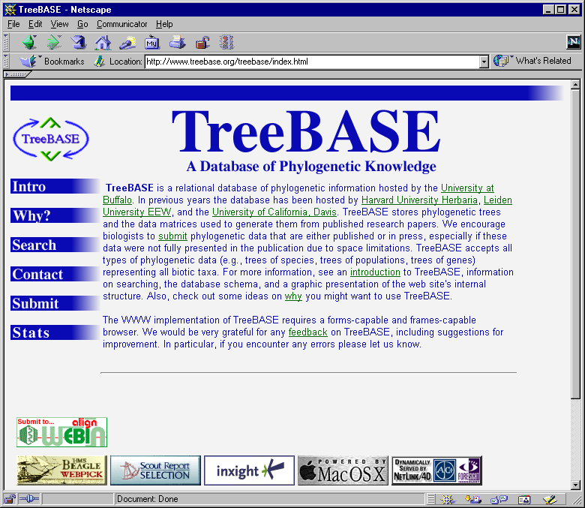
Rate of growth of phylogenetic knowledge
Number of papers with “molecular” and “phylogeny” in Web of Science
Number of studies in TreeBASE

Slide 69
Why aren’t we archiving these trees?

Slide 70
How can we find the trees that we have?

Slide 71
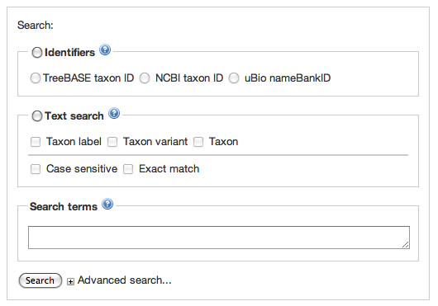
TreeBASE interface

Slide 72
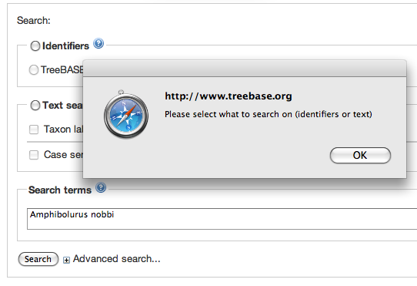
TreeBASE interface

Slide 73
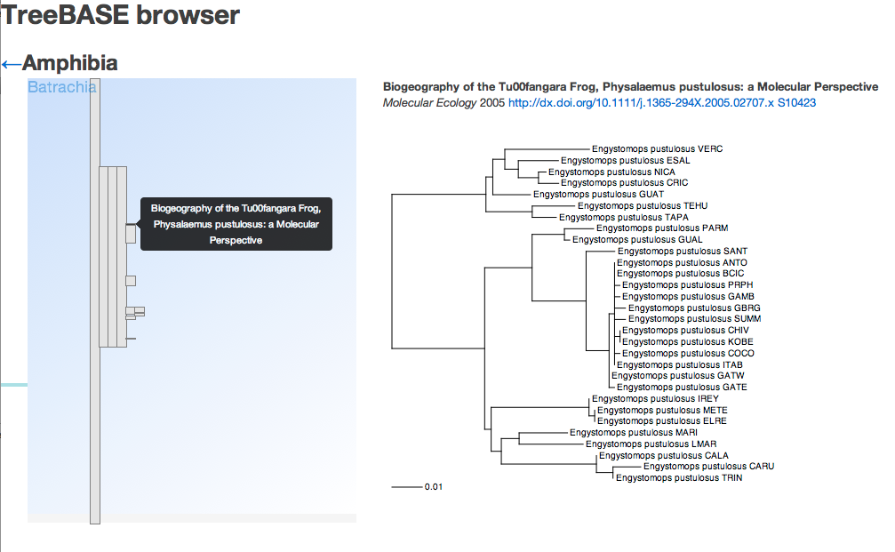
Browser

Slide 74
The End

