Slide 1
Biodiversity Informatics 1.

Slide 2
What are you interested in? species, topic, area, etc.

Slide 3
What skills do you have? Programming languages, software, graphics, languages

Slide 4

What sort of computer do you use? PC, Mac, tablet, Linux, iOS, Android, etc.

Slide 5
What sources of species information are available?

Slide 6
Make a list of sources and their features
http://bit.ly/2ON8ldi
Notes:
http://bit.ly/2ON8ldi

Slide 7
Finding out about one species
http://bit.ly/3qyHBuB
Notes:
http://bit.ly/3qyHBuB

Slide 8
The web is not just for web pages (there’s data too)
http://rdmpage-teaching.herokuapp.com/pgt/services/inspector.php
Notes:
http://rdmpage-teaching.herokuapp.com/pgt/services/inspector.php

Slide 9

RSS feeds

Slide 10
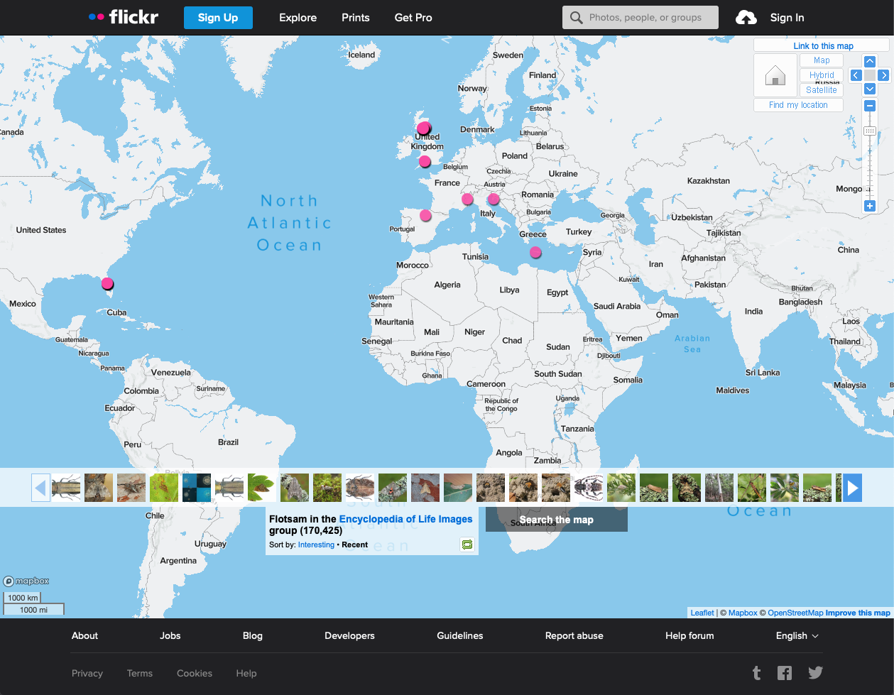
Notes:
https://www.flickr.com/groups/encyclopedia_of_life/

Slide 11
Taking data from RSS feed to make your own website
http://rdmpage-teaching.herokuapp.com/pgt/course/introduction/leafletrss.html
Notes:
http://rdmpage-teaching.herokuapp.com/pgt/course/introduction/leafletrss.html

Slide 12
Mashups
https://ispecies.org

Slide 13
Feedback
What is missing?

Slide 14
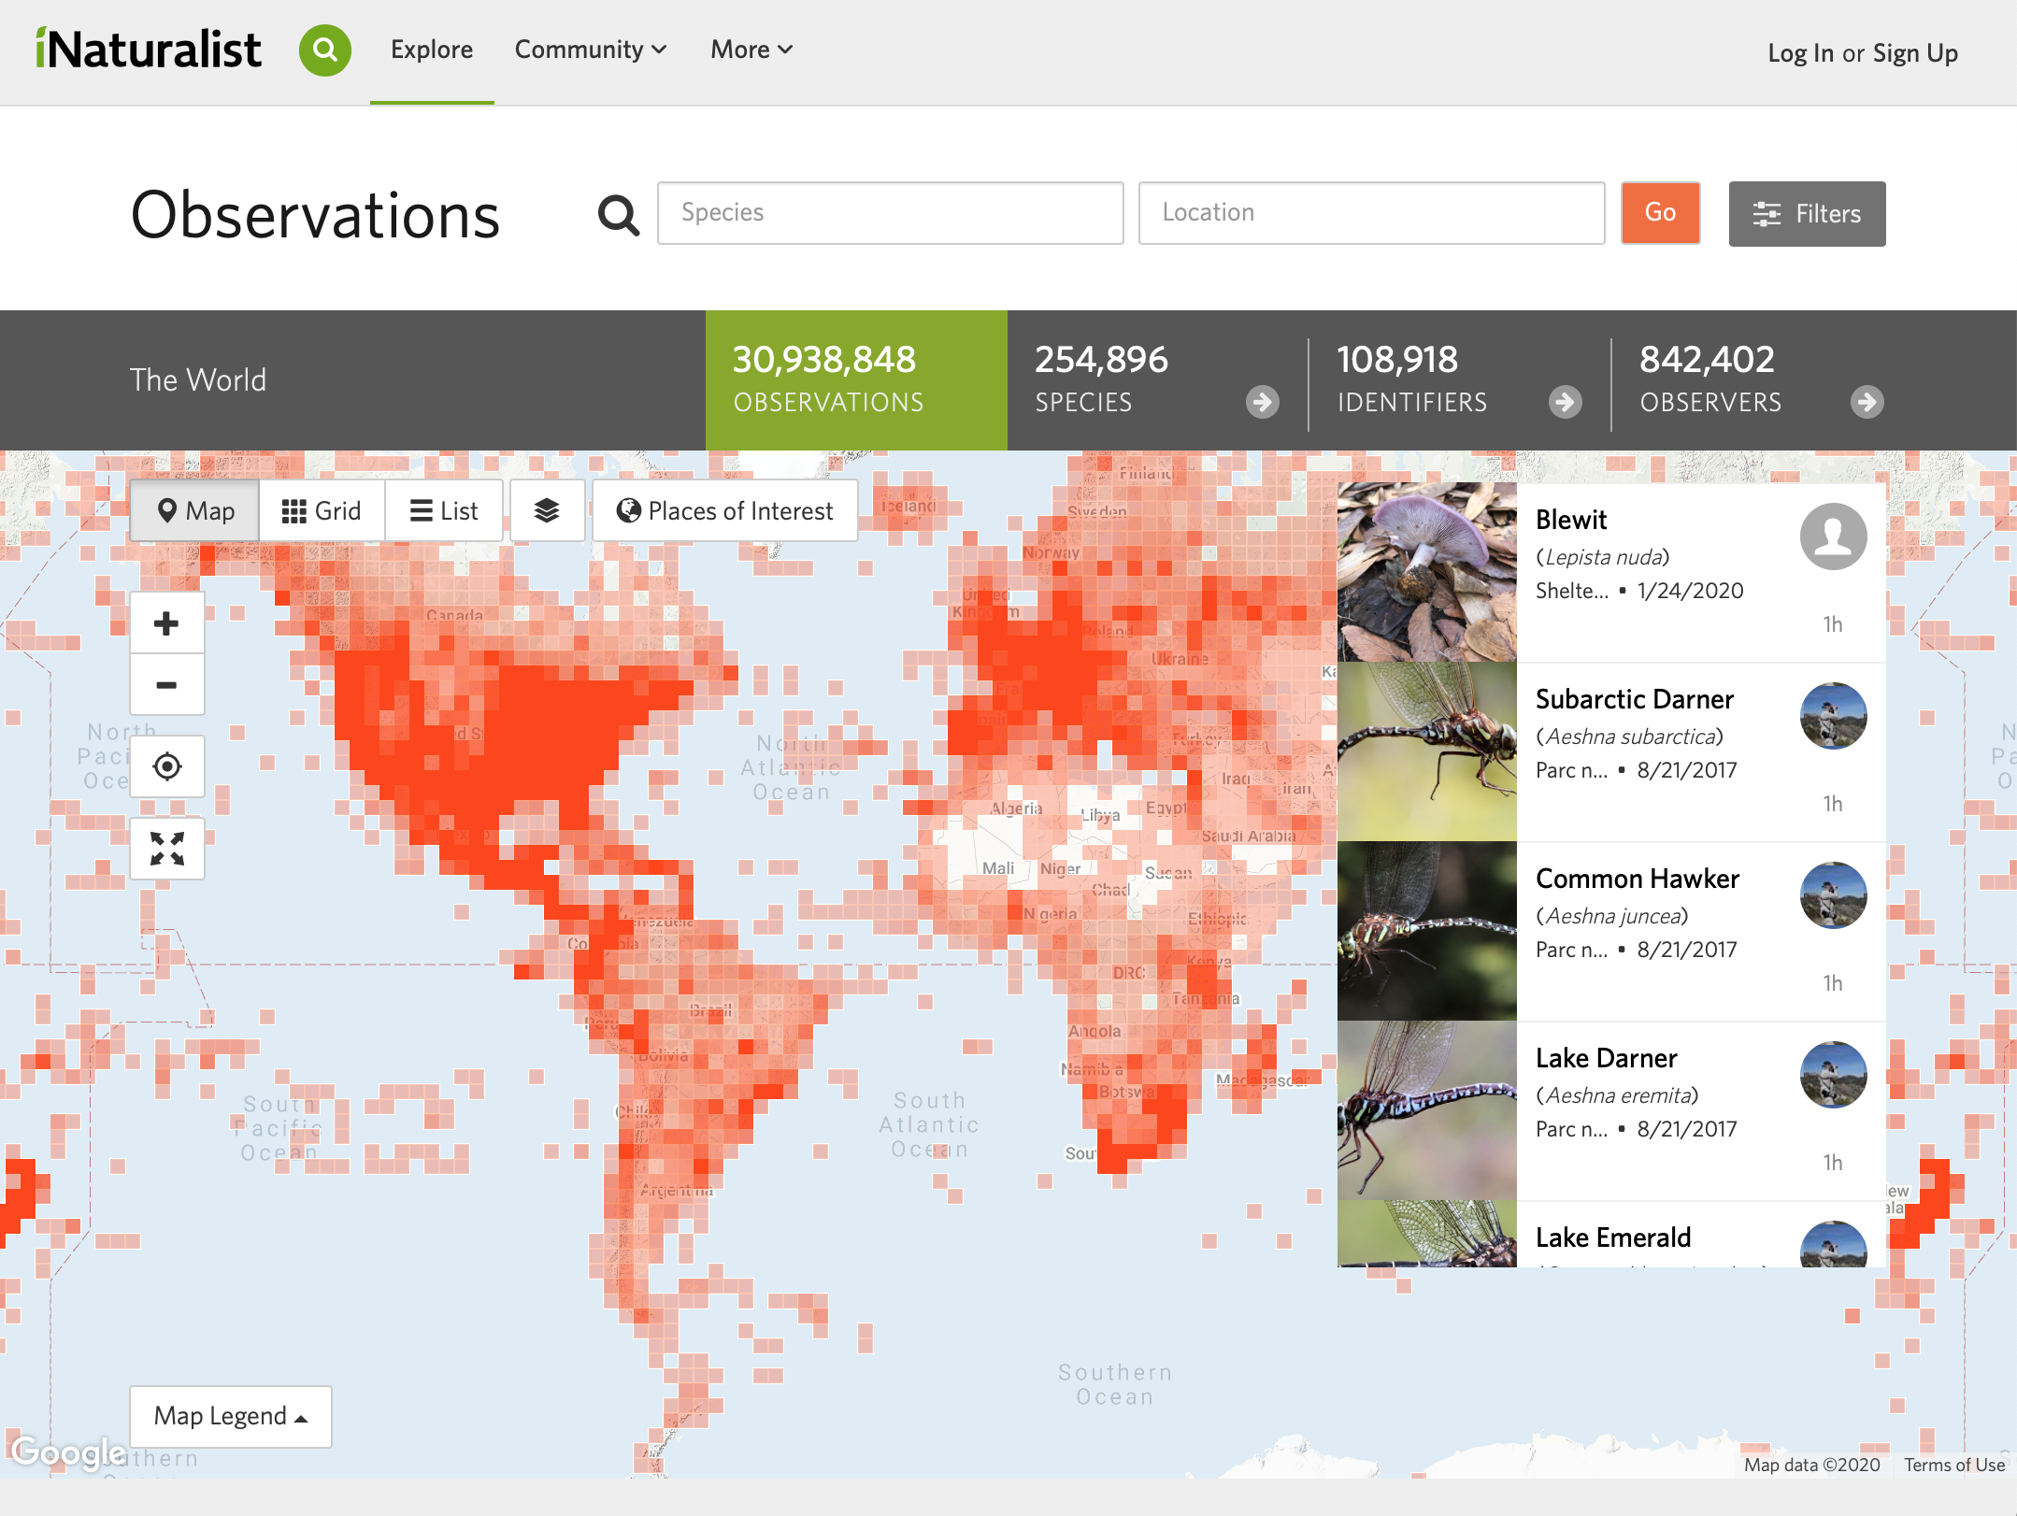

Slide 15
Demo

Slide 16
Q & A

