Slide 1
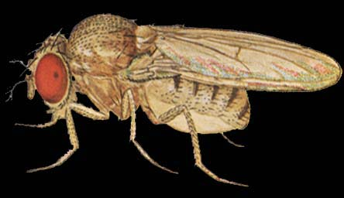
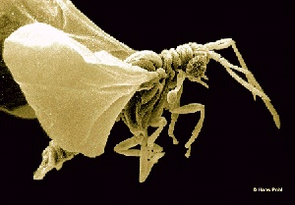
Aedes
Drosophila
Strepsipte
Halteres
Polistes
Flea
Scorpionfl
Sawfly
Meloe
Tenebrio
Lacewing
18S rRNA sequences
Parsimony groups Strepsiptera and flies
Antlion
OUU06478
PSU06480
0.1

Slide 2
Sawfly
Strepsipte
Meloe
Tenebrio
Polistes
Aedes
Drosophila
Lacewing
Antlion
Flea
18S rRNA sequences
Maximum likelihood suggests a different tree
Scorpionfl
OUU06478
PSU06480

