Slide 1

Order Book Data Processing
(Proof of Concept)
Durai Rajamanickam
02/25/2022

Slide 2
Table of Contents
Scope of Work
Architecture and Design Considerations
Solution design for PoC
Solution Architecture for Data Platform (Real time and Batch)
Conclusion

Slide 3

Scope of Work
Requirement
Implement a proof-of-concept data pipeline to collect and analyze cryptocurrency orderbook
Data Pipelines
Create a data pipeline/ETL to ingest and persist order book data across two (2) different exchanges for both BTC/USD and ETH/USD markets:
Every 60 seconds poll each exchange API for the current order book and persist raw order book data
For each poll, extract $100k of bid and ask order book data for each exchange
Live Reporting
What is the average mid price per market?
Which exchange would we prefer to execute a $50k buy or sell order on? At what price?

Slide 4

Architecture and Design Consideration
Architecture Consideration:
Elastic Scalability
Performance
Cost of Operations (DevOps, DataOps)
Ease of Development and Integration
Ease of Maintenance
Adaptable to future change
Design Considerations:
Data Processing approach:
Enable Live reporting – Real time analysis
ETL is required to normalize data coming from various exchanges. Each exchange reports orderbook at various lengths, and fields.
Use Analytics warehouse to process large volume of data. (considering 60 sec continued stream of data)
Ability to enable Batch processing for Historical/Timeseries analysis
Data Pipelines
Use data pipeline that is scalable and real time (considering 60 sec data feed). High throughput, and dynamic scaling required to meet the requirements.
Perform data normalization (can be done at various scale) for PoC, two exchanges were considered to retrieve order book, So ETL is performed at the data collection function.
Extract $100k of bid and ask order book data for each exchange
Use scheduler to poll the exchange’s orderbook API end point every 60 seconds
Live Reporting
Enable analytics warehouse to meet live reporting requirements to find the average mid-price. [Moving average if timestamp is not used]
Provide granularity at exchange and type of trade level between asks and bids. [Persist data at granular level]

Slide 5


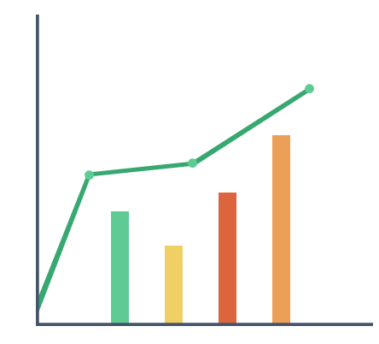





Solution design for Proof Of Concept
Solution Design – Data flow details
Systems of Engagement
Functionality and Design decisions
Publish trigger message to Topic to initiate function
Core Scientific uses GCP and AWS, The PoC is leveraging GCP managed services.
Use Orderbook API from Binance and Coinbase exchanges for the PoC
Each exchange sends a slightly different structure of order book. Build modularized ETL framework to clean up the order book and standardize the data (Embedded in Cloud Function for PoC purpose)
Use Cloud Scheduler (GCP component) to trigger the cloud function. The scheduled sends a message in a 60-sec interval to topic that triggers the function to pull data from exchanges.
Use on-demand scalable cloud function. Build framework to extract the data in order to add more exchanges in the future.
Once the function is triggered, the process will retrieve order book data through API.
Send standardized "order book" with the following data structure [side(bid, asks), price, quantity, cost, timestamp, exchange] to BigQuery (Data Warehouse) and Cloud Storage. (This program extracts only trade values between $40K to $100 K for PoC purpose)
From Big query we can analyze and extract mid-price ranges and other questions like when we can likely purchase 50k crypto tokens.
Scheduler
Pub/Sub
Retrieve data through subscription to various topics
Dashboard/Reports
Pub/Sub
Cloud Storage
Scheduled query can send the data to PubSub. Can be consumed by any application.
Crypto Orderbook API
Binance
Mobile
Data Warehouse
Cloud Function
Pub/sub triggers cloud function
BigQuery
API
Crypto Orderbook API
Coinbase
Cloud Function writes to Big Query directly in Data warehouse for storage/analysis
Proof Of Concept Data pipeline

Slide 6






Solution Architecture – Data platform
Data Sources
Data integration Layer
Data Pipelines
Systems of Engagement
Complex ETL and data processing
Data Pipline
Data lake Construct
Cloud Function
Other
Data Sources
Dashboard/Reports
Topics
Dataflow
Stage
Process
Publish
Real time/Batch
Pub/Sub
IOT sources
Mobile
Data Warehouse
Raw Files Storage
API Sources
Scheduler
BigQuery
Topics
Cloud Storage
API
Dimensional Model and Analytical reporting
Pub/Sub
Scheduler
Strategic Data Platform Build
Data Pipelines

Slide 7
DEMO

Slide 8

Conclusion
Following are achieved in this proof of concept.
Collected data from various exchanges
Sent data to storage accounts (for raw data persistent)
Achieved data standardized from various exchanges with timestamp.
Enabling analytics using data warehouse (Big query)
Enabled polling for every 60 sec.
Enabled real time access to polled data from exchanges.
Expandable architecture to realize enterprise data platform.

Slide 9
Thank You

