Slide 1
Project Hazzard
A Remote Controlled Racing Adventure Game Experiment
Robert Nelson
Hasith Vidanamadura
Hao Chen
Darren Stahl

Slide 2
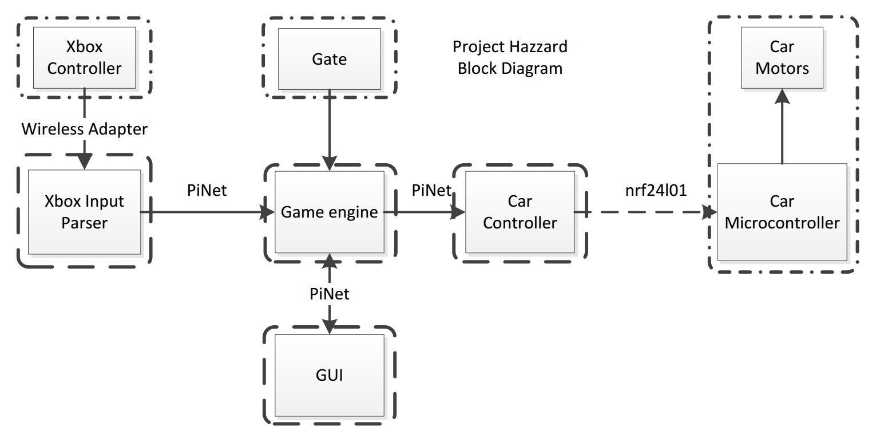
Project Block Diagram

Slide 3
GUI MVC Model
Model:
  PiNet’s network synchronous data packet is the model
View
  GUI reads network packet, updates
Controller
  Game Engine pushes updates to PiNet’s Network packet (Model)

Slide 4
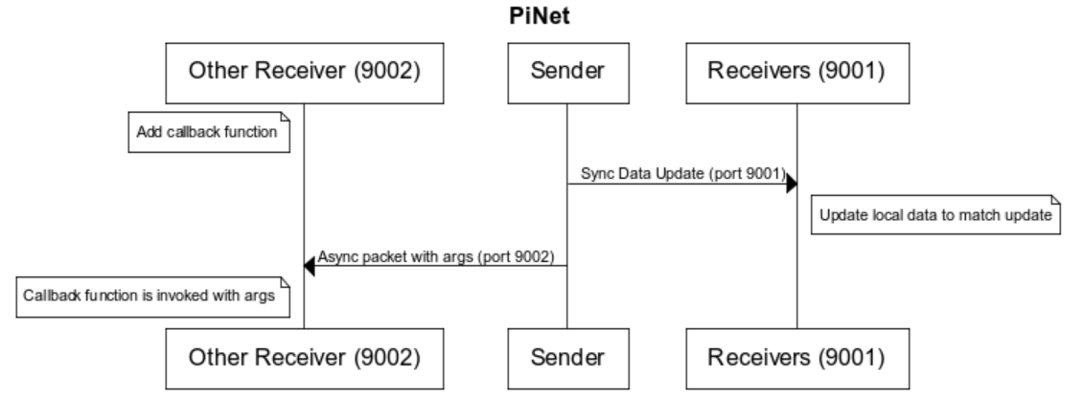
PiNet
All network communication is through PiNet
PiNet multicasts over UDP, works in Python and Java

Slide 5
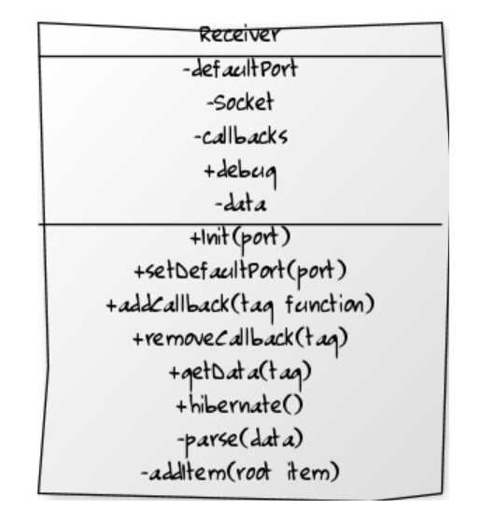
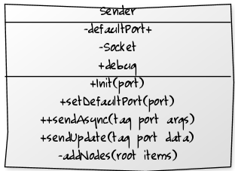
PiNet UML

Slide 6
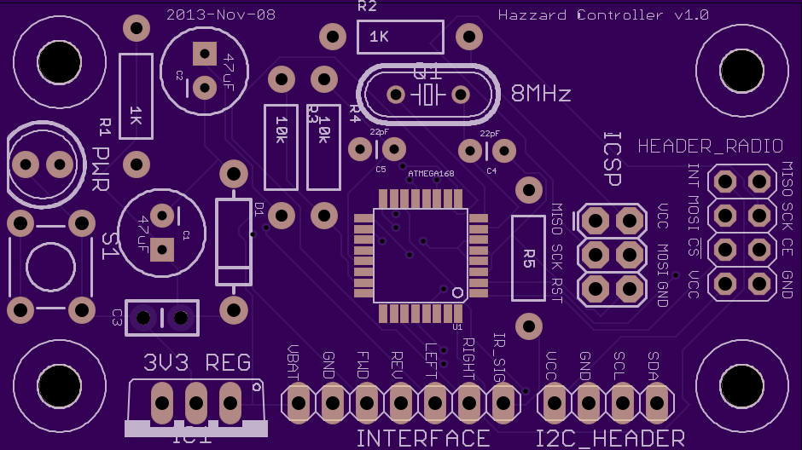
Car Controller
Custom designed and fabricated PCB replacing the car’s controller
Using an ATMega328

Slide 7
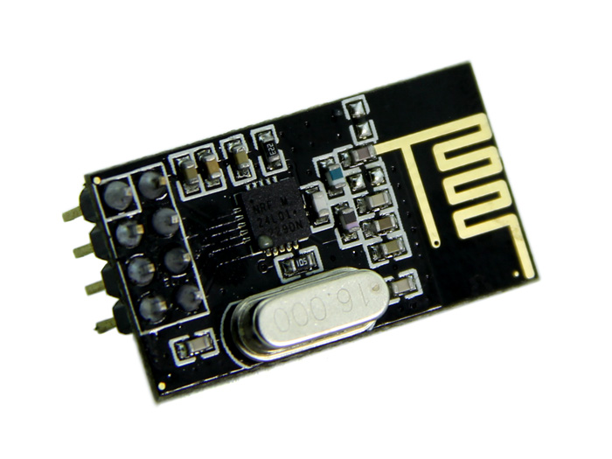
Car Radios
Nrf24l01+
RF Radio link to replace car’s due to poor performace (<5m range)
Tested new radios to 10m through walls, 0% packet loss

Slide 8
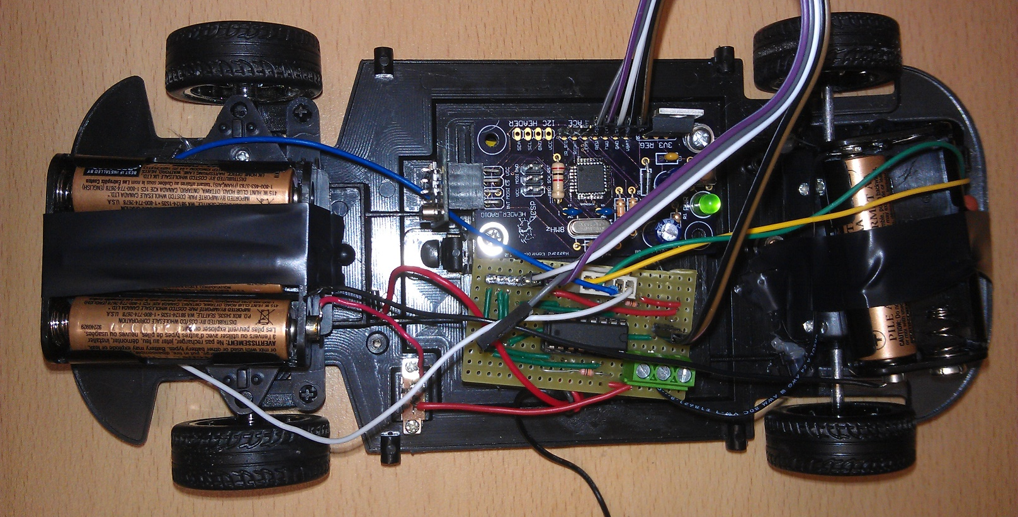
Car assembly
Car internals all replaced, case and motors left intact

Slide 9
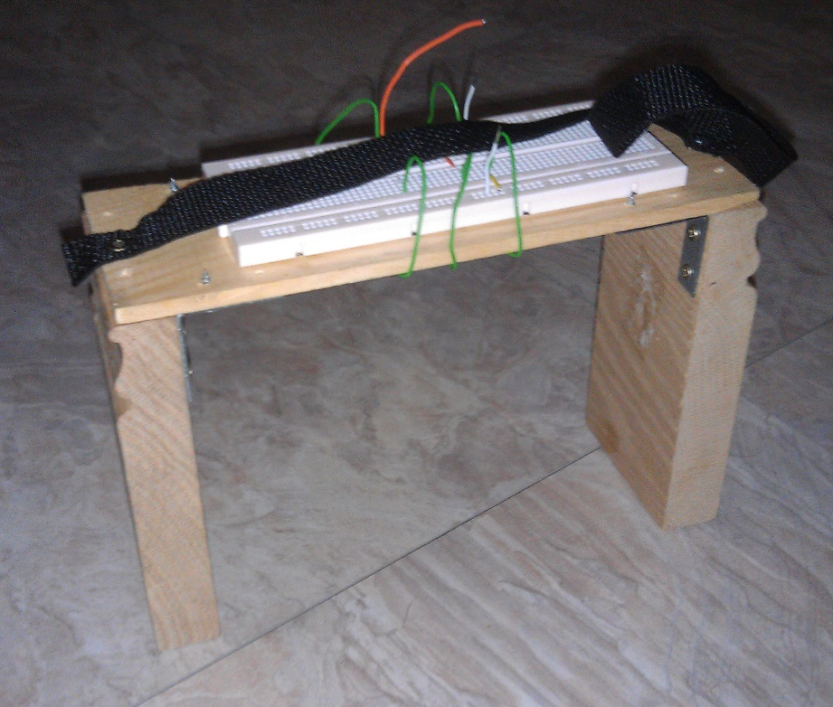
Gate
Detects cars based on IR LED frequency using an OPT101
Tested to 6khz frequency, running at 100hz-500hz

Slide 10
Xbox Input Parser
Parses the xbox controller data
Sends to Game Engine over PiNet
Tested to 1300 controller events per second, limited to 20

