Slide 1
Project Hazzard
A Remotely Controlled Racing Adventure Game Experiment
Darren Stahl
Hao Chen
Hasith Vidanamadura
Robert Nelson

Slide 2
User Story
Project Hazzard is a racing game that takes several features of racing video games, but uses real RC cars. Features like automatic track times, powerups, and traps will be added to make the game more challenging.

Slide 3
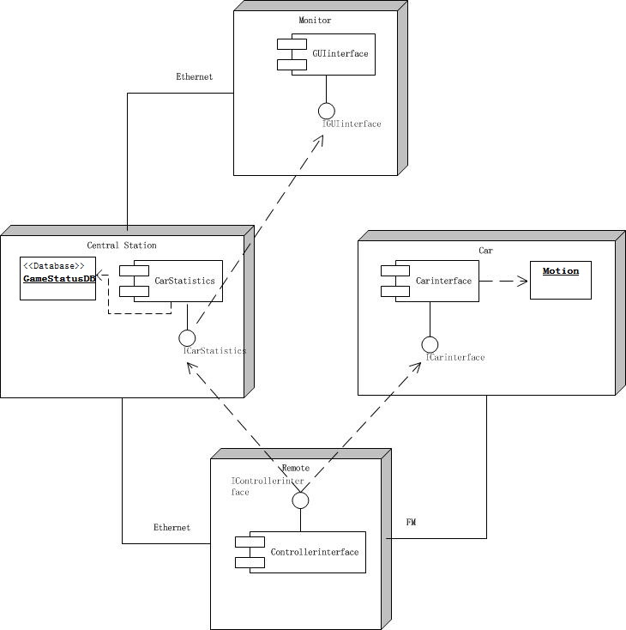
UML Diagram

Slide 4
System Requirements
Players must not move until the race begins
Players' track time must be recorded
Players should be able to apply modifiers to each other
Players must be able to control the car in real-time
Players must be able to see their current status

Slide 5
Design: Pi-Car Interface
Forwards commands to actual RC car
Pi’s are not placed on the car for safety
Input injection does not look feasible on the RC controller
Connect a microcontroller/RF module pair to the drive electronics on the car

Slide 6
Design: Identification and Finish
Identifying the car uniquely is necessary for determining the winner
IR LED blinking a Manchester-encoded ID allows unique ID at the finish
Requires very few components to implement on car
Pi at the gate determines winner

Slide 7
Testing
Interconnections make testing difficult
Isolation when possible, “Black box” when not
Isolate cars
Blackbox cars to test RC controllers
Blackbox OS and drivers to test Xbox controllers
Isolate finish gate
Isolate networking
Isolate GUI
Interference testing

Slide 8
Testing Networking
Use an extra Pi as a “Packet Sniffer”
Interference testing
Receiver
Sender
Sniffer
Receiver
Sender 1
Sniffer
Sender 2

Slide 9
Milestones
Milestone 1: Nov. 4
Cars must be controlled by a Raspberry Pi (Hasith)
XBox controller input must be functional (Robert)
Status GUI must display controller input (Hao)
Milestone 2: Nov. 11
XBox controllers must control cars (Hasith & Robert)
Status GUI must display game modifiers (Hao)
Milestone 3: Nov. 18
Finish gate must identify cars passing through (Darren)
Status GUI must display car track times (Hao & Darren)
Game modifier framework must be in place
Milestone 4: Nov 25
Final cleanup of game dynamics (All)
Project documentation (All)

Slide 10
Q/A

