Slide 1

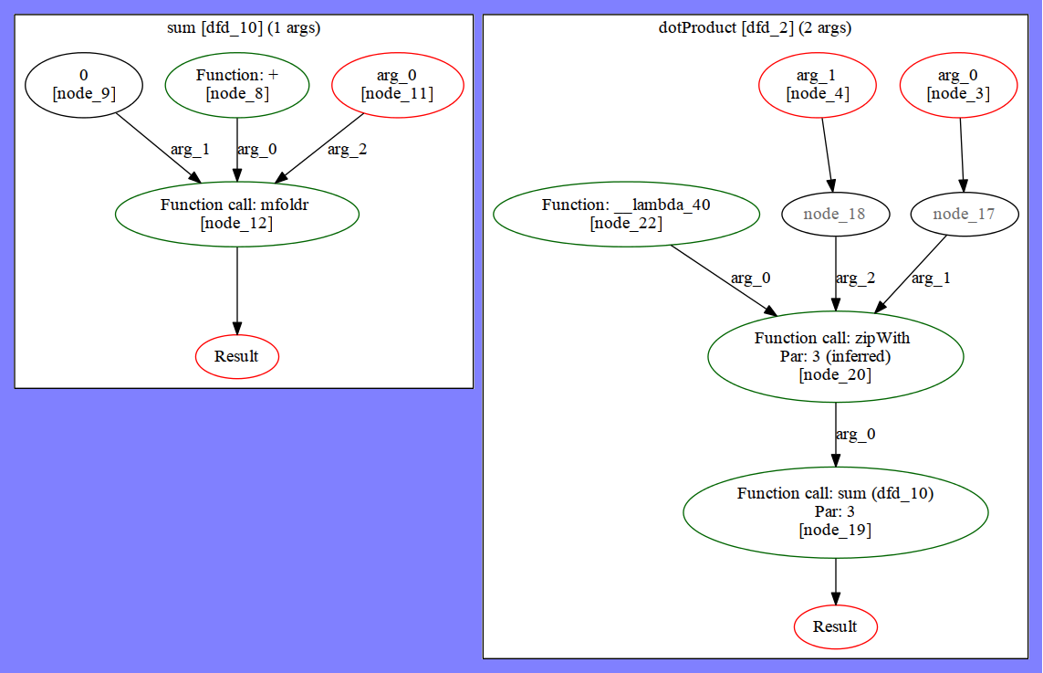

H2V – a Haskell to Verilog Compiler
Reuben D’Netto
Supervisor: Dr. David Boland
Verilog is often used to implement hardware accelerators, which are used to perform expensive computations faster than a general purpose CPU would allow.
H2V generates Verilog modules from concise functional descriptions of logic, making it trivial to leverage data-level parallelism.
Logic can be tested with desktop Haskell compilers, reducing development time.
Trivial composition of modules
Compatible with existing Haskell compilers
Easily tuned N-degree parallelization
sum :: [Int] -> Int sum = mfoldr (+) 0
dotProduct :: [Int] -> [Int] -> Int dotProduct u v = sum $ zipWith (*) u v ||| 3
demo _ = dotProduct [1, 2, 3] [4, 5, 6] ||| 3
Source available at: https://github.com/rdnetto/H2V

