Slide 1

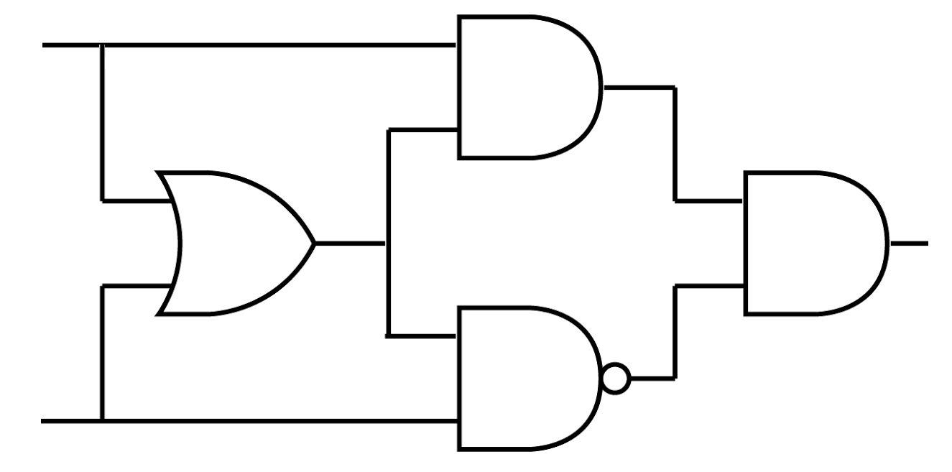
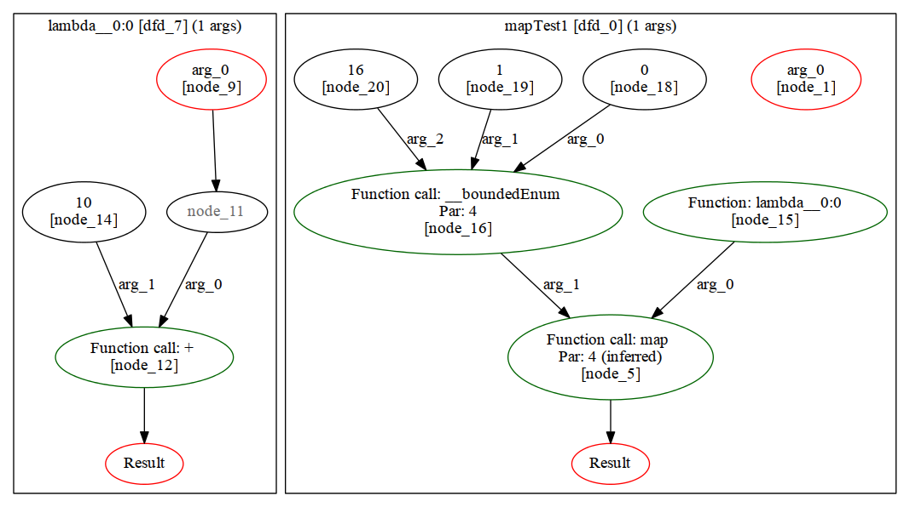

H2V – a Haskell to Verilog Compiler
Reuben D’Netto
Supervisor: Dr. David Bolland
Explanation of Haskell, functional programming etc.
Pro/benefit 1
Pro/benefit 2
Pro/benefit 3
Example Haskell and corresponding DFD line1 line2 line3
Diagram of hardware representation?
Graph of resource consumption/speed
(compared to C2H)
Source available at: https://github.com/rdnetto/H2V
TODO: make textboxes snazzy using SmartArt

