Slide 1

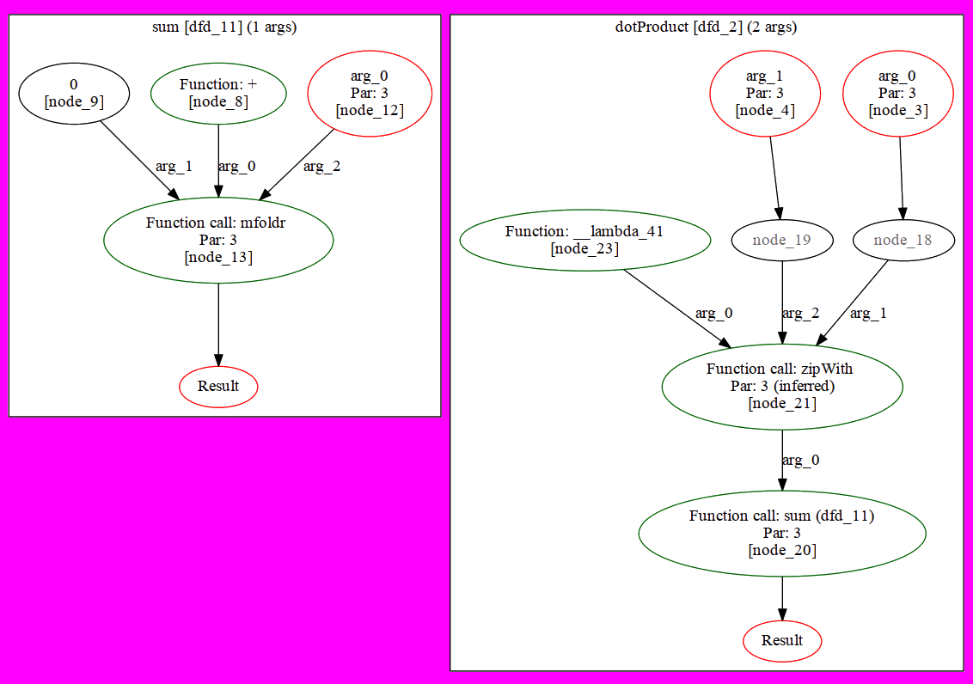

H2V – a Haskell to Verilog Compiler
Reuben D’Netto
Supervisor: Dr. David Boland
Verilog is often used to implement hardware accelerators, which are used to perform expensive computations faster than a general purpose CPU would allow.
H2V generates Verilog modules from concise functional descriptions of logic, making it trivial to leverage data-level parallelism.
Logic can be tested with desktop Haskell compilers, reducing development time.
Trivial composition of modules
Compatible with existing Haskell compilers
Easily tuned N-degree parallelization
sum :: [Int] -> Int sum = mfoldr (+) 0 ||| 3
dotProduct :: [Int] -> [Int] -> Int dotProduct u v = sum $ zipWith (*) u v ||| 3
demo _ = dotProduct vec1 vec2 ||| 3 where vec1 = [+1, -1, +1, -1, +1, -1] vec2 = [1 .. 6]
Lists – processing 3 elements at once
sum
vec1
+1
-1
+1
-1
+1
-1
zipWith (*)
acc
+
×
+
result
vec2
1
2
3
4
5
6
×
+
×
Source available at: https://github.com/rdnetto/H2V

