Slide 1

Investigating the Impact of Weather and Influenza as Well as Population Growth
Brian Campbell
Mike Saunders
Ryan Donegan

Slide 2
Data Sets
Weather
openweathermap.org
Columbus, Cincinnati, Cleveland
40 years of hourly weather data
Influenza Hospitalizations
Ohio Department of Health
Weekly hospitalization due to influenza for Franklin, Hamilton, and Cuyahoga Counties (corresponds with Columbus, Cincinnati, and Cleveland)
2017 – 2021 Influenza Seasons
Census
Ohio Census

Slide 3
Questions to Answer
Do the number of influenza hospitalizations rise with falling temperatures?
Does the weather data show a warming trend over 40 years?
Are weather trends related to population growth/decrease?

Slide 4
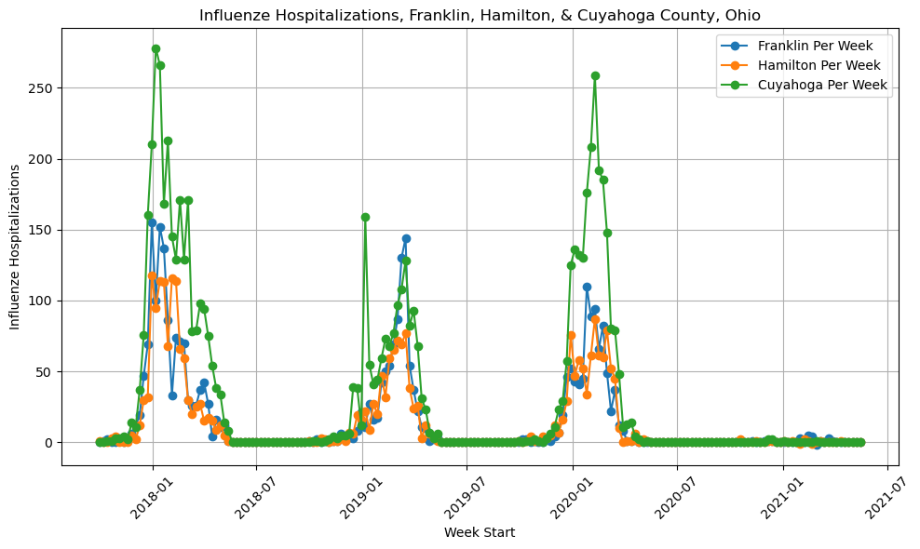
Influenza Hospitalizations
Note 2020-2021 - Covid

Slide 5
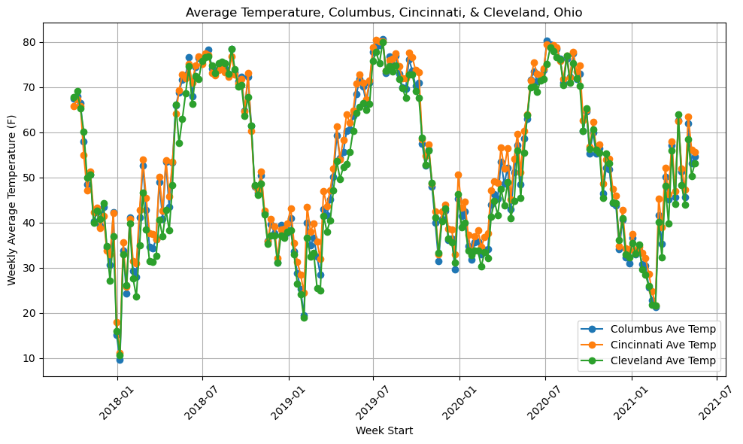
Weekly Average Temperatures

Slide 6
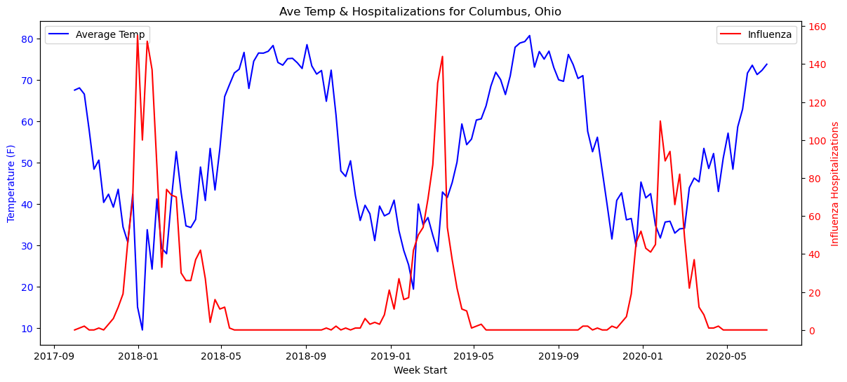
Weekly Temperatures & Influenza Hospitalizations - Columbus
Correlation: -0.520
Note: 2020-2021 Season Was Excluded Due To Covid

Slide 7
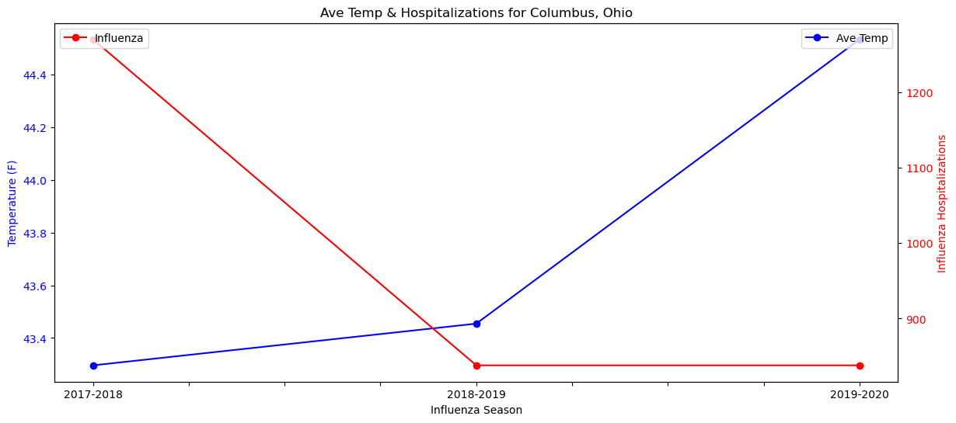
Seasonal Average Temperature & Seasonal Total Hospitalizations - Columbus
Correlation: -0.598

Slide 8
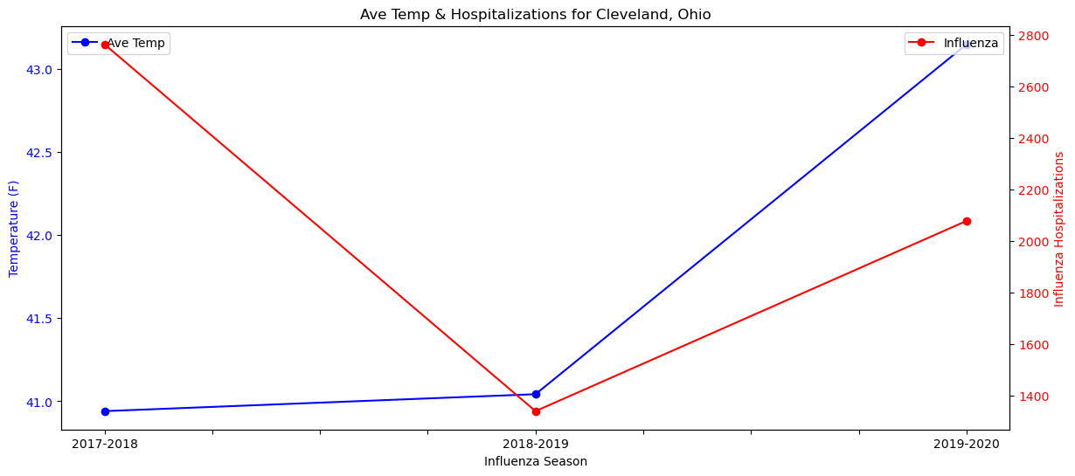
Seasonal Average Temperature & Seasonal Total Hospitalizations - Cleveland
Correlation: -0.019

Slide 9
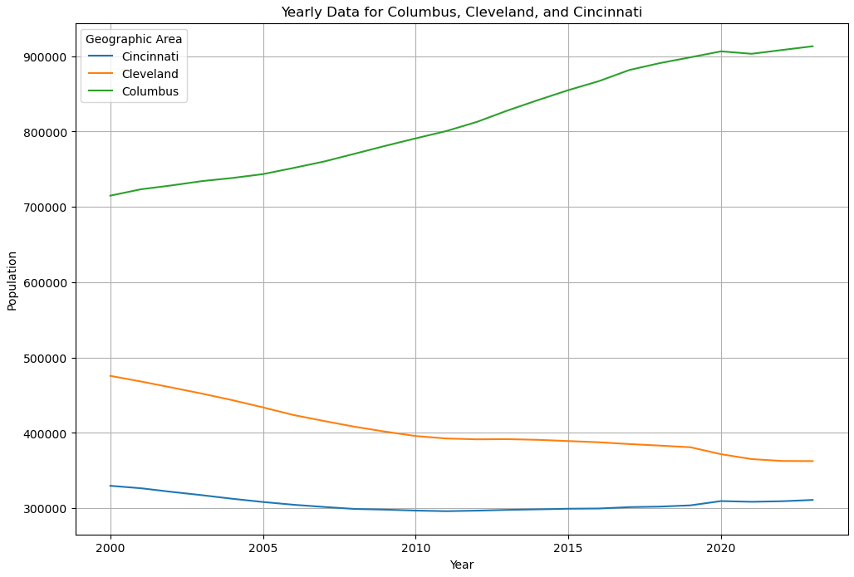
Population Trends for Columbus, Cleveland, and Cincinnati

Slide 10
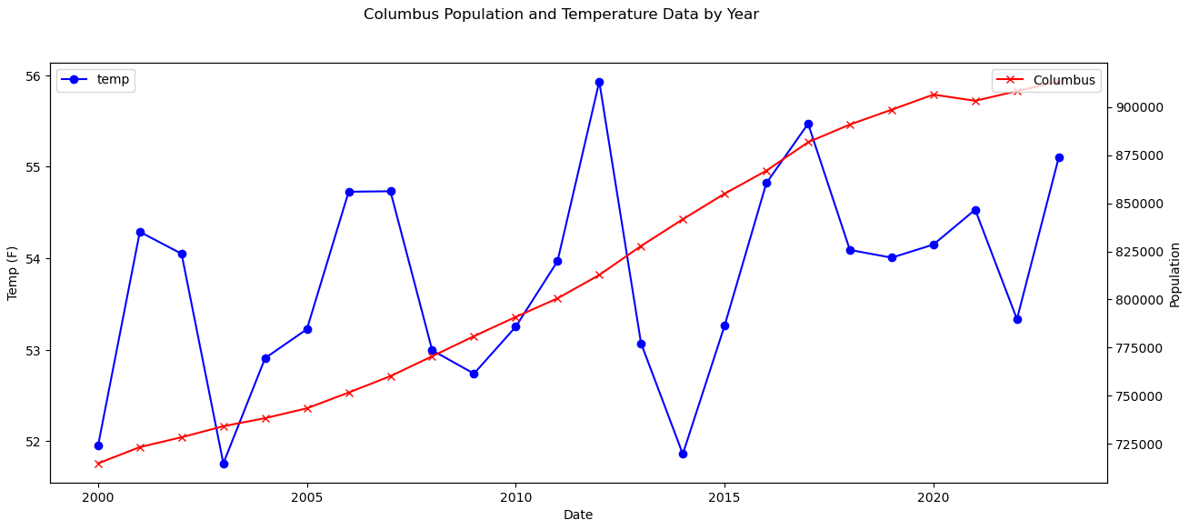
Temperatures & Population- Columbus
Correlation: 0.3725
Notes:
The temperate values had to be averaged for each year, 2000 – 2023 because we only have population data per each year.

Slide 11
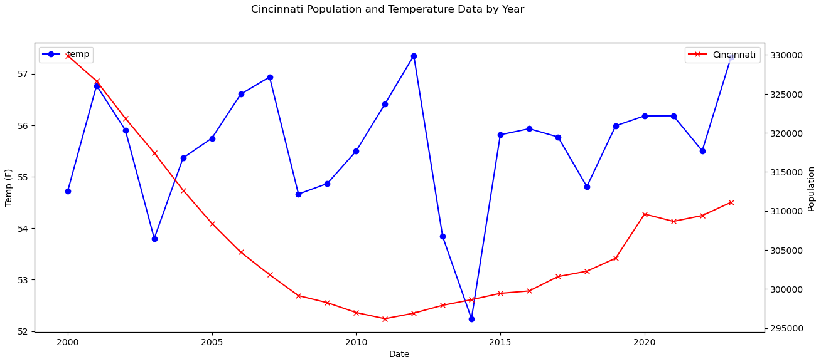
Temperatures & Population- Cincinnati
Correlation: 0.0667
Notes:
The temperate values had to be averaged for each year, 2000 – 2023 because we only have population data per each year.

Slide 12
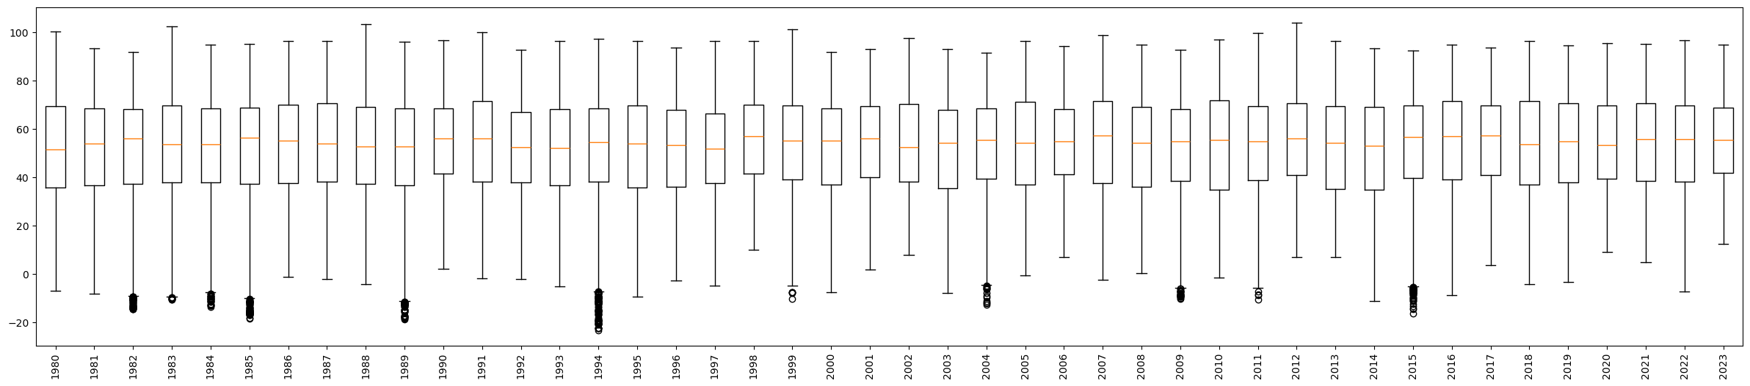
Ohio Average Temperature Trend
Cleveland, Columbus, Cincinnati

Slide 13
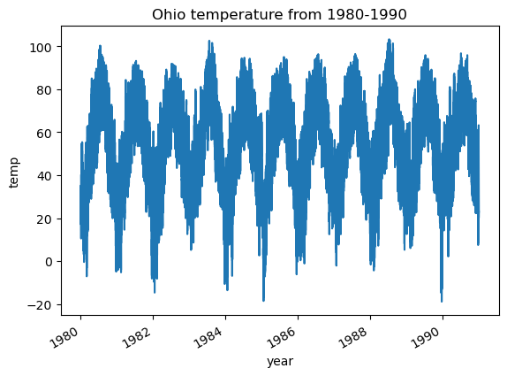
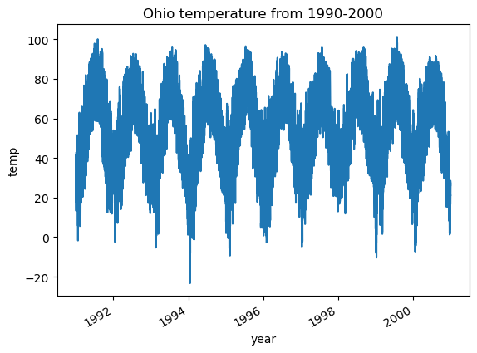
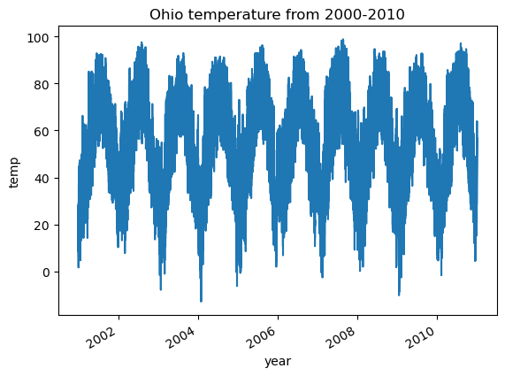
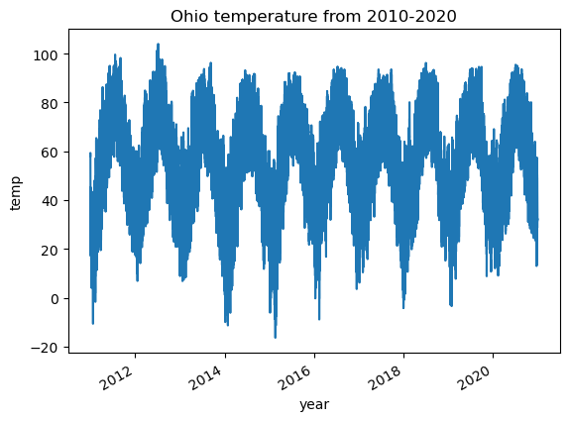
Ohio Average Temperature Trend from 1980-2020
Cleveland, Columbus, Cincinnati

Slide 14
Summary
Do the number of influenza hospitalizations rise with falling temperatures?
Yes, for the most part. Correlation we think is higher, except data available is weekly/seasonal, vs more granular.
Does the weather data show a warming trend over 40 years?
Yes. Interesting trend of less extreme cold years.
Are weather trends related to population growth/decrease?
Possibly. But due to differences in data granularity, it’s difficult to say for sure.

Slide 15
Next Steps
Influenza
Try to get influenza granular data based on diagnosis vs hospitalizations
Temperature
Evaluate how other weather data such as humidity, cloudiness, rain, etc. impacts influenza and population.
Census
Analyze temperatures based on seasons. Graph and look for correlations.

Slide 16
Thank You!
Questions?

Slide 17
Appendix

Slide 18
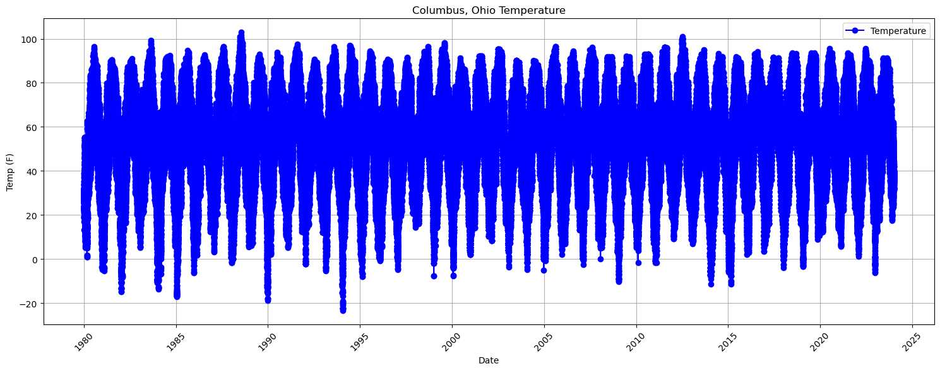
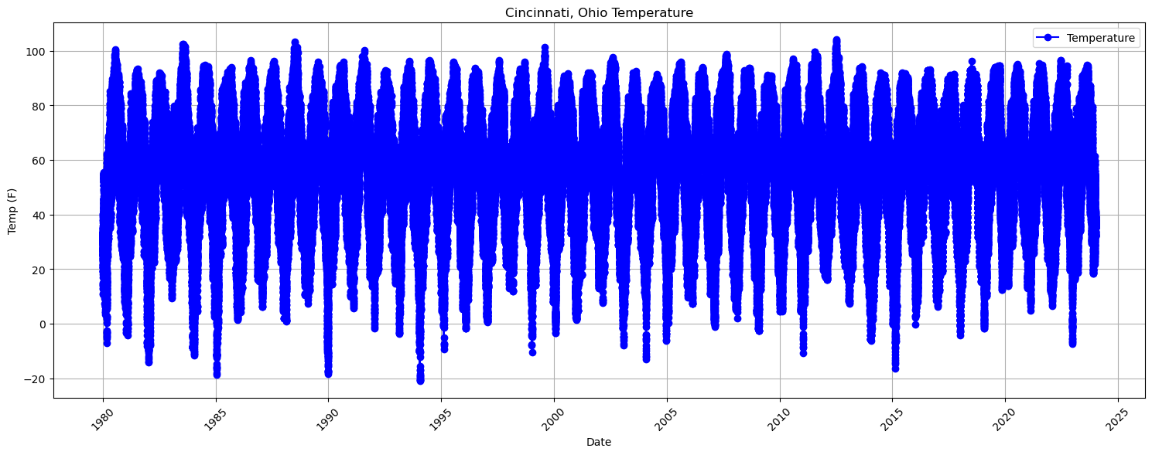
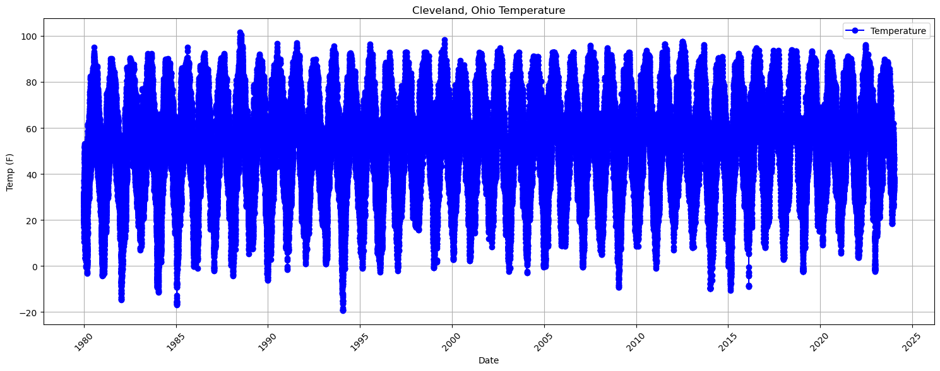
Temperature Trends

Slide 19
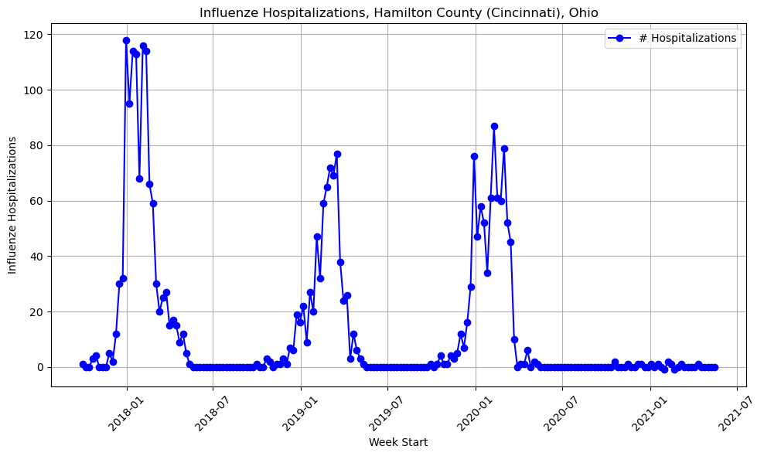
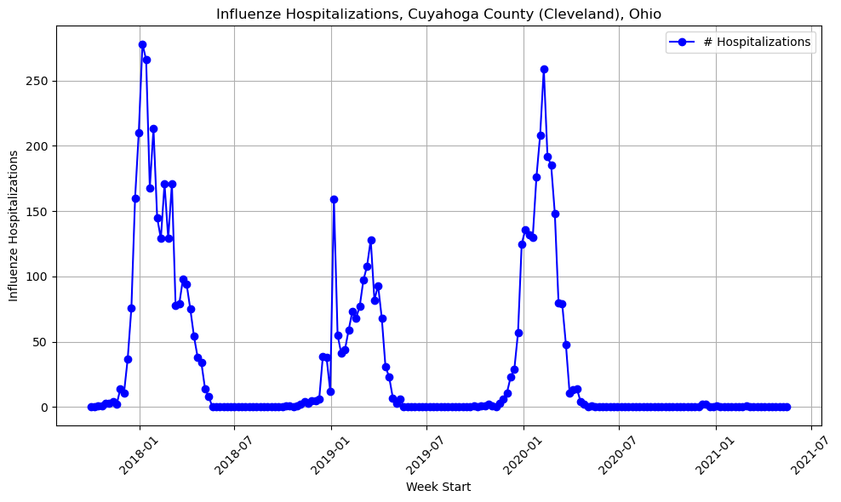
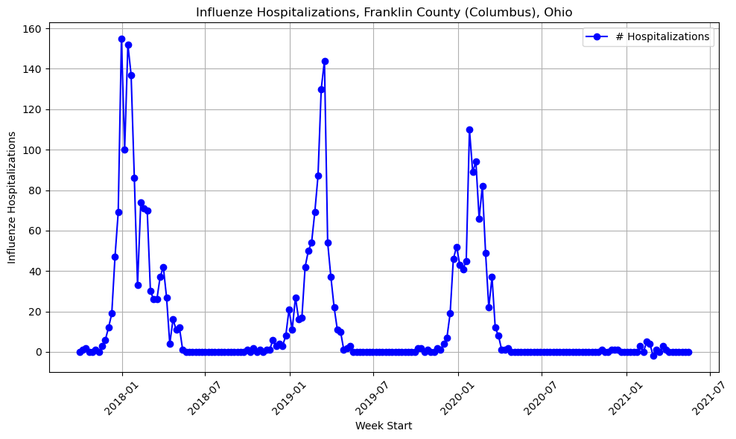
Influenza Hospitalizations
Note 2020-2021 - Covid

Slide 20
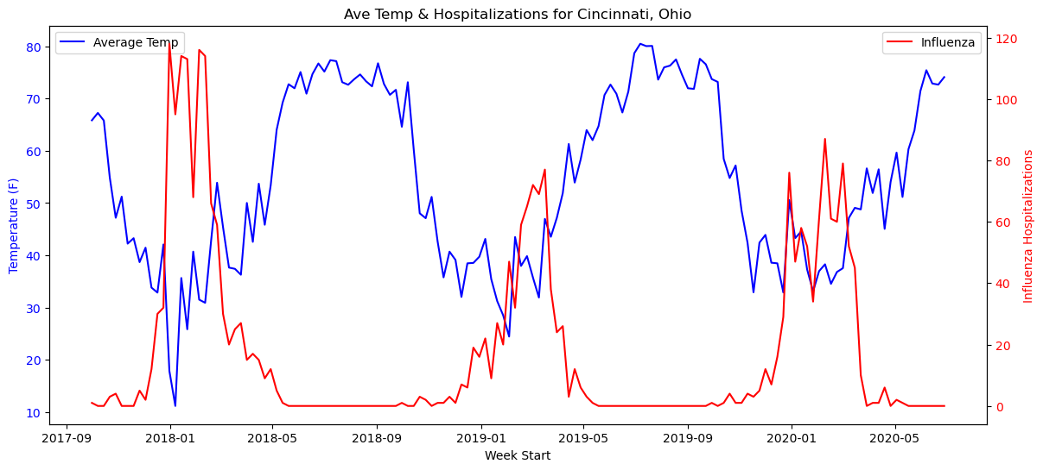
Weekly Temperatures & Influenza Hospitalizations - Cincinnati
Correlation: -0.513
Note: 2020-2021 Season Was Excluded Due To Covid

Slide 21
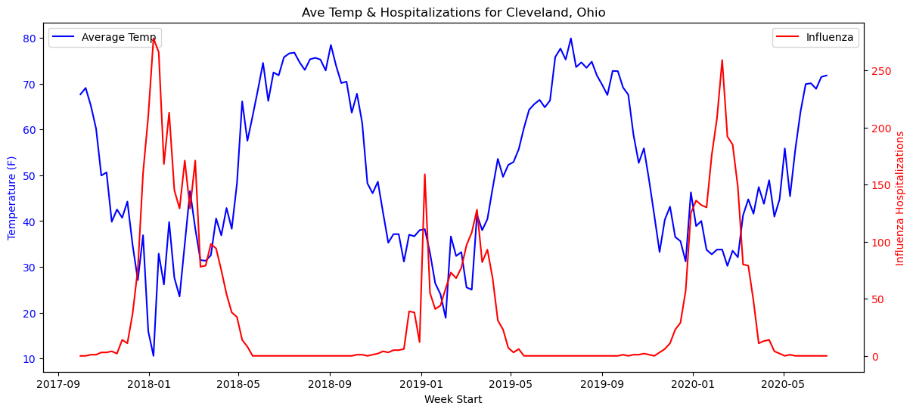
Weekly Temperatures & Influenza Hospitalizations - Cleveland
Correlation: -0.534
Note: 2020-2021 Season Was Excluded Due To Covid

Slide 22
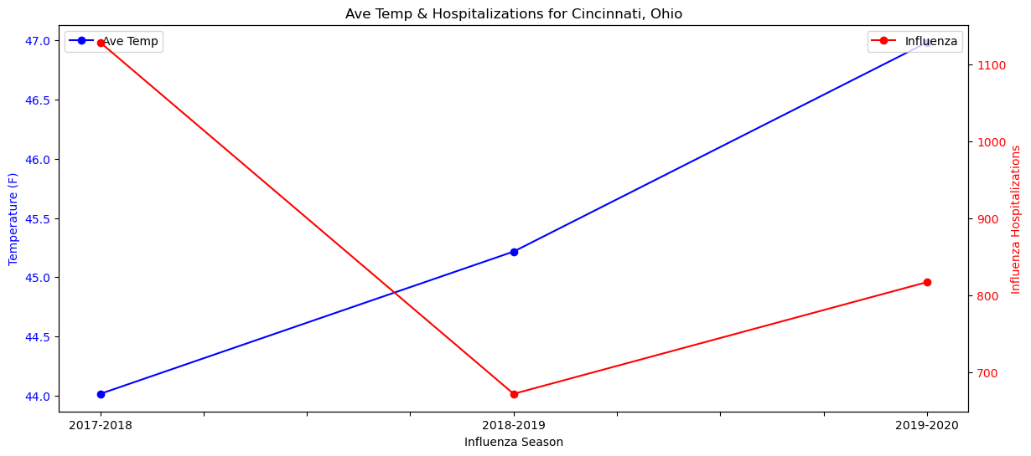
Seasonal Average Temperature & Seasonal Total Hospitalizations - Cincinnati
Correlation: -0.582

Slide 23
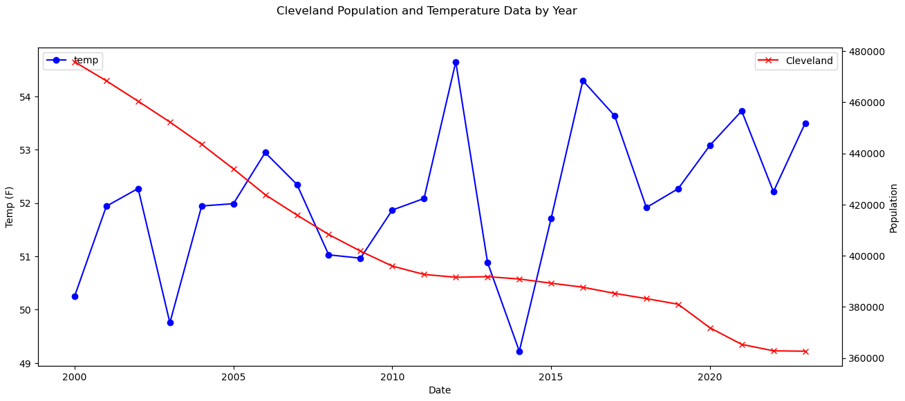
Weekly Temperatures & Population- Cleveland
Correlation: -0.4140

