Slide 1
Project Overview: Financial Data Analysis using Machine Learning
Analyzing stock data with technical indicators and neural networks

Slide 2
Introduction to the Project
Objective: Analyze stock data using technical indicators to predict trends.
Focus: Applying machine learning models to process and analyze stock metrics.

Slide 3
Data and Preprocessing
Dataset: Stock data with columns for high, low, close prices.
Data Preparation Steps:
- Combine all stock data CSV’s into one csv
- Handle missing values
- Scaled data
Stored each stocks data stored in its own dataFrame

Slide 4
Feature Engineering
Calculated Technical Indicators:
- RSI (Relative Strength Index): Measures momentum
- PPO (Percentage Price Oscillator): Tracks momentum
- ROC (Rate of Change): Indicates price trend shifts
- Williams %R: Identifies overbought/oversold conditions
- Stochastic Oscillator (%K and %D): Tracks price positions
- ATR (Average True Range): Measures volatility

Slide 5
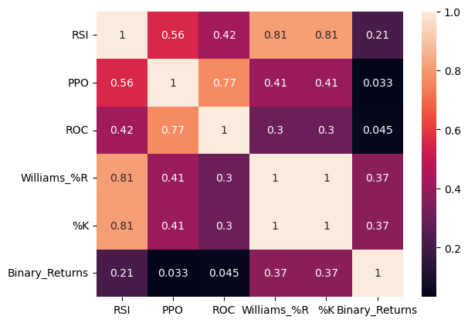
Correlation

Slide 6
Machine Learning Models
Models Developed:
-Neural Network in Keras
- Neural Network in PyTorch

Slide 7
Building a Neural Network (Keras)
Keras Sequential Model Structure:
- Input layer (nodes = number of features)
- Two hidden layers (12 and 6 nodes with sigmoid activation)
- Output layer (1 node with sigmoid for binary classification)
Training: 25 epochs, accuracy evaluation on test data

Slide 8
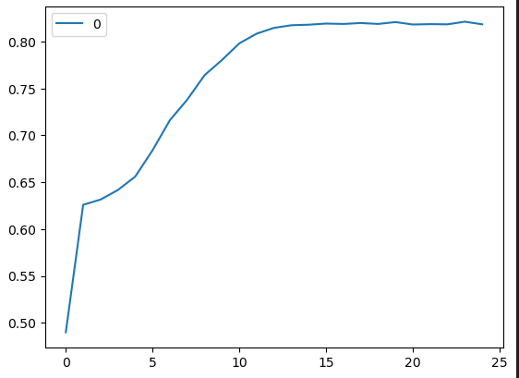
Number of epochs and accuracy score

Slide 9
Building a Neural Network (PyTorch)
Using PyTorch for model flexibility:
- Custom dataset class and DataLoader for batch processing
Model Structure:
- Input layer, hidden layer (64 nodes, ReLU), output layer (1 node, Sigmoid)
- Binary Cross-Entropy Loss and Adam Optimizer

Slide 10
Training and Evaluation (PyTorch)
Training Process:
- 50 epochs with batch training
- Loss calculation over each epoch

Slide 11
Results and Comparison
Comparison of Model Performance:
- Keras Model Accuracy: ~82% for Adobe and apple
Keras Model Accuracy: ~83% for Abbvie Inc
- PyTorch Model Accuracy: ~82%
Observations:
- Both models performed comparably; additional tuning may improve results.

Slide 12
Conclusion
Summary:
- Successfully implemented technical indicators and neural networks for trend analysis
- Keras and PyTorch models achieved similar accuracy
Future Work:
- Experiment with model parameters and advanced neural networks

Slide 13
Q&A
Please feel free to ask any questions!

