Slide 1
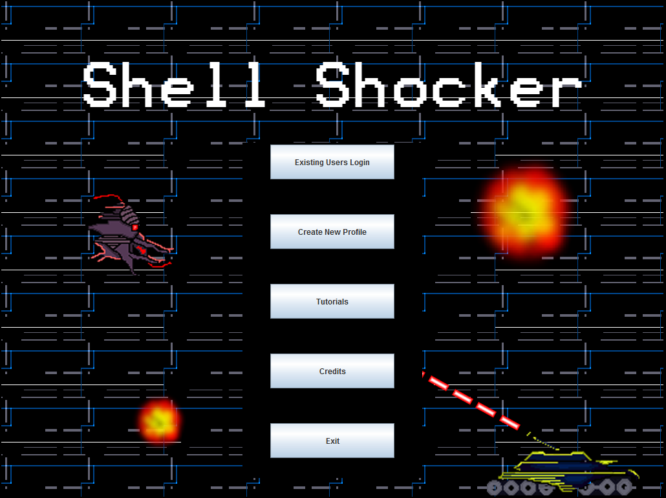
A Sandstorm Production

Slide 2
Group Responsibilities
Development Manager and Lead Programmer – Richard
Project Manager and Graphic Designer – Patrick
Database Manager and Developer – Chance
Training – Tharindu

Slide 3
Project Manager and Graphic Designer – Patrick
Delegated tasks to group members
Optimized time management
Designed original graphics for Shell Shocker
Interacted with all members to ensure necessary graphics produced in timely manner
Designed menu and interactive components
Designed professional presentation

Slide 4
Development Manager and lead programmer–Richard
Programed a majority of code
Made use of good Java programming attributes
Designed player login
Maintained consistent style
Composed original 8 bit style music

Slide 5
Database manager - Chance
Worked alongside lead programmer
Created database to store essential game information
Constructed efficient data flow system
Assisted with other various tasks

Slide 6
Training – Tharindu
Recorded proper documentation for game code
Generated computer training solution to aid users
Clarified system usage
Assisted with other miscellaneous but necessary tasks

Slide 7
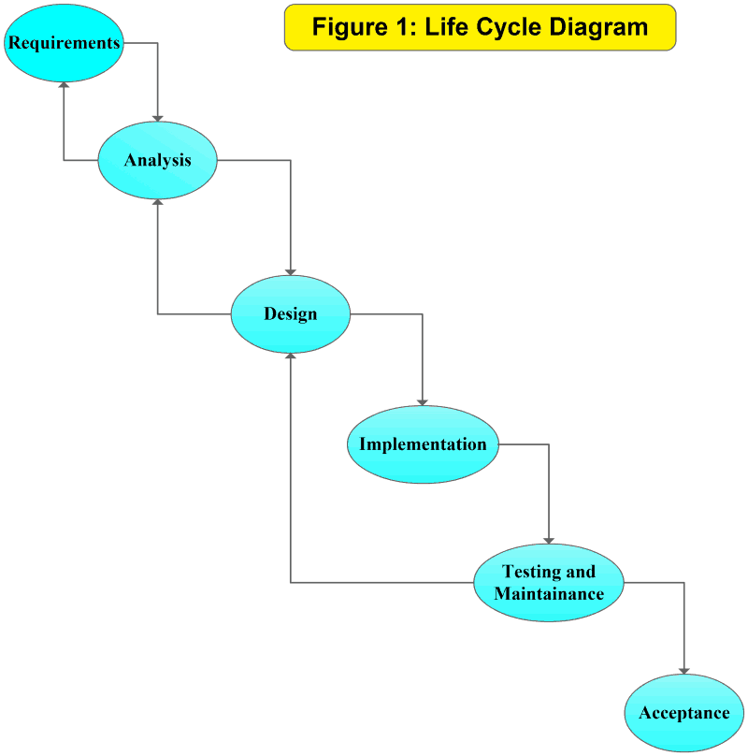
The Waterfall Method

Slide 8
Requirements
Server Requirements
Relational database to store all persistent player data and game states
Database must be constructed using a truly relational schema with logical separation of data into distinct tables
Player login via secure username and password
Administration console that supports the following
Clear display of system status
Ability to remove and/or ban players based on reports of cheating
Ability to shut down/restart server

Slide 9
Requirements
Client Requirements
Client must support player login to the server
The client must implement a minimal model of the game being played; all game state should be retrieved from and sent to the server for storage
Technology requirements
Java 6
PHP (server-only; clients must not be web based)

Slide 10
Analysis
Standalone Java client
Login support
Saves login and game states to database
Admin console

Slide 11
Design
Platformer in 8-bit style
Player will manage a default character (“RAGnar”)
Have one large map with various unlockable areas
Player engages in active combat with NPCs
Player receives items to increase effectiveness in combat
Ability to level up after gathering a certain amount of experience

Slide 12
Coding
Code class “shells” and method “shells”
Comment all methods in JAVADOC format
Fill in methods
Edit for compatibility with other classes
Compile into a single project
Edit to make it work

Slide 13
Testing
Alpha – distribute to a select number of people
People find bugs and logical errors
Fix logical errors and bugs
Beta- Redistribute to find more errors and get user feedback on gameplay mechanics
Fix errors
Fix logical errors
Improve mechanics

Slide 14
Acceptance
Project meets client’s standards
Ready to distribute

Slide 15
Shell shocker Description
Inspired by platformers of the 1990s
Control a mechanized vehicle to save the planet Earth from extraterrestrial invaders
Combat with enemies and grow stronger in order to eventually abolish sinister threat

Slide 16
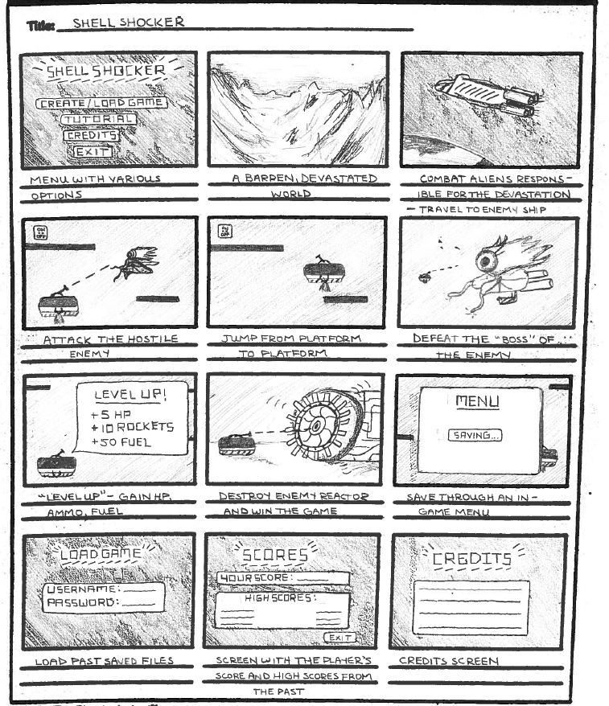
Storyboard

Slide 17
Storyboard cont.

Slide 18
Game

Slide 19
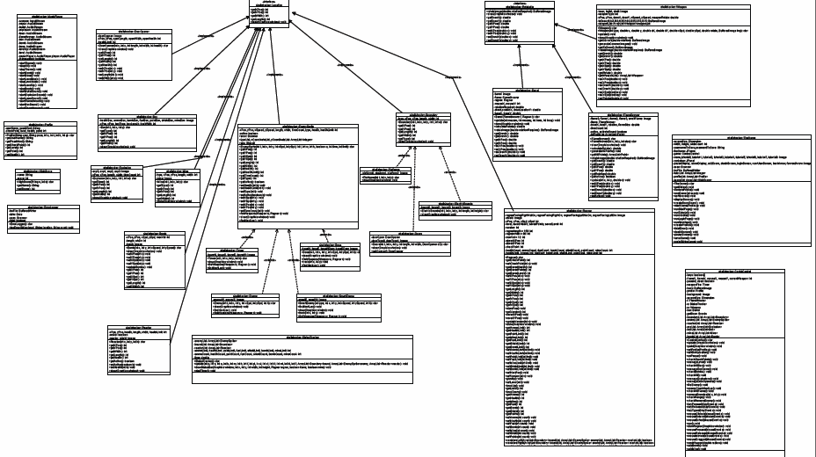
UML Diagram

Slide 20
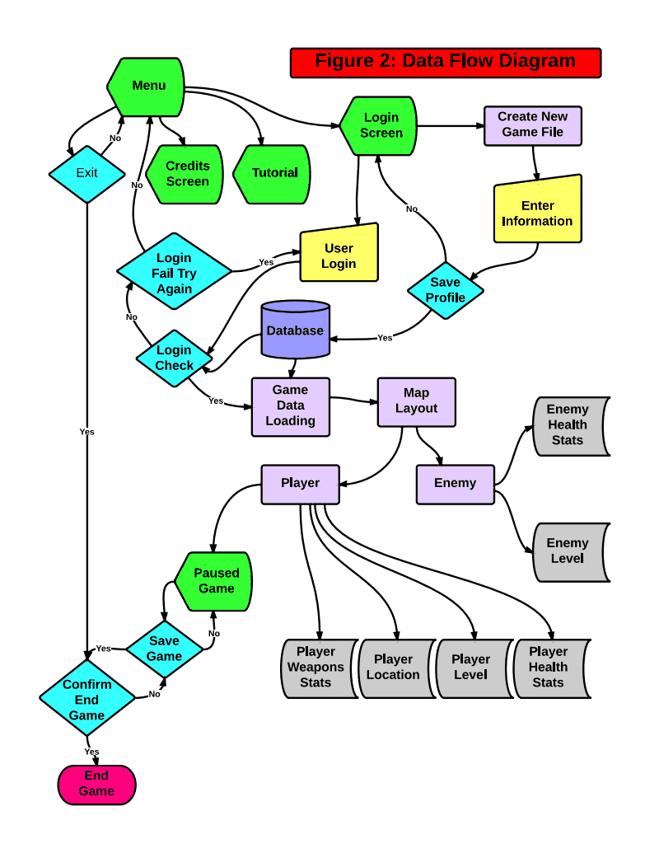
Data Flow Diagram

Slide 21
Thank You for Viewing our presentation Any questions?

