Slide 2


http://gretl.sourceforge.net
https://www.r-project.org/

Slide 3
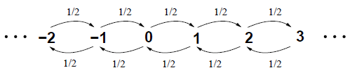



Slide 4
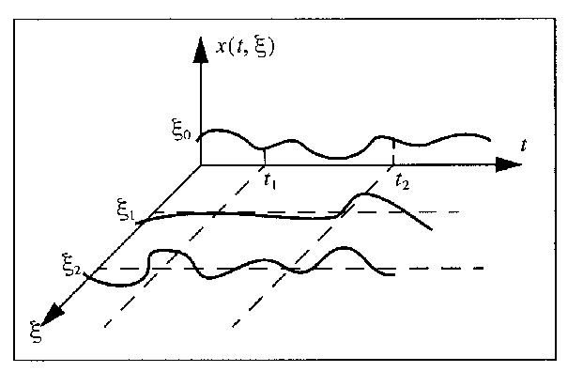

Slide 5
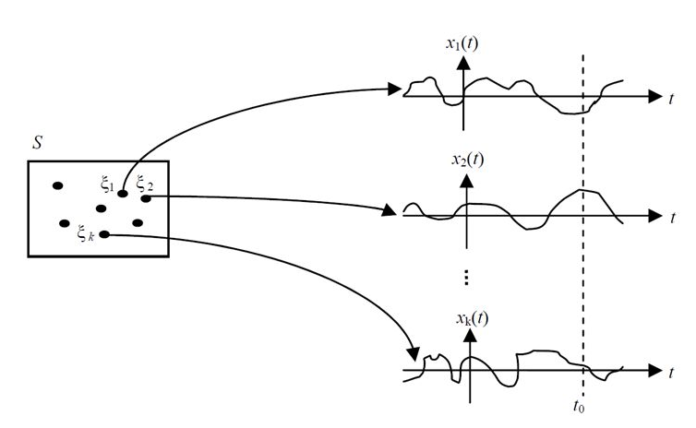




$$Ω$$
$$ω_{1}$$
$$ω_{2}$$
$$ω_{k}$$

Slide 6













$$p_{53}$$
$$p_{66}$$
$$p_{55}$$
$$5$$
$$3$$
$$p_{34}$$
$$4$$
$$p_{67}$$
$$p_{95}$$
$$p_{59}$$
$$p_{35}$$
$$p_{14}$$
$$p_{42}$$
$$6$$
$$7$$
$$p_{12}$$
$$p_{26}$$
$$p_{76}$$
$$p_{87}$$
$$p_{99}$$
$$9$$
$$1$$
$$2$$
$$8$$
$$p_{19}$$
$$p_{21}$$

