Slide 1
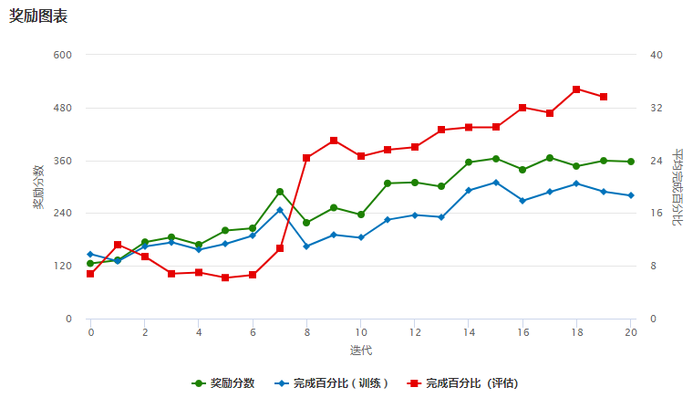
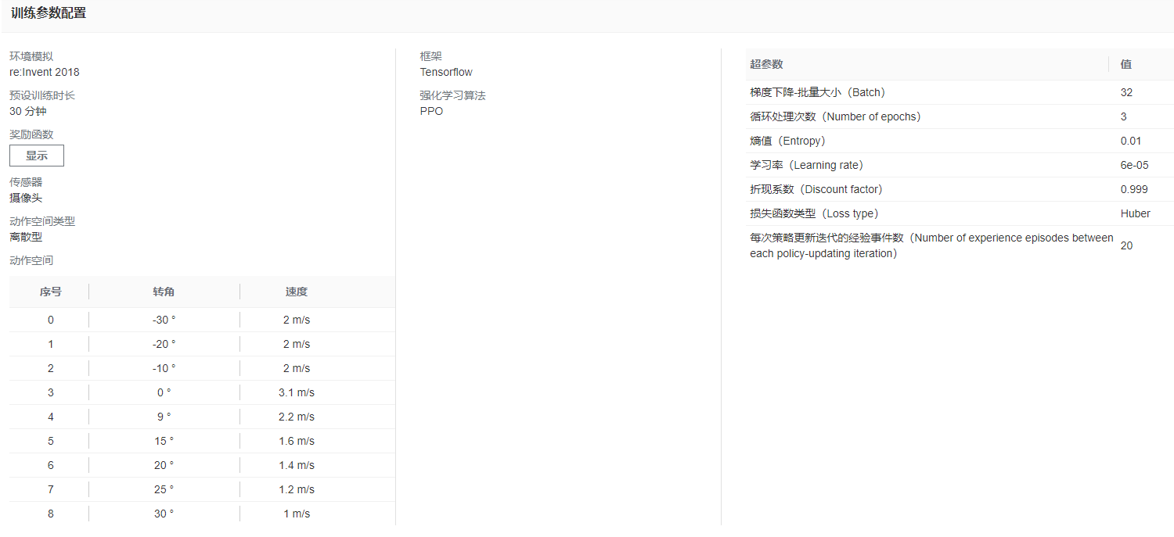
V2

Slide 2
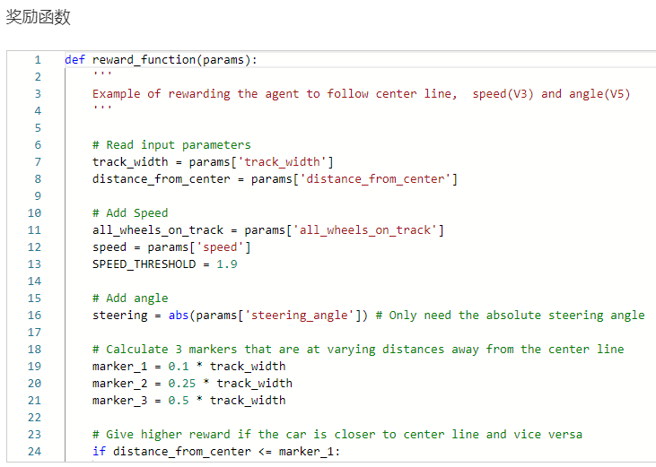
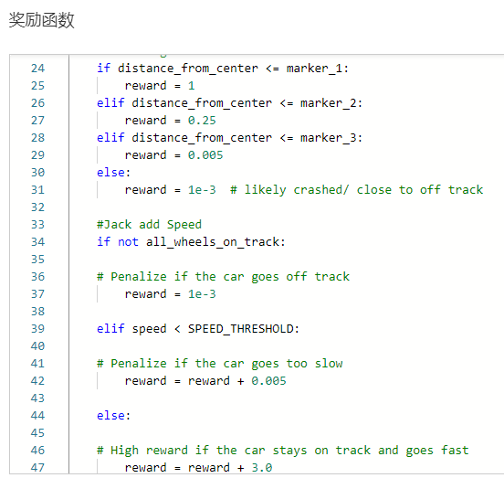
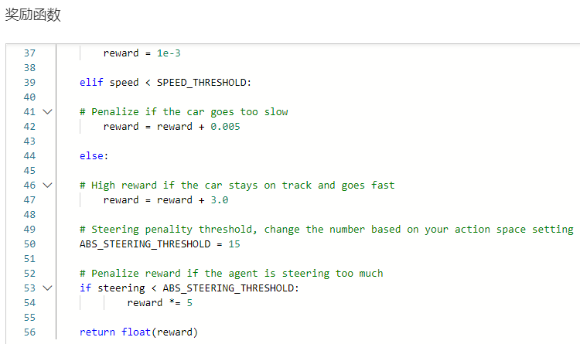

Slide 3
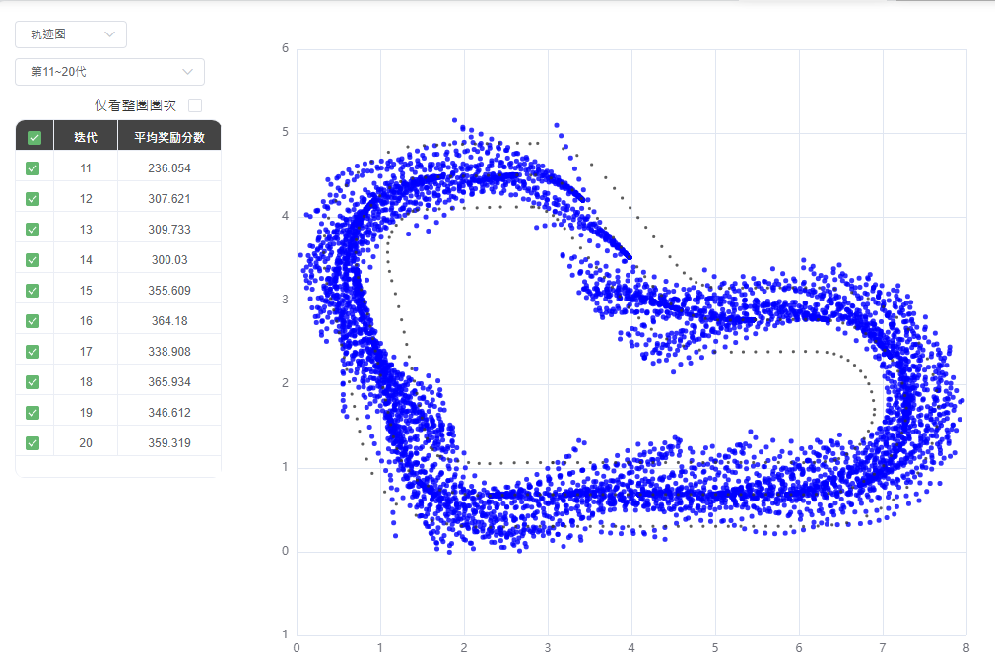
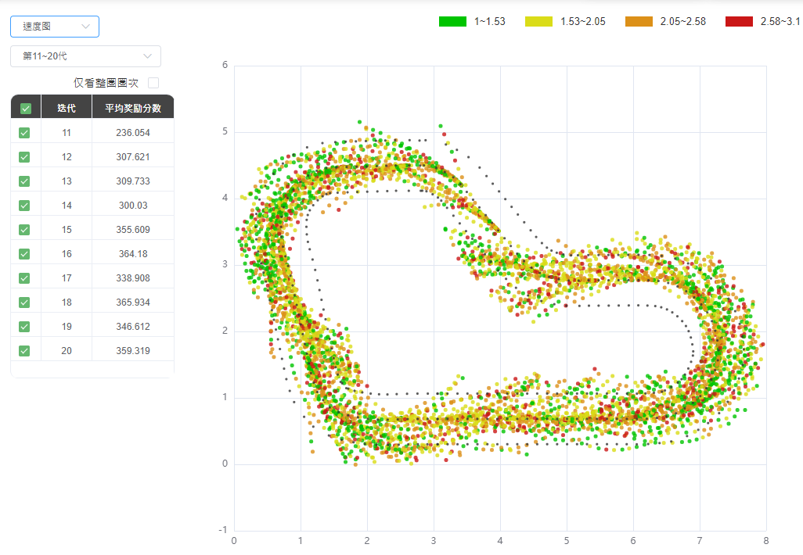
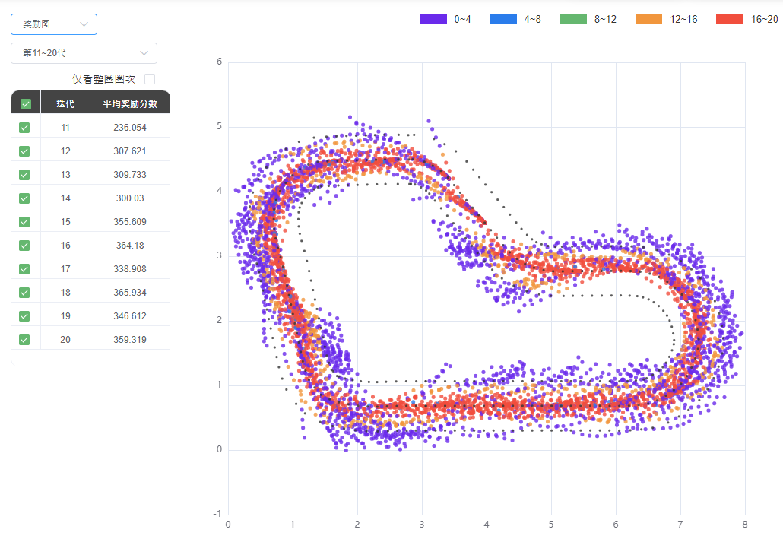
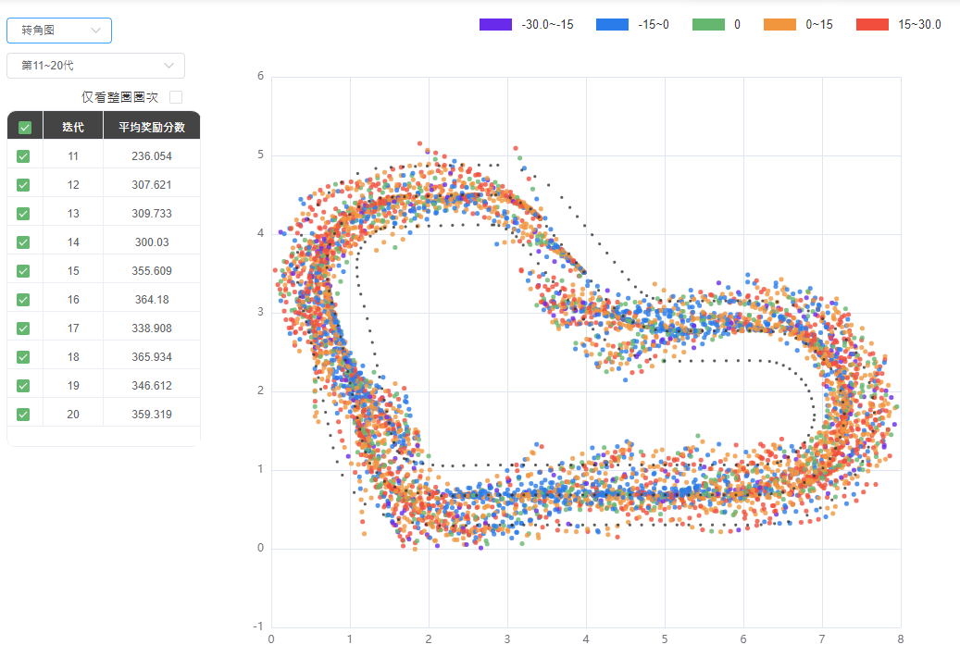

Slide 4
{
"all_wheels_on_track": Boolean, # flag to indicate if the agent is on the track
"x": float, # agent's x-coordinate in meters
"y": float, # agent's y-coordinate in meters
"closest_objects": [int, int], # zero-based indices of the two closest objects to the agent's current position of (x, y).
"closest_waypoints": [int, int], # indices of the two nearest waypoints.
"distance_from_center": float, # distance in meters from the track center
"is_crashed": Boolean, # Boolean flag to indicate whether the agent has crashed.
"is_left_of_center": Boolean, # Flag to indicate if the agent is on the left side to the track center or not.
"is_offtrack": Boolean, # Boolean flag to indicate whether the agent has gone off track.
"is_reversed": Boolean, # flag to indicate if the agent is driving clockwise (True) or counter clockwise (False).
"heading": float, # agent's yaw in degrees
"objects_distance": [float, ], # list of the objects' distances in meters between 0 and track_length in relation to the starting line.
"objects_heading": [float, ], # list of the objects' headings in degrees between -180 and 180.
"objects_left_of_center": [Boolean, ], # list of Boolean flags indicating whether elements' objects are left of the center (True) or not (False).
"objects_location": [(float, float),], # list of object locations [(x,y), ...].
"objects_speed": [float, ], # list of the objects' speeds in meters per second.
"progress": float, # percentage of track completed
"speed": float, # agent's speed in meters per second (m/s)
"steering_angle": float, # agent's steering angle in degrees
"steps": int, # number steps completed
"track_length": float, # track length in meters.
"track_width": float, # width of the track
"waypoints": [(float, float), ] # list of (x,y) as milestones along the track center
}

Slide 5
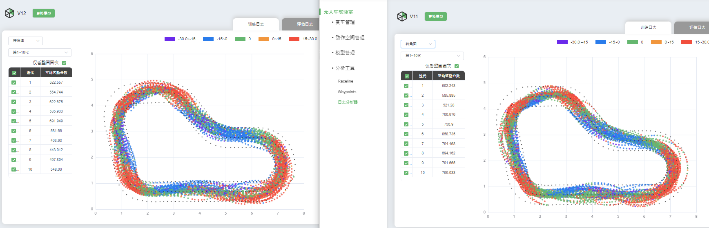
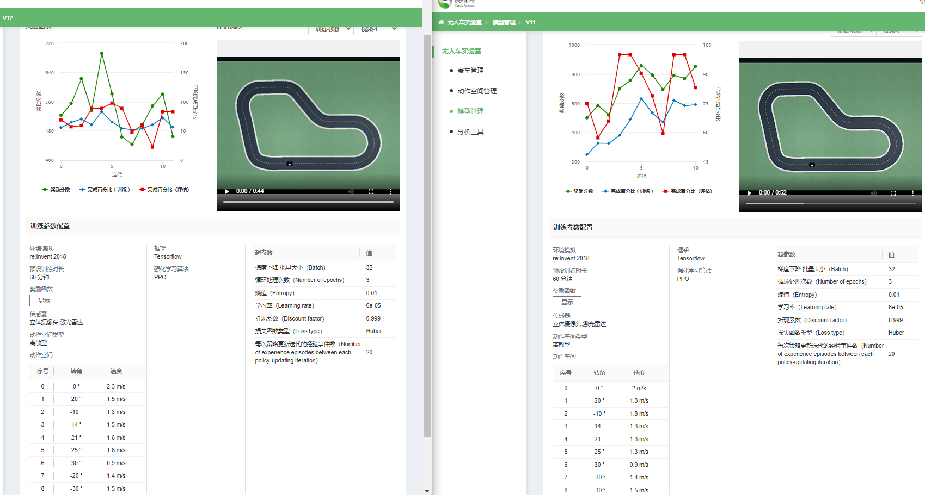

Slide 6
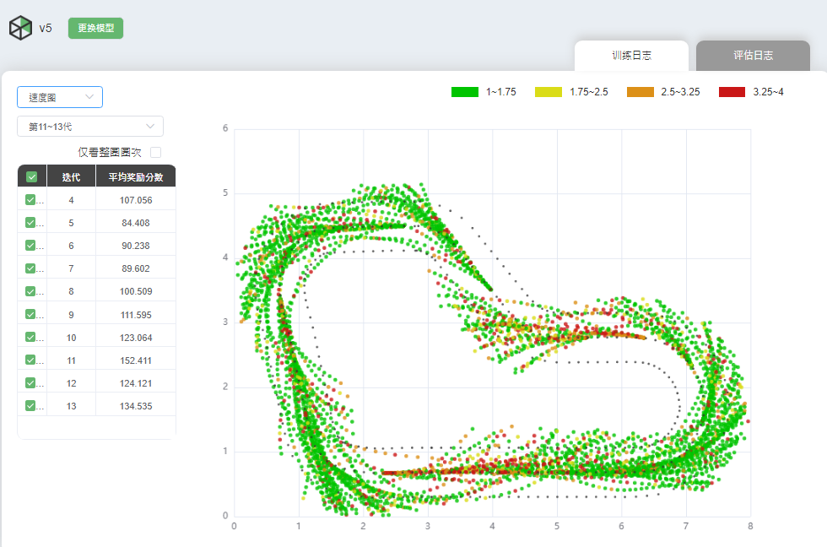
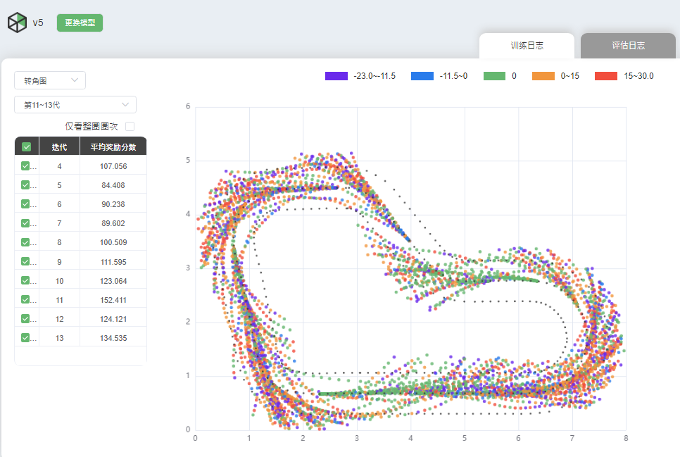
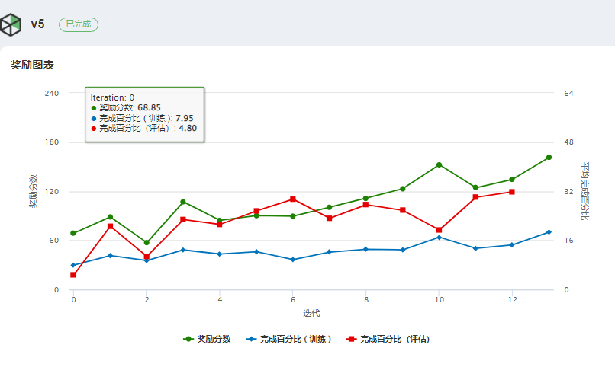
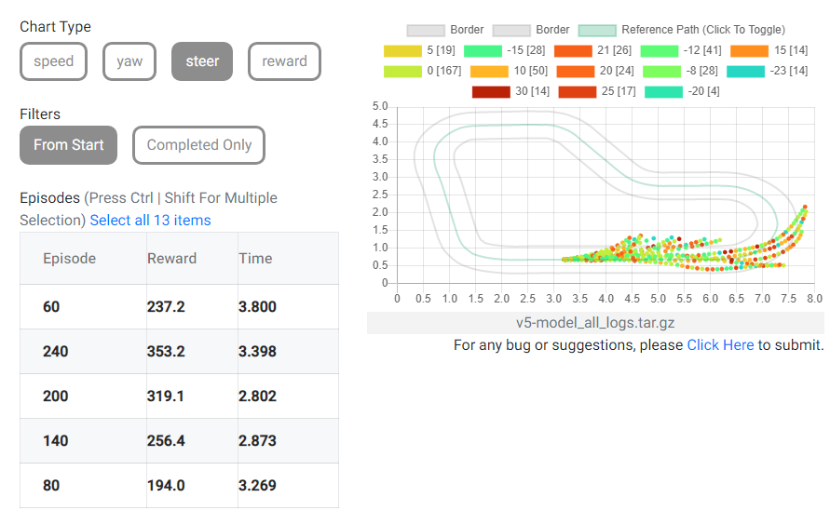
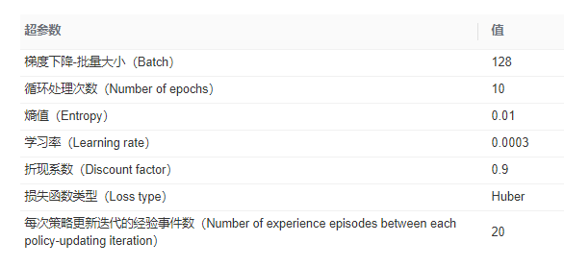
Bad model v5

Slide 7
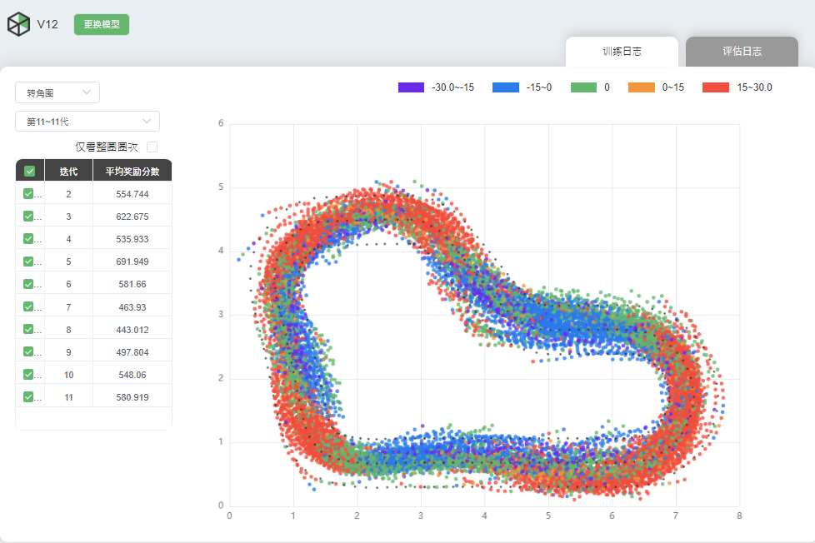
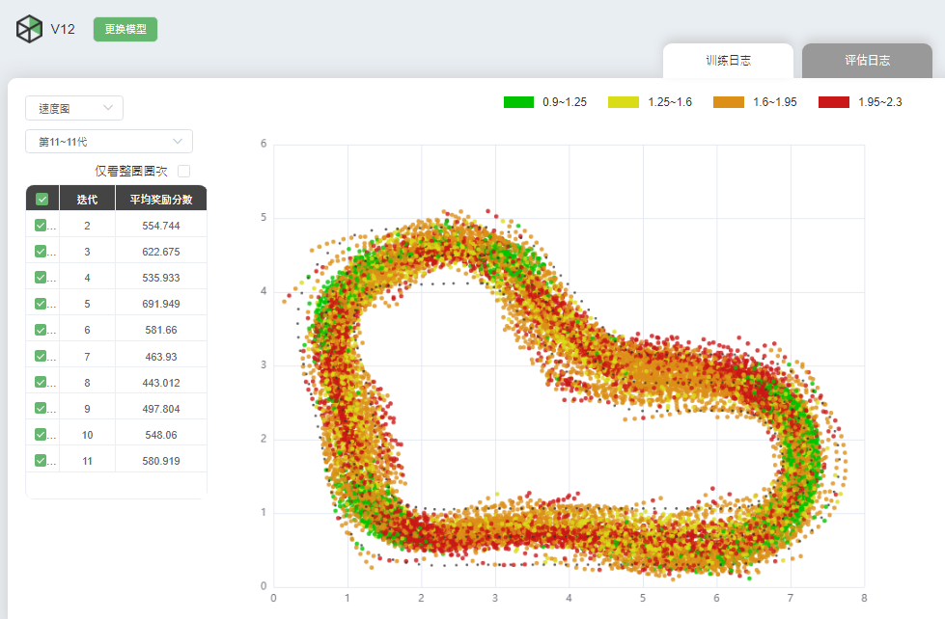
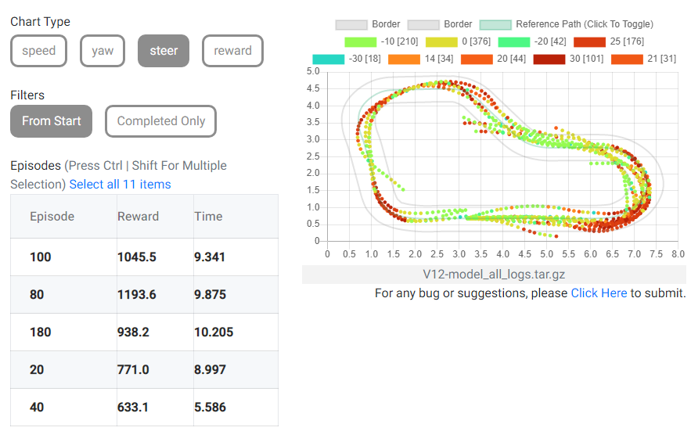
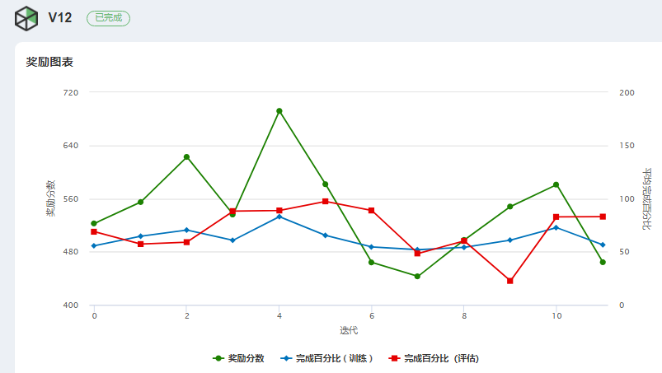
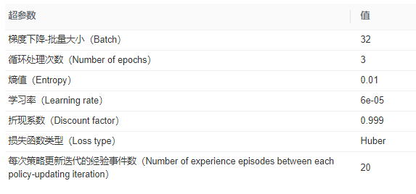
Current better model v12

