Slide 1
A Machine Learning Based Approach to Predicting long covid
Katrina Dotzlaw, Ryan Dotzlaw, sean Szturm, da tan
Notes:
For our project, our group is developing a machine learning-based approach to predict whether or not an individual will be diagnosed with Long Covid.

Slide 2
Background and importance
The WHO has defined Long Covid as Covid-19 symptoms which persist after the initial infection period¹
The Canadian Journal of Health Technologies has classified Long Covid into two stages¹:
Displaying symptoms between 4 to 12 weeks after infection with Covid-19
Displaying symptoms beyond 12 weeks after infection with Covid-19
The WHO estimates that up to 20% of individuals who are diagnosed with Covid-19 will develop Long Covid²
The Covid-19 pandemic is still ongoing and Long Covid is still an active area of research
Notes:
Consensus on a definition of Post Covid-19 condition, better known as Long Covid, has not yet been reached. According to the World Health Organization, a potential definition of Long Covid could be new or ongoing symptoms occurring after the initial four week infection period. The Canadian Journal of Health Technologies has classified Long Covid into two stages: “Ongoing symptomatic Covid-19” which they define as symptoms occurring between 4 and 12 weeks after an individual has been infected with Covid-19 and “Post Covid-19 Syndrome” which they define as symptoms occurring 12 weeks or more after an individual has been infected with Covid-19. The World Health Organization estimates that up to 20% of individuals diagnosed with Covid-19 will develop Long Covid. According to the World Health Organization, symptoms of Long Covid could include any of the Covid-19 symptoms.
We chose this topic as the world is still in the midst of the Covid-19 pandemic with Long Covid becoming an increasingly active area of research. Since a material proportion of individuals who have been diagnosed with Covid-19 will end up getting Long Covid, identifying relationships and patterns between Covid-19 symptoms and Long Covid development could help contribute to a better understanding of the illness and allow for more effective treatment.

Slide 3
Project overview and current research
Analyzing Covid-19 and Long Covid datasets
Using the Apriori Algorithm to mine interesting associations occurring in individuals diagnosed with Covid-19
Building and training a model using K-Mode Clustering to predict the possibility of developing Long Covid
Use the discovered association rules to analyze the accuracy of the model
Notes:
Our group is first using the Apriori Algorithm to mine interesting associations occurring in individuals diagnosed with Covid-19 that would imply the development of Long Covid. We are then building and training a model using K-Mode Clustering to predict the possibility of developing Long Covid based on demographic and symptom data surveyed from individuals who have been diagnosed with Long Covid. The model will be validated, with the number of clusters optimized, and then tested for accuracy using additional Covid-19 and Long Covid datasets. Finally, we will use the discovered association rules to further analyze and track the accuracy of the model.
Our current research consists of datasets containing both Covid-19 and Long Covid data. Two datasets important to our analysis include surveys completed in Kenya and Malawi detailing demographical information and symptoms of individuals who have been diagnosed with Long Covid in those countries. We have also found demographic and symptom data made up of individuals from a wide range of countries who have been diagnosed with Long Covid.
Long Covid is still an active area of research, therefore it is difficult to find datasets containing both Covid and Long Covid data. Some of the datasets we originally found were removed by their authors including a CDC dataset on Long Covid and demographics and a UK Government dataset examining the connections between Covid variants and Long Covid diagnosis.

Slide 4
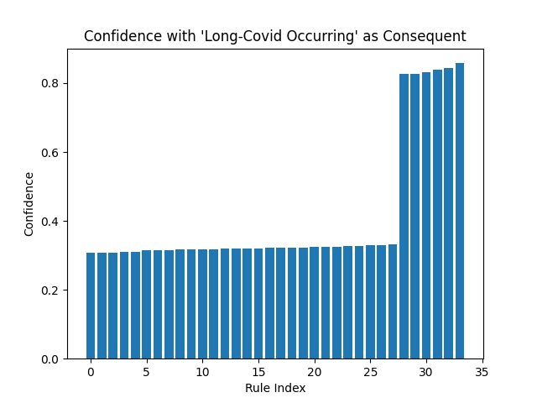
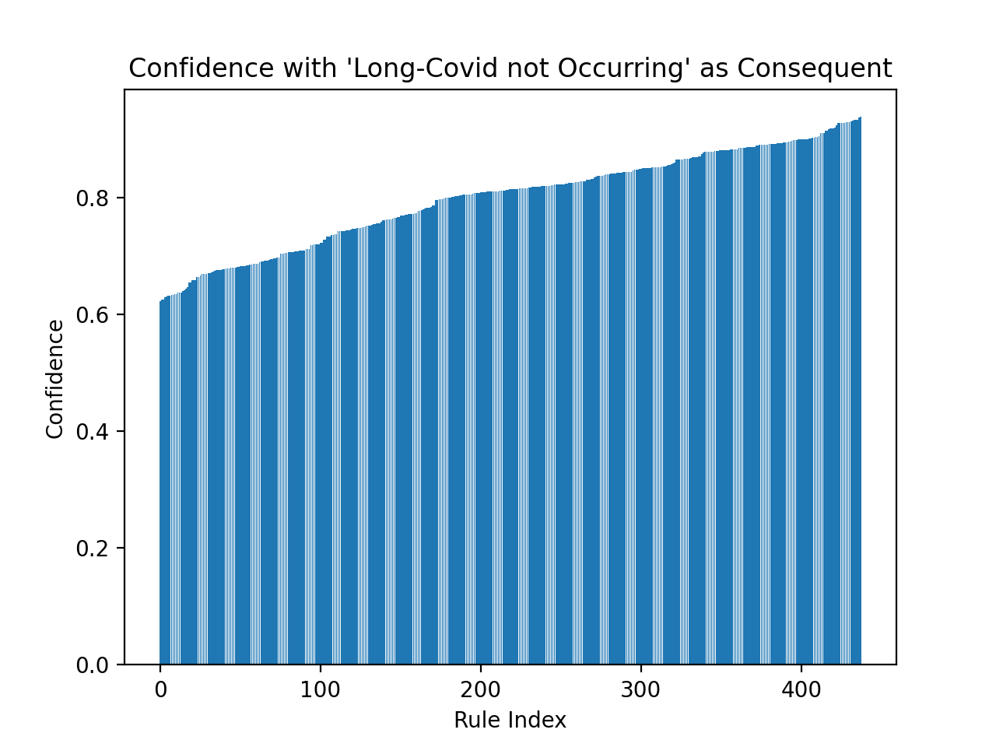
association rule mining
Associative Rule Mining using the Apriori Algorithm was performed data from the U.S Census Bureau
Discover interesting association rules
Notes:
Our first step was to discover interesting association rules using the Apriori Algorithm. The data used for the Associative Rule Mining was a dataset from the United States Census Bureau. The dataset included demographic information including age, gender, level of education, as well as health information including vaccination status, Covid-19 symptoms and whether or not the individual has or has been diagnosed with Long Covid. 28% of individuals in this dataset reported experiencing Long Covid whereas 72% of the individuals in the dataset did not experience Long Covid.
33 interesting association rules were found that included Long Covid Occurring as the consequent. The confidence of these rules ranged from 0.31 to 0.86. Additionally, over 400 interesting association rules were found that included Long Covid Not Occurring as the consequent. This is not surprising as 72% of Covid-19 patients in the dataset did not experience Long Covid. The confidence of these rules ranged from 0.6 to around 0.8.
Selected interesting association rules that included Long Covid Occurring as the consequent include: Experiencing Current Symptoms and Long Covid with a support of 0.147 and a confidence of 0.84 and Birth Gender of Female and Long Covid with a support of 0.186 and a confidence of 0.333. It is important to note that Covid-19 testing and treatment is not always accessible which could impact the results of our analysis.

Slide 5
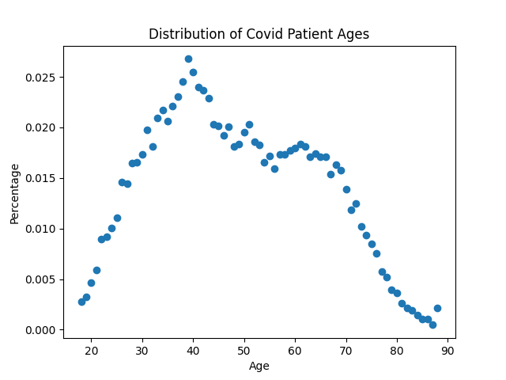
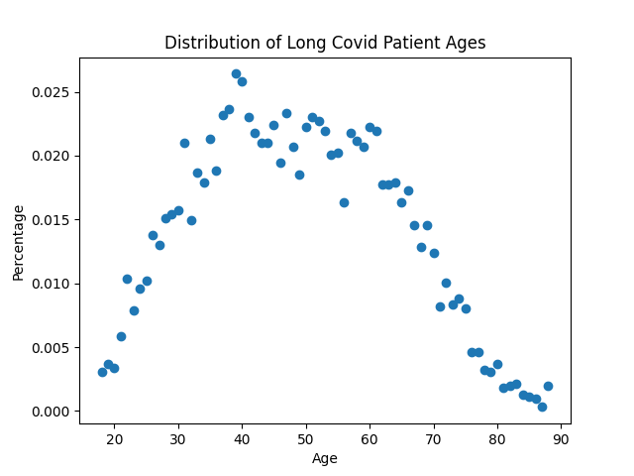
Graph analysis – long covid diagnosis
Notes:
In addition to the association rule mining, the following graphs highlight select statistics from the data. These graphs are based on the same United States Census Bureau dataset used in the association rule mining. The majority of individuals from this dataset diagnosed with Covid-19 are between the ages of 30 and 60. Ages of individuals diagnosed with Long Covid follow a similar distribution with the majority of them being between 30 and 60 years old.

Slide 6
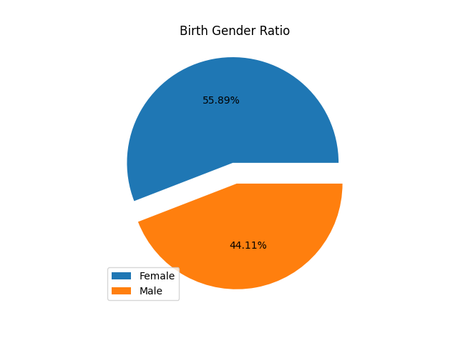
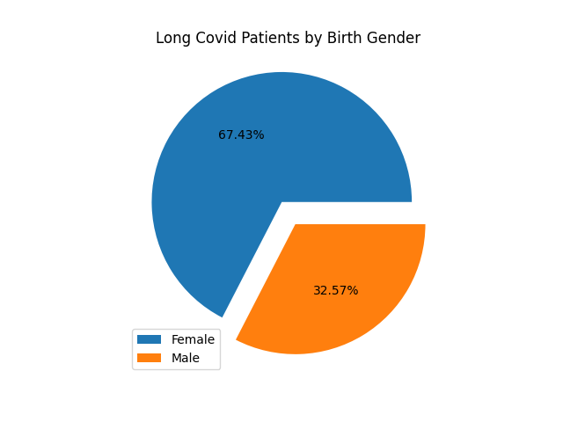
Graph analysis – Gender
Notes:
According to the dataset, 56% of individuals were assigned female at birth, while 44% were assigned male at birth. There is a higher percentage of individuals assigned female at birth who have Covid-19 in this dataset. 67% of individuals experience Long Covid were assigned female at birth, compared to 33% of individuals diagnosed with Long Covid who were assigned male at birth. This could indicate that individuals assigned female at birth are more likely to develop Long Covid, but as mentioned previously the dataset used contains a majority of individuals assigned female at birth.

Slide 7
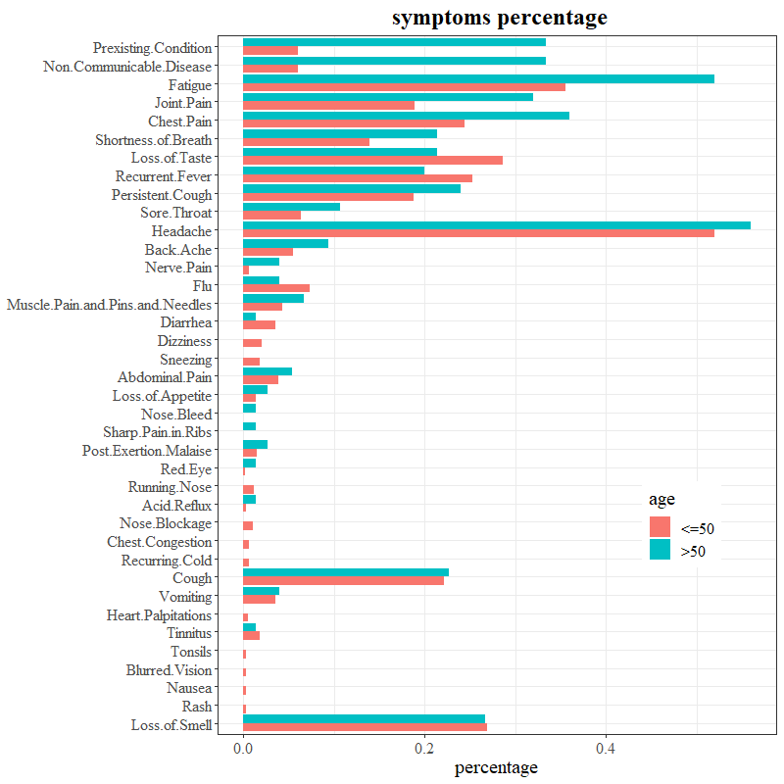
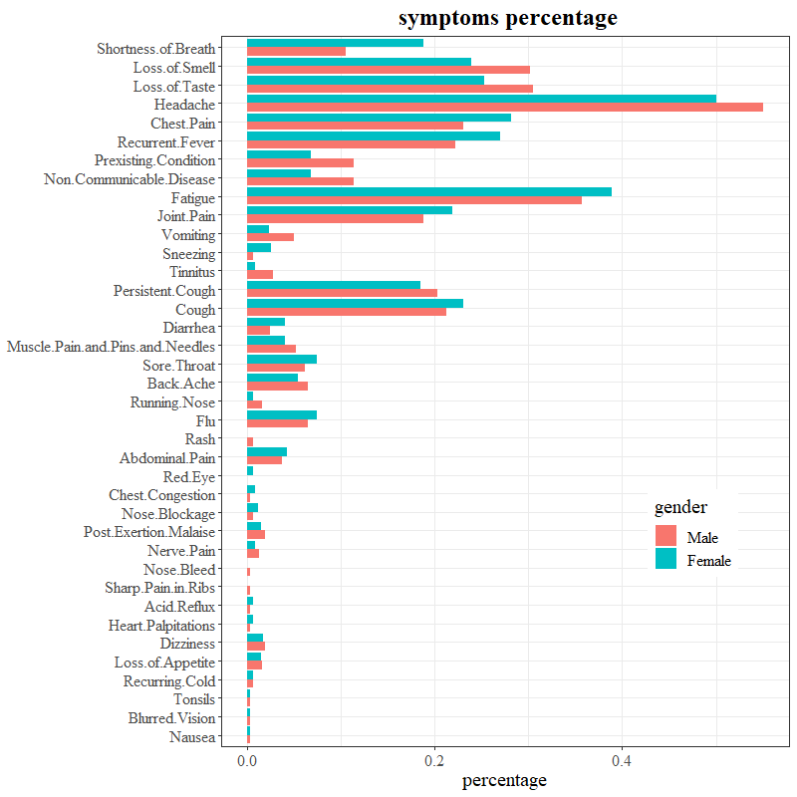
Symptom percentage
Notes:
The next step in our project is to perform K-Mode Clustering on the Long Covid data. This was initially performed on the data from surveys of Long Covid patients located in Kenya. We were initially planning on using the Random Forest algorithm to create our model, however since the Random Forest algorithm is a supervised method and the data we have found is unsupervised/uncertain we decided to use a K-Mode clustering algorithm.
We compared frequencies of Long Covid symptoms between two age groups (50 years old and younger and older than 50) and between two gender groups (Male and Female). For most of the symptoms the frequencies between the two age groups are not significant, however the symptom of Fatigue was much more prevalent in the above 50 year-old age group, being in around 50% of the individuals over 50 compared to around 35% of individuals 50 and younger. Some symptoms occurred more in individuals 50 and younger including Diarrhea and Loss of Taste.
The deviances for most of the symptom frequencies between the given genders of Male and Female are not significant. Some symptoms are more prevalent in individuals identifying as Female including Shortness of Breath, Chest Pain and Recurrent Fever. Other symptoms are more prevalent in individuals identifying as Male including Loss of Smell, Loss of Taste and Headache

Slide 8
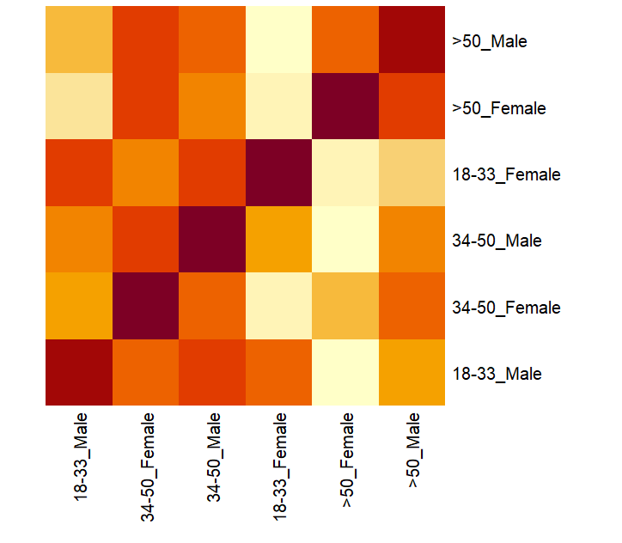
Frequency similarities
Notes:
Next, we computed the frequency similarities among the six age/gender combo subgroups – 18 to 33 Year Old Male and Female, 34 to 50 Year Old Male and Female and greater than 50 years old Male and Female. We omitted the symptoms that had 0 positive reports, reducing the number of symptoms from 45 to 38. For each age/gender subgroup and for each symptom, we computed the frequencies and percentages of the positive reports. Then each subgroup has a vector of occurrence percentage for the symptoms.

Slide 9
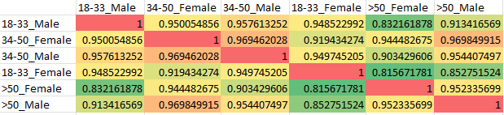
Cosine similarity matrix
Notes:
We then computed a cosine similarity matrix among the 6 subgroups previously defined, resulting in the shown table. Values range from 0.82 to 0.97.

Slide 10
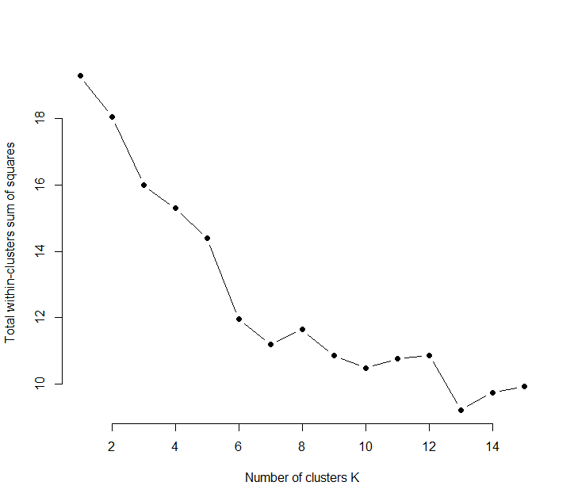
K-Mode clustering
Notes:
To begin the K-Mode Clustering Analysis, we further reduced the number of symptoms, eliminating those symptoms that occurred in less than 5% of the individuals surveyed, resulting in 15 symptoms total. Since all the symptoms are categorical – either the individual has the symptom or they do not – we performed a K-Mode analysis on the data.
First, we optimized the number of clusters within the dataset using the metric of Total of Within Cluster Sum of Square which is a measurement of compactness within a cluster. We chose the elbow point when k equals 7, demonstrated by the following optimization path resulting in 7 total clusters.

Slide 11
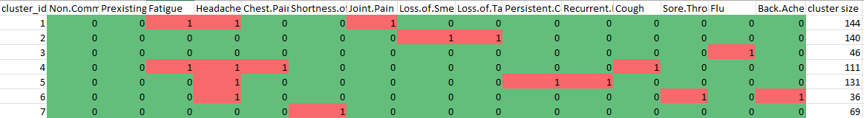
K-mode clustering
Notes:
The modes of the seven clusters are displayed here.
Cluster 1 consists of the symptoms Fatigue, Headache and Joint Pain
Cluster 2 consists of the symptoms Loss of Smell and Loss of Taste
Cluster 3 consists of the symptom Flu
Cluster 4 consists of the symptoms Fatigue, Headache, Chest Pain and Cough
Cluster 5 consists of the symptoms Headache, Persistent Cough and Recurrent Fever
Cluster 6 consists of the symptoms Headache, Sore Throat and Back Ache
Cluster 7 consists of the symptom Shortness of Breath

Slide 12
K-mode clustering results
Cluster | 18-33 Years Old | 34-50 Years Old | Greater than 50
1 | 60 | 61 | 23
2 | 76 | 52 | 12
3 | 35 | 8 | 3
4 | 53 | 47 | 11
5 | 64 | 53 | 14
6 | 9 | 20 | 7
7 | 29 | 35 | 5
Notes:
We then mapped the 7 clusters with the three age groups of 18 to 33 years old, 34 to 50 years old and greater than 50 years old, as there was no significant difference between the two gender groups. The clusters did not fit exceptionally well with the age groups, however concentrations can be observed. For example, the greater than 50 years old age group only has 75 cases, however these cases are mainly found in clusters 1, 2, 4 and 5.

Slide 13
Next steps
Further analysis on additional datasets
Model validation using 10-Fold Cross Validation
Creating a predictive model and performing predictive analysis on test data
Analysis of accuracy when predicting Long Covid
Notes:
Next steps for our project include performing analysis on the Malawi survey data as well as performing additional analysis on the United States Census Bureau Data. We will also perform model validation using 10-fold Cross Validation to optimize hyperparameters, specifically the number of clusters.
Next, we will perform predictive analysis on test data using the results generated by our K-Mode Clustering Algorithm to create a model to predict whether an individual will develop Long Covid as well as perform an analysis of the model’s accuracy when predicting Long Covid using the test dataset.

Slide 14
thank you
Notes:
Thank you and we now welcome any questions.

