Slide 1

A Machine Learning Based Approach to Predicting long covid
Katrina Dotzlaw, Ryan Dotzlaw, sean Szturm, da tan
Notes:
Good afternoon everyone. For our project, our group is attempting to develop a machine learning-based approach to predict whether or not an individual will get Long Covid.

Slide 2
Background and importance
The WHO has defined Long Covid as Covid-19 symptoms which persist after the initial infection period (World Health Organization, 2022)
The Canadian Journal of Health Technologies has classified Long Covid into two stages (Canadian Journal of Health Technologies, 2021):
Displaying symptoms between 4 to 12 weeks after infection with Covid-19
Displaying symptoms beyond 12 weeks after infection with Covid-19
The WHO estimates that up to 20% of individuals who are diagnosed with Covid-19 will develop Long Covid (World Health Organization, 2022)
The Covid-19 pandemic is still ongoing and Long Covid is still an active area of research
Notes:
Consensus on a definition of Post Covid-19 condition, better known as Long Covid, has not yet been reached. According to the World Health Organization, a potential definition of Long Covid could be new or ongoing symptoms occurring after the initial four week infection period. The Canadian Journal of Health Technologies has classified Long Covid into two stages: “Ongoing symptomatic Covid-19” which they define as symptoms occurring between 4 and 12 weeks after an individual has been infected with Covid-19 and “Post Covid-19 Syndrome” which they define as symptoms occurring 12 weeks or more after an individual has been infected with Covid-19. The World Health Organization estimates that up to 20% of individuals diagnosed with Covid-19 will develop Long Covid. According to the World Health Organization, symptoms of Long Covid could include any of the Covid-19 symptoms.
We chose this topic as the world is still in the midst of the Covid-19 pandemic with Long Covid becoming an increasingly active area of research. Since a material proportion of individuals who have been diagnosed with Covid-19 will end up getting Long Covid, identifying relationships and patterns between Covid-19 symptoms and Long Covid development could help contribute to a better understanding of the illness and allow for more effective treatment.

Slide 3
Project overview and current research
Analyzing Long Covid datasets
Using the Apriori Algorithm to mine interesting associations occurring in individuals diagnosed with Covid-19
Performing K-Mode Clustering and training a classifier to predict the possibility of developing Long Covid
Use the discovered association rules to analyze the accuracy of the model
Notes:
Our group is first using the Apriori Algorithm to mine interesting associations occurring in individuals diagnosed with Covid-19 that would imply the development of Long Covid. We are using K-Mode Clustering to explore datasets detailing demographical information and symptoms surveyed from Long Covid patients and then plan on training a classifier on an additional dataset to predict the possibility of developing Long Covid. The model will be validated, with the number of clusters optimized, and then tested for accuracy using additional Long Covid datasets. Finally, we will use the discovered association rules to further analyze and track the accuracy of the model.
Our current research includes datasets containing both Covid-19 and Long Covid data. Two datasets important to our analysis include surveys from the United Nations Office for the Coordination of Humanitarian Affairs completed in Kenya and Malawi detailing demographical information and symptoms of individuals who have been diagnosed with Long Covid in those countries.
Long Covid is still an active area of research, therefore it is difficult to find datasets containing both Covid and Long Covid data. Some of the datasets we originally found were removed by their authors including a CDC dataset on Long Covid and demographics and a UK Government dataset examining the connections between Covid variants and Long Covid diagnosis.
In addition to the datasets, we found an article from Sudre et al. 2021 where they attempt to predict Long Covid based on symptoms experienced during the first 7 days of being infected with Covid-19.

Slide 4
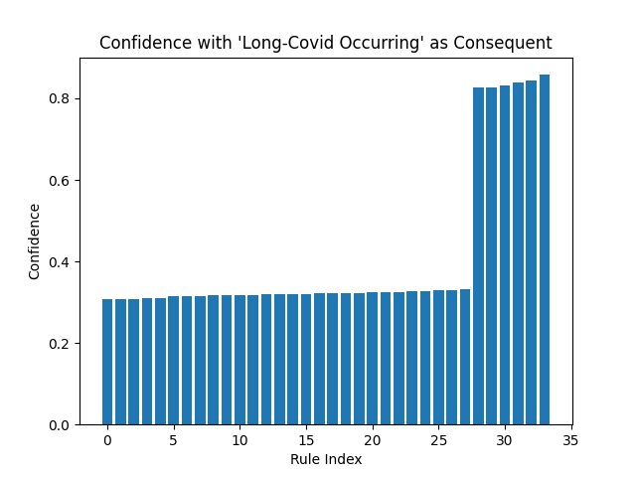
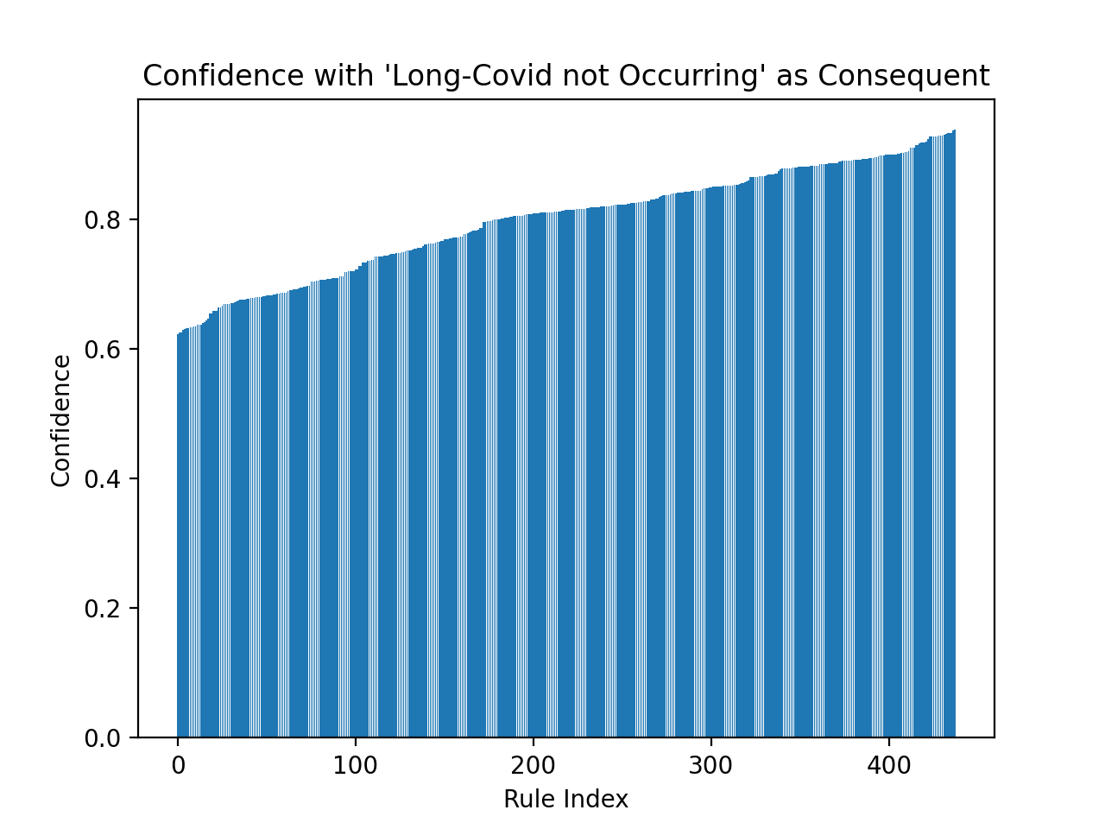
association rule mining
Associative Rule Mining using the Apriori Algorithm was performed data from the U.S Census Bureau
Discover interesting association rules
Notes:
Our first step was to discover interesting association rules using the Apriori Algorithm. The data used for the Associative Rule Mining was a dataset from the United States Census Bureau. The dataset included demographic information including age, gender, level of education, as well as health information including vaccination status, Covid-19 symptoms and whether or not the individual has or has been diagnosed with Long Covid. 28% of individuals in this dataset reported experiencing Long Covid whereas 72% of the individuals in the dataset did not experience Long Covid.
33 interesting association rules were found that included Long Covid Occurring as the consequent. The confidence of these rules ranged from 0.31 to 0.86. Additionally, over 400 interesting association rules were found that included Long Covid Not Occurring as the consequent. This is not surprising as 72% of Covid-19 patients in the dataset did not experience Long Covid. The confidence of these rules ranged from 0.6 to around 0.8.
Selected interesting association rules that included Long Covid Occurring as the consequent include: Experiencing Current Symptoms and Long Covid with a support of 0.147 and a confidence of 0.84 and Birth Gender of Female and Long Covid with a support of 0.186 and a confidence of 0.333. It is important to note that Covid-19 testing and treatment is not always accessible which could impact the results of our analysis.

Slide 5
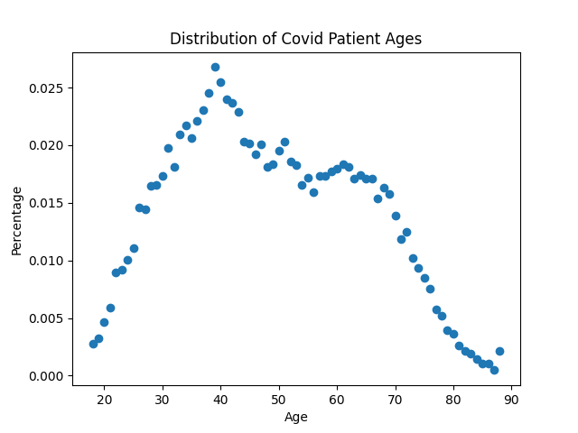
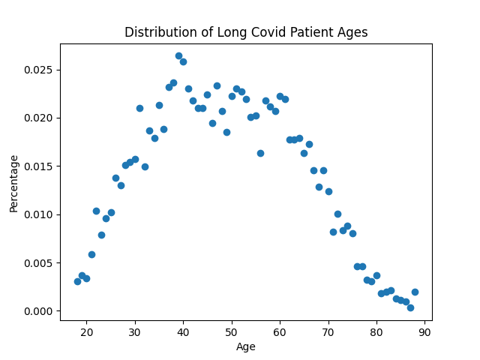
Graph analysis – long covid diagnosis
Notes:
In addition to the association rule mining, the following graphs highlight select statistics from the data. These graphs are based on the same United States Census Bureau dataset used in the association rule mining. As can be seen here, the majority of individuals from the dataset diagnosed with Covid-19 are between the ages of 30 and 60. Ages of individuals diagnosed with Long Covid follow a similar distribution with the majority of them being between 30 and 60 years old.

Slide 6
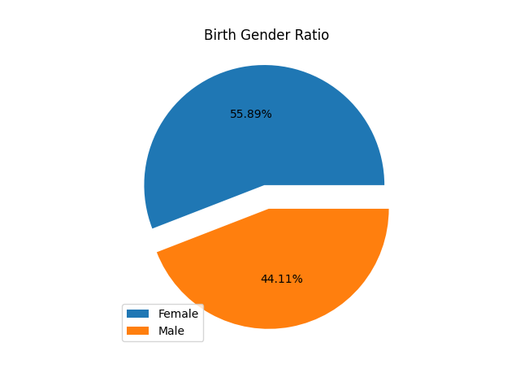
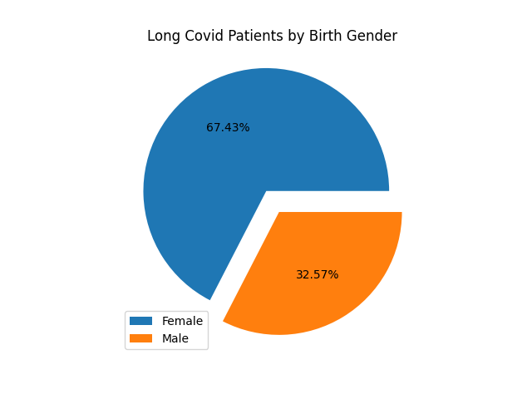
Graph analysis – Gender
Notes:
According to the dataset, 56% of individuals were assigned female at birth, while 44% were assigned male at birth. There is a higher percentage of individuals assigned female at birth who have Covid-19 in this dataset. 67% of individuals experiening Long Covid were assigned female at birth, compared to 33% of individuals diagnosed with Long Covid who were assigned male at birth. This could indicate that individuals assigned female at birth are more likely to develop Long Covid, but as mentioned previously the dataset used contains a majority of individuals assigned female at birth.

Slide 7
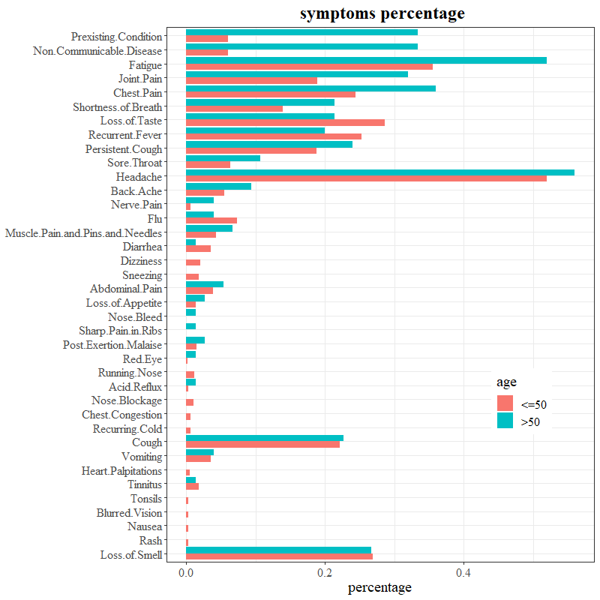
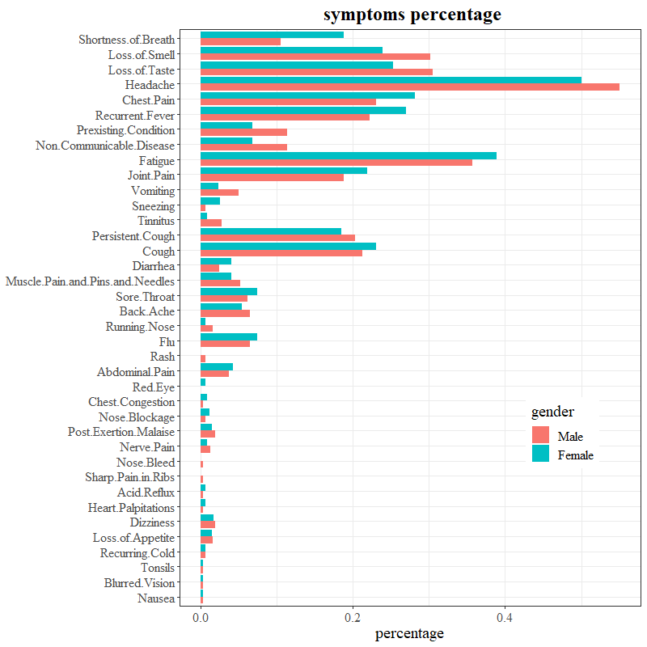
Symptom percentage
Notes:
The next step in our project is to perform K-Mode Clustering on the Long Covid data. This was initially performed on the data from surveys of Long Covid patients located in Kenya.
We compared frequencies of Long Covid symptoms between two age groups (50 years old and younger and older than 50) and between two gender groups (Male and Female). For most of the symptoms the frequencies between the two age groups are not significant, however the symptom of Fatigue was much more prevalent in the above 50 year-old age group, being in around 50% of the individuals over 50 compared to around 35% of individuals 50 and younger. Some symptoms occurred more in individuals 50 and younger including Diarrhea and Loss of Taste.
The deviances for most of the symptom frequencies between the given genders of Male and Female are not significant. Some symptoms are more prevalent in individuals identifying as Female including Shortness of Breath, Chest Pain and Recurrent Fever. Other symptoms are more prevalent in individuals identifying as Male including Loss of Smell, Loss of Taste and Headache

Slide 8
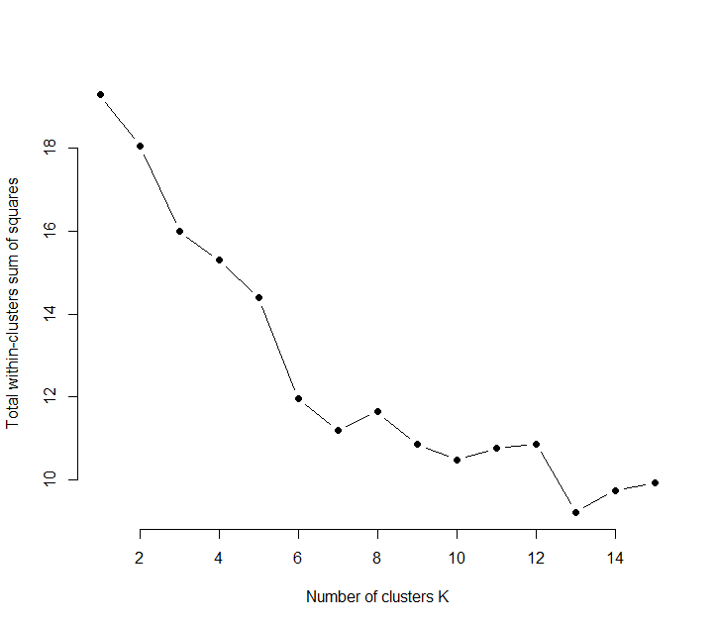
K-Mode clustering
Notes:
To begin the K-Mode Clustering Analysis, we reduced the number of symptoms, eliminating those symptoms that occurred in less than 5% of the individuals surveyed, resulting in 15 symptoms total. Since all the symptoms are categorical – either the individual has the symptom or they do not – we performed a K-Mode analysis on the data.
First, we optimized the number of clusters within the dataset using the metric of Total of Within Cluster Sum of Square which is a measurement of compactness within a cluster. We chose the elbow point when k equals 7, demonstrated by the following optimization path resulting in 7 total clusters.

Slide 9
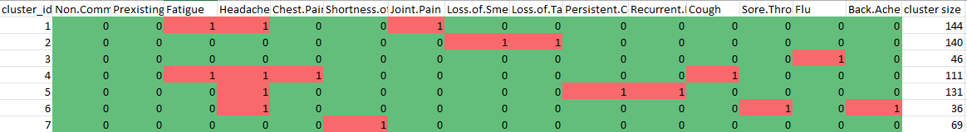
K-mode clustering
Notes:
The modes of the seven clusters are displayed here.
Cluster 1 consists of the symptoms Fatigue, Headache and Joint Pain
Cluster 2 consists of the symptoms Loss of Smell and Loss of Taste
Cluster 3 consists of the symptom Flu
Cluster 4 consists of the symptoms Fatigue, Headache, Chest Pain and Cough
Cluster 5 consists of the symptoms Headache, Persistent Cough and Recurrent Fever
Cluster 6 consists of the symptoms Headache, Sore Throat and Back Ache
Cluster 7 consists of the symptom Shortness of Breath

Slide 10
K-mode clustering results
Cluster | 18-33 Years Old | 34-50 Years Old | Greater than 50
1 | 60 | 61 | 23
2 | 76 | 52 | 12
3 | 35 | 8 | 3
4 | 53 | 47 | 11
5 | 64 | 53 | 14
6 | 9 | 20 | 7
7 | 29 | 35 | 5
Notes:
We then mapped the 7 clusters with the three age groups of 18 to 33 years old, 34 to 50 years old and greater than 50 years old, as there was no significant difference between the two gender groups. The clusters did not fit exceptionally well with the age groups, however concentrations can be observed. For example, the greater than 50 years old age group only has 75 cases, however these cases are mainly found in clusters 1, 2, 4 and 5.

Slide 11
Next steps
Preparing a classifier to predict whether a Covid-19 patient will get Long Covid
Evaluate the model
Notes:
Next steps for our project include preparing a classifier to predict whether a Covid-19 patient will get Long Covid based on the results analyzing the individuals who were diagnosed with Long Covid from the Kenya Long Covid survey database. This analysis will be based on the same United States Census dataset mentioned previously.
We will first deal with any NA values, then divide the dataset into training and validation test sets. For the test dataset we will only use cases that do not contain NA values. Then we will apply feature selection and engineering steps. Next, we plan on using 10-fold-cross-validation to optimize the parameters of the model. We will then apply an algorithm to predict whether the patient will get Long Covid then use AUC on the test dataset to evaluate the model.

Slide 12
thank you
Notes:
Thank you and we now welcome any questions.

Slide 13
References
Canadian Journal of Health Technologies. (2021, September). CADTH Horizon Scan – An Overview of Post- COVID-19 Condition (Long COVID). https://www.cadth.ca/sites/default/files/hs- eh/EH0096%20Long%20COVID%20v.7.0-Final.pdf
Diab, O. (2022). Kenya, Malawi, Long Covid-19 effects survey dataset [Data set]. The Humanitarian Data Exchange. https://data.humdata.org/dataset/long-covidresearchagenda
Kuodi, P. (2022). Long Covid Data Set [Data set]. Harvard Dataverse. https://dataverse.harvard.edu/dataset.xhtml?persistentId=doi:10.7910/DVN/N5I10C
Sudre, C. H., Murray, B., Varsavsky, T., Graham, M. S., Penfold, R. S., Bowyer, R. C., Pujol, J. C., Klaser, K., Antonelli, M., Canas, L. S., Molteni, E., Modat, M., Cardoso, M. J., May, A., Ganesh, S., Davies, R., Nguyen, L. H., Drew, D. A., Astley, C. M.,… Steves, C. J. (2021). Attributes and predictors of long covid. Nature Medicine, 27, 626-631. https://doi.org/10.1038/s41591-021-01292-y
United States Census Bureau. (2022, October 20). Household Pulse Survey Public Use File (PUF). https://www.census.gov/programs-surveys/household-pulse-survey/datasets.html
World Health Organization. (2022, September 8). Post COVID-19 condition (Long COVID). https://www.who.int/europe/news-room/fact-sheets/item/post-covid-19-condition

