Slide 1



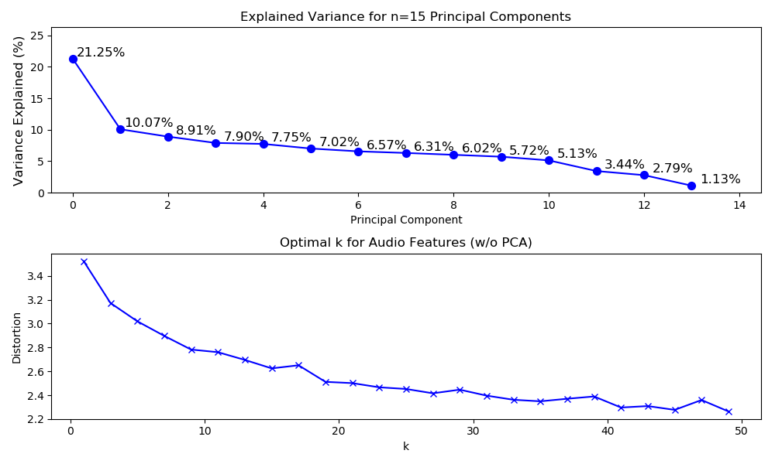
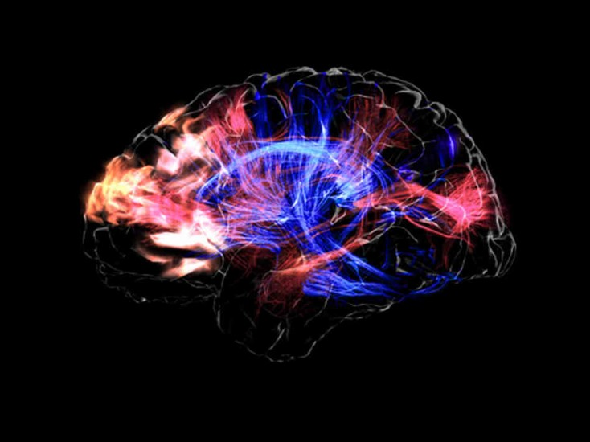
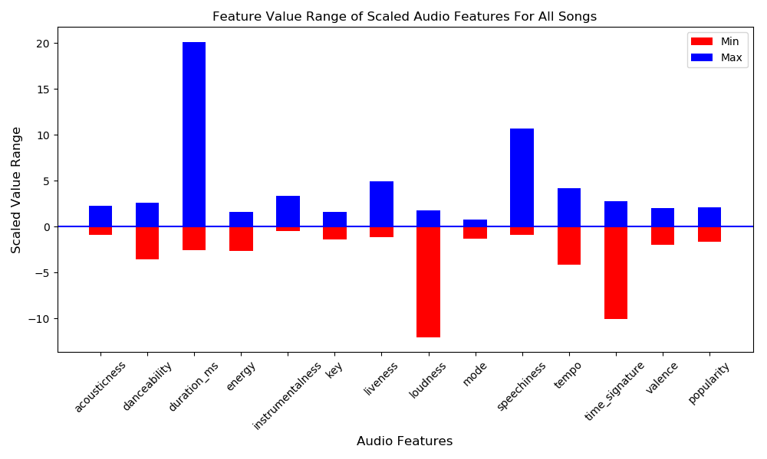
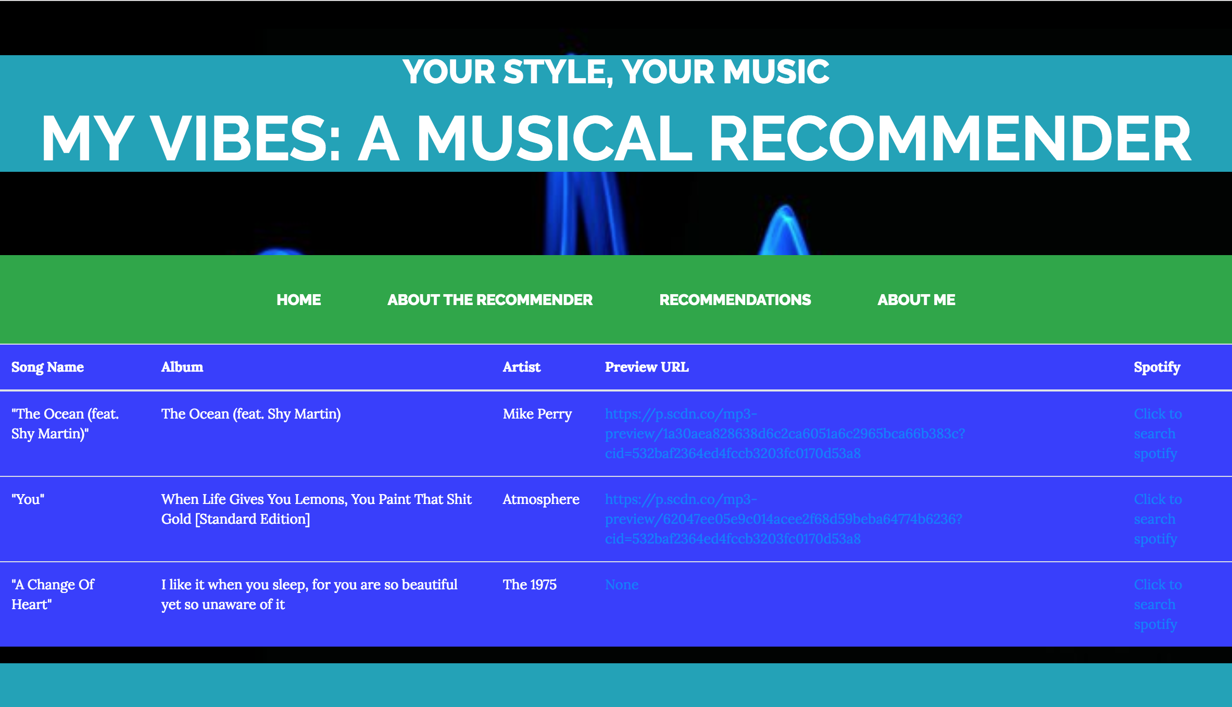
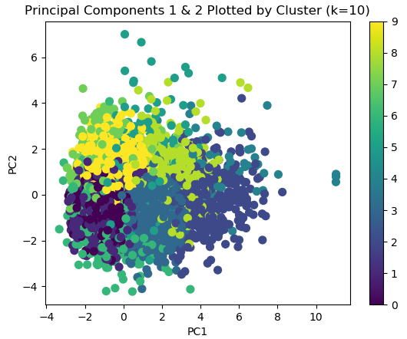
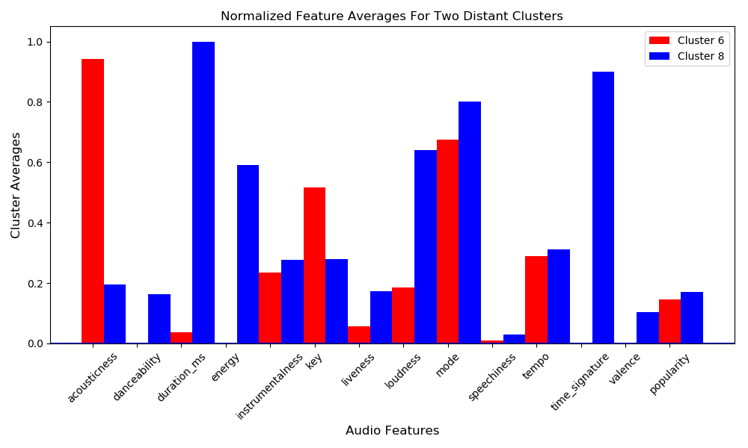
MyVibes: A Musical Recommender
Robert Dowd
github.com/rdowd003
In
/in/rdowd003
rdowd003@hotmail.com
Introduction
Methods
Results
Discussion
Advanced cognition in humans is an astounding evolutionary feat and its driving forces continue to persist as a mystery. Despite our ignorance of the underlying mechanisms, the ability to transform electrical (neural) signals into something with greater meaning is what makes our lives so interesting, and of course, so unique. Enhancing these subjective cognitive experiences, in the context of music, is the primary motivation for this project.
Data processing and clustering
Data consisted of 14 proprietary audio-features, sourced through the Spotify API for a public playlist of 10,000 tracks. The playlist includes a diverse set of musical styles, artists, genres, and thus, a wide range of values for each feature (figure 1). To remove collinearity among features, the data set was first standardized, and then transformed using Principal Component Analysis.
Figure 1. Max-min range of audio-feature values for entire, 10,000 track dataset.
Kmeans clustering was used to group the tracks by audio features, setting the clusters up for the recommendation process.
Recommending
The MyVibes recommender was deployed using a Flask App, and proceeds as follows:
Preview a random selection of songs, 1 from each of the 10 clusters.
Select the cluster, or the “vibe” to which the strongest connection was felt.
Select an audio feature to prioritize, and whether more, or less popular (according to Spotify counts) songs should be recommended.
Ten principal components were sufficient to explain 90% of the variance, and were used for Kmeans analysis (figure 2). Additionally, 10 clusters were set, as this number gave the largest decrease in distortion while satisfying the “reasonable time” requirement of using a recommender interactively.
Recommendations and Limitations
Ultimately, this musical recommender achieves the goal of delivering individualized song recommendations in a fast and efficient manner. Limitations included a lack of access to the raw wave-derived audio features, having to cold-start all users, and a lack of metadata for tracks that could potentially be used to filter features or conduct an NLP analysis.
Figure 2. PCA transformations and clustering.
Top: Scree plot (to determine optimal principal components) and elbow plot (optimal k, clusters).
Bottom: First two components plotted against one another, together explaining roughly 34% of the data’s variance.
Future Directions
Allow users to sign in with spotify credentials and gather information about top artists, top played songs, etc., to enhance recommendations.
With access to raw audio features, conduct a more thorough feature-engineering analysis to improve the clustering
Store information for each user and make response-based updates.
Mickey Hart. This is your brain on music. http://libguides.humboldt.edu/c.php?g=303882&p=2030458. 09/01/2018.
For musical recommender systems, there are many ways to create a starting point. Favorite song, favorite artist, era, existing playlists, etc. While this project does eventually utilize similar categorizers for filtering, the basis of its recommendations are driven by connections to the deeper, more complex elements of music. This unique recommender allows users to choose a cluster, or group “vibe”, from which new songs are recommended.
Average audio features varied considerably between clusters, as expected. Cluster 6 and 8 were the furthest apart in Euclidean Distance (figure 3).
Objectives
References
Develop a versatile recommender algorithm that can easily be used by any kind of listener.
Launch a simple, interactive web-based environment for users to experiment with the recommender system.
T. Bertin-Mahieux. Large-Scale Pattern Discovery in Music. PhD thesis, Columbia University, February 2013.
Spotify API (code available on github.com/rdowd003/Capstone-3/src
Flask, Pandas, Spark, sklearn documentation
Figure 3. Cluster 6 and cluster 8 audio features (average)

