Slide 1

Python Snake Game
External Project Viva 2022-2023
Parul Institute of Computer Applications
Semester 2 Project -1
2022-23
Team members
Rashika Vidyarthi 2205103120019
Rishabdev Panchal 2205103140012
Swayam Rajora 2205103130003

Slide 2
INDEX
Abstract
Tools and Technology Used
Features of Proposed System
Limitation of Proposed System
Users and their role description
System Flow Diagram
Data Flow Diagram ( All Levels)
Use Case Diagram
Data Dictionary
Screenshots of Development Phase 1 ( Designing of your Project)
Screenshots of Development Phase 2 ( Features Implementation)
Screenshots of Development Phase 3 ( Features Implementation)
Future Enhancement
Conclusion
References

Slide 3
Abstract
Snake game is one of the most popular arcade games of all time. In this game, themain objective of the player is to catch the maximum number of fruits withouthitting the wall or itself.
It is one of the best beginner-friendly projects that every novice programmershould take as a challenge.
The game should be displayed on a window with a fixed size.
The snake should consist of a head and a body made up of square blocks. The head should move around the screen, and the body should follow behind it.
The game should end if the snake collides with the walls or with its own body.

Slide 4
Tools and Technology Used
Language Used: Python
Liblaries/Modules Used:
Turtle – Allows users to create pictures and shapes with a provided, virtual canvas.
Random – Generated random positions, numbers, and values.
Time - It allows functionality like getting the current time, pausing the Program from executing, etc.

Slide 5
Features of Proposed System
Simple Python-Based
Source of entertainment
Simple and easy to use
Brings back old memories

Slide 6
Limitation of Proposed System
Not fully fledged game
Not amazing enjoyable graphics
The source code is available with different variaints across the internet.

Slide 7
Users and their role description
There is only one user in the proposed system. It is the player himself who plays the game.
The Main role of the user is to play and enjoy the game and create the highest score possible.

Slide 8
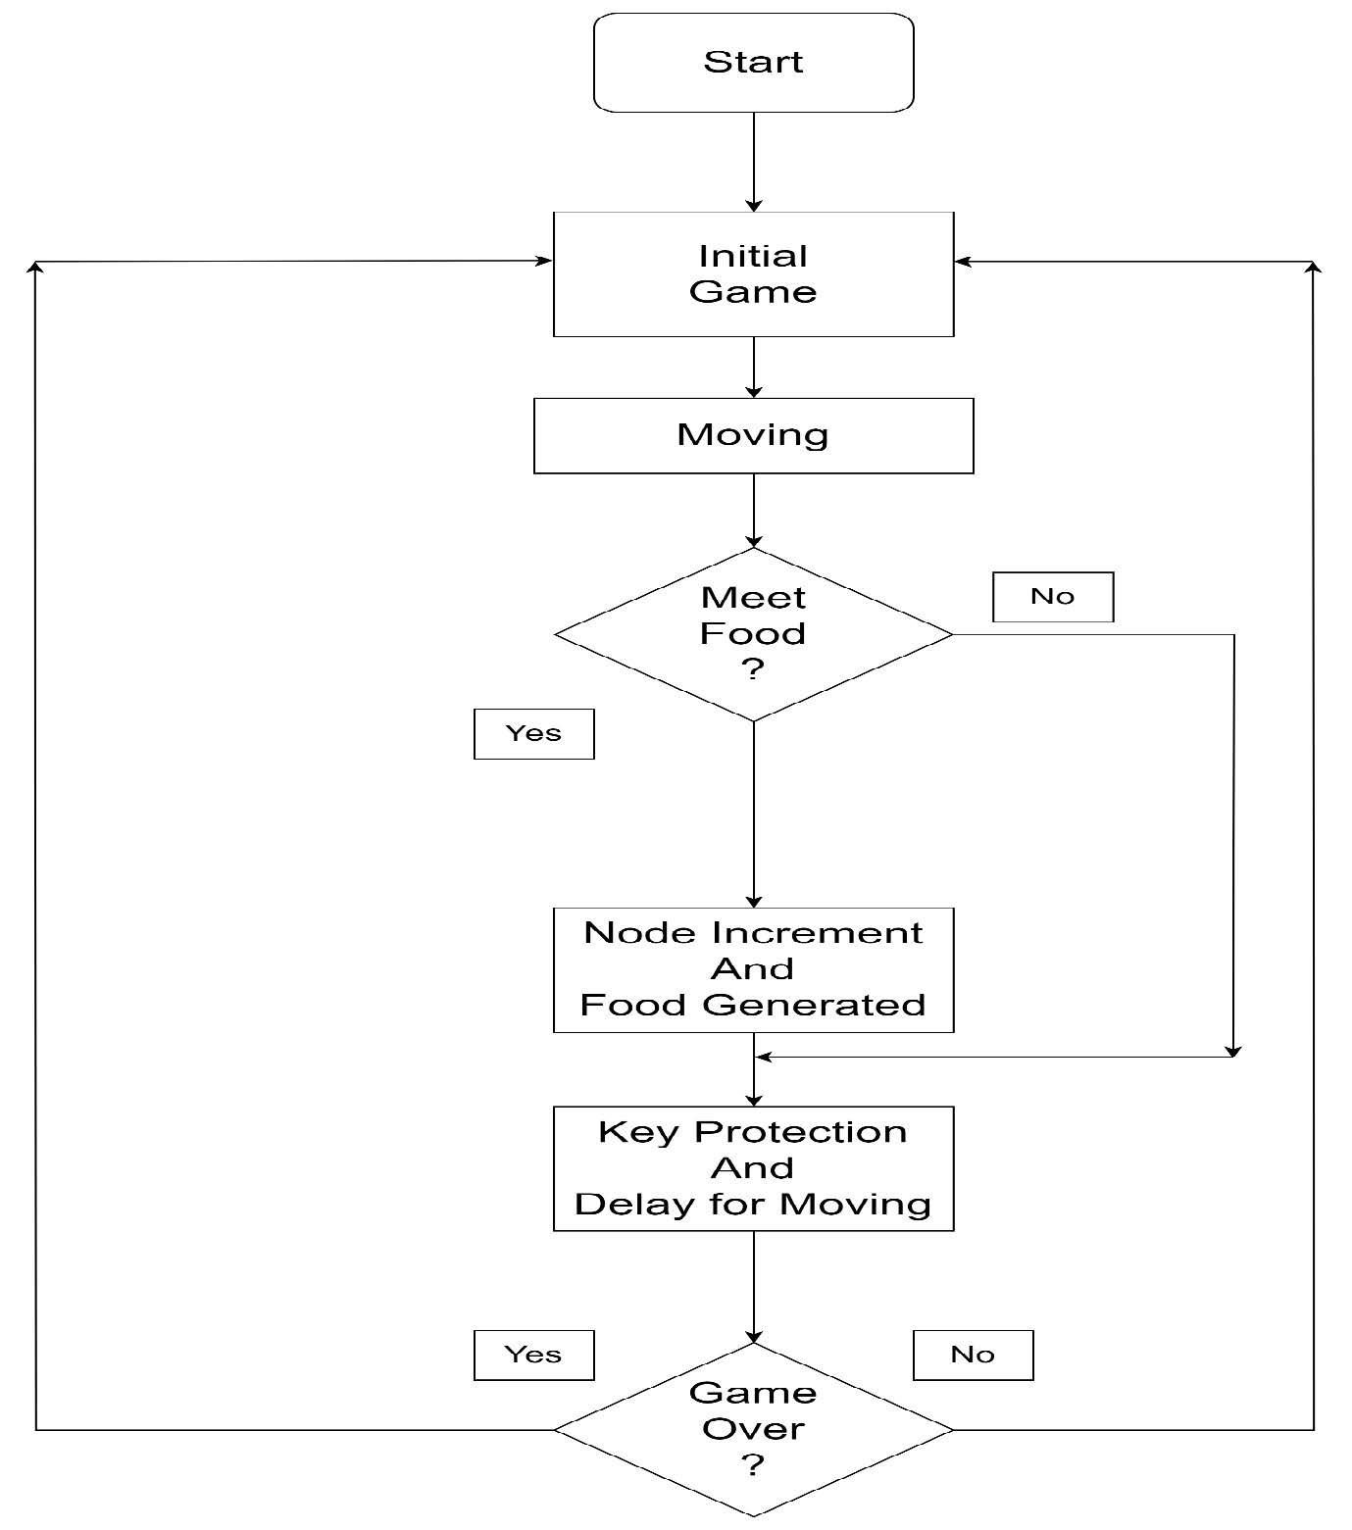
System Flow Diagram

Slide 9
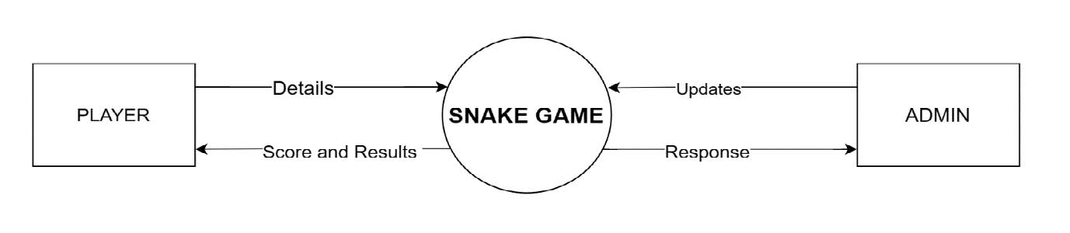
Data Flow Diagram ( All levels of DFDs)
Level Zero DFD

Slide 10
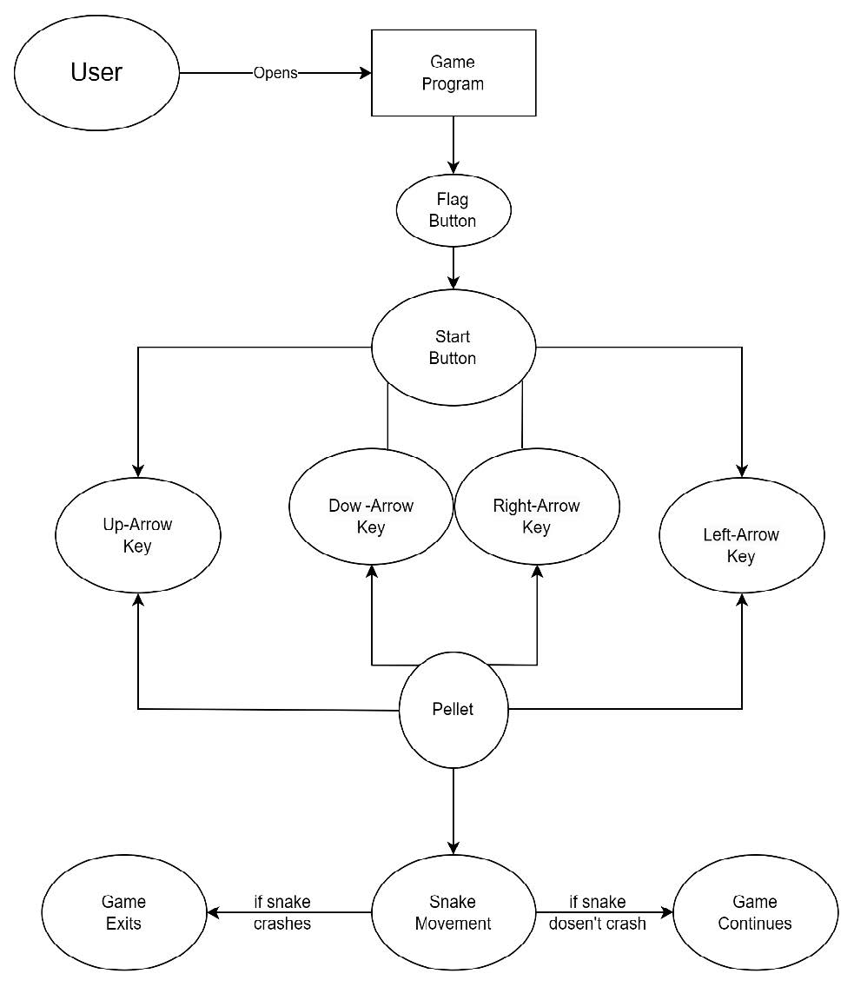
Level One DFD

Slide 11
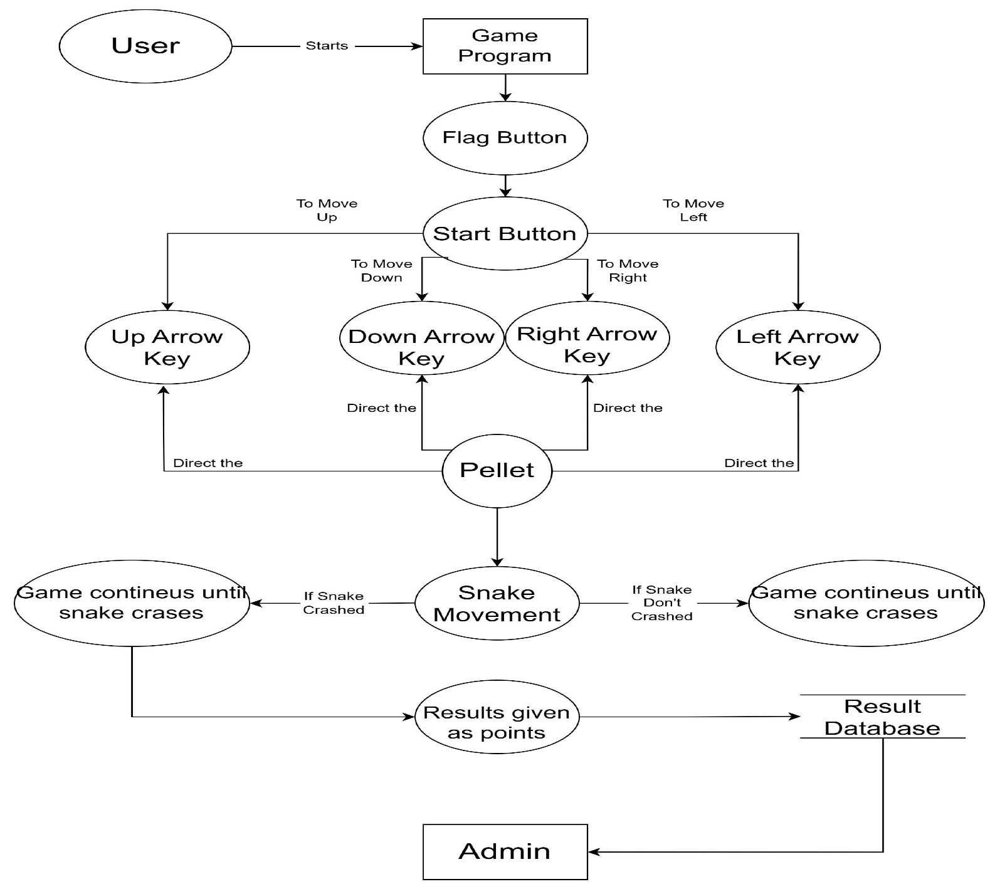
Level Two DFD

Slide 12
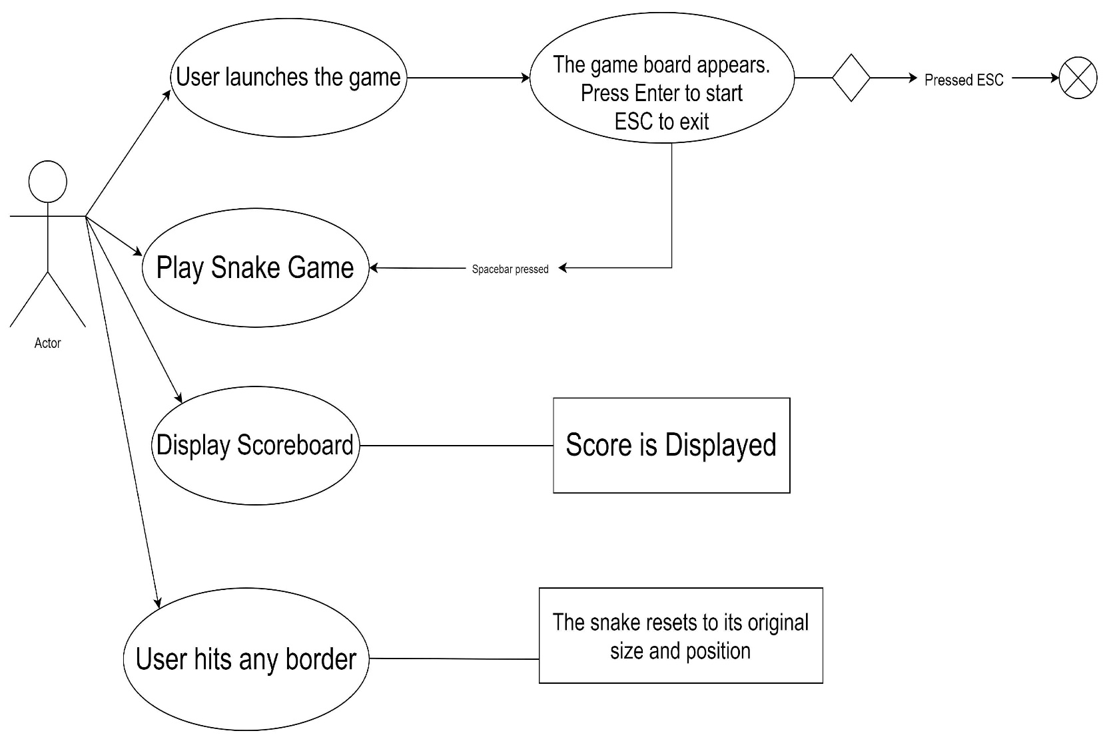
Use Case Diagram

Slide 13
Data Dictionary

Slide 14
Screenshots of Development Phase 1 ( Designing of your Project)

Slide 15
Screenshots of Development Phase 2 ( Features Implementation)

Slide 16
Screenshots of Development Phase 3 ( Features Implementation)

Slide 17
Future Enhancement
Later our team will be creating a website that lets a user play some beginner level python-based games
The Website will even let a user upload their self-made python games.
The Future website will be similar to a code complier rather than other normal comilers, it will have many pre-installed plugins, liblaried, and modules.

Slide 18
Conclusion
The simple game is entertaining, still is not a fully fledged game with good graphics.
We will be working on similar python-based games.

Slide 19
References
Website:
https://stackoverflow.com/questions/30050194/snake-game-in-python-using-turtle-graphics
Book:
Class 12 Computer Science Textbook
Other Resources:
https://www.youtube.com/watch?v=bfRwxS5d0SI&t=1284s (Youtube)

Slide 20





