Slide 1
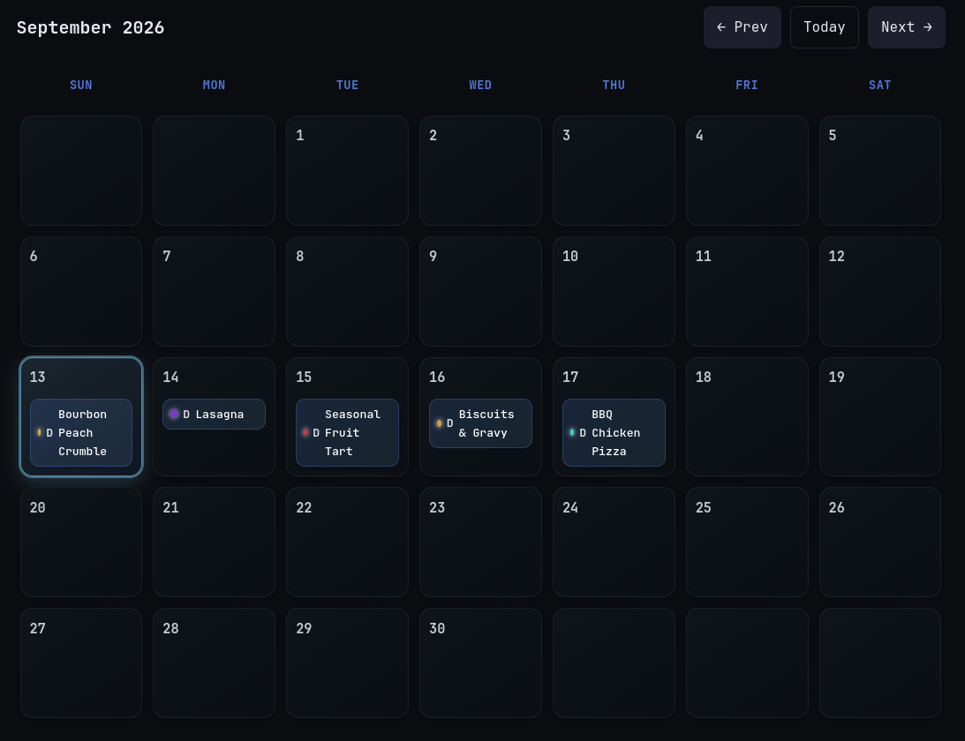
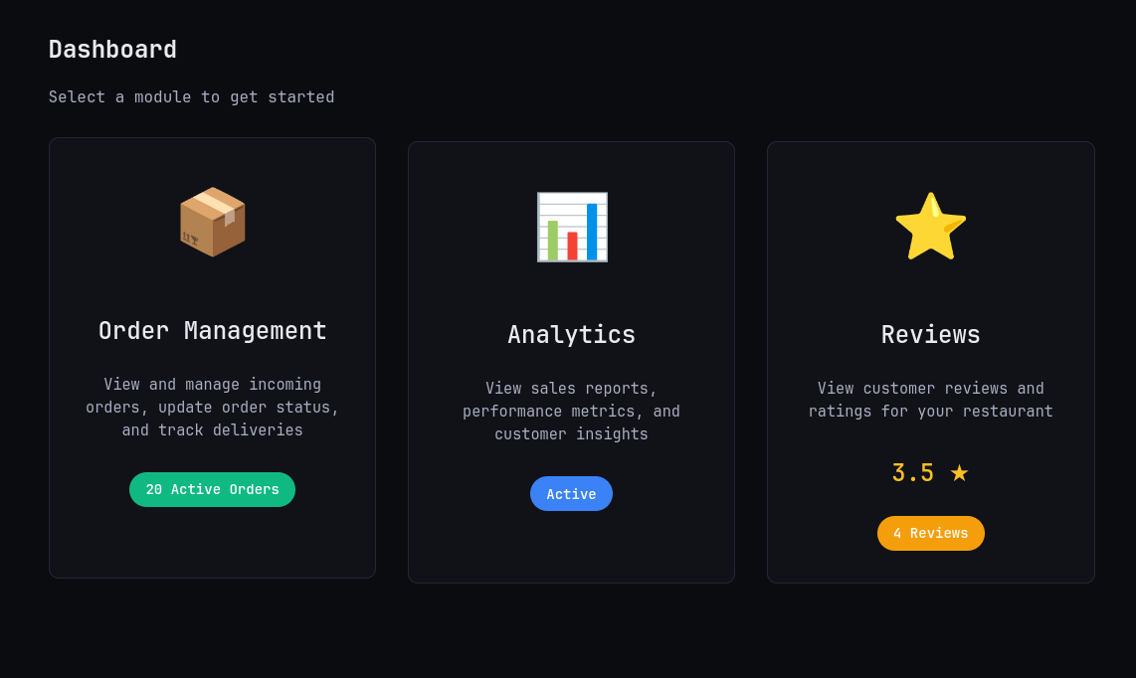
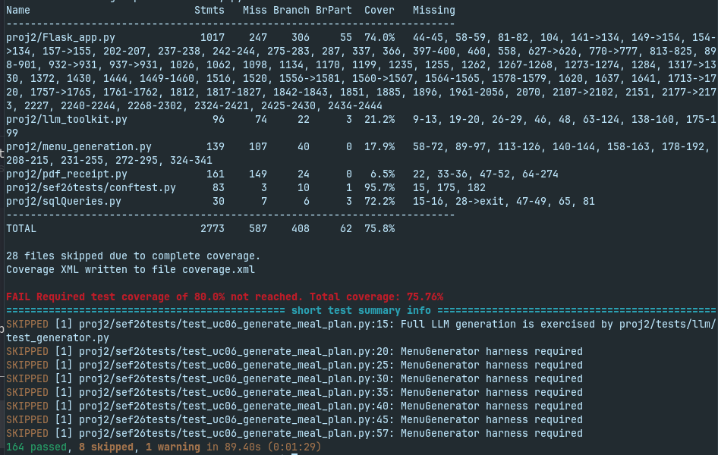
CSC 510 / PROJECT 1b / PROPOSAL
Weeklies
Your meals. Your schedule. Your budget.
Group 11 | Srikar Desemsetti, Rohan Patel, Alex Tanton, Kushal Upretti]
PROJECT OVERVIEW
Choosing meals every day takes time, and more often than not a weekly plan can be costly and get old quick. We propose extending Weeklies into a budget-aware meal planner that lets customers set a weekly limit, understand selections, and replace meals without rebuilding their calendar. Restaurant owners and kitchen staff gain clearer order updates and a view of upcoming demand: less daily planning, more spending control, and better coordination.
Customers
Restaurant owners
Kitchen staff
Maintainers
Busy people who need to balance time, cost, and preferences.
See upcoming demand and manage fulfillment.
Follow an explicit preparation queue.
Build on reproducible use-case tests.
BUDGET
MEAL SELECTION
ORDER STATUS
Weekly spending limits
Individual meal replacement
Order progress timeline
Compare meal prices across vendors and allocate a weekly budget for meals.
Swap a single calendar entry for the week without ruining future plans.
See recorded order transitions on a timeline that refreshes as the restaurant progresses through fulfillment.
DEVELOPMENT PLAN
Proposed scope · goals paired with methods
BEFORE
NOW
FUTURE
PROJECT 1a · BASELINE EVIDENCE
PROJECT 2 · THIS MONTH'S PROPOSAL
PROJECT 3 · NEXT MONTH'S OPTIONS
Map real user goals
Budget-aware generation
Reusable weekly templates
28 documented use cases. Trace routes and record success and exception paths for accounts, planning, orders, reviews, and analytics.
Add a weekly cap and item total; filter and rank eligible candidates. Test exact-limit and impossible-budget cases.
Save and copy a week to new dates; recheck prices, hours, and stock. Require review before creating orders.
Establish regression evidence
Single-meal swaps
Explainable suggestions
172 test functions in 28 modules. Use Flask clients and temporary SQLite fixtures; attach a verified run summary.
Replace one date/meal slot after server-side availability and allergen checks. Test that other slots stay intact.
Allow users to get suggestions based on previous preferences, available budget, etc.
Understand planning limits
Visible order progress
Restaurant demand preview
Trace UC06–07 and tests: generation checks hours, stock, and declared allergies while retaining existing slots.
Persist transition timestamps; refresh a customer timeline. Test ownership, legal transitions, and terminal states.
Aggregate plans by date and meal. Separate tentative selections from orders; omit customer identities.
28
28
172
164
8
75.8%
documented use cases
Project 1a test modules
test functions
Tests passing
Tests skipped (temporary)
Test Coverage
INSERT TEST-RUN CAPTURE
Project 1a suite summary
Include date and commit
Existing system · your week at a glance.
Existing system · manage the order lifecycle.
Evidence · report actual results before submission.
Py
Python / Flask
DB
SQLite
</>
HTML / CSS / JS
AI
LLM + fallback
CI
pytest / Actions
Extend existing planning and order routes.
Store budgets, meals, and transition history.
Calendar actions and timeline refresh.
Rank candidates; enforce constraints in code.
Check regressions as features evolve.
REPOSITORY
DISCUSSION FORUM
FEATURE WALKTHROUGH
INSERT
REPO QR
INSERT
FORUM QR
INSERT
VIDEO QR
https://github.com/rdpatel2/Weeklies
[FORUM URL]
[VIDEO URL]
DRAFT · Replace team details, screenshots, test evidence, icon badges, and QR/link placeholders before submission.
Notes:
# WEEKLIES — Meal planning with a weekly budget
**CSC 510 · Project 1b · Proposed next version**
**Group:** [GROUP NUMBER]
**Members:** [ALL CURRENT GROUP MEMBERS]
## Mission
Choosing meals every day takes time, and a convenient plan can still exceed your budget or become outdated when menus change. We propose extending Weeklies into a budget-aware meal planner that lets customers set a weekly spending limit, understand why meals were selected, and replace individual meals without rebuilding their calendar. Restaurant owners and kitchen staff will gain clearer order updates and a view of upcoming demand. The result: less daily planning, more control over spending, and better coordination from meal selection to fulfillment.
## Who benefits?
- **Customers, including busy students:** plan around time, spending limits, and declared dietary preferences.
- **Restaurant owners:** see upcoming demand and manage fulfillment.
- **Kitchen staff:** follow an explicit preparation queue.
- **Maintainers:** extend behavior backed by reproducible use-case tests.
## Our next version
**Weekly spending limits** Show estimated menu-item spending against a weekly limit; explain when no suitable plan fits. Label taxes and fees separately where applicable.
**Individual meal replacement** Swap a single calendar entry using current availability and declared allergen filters while retaining the remaining plan.
**Order progress timeline** Present an order timeline with recorded transitions and refresh it as the restaurant progresses through fulfillment.
*These are proposed improvements, not claims of completed implementation.*
## Before · Project 1a baseline
1. **Map real user goals.** Existing evidence: 28 documented use cases spanning accounts, planning, ordering, receipts, reviews, and analytics. Method: trace implemented routes and record success and exception paths in `use-cases.md`.
2. **Establish regression evidence.** Existing evidence: 172 test functions across 28 Project 1a test modules. Method: use Flask test clients and a temporary SQLite database; attach the actual run summary before submission. These are source counts, not passing-test counts.
3. **Understand planning limits.** Existing behavior: generation considers preferences, declared allergies, restaurant hours, and stock, and retains already planned slots. Method: trace UC06–UC07 and their corresponding tests to identify extension points.
## Now · Project 2 proposed work
1. **Budget-aware generation.** Add a weekly limit and estimated menu-item total; filter and rank candidates under the cap. Verify exact-limit, impossible-budget, and empty-candidate cases.
2. **Single-meal swaps.** Add a replace action for one date/meal slot; revalidate item availability and declared allergens server-side, then save only that slot. Verify unrelated entries remain unchanged.
3. **Visible order progress.** Store transition timestamps and render a customer timeline with periodic refresh. Verify restaurant ownership, legal transitions, and terminal states.
## Future · Project 3 candidate work
1. **Reusable weekly templates.** Save a week as a template; revalidate prices, hours, and availability before copying it to new dates. Require review before creating any orders.
2. **Explainable suggestions.** Show factual selection reasons derived from preferences, prices, and availability checks; handle missing metadata and model fallback explicitly.
3. **Restaurant demand preview.** Aggregate saved meal selections by restaurant, date, and meal period. Distinguish tentative plans from placed orders and keep customer identities out of the summary.
## Evidence and system views
**28 documented use cases · 28 Project 1a test modules · 172 test functions**
Source counts checked locally. Test execution, pass/fail totals, and coverage remain to be verified.
- [INSERT ACTUAL SCREENSHOT: existing customer meal calendar, showing generated entries.]
- [INSERT ACTUAL SCREENSHOT: existing restaurant order dashboard, showing fulfillment controls.]
- [INSERT ACTUAL TEST-RUN CAPTURE: Project 1a suite summary with date and commit.]
## Proposed stack — extend the existing foundation
- **Python + Flask:** add planning and fulfillment routes to the existing application.
- **SQLite:** persist budget settings, selected meals, and order-transition history.
- **HTML / CSS / JavaScript:** extend the calendar and refresh the order timeline.
- **LLM toolkit + deterministic fallback:** rank eligible meal candidates; enforce constraints in application code.
- **pytest + GitHub Actions:** check regressions as features evolve.
Use recognizable technology icons beside these labels in the final layout. The HTML draft uses labeled symbol badges as layout stand-ins.
## Explore the project
- **Repository:** https://github.com/rdpatel2/Weeklies — derived from this checkout's origin. [INSERT QR ENCODING THIS EXACT URL.]
- **Discussion forum:** [FORUM URL] — give CSC 510 tutors and lecturers access. [INSERT MATCHING QR.]
- **Feature walkthrough, 2–5 minutes:** [VIDEO URL]. [INSERT MATCHING QR.]
Print each complete URL directly underneath its QR code.
## Finalization notes — not poster copy
- `poster.html` is the compact, editable, US-letter layout. Open it in a browser and print to PDF at 100% scale, with browser headers/footers off and background graphics on. Confirm it exports as one page.
- Replace the current group number and member placeholders. The root README credits a Fall 2025 team, so those names were not assumed to be the current group.
- Confirm the proposed scope with the team. Before milestones describe artifacts and existing behavior found in this checkout; confirm which work belongs to your Project 1a submission.
- Add real screenshots, the verified Project 1a test-run evidence, official stack icons, and three functioning QR codes with their matching URLs. The draft intentionally contains no fabricated screenshots or QR codes.
- Confirm the repository destination, forum permissions, and walkthrough duration. The README's older demo videos were not assumed to be the current submission.
- Replace source test-function counts with a clearly labeled executed/passed result only after running the suite. Parameterization can make collected-test counts differ from function counts.
- Local sources: `poster.md` (requirements), `use-cases.md` (baseline behavior), `proj2/sef26tests/` (test inventory), and `README.md` (project overview and stack).

