Slide 1
Getting Help
Computing for Data Analysis

Slide 2
Asking Questions
Asking questions via email is different from asking questions in person
People on the other side do not have the background information you have
  they also don’t know you personally (usually)
Other people are busy; their time is limited
The instructor (me) is here to help in all circumstances but may not be able to answer all questions!

Slide 3
Finding Answers
Try to find an answer by searching the archives of the forum you plan to post to.
Try to find an answer by searching the Web.
Try to find an answer by reading the manual.
Try to find an answer by reading a FAQ.
Try to find an answer by inspection or experimentation.
Try to find an answer by asking a skilled friend.
If you're a programmer, try to find an answer by reading the source code.

Slide 4
Asking Questions
It’s important to let other people know that you’ve done all of the previous things already
If the answer is in the documentation, the answer will be “Read the documentation”
  one email round wasted

Slide 5
Example: Error Messages
> library(datasets)
> data(airquality)
> cor(airquality)
Error in cor(airquality) : missing observations in cov/cor

Slide 6
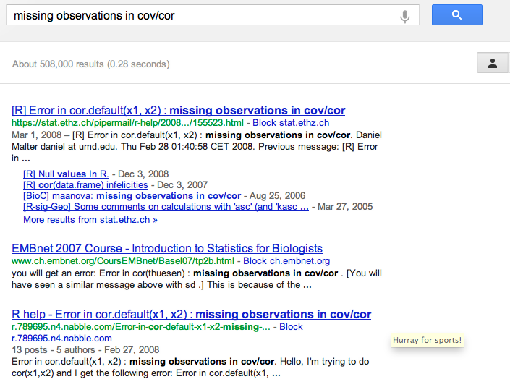
Google is Your Friend

Slide 7
Asking Questions
What steps will reproduce the problem?
What is the expected output?
What do you see instead?
What version of the product (e.g. R, packages, etc.) are you using?
What operating system?
Additional information

Slide 8
Subject Headers
Stupid:
HELP! Can’t fit linear model!
Smart:
R 2.15.0 lm() function produces seg fault with large data frame, Mac OS X 10.6.3
Smarter:
R 2.15.0 lm() function on Mac OS X 10.6.3 -- seg fault on large data frame

Slide 9
Do
Describe the goal, not the step
Be explicit about your question
Do provide the minimum amount of information necessary (volume is not precision)
Be courteous (it never hurts)
Follow up with the solution (if found)

Slide 10
Don’t
Claim that you’ve found a bug
Grovel as a substitute for doing your homework
Post homework questions on mailing lists (we’ve seen them all)
Email multiple mailing lists at once
Ask others to debug your broken code without giving a hint as to what sort of problem they should be searching for

Slide 11
Case Study: A Recent Post to the R-devel Mailing List
Subject: large dataset - confused
Message:
I'm trying to load a dataset into R, but I'm completely lost. This is probably due mostly to the fact that I'm a complete R newb, but it's got me stuck in a research project.

Slide 12
Response
Yes, you are lost. The R posting guide is at http://www.r-project.org/posting-guide.html and will point you to the right list and also the manuals (at e.g. http://cran.r-project.org/manuals.html, and one of them seems exactly what you need).

Slide 13
Analysis: What Went Wrong?
Question was sent to the wrong mailing list (R-devel instead of R-help)
Email subject was very vague
Question was very vague
Problem was not reproducible
No evidence of any effort made to solve the problem
RESULT: Recipe for disaster!

Slide 14
Places to Turn
Class discussion board; your fellow students
r-help@r-project.org
Other project-specific mailing lists
(This talk inspired by Eric Raymond’s “How to ask questions the smart way”)

