Slide 1
Bike Works Learning
Robotics Basics
Uzma Nishat
Sr. Systems Engineer
7/21/2017

Slide 2
BikeWorks Robotics Basics

Slide 3
Introduction
Introductions
Instructor: Uzma Nishat
background
Students?

Slide 4
Objective: Robotics Basics Course
The purpose of this course will help to provide a basic understanding of the
Arduino Platform and basic Sensor, motor and communications. The Arduino
open source platform will be used as it is readily available, low cost and very
intuitive for the beginner. This is a very basic information course used to
teach one how to use a particular piece of hardware or software and not
an in-depth discussion on the theory of anything.

Slide 5
Getting Started: Hardware
The Arduino Hardware
What is it
Which one do I need
How do I use it and why

Slide 6
Getting Started: Hardware
The Arduino Hardware
What is it
Arduino is a tool for making computers that can sense and control more of the physical world than your desktop computer. It's an open-source physical computing platform based on a simple microcontroller board, and a development environment for writing software for the board. The boards are primarily based on the Atmel Atmega Processors, but not all.
Arduino can be used to develop interactive objects, taking inputs from a variety of switches or sensors, and controlling a variety of lights, motors, and other physical outputs. Arduino projects can be stand-alone, or they can communicate with software running on your computer (e.g. Flash, Processing, MaxMSP.) The boards can be assembled by hand or purchased preassembled; the open-source IDE can be downloaded for free.
The Arduino programming language is an implementation of Wiring, a similar physical computing platform, which is based on the Processing multimedia programming environment.
Which one do I need
There are a lot of different boards on the market today. Too many to list. The one we will be using in this class is the Arduino UNO R3
Some different Popular boards
Uno
Mega
Mega2560
Mini
LillyPad
And the list goes on
The one you need depends on what you want to do. Low I/O then the UNO, Mini or LillyPad may be fine. More I/O needed then a Mega might be the right choice.
In general the bigger the processor the more internal memory and I/O the uProcessor has.
How do I use it and why
How the boards will be used is entirely up to you, the possibilities are endless…..Mostly.
It can be used for robotics, to add simple I/O to a computer, as a stand alone controller for something….
Resources http://arduino.cc/en/guide/introduction

Slide 7
The Arduino IDE
Arduino IDE
IDE – Integrated Development Environment
A single place where you can develop code, compile and load to the target
Where do I get it?
The Arduino IDE is a free download.
http://arduino.cc/en/Main/Software download the latest version 1.6.8
How to use?
Lab Exercise – load the example program BASIC_SERIAL.INO under the course material folder
Take aways -
Intent to learn how to use the IDE
How to open the Serial port
The different calls to the Serial Lib
Serial.begin();
Serial.Print();
Serial.available();
Serial.read();
Serial.write();

Slide 8
Communications
We covered the basics of communications to and from your arduino board.
Why do we need to do this?
Well most of the time we want to either send a command or receive feedback
Sometimes we don’t care as in a stand alone application
Types of Communication
Serial
RS232, RS422, RS485, I2C, SPI are very common there are many others
We will be using RS232-TTL
Uses less IO than Parallel
Parallel
Some devices use a Parallel bus of Data and/or Address

Slide 9
BASIC_SERIAL Guide

Slide 10
Actuators
Types of Actuators (Most Common)
DC motor
Direct Current Motor
BLDC motor
Brushless DC motor
Servo
Geared Motor usually utilizes a DC motor with Custom Driver board
Stepper motor
BLDC motor with multiple coils that will allow discrete steps when energized.
Linear Actuators / Motors
May or may not have position feedback, DC or BLDC motor with gear train to translate rotation of motor into linear movement.

Slide 11
Actuators – Cont.
This course will cover the Servo with labs
Due to time constraints we can’t cover all with a lab as some are just to wiring intensive, or just not possible with our kits.
The Robot arm that we are using only uses the Servos for motion so that will be our emphasis.

Slide 12
The Servo
What is a Servo?
A servo is a motor that can be driven to a give position based on some sort of input. Usually a PWM but could be some other form of input (serial, analog…)
How do they work
The servos we will be working with use PWM as input signals
PWM – Pulse Width Modulated
Standard Hobby Servos will recognize a PWM in the 900uS – 2.1mS range at 50Hz.
Some can operate at higher Frequencies and wider PWM range
Why do we need them?
They are an easy way to make things move. Robotics usually involves making something move in some sort of fashion.
So an easy way to accomplish this is with a servo.

Slide 13
The Servo Cont.
How do I make it do what I want?
There are many ways to do this.
In simplest terms, using the servos provided, we will generate a PWM signal that will command the servo to a specific position, or angle. Some are Continuous rotation, so 1.5ms will be no movement, and the closer to the extents the faster it will rotate.
What is the PWM – Pulse Width Modulated signal.
It is the amount of time within the 50hz update rate that we have a High going pulse.
A 1.5ms pulse will Center the Servo and anything lower or high will move the servo towards the extents of its movement.
20ms / 50hz
PWM – (0.9ms – 2.1ms)
4.5% - 10.5%

Slide 14
The Servo Cont.
You can characterize the servo with the PWM to correlate a PWM to actual servo angle to use in controls.
So if a servo has 90* of movement over the standard range of 0.9mS to 2.1mS that is a total of 1.2mS or 1200uS.
Ex. 1200 / 90 = 13.333uS / Deg
or a resolution of 0.075*/ 1uS
So we want to move to 60* we 60 * 13.333uS = 799.999 plus our offset of 900uS = 1699.999 0r 1700uS = 1.7mS

Slide 15
Servo Lab.
Open the BASIC_SERVO.INO from the course material folder
Learning objectives:
How to define a servo object
Setting up limits
MyServo.attach();
MyServo.write();

Slide 16
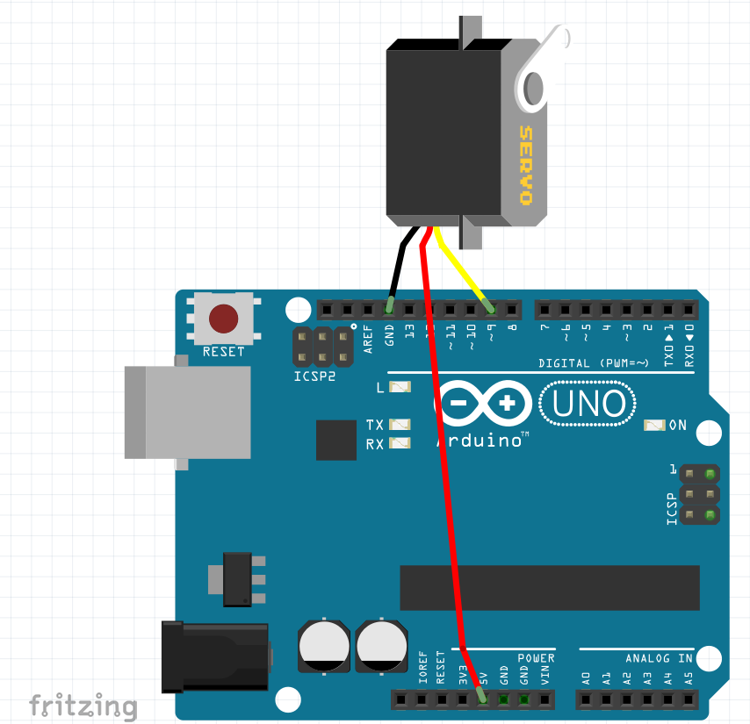
BASIC_SERVO Guide

Slide 17
Sensors
What are they?
Sensors can be anything that gets feedback or senses the environment.
Potentiometer, Accelerometer, ultrasonic range finder, Gyro, Light Sensor,
Encoders….
What do I do with them?
Sensors
Can use a POT to adjust the speed or volume of something.
Accels can be used to sense Accelerations in different directions
Range finder could be used for obstacle advoidance.
Encoders, we are using to sense wheel movement

Slide 18
Sensors Cont. Reading a Pot
How do I use them?
Sensors
POT (very usefull sensor)
Can be used for position feedback or for user input to control Volue, speed, brightness so on……
LAB exercise – BASIC_POT.ino
In this lab we will read in a Potentiometer and display the value on the Serial Monitor Window.
Take aways -
The different calls Serial.begin();
pinMode();
analogRead();
digitalRead();
Serial.write();

Slide 19
Sensors Cont. Reading a Pot and moving stuff
How to translate Pot position to motion of a servo
LAB exercise – ADVANCED_POT.ino
In this lab we will read in a Potentiometer and display the value on the Serial Monitor Window.
Take aways -
How to map a pot Pos to a servo PWM value

Slide 20
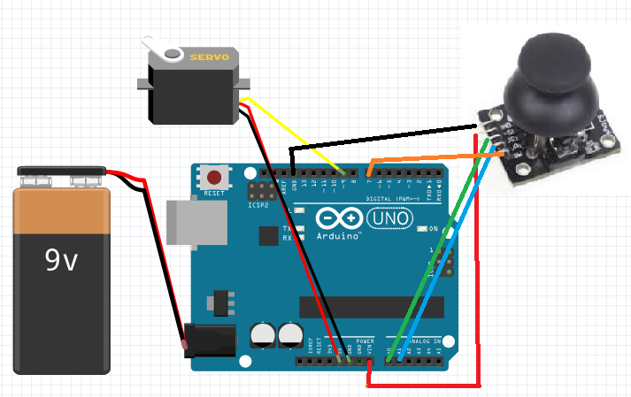
ADVANCED_POT Guide

Slide 21
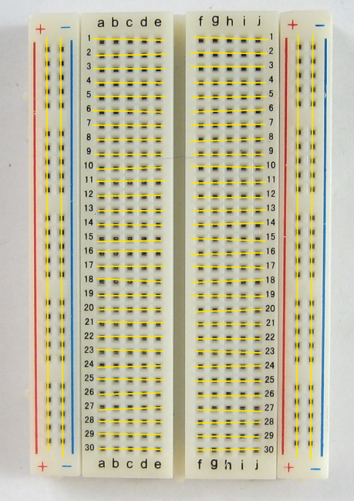
Breadboard Basics

Slide 22
Putting it all together
OK so lets make a Robot Arm!!!
By now we should have covered enough to put together our Robot Arm and make it move.
Rover Bots to play with.

