Slide 1
Group Pattern Discovery from Trajectory Data

Slide 2
Trajectory Data
Also known as spatial-temporal data
the historical location record of a moving object along with the time
moving object →a person, an animal, a vehicle, a mobile device, or even a phenomenon
“a series of chronologically ordered points with corresponding timestamps in spatiotemporal space, i.e., T= {< p₁, t₁>,< p₂, t₂>,….., < p_{n}, t_{n} >}
where each element < p_{i}, t_{i} > indicates a moving object is at location p_{i} with timestamp t_{i}.”
Notes:
Represented trajectory T that consists of a series of point p,time t

Slide 3
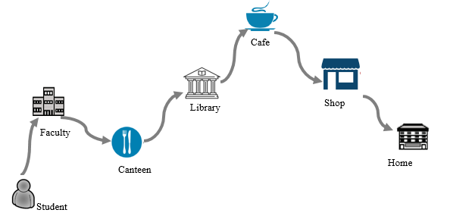
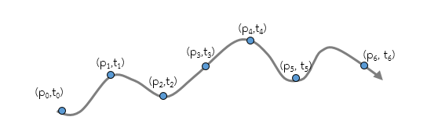

Example
Trajectory of one college student
Notes:
This figure is the eg of trajectory of one college student. Normally, student go faculty and canteen…….in the day time and go back home at night.
Along his path, we record the .a series of his location that are associated with timestamp.

Slide 4
Basic element of a trajectory
ID → a unique identifier of the individual object
Location → a spatial descriptor (i.e. Longitude, Latitude)
Time → the timestamp when the individual was at a particular location
Obj_ID | Longitude | Latitude | Time
1 | 116.29205 | 39.97305 | 2008-02-02 18:19:54
1 | 116.28772 | 39.96466 | 2008-02-02 18:24:54
1 | 116.28339 | 39.95627 | 2008-02-02 18:29:54
1 | 116.27436 | 39.95294 | 2008-02-02 18:34:12
1 | 116.27523 | 39.94958 | 2008-02-02 18:37:22

Slide 5
Types of Trajectory Data
Mobility Data of Human
Mobility Data of Animals
Mobility Data of Vehicles
Trajectory Data
Mobility Data of Natural Phenomena
Notes:
Based on the different kinds of moving object, we can classify the trajectory data into four types

Slide 6
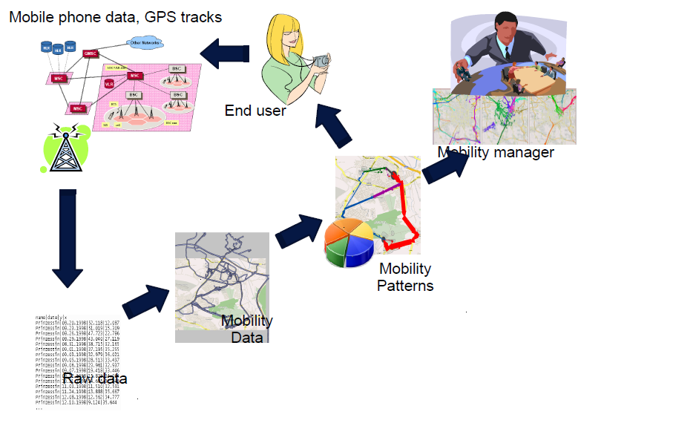
Framework
4. Results Reporting (Virtualization)
1 . Data Collection
3. Pattern Mining
2 . Preprocessing

Slide 7
Trajectories of Moving Objects
Trajectories of human
Trajectories of vehicles
Trajectories of animals
Trajectories of hurricanes
Trajectory Data Mining
Classification
Frequent Pattern Mining
Clustering
Group Pattern Mining
Applications
Traffic Analysis
Scientific studies
Weather Forecasting
Location Prediction
Notes:
By applying trajectory mining techniques, such as, we extract the knowledge that contribute to application

Slide 8


t_{i} = transition time, A_{i} = spatial region
What is Trajectory pattern?
Notes:
descriptions of frequent behaviours of moving objects, in terms of both spatial and temporal.
For example, a user is at station, then 20 min later, it arrive to castle and after 65 minute last , it arrive to museum.

Slide 9
Trajectory Pattern Mining
discovering and describing the movement patterns hidden in trajectories.
an emerging and rapidly developing topic in the areas of data mining and query processing
aims at discovering groups of trajectories based on a spatial or a spatiotemporal consideration.

Slide 10
Trajectory Pattern Mining
Trajectory Pattern Mining
Frequent Pattern Mining
Group Pattern Mining
Notes:
depending on what we want to reveal from the sensed data

Slide 11
Group Pattern Mining
Find co-travelers from the moving object trajectory
Application driven: depending on what we want to reveal from the sensed data
Example
Flock
Convoy
Swarm

Slide 12
Flock
Flock (m,k,r): a group of at least m objects that move together for at least k consecutive time points, while staying within a disc with. radius r.

Slide 13
Flock
Let m=3, k=3.
output: flock :<o₁,o₂, o₃>
Problem: The proper disc radius r is difficult to choose.
Figure: Example of flock pattern
Figure: Lossy-flock problem

Slide 14
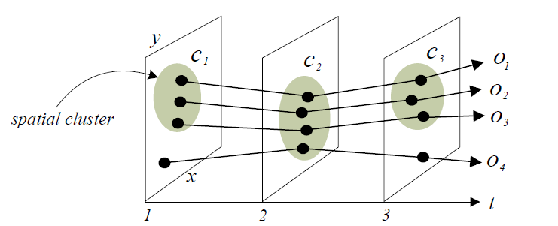
Convoy
Convoy: “a group of at least m objects traveling together for at least k consecutive timestamps” [Jeung et al., 2008]
candidate size threshold m=3,
candidate lifetime threshold k=3,
convoy={O₁, O₂ ,O₃ }

Slide 15
Swarm
While both flock and convoy have a strict requirement on k consecutive period:
Swarm: an arbitrary shape of moving objects cluster group lasting for at least k non-consecutive timestamps.
candidate size threshold m=3,
candidate lifetime threshold k=2,
swarm={O₁, O₂ ,O₃ ,O₄ }, <t₁,t₃>

Slide 16
General Process for Group Pattern Mining
Data Collection
Preprocessing
To remove point redundancy and fill missing point.
Clustering
To find moving object group
Pattern Extraction
To extract group pattern
Methods can vary by depending on the kinds of pattern
Virtualization

Slide 17
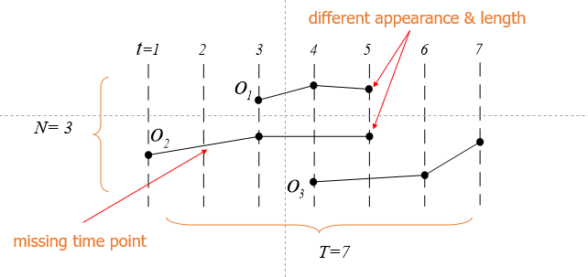
Preprocessing

Slide 18
Clustering
To group the set of objects into a group (cluster) in which the objects are similar to each other in the sense other than to those in other groups (clusters).
Types of Clustering
1) Hierarchical
2) Grid based
3) Partitioning
4) Density-based (arbitrary shape cluster)
Notes:
The task of clustering

Slide 19
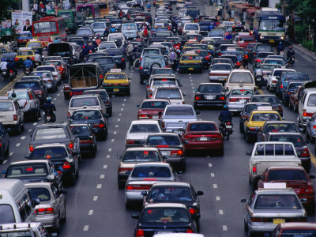
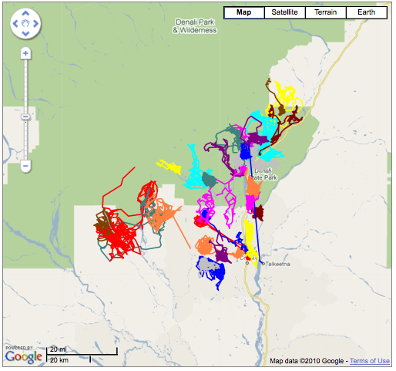
Application: Transportation
Extract knowledge ⇒
Traffic jam
Crowd
Carpooling
By discovering group movement pattern
Notes:
We extract the knowledge to detect traffic jam and crow on the road.

Slide 20
Application: Scientific Studies
Animals
Migration structures (i.e. group or individual)
Living environment
Notes:
In scientific studies, biologist studied the animal’s migration structure(i.e. group or individual ) and their living environment analyzing the animal trajectories,
In environment studies, By forcasting hurricane path in advance, it help in protection of people and animals.

