Slide 1
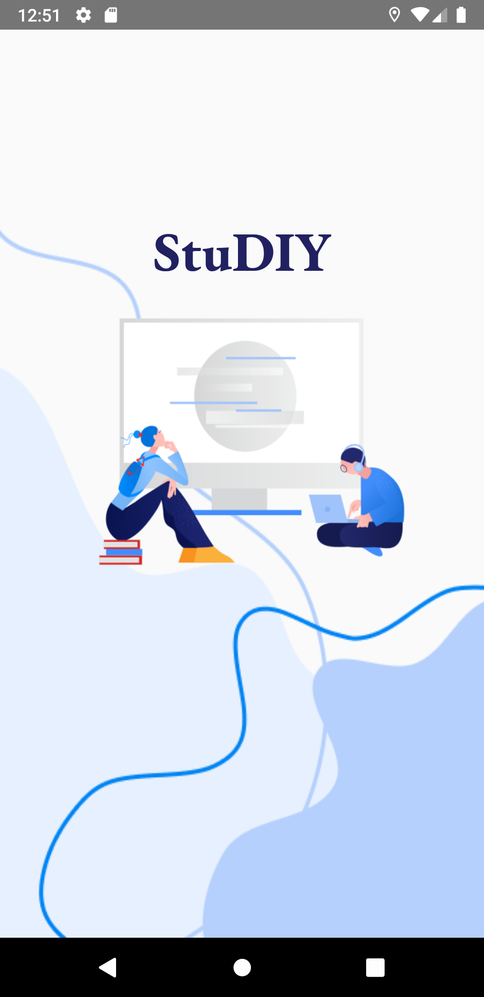
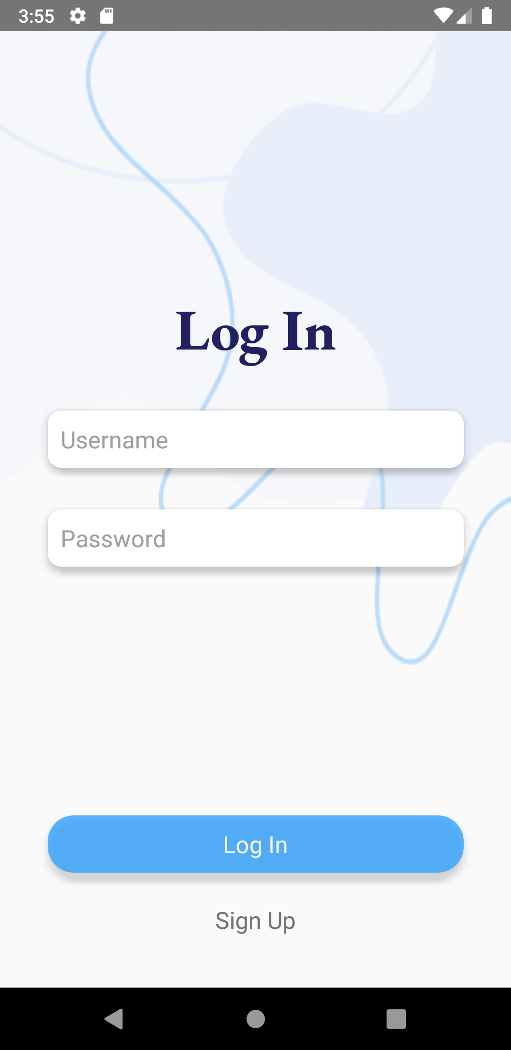
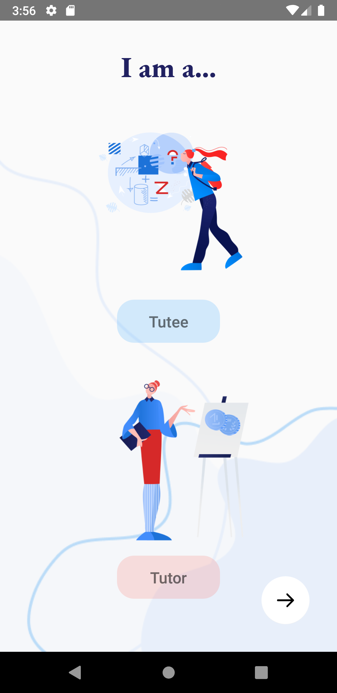
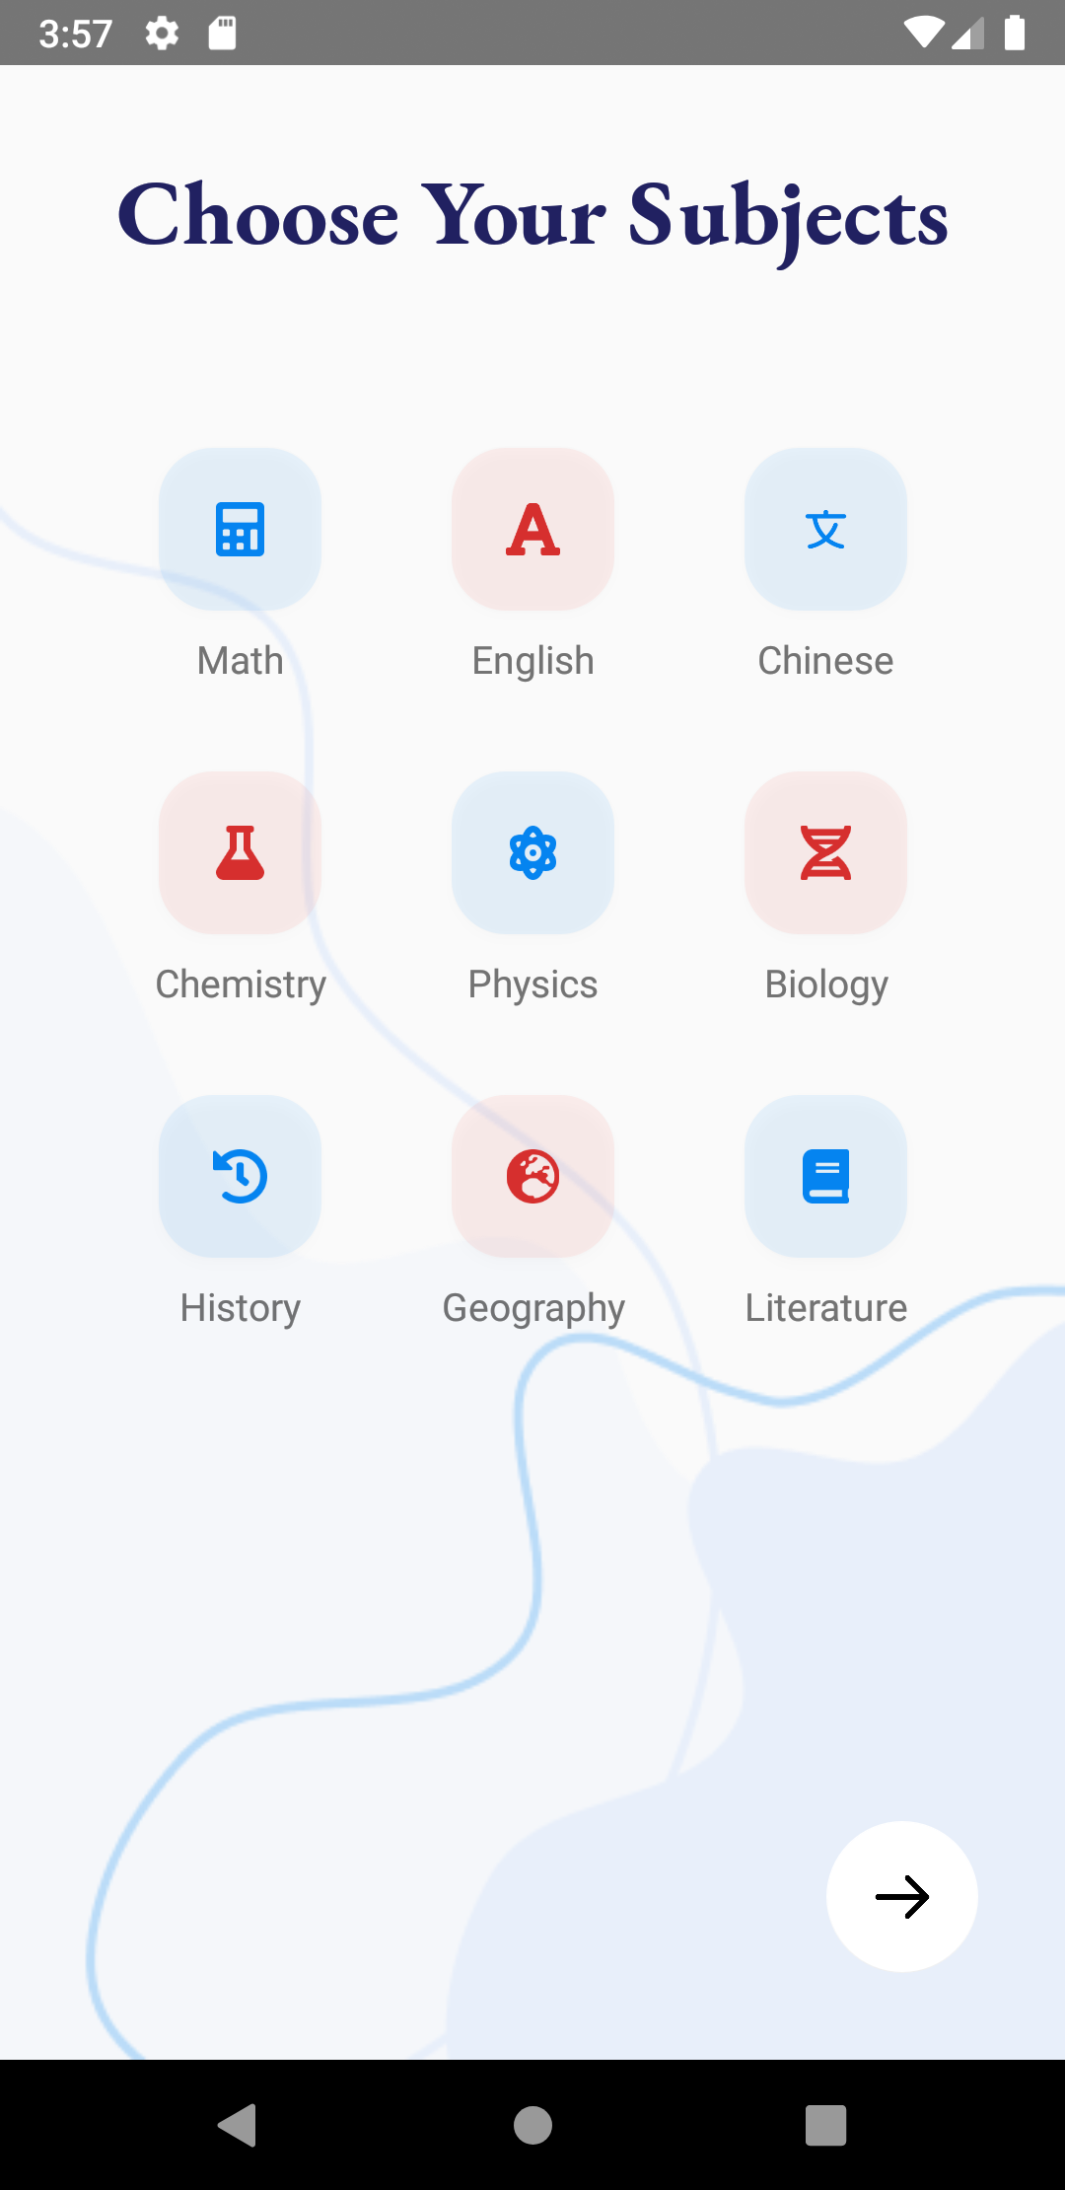
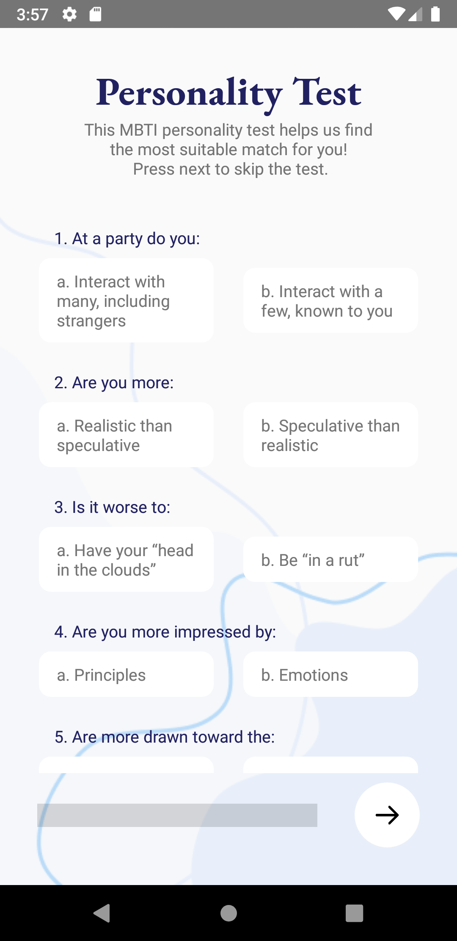
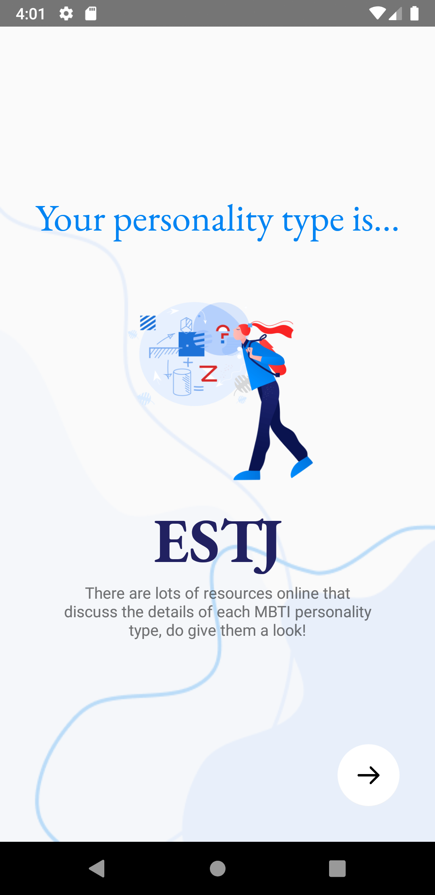
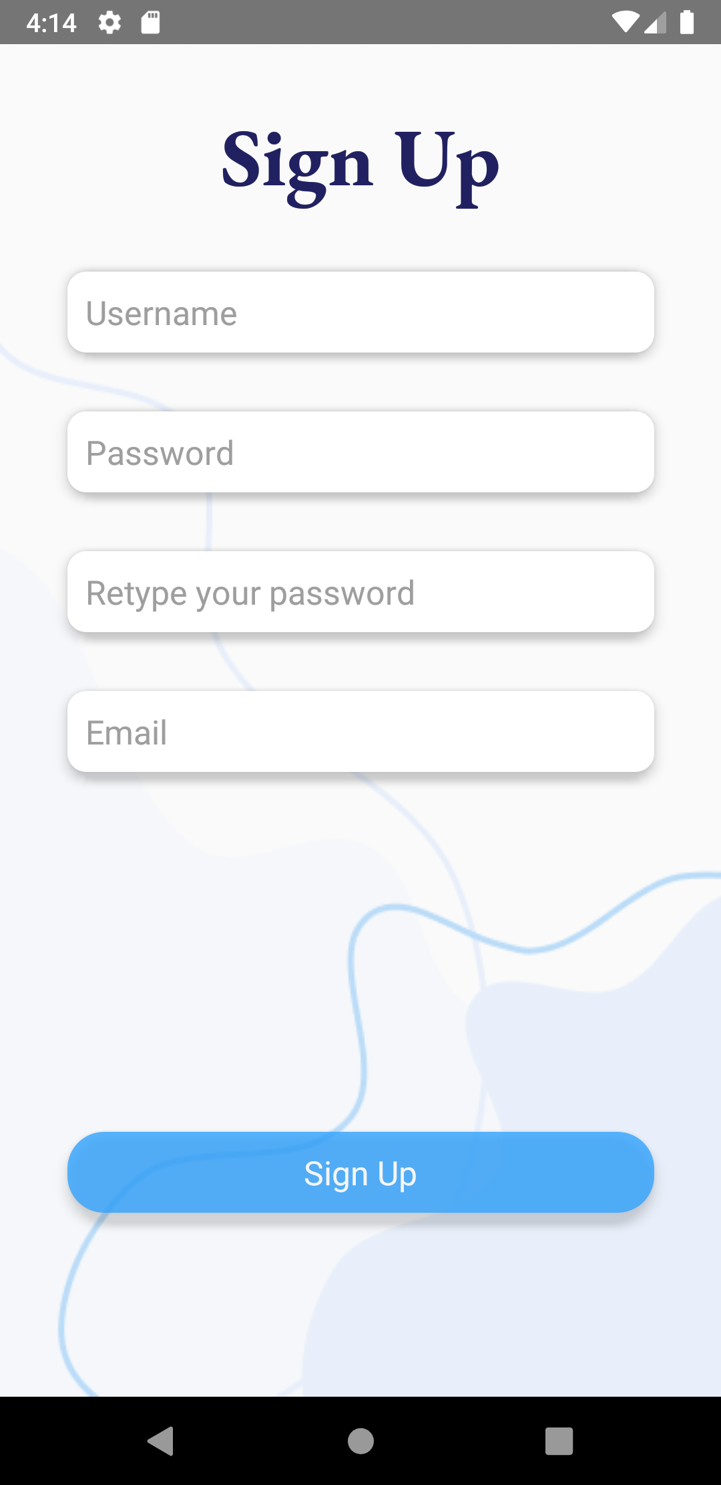
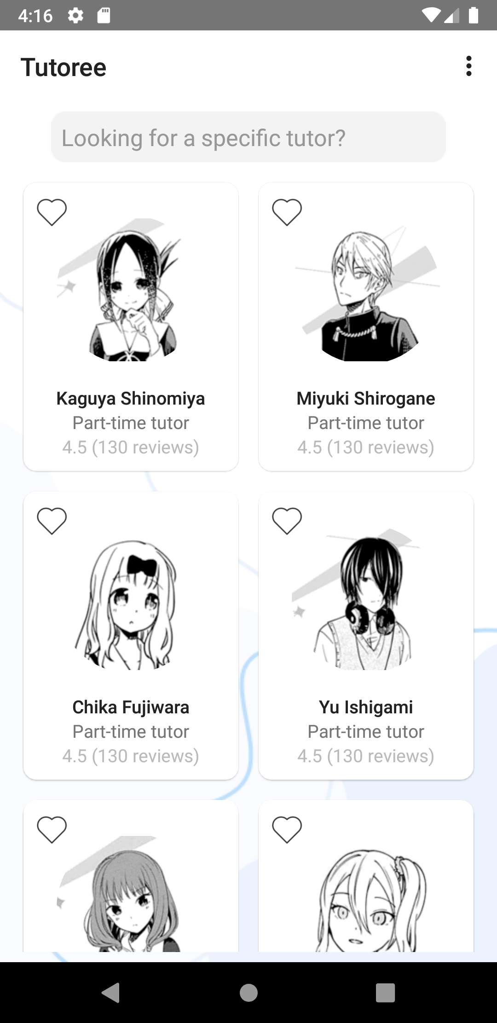
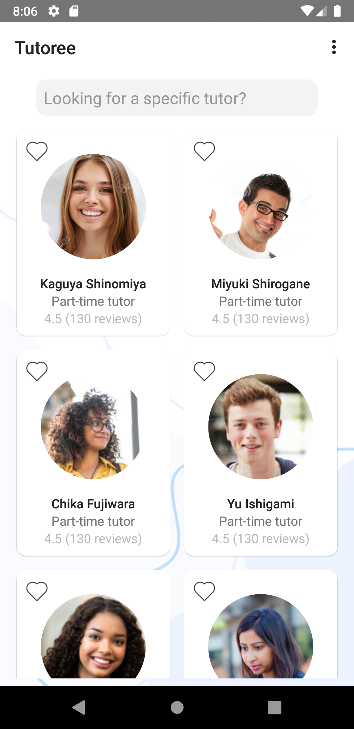
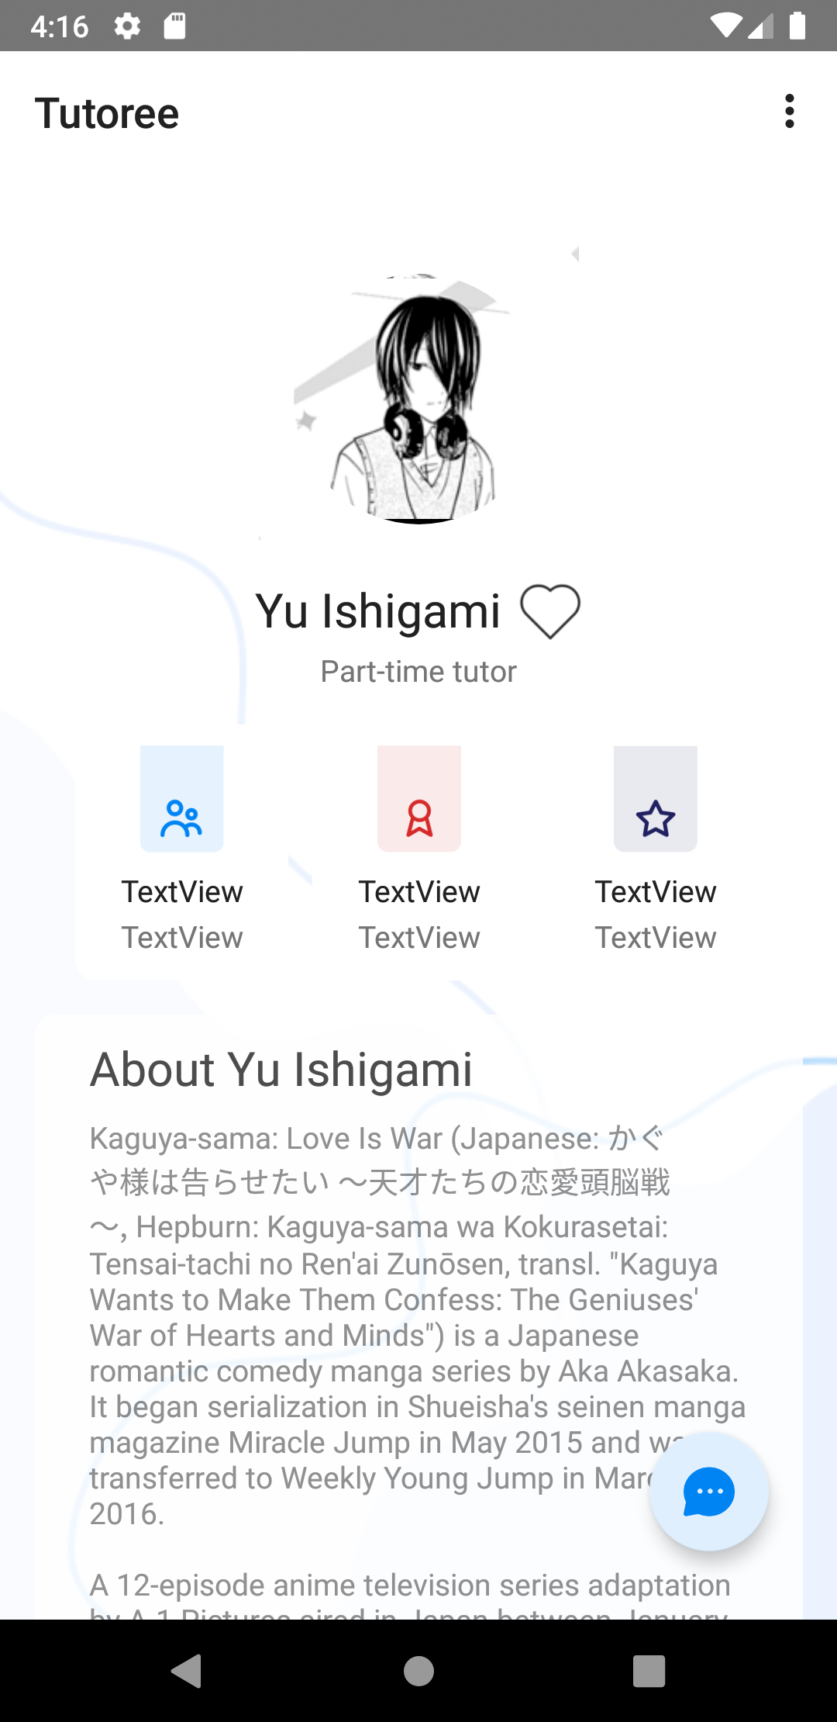
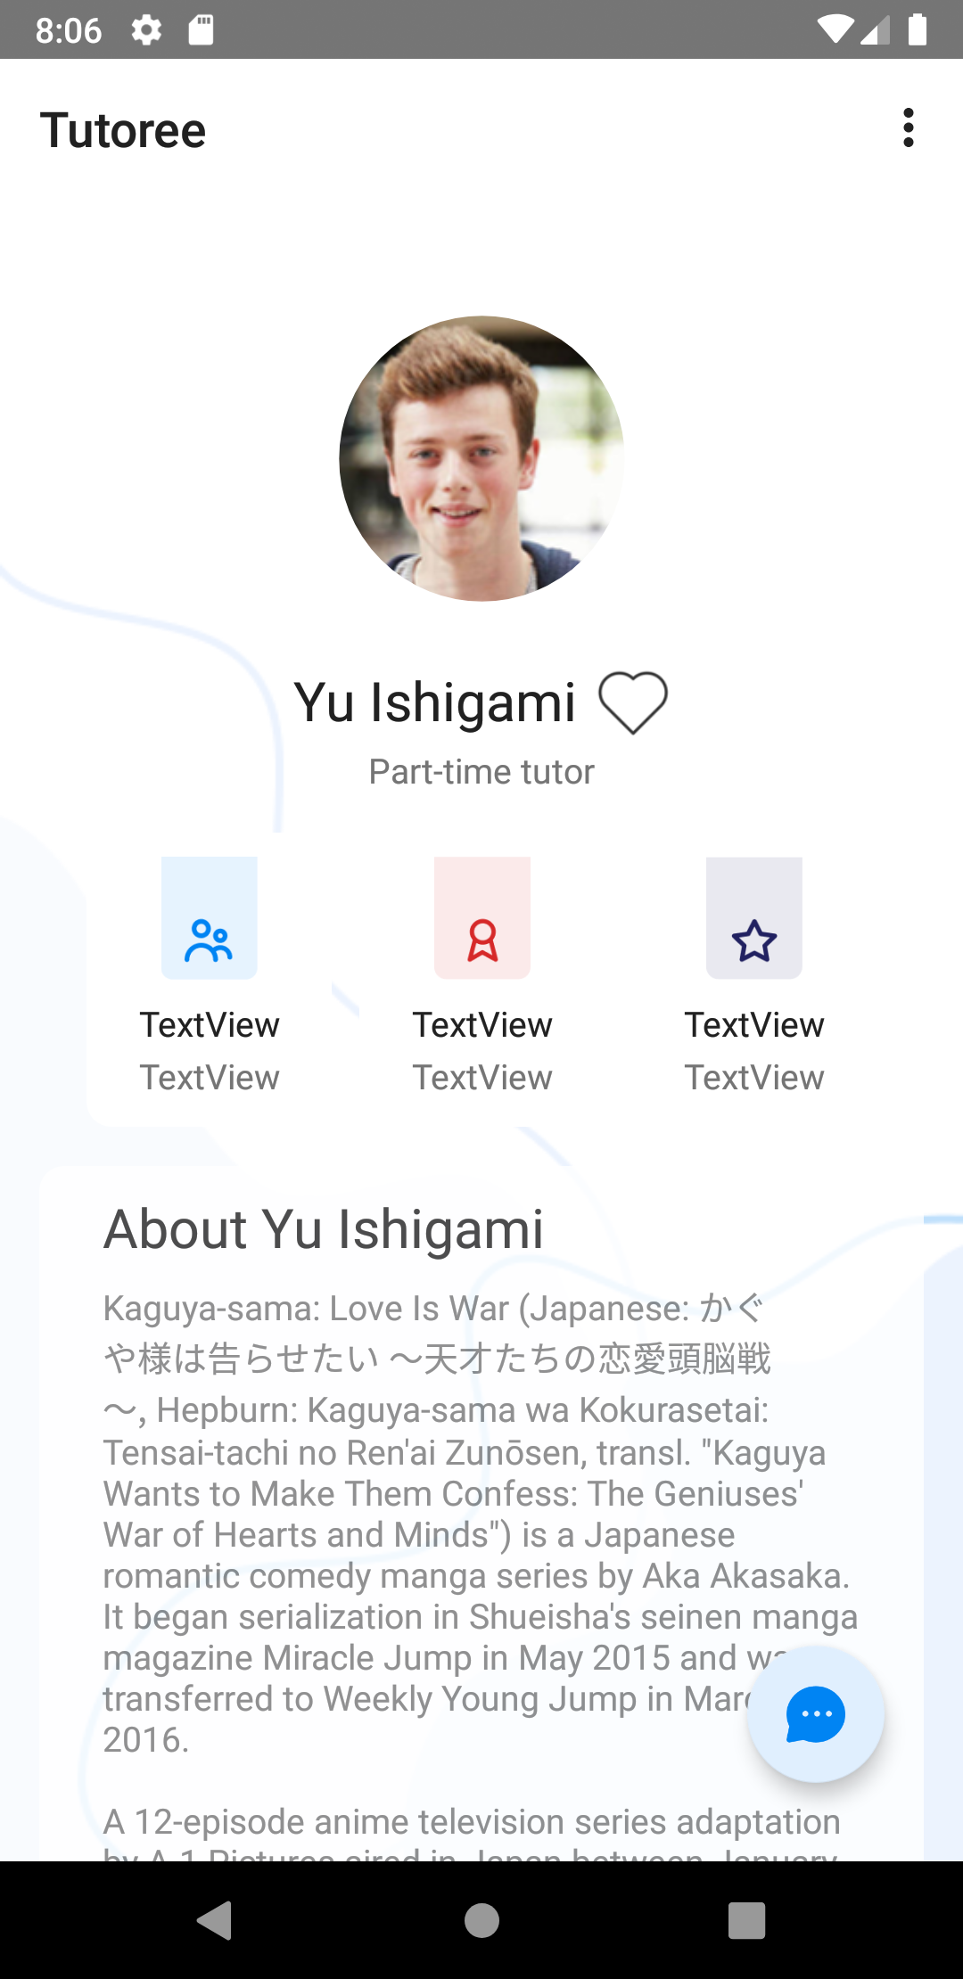
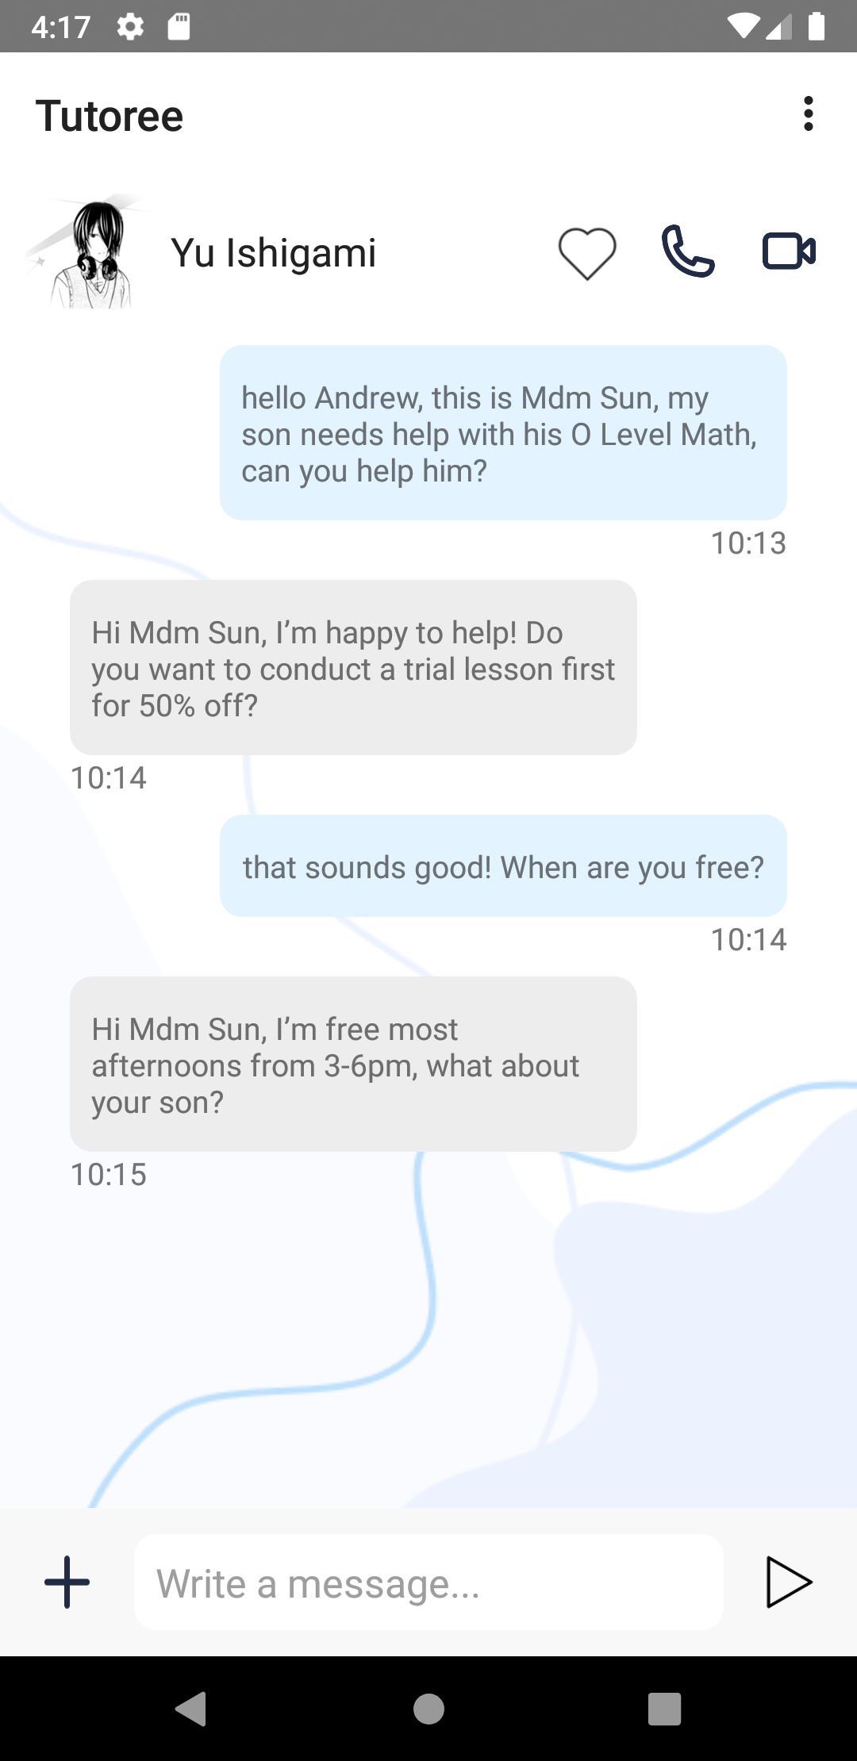
Splash Activity
Welcome Activity
Signup Activity
Test View Model
Person View
Model
Main Activity
Main View Model
Profile View Model

Slide 3
Input | Description
8 | Signed difference between tutor/tutee scores
4 | Similarity between tutor/tutee MBTI
4 | Similarity between tutor/tutee interests/activities
Output | Description
8 | Compatibility score for each subject
And the outputs are:

Slide 4
Welcome
Activity
Signup
Activity
Main
Activity
Test View Model
Person View
Model
Main View Model
Profile View Model
Splash
Activity
Misc Repository
Person Repository
Local Database
Online Database

Slide 5
Pid
Name
Sid
Job
MBTI
Subject
Ability
Person
Interests
Name
Score
Is - A
Learning Style
Teacher
Teach
Student
Chatid
Heart
Rating

