Slide 1


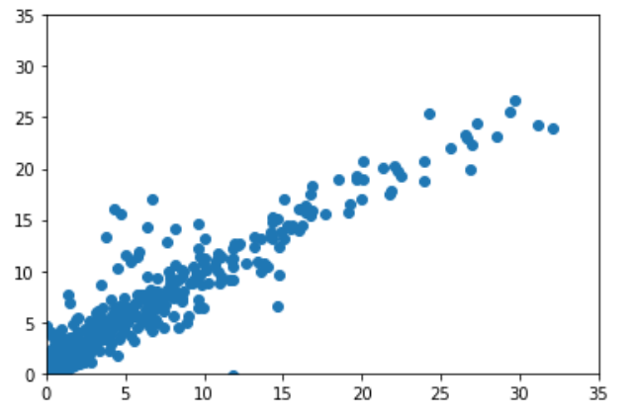
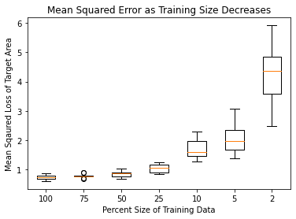
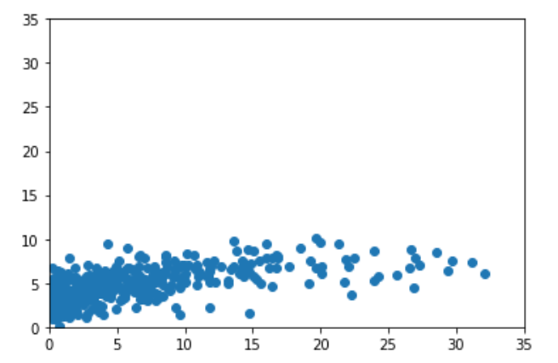
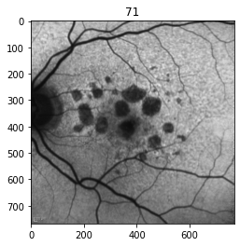
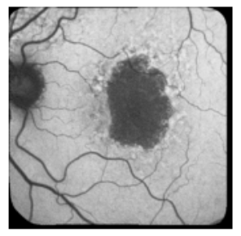
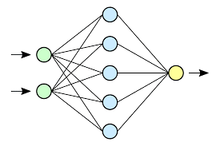
Training Same Size Effect on Deep Learning Models for Geographic Atrophy
¹WISCONSIN READING CENTER
²A-EYE Unit
³Annexon Biosciences
Robert Slater², Jacob Bogost¹, Rohit Balaji¹, Gelique Ayala¹, Jeong Pak¹, Rick Voland¹, Barbara A. Blodi¹, Roomasa Channa¹, Donald Fong³, Amitha Domalpally^{1,2}
224-C0063
ARVO 2023
Background and Purpose
Training Sample size | Percentage of available training sample | Mean area on training set ( n = 511 ) | Mean difference between ground truth and AI prediction ( 95% CI) | Intraclass Correlation (ICC)
1515 | 100% | 5.37 | 1.39 (0.07 – 4.52) | 0.94
1135 | 75% |  | 1.39 (0.06 – 4.74) | 0.93
757 | 50% |  | 1.50 (0.08 – 5.14) | 0.93
378 | 25% |  | 1.61 (0.07 – 5.65) | 0.90
151 | 10% |  | 2.07 (0.10 – 7.39) | 0.85
75 | 5% |  | 2.33 (0.13 – 8.23) | 0.81
30 | 2% |  | 3.35 (0.22 – 11.55) | 0.57
Results
Data is expensive and time consuming to explain and annotate
One of the most important questions for experiments is “How much data do we need”
The answer is often “As much as we can get”
More is better
Geographic Atrophy (GA) is a debilitating eye disease with only a single approved treatment
The standard modality to measure GA is Fundus Autofluorescence, which is not widely available, limiting the number of examples that can be used for Deep Learning (DL) or Artificial Intelligence (AI) Models.
What effect does sample size have on the performance of AI models?
In this use case of predicting GA area, the algorithm performance metrics were similar with sample size ranging between 500 - 1500 autofluorescence images
Performance of the algorithm started dropping at 25% data ( ~375 autofluorescence images and was significantly worse at < 25%.
100% Training Sample
Mean Squared Error was used as a loss function and thus us a proxy for model performance.
The lower the MSE on the validation set, the better the model performance.
The MSE is comparable at 100%, 75% and 50% sample size indicating that model accuracy is maintained even with 50% (n= xx ) training data.
At 25% sample size ( n =378) , model accuracy starts dropping
Predicted Area mm²
Methods
1515 Autofluorescence images from Age-Related Eye Disease Study 2 were used in the training set
An independent set of 511 images were used for validation
At each percent level an EffcientNetB0 was trained on either the full training set (p=100) or a random subset of the training set (p<100).
The target of the model was the area of GA as measured by human graders. The AI was trained to predict the area in mm²
At p = (100,75,50,25,10,5,2) a p percent random subset of the training data was selected and used to train the model, while the validation set was held constant at n=511
Analysis:
The lowest MSE validation loss for each run
The number of training steps; the batch size was held constant so each training step represents a forward and backward pass of the network and is a metric for the time to train.
Measured Area mm²
2% Training Sample
Predicted Area mm²
8.53 mm ²
Ground truth : 3.25 mm²
The table below shows AI prediction of area of GA on this image . Each row represents the prediction of an independent model that was trained on sequential reduction of training data
Measured Area mm²
Decreasing the training size causes the model to severely under preform at larger GA areas
Given only this Black and White Fundus Autofluorescence Image, the Neural Network is trained to predict an area (number only)
Conclusions
Training sample size is an important hyperparameter that influences the learning of the algorithm
Annotations can take 30-60 Minutes, so training with less data can decrease cost, at the risk of decreased performance.
Model training size (percentage of available data used for training | Area prediction | Percentage difference between ground truth and AI prediction
100% | 3.07 | 5.4%
75% | 3.19 | 2.0%
50% | 3.00 | 7.4%
25% | 2.76 | 15.1%
10% | 2.97 | 8.3%
5% | 2.98 | 8.0%
2% | 3.17 | 2.5%
References
1. Bailly A, Blanc C, Francis É, et al. Effects of dataset size and interactions on the prediction performance of logistic regression and deep learning models. Computer Methods and Programs in Biomedicine. 2022/01/01/ 2022;213:106504.
2. Domalpally A, Danis R, Agron E, Blodi B, Clemons T, Chew E. Evaluation of Geographic Atrophy from Color Photographs and Fundus Autofluorescence Images: Age-Related Eye Disease Study 2 Report Number 11. Ophthalmology. Jul 19 2016
Commercial interest disclosures: NONE for RB, RS, JB, GA, JP, RV, BB, RC, AD
DF is an employee of Annexon Biosciences

