Slide 1

Store Sales - Time Series Forecasting
Use machine learning to predict grocery sales

Slide 2

PROJECT
IDEA
Predicting Sales of a Superstore dataset from Kaggle

Slide 3
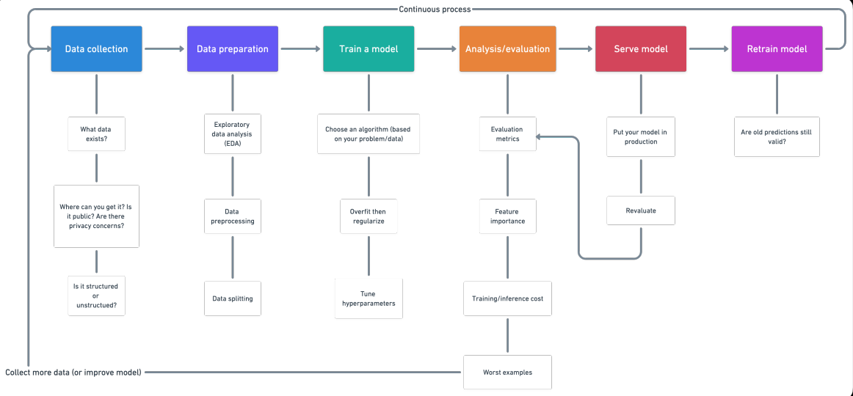
Working Steps for Machine Learning Algorithm

Slide 4
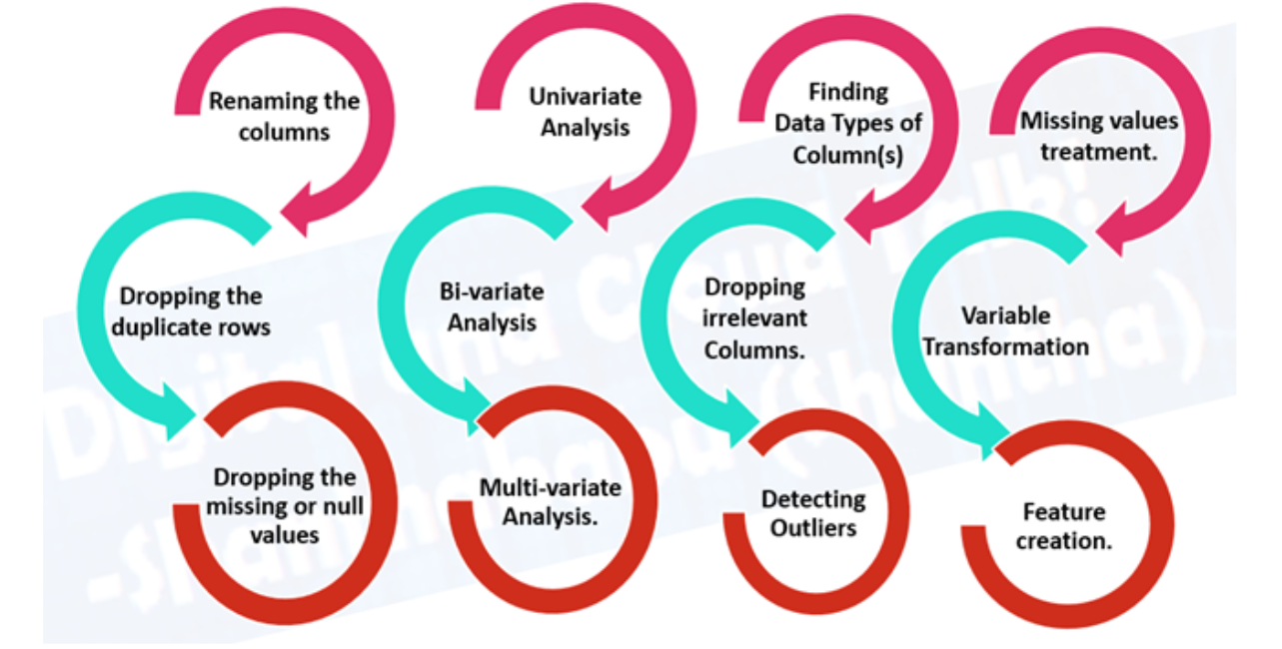
Feature Handling for Attributes in Dataset

Slide 5
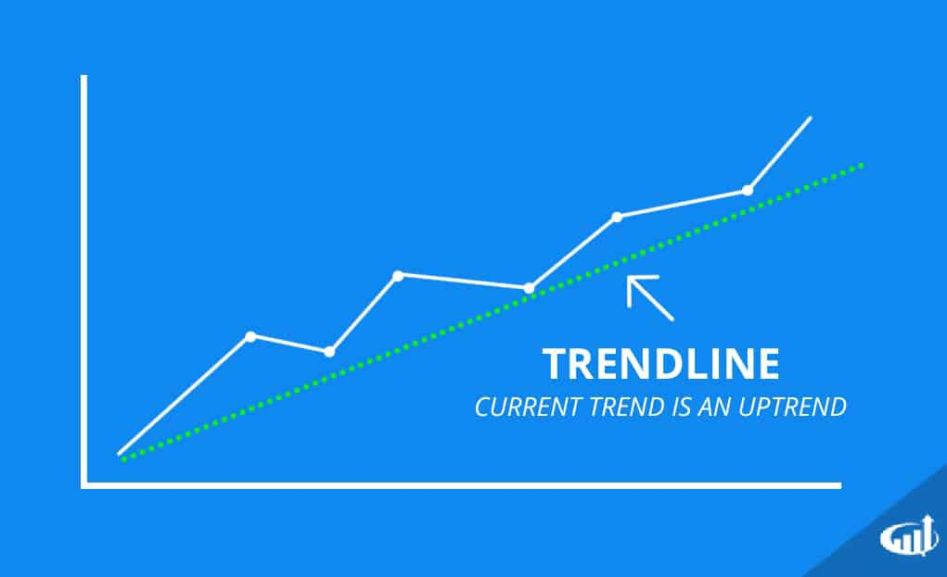
Project Idea
TimeSeries Sales Analysis
Sales Forecasting– is the process of predicting how much revenue a company, team, or person can generate within a certain timeframe.
Accurate sales forecasts allow business leaders to make smarter decisions about setting goals, budgeting, hiring, prospecting, and determining how to fuel companies’ growth.
So, in many ways, sales forecasting affects everyone in the organization.
According to Mckinsey’s report, a global manufacturer’s demand forecasts were regularly off by 30% or more.
As a result, teams rely on gut instincts to generate sales goals

Slide 6
When building a forecasting model, the data is evaluated according to the following parameters:
Consistency
Accuracy
Validity
Relevance
Accessibility
Completeness
Detalization

Slide 7
Steps Performed By us on Training Dataset

Slide 8
Overview of Dataset
The data has been split into five groups:
Diamensions of train data : (3000888, 6)
Diamensions of test data : (28512, 5)
File Descriptions and Data Field Information
1) train.csv
The training data, comprising time series of features store_nbr, family, and onpromotion as well as the target sales.
store_nbr identifies the store at which the products are sold.
family identifies the type of product sold.
sales gives the total sales for a product family at a particular store at a given date. Fractional values are possible since products can be sold in fractional units (1.5 kg of cheese, for instance, as opposed to 1 bag of chips).
onpromotion gives the total number of items in a product family that were being promoted at a store at a given date.
2)test.csv
The test data, having the same features as the training data. You will predict the target sales for the dates in this file.
The dates in the test data are for the 15 days after the last date in the training data.

Slide 9
3) stores.csv
Store metadata, including city, state, type, and cluster.
cluster is a grouping of similar stores.
4)oil.csv
Daily oil price. Includes values during both the train and test data timeframes. (Ecuador is an oil-dependent country and it's economical health is highly vulnerable to shocks in oil prices.)
5)holidays_events.csv
Holidays and Events, with metadata
NOTE: Pay special attention to the transferred column. A holiday that is transferred officially falls on that calendar day, but was moved to another date by the government. A transferred day is more like a normal day than a holiday. To find the day that it was actually celebrated, look for the corresponding row where type is Transfer. For example, the holiday Independencia de Guayaquil was transferred from 2012-10-09 to 2012-10-12, which means it was celebrated on 2012-10-12. Days that are type Bridge are extra days that are added to a holiday (e.g., to extend the break across a long weekend). These are frequently made up by the type Work Day which is a day not normally scheduled for work (e.g., Saturday) that is meant to payback the Bridge.
Additional holidays are days added a regular calendar holiday, for example, as typically happens around Christmas (making Christmas Eve a holiday).

Slide 10
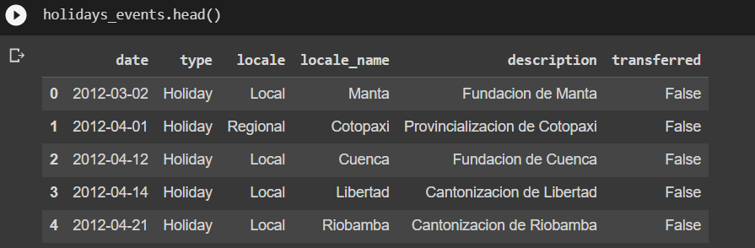
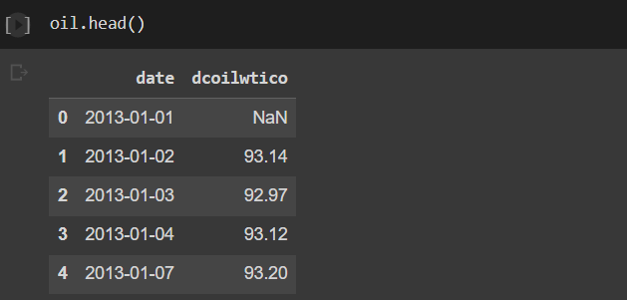
Sample Data
Holiday Events DataFile
Oil DataFile

Slide 11
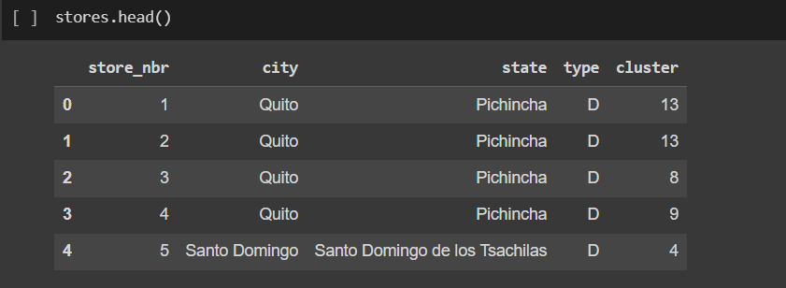
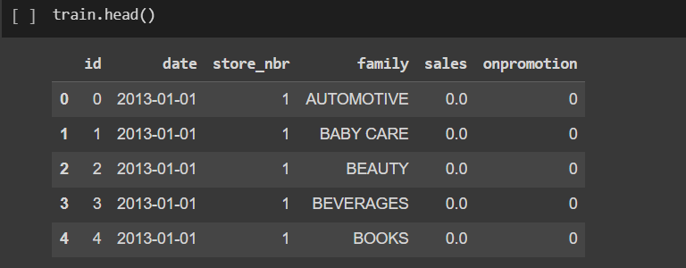
Store List DataFile
Train DataFile

Slide 12
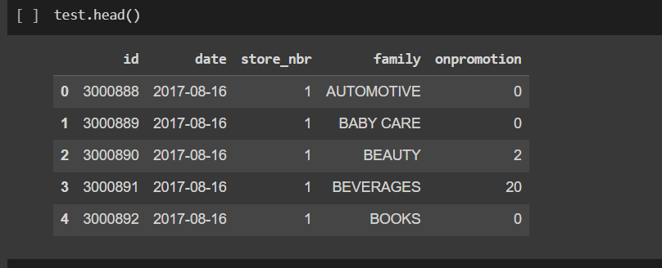
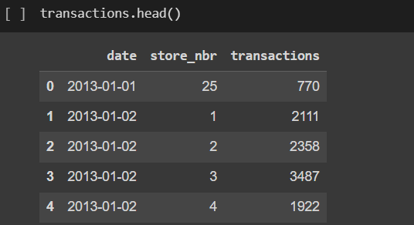
Test DataFile
Transaction DataFile

Slide 13
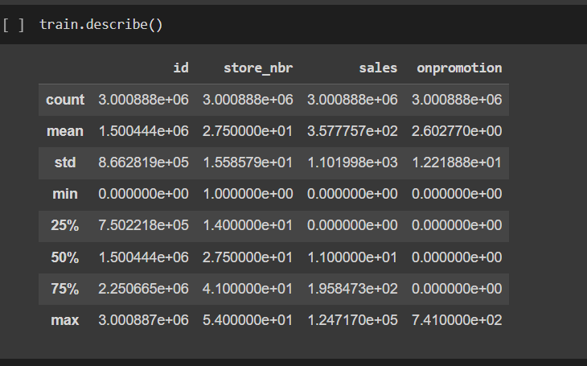
Statistical Information About Data

Slide 14
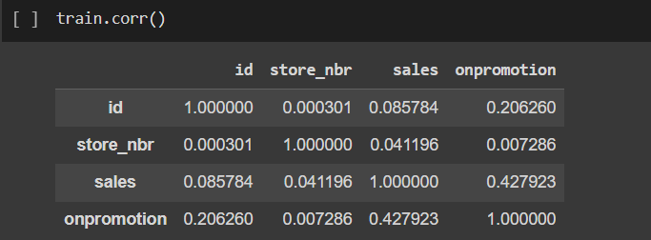
Correlation of Training Set Data

Slide 15
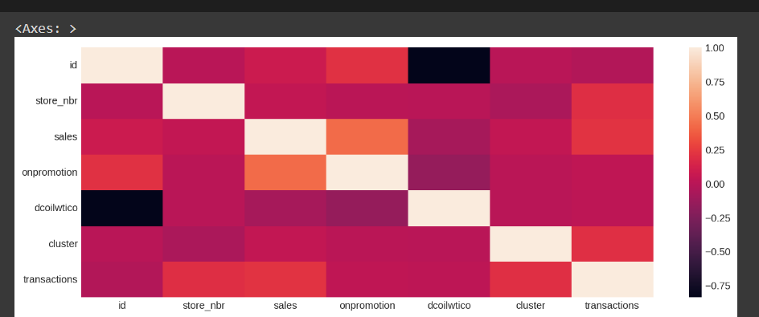
HeatMap of Correlation

Slide 16
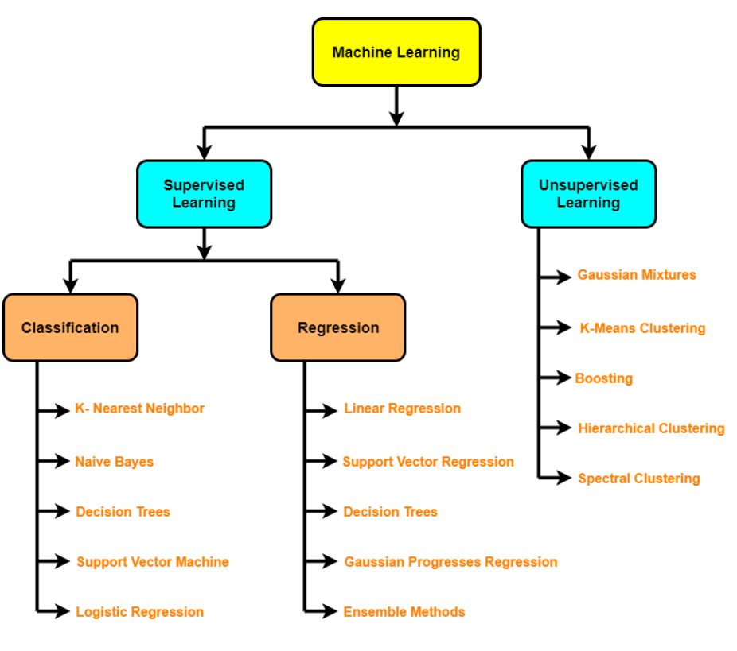

Slide 17
Our Proposed Model
DATA
PREPARATION
Collecting Data
VISUALIZATION
PREPROCESSING
Linear Regression using TimeFrame
MODELING
MODEL IDENTIFICATION
PREDICTION
MODEL PREDICTION

Slide 18
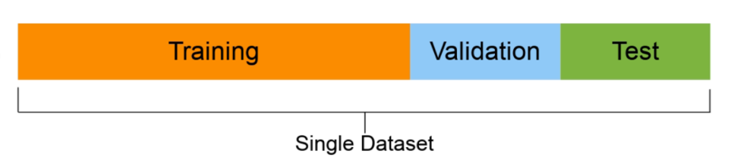
Data splitting
Training set (usually 70-80% of data): Model learns on this.
Test set (usually 10-15% of data): Models’ final performance is evaluated on this. If you have done it right, hopefully, the results on the test
set give a good indication of how the model should perform in the real world. Do not use this dataset to tune the model.
X_train, X_test, Y_train, Y_test = train_test_split(X,Y, test_size=0.2, random_state=2)

Slide 19
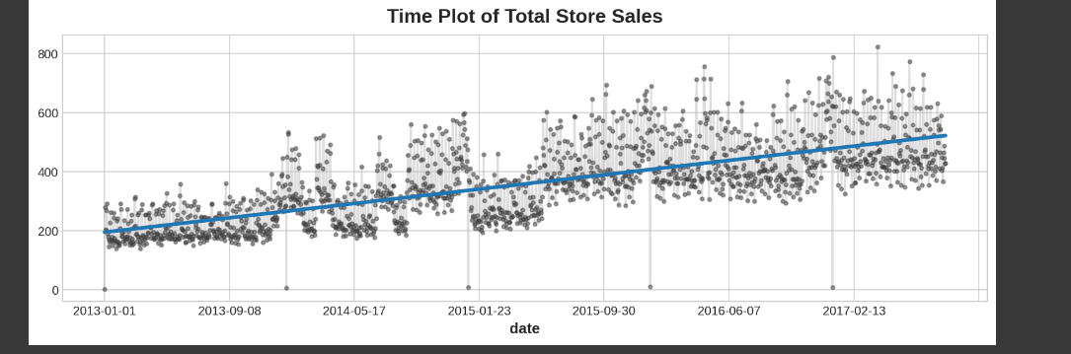
Linear Regression Model
DateWise Store Sales Analysis

Slide 20
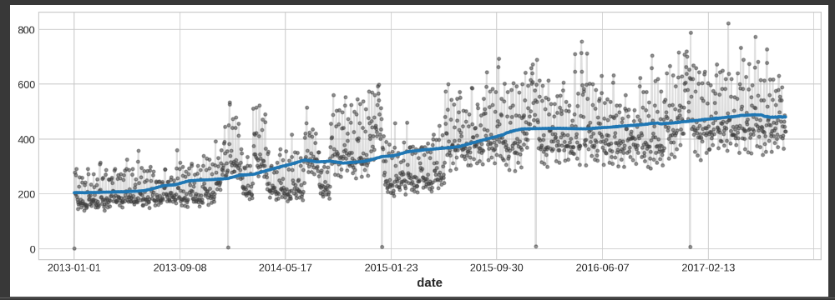
To see what kind of trend a time series might have, we can use a moving average plot.
#The idea is to smooth out any short-term fluctuations in the series so that only long-term changes remain

Slide 21
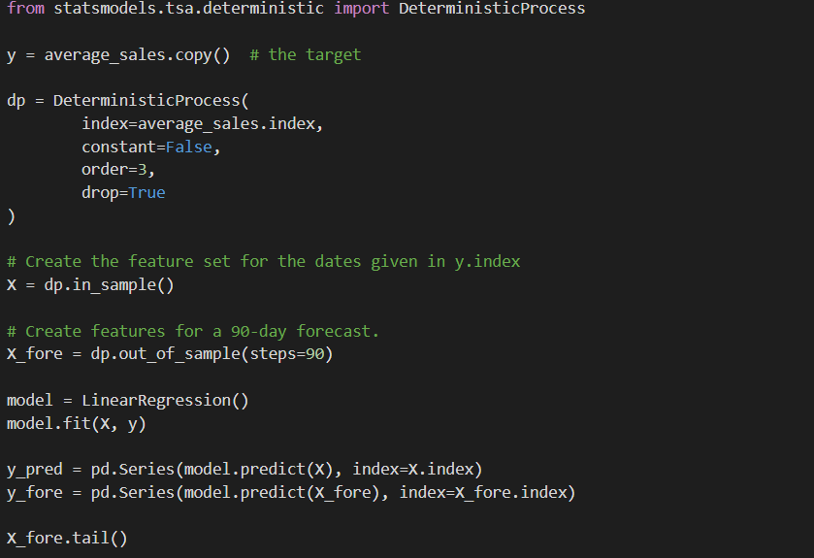
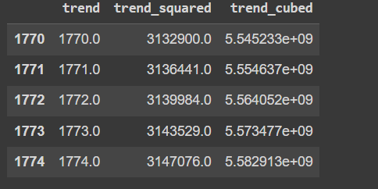

Slide 22
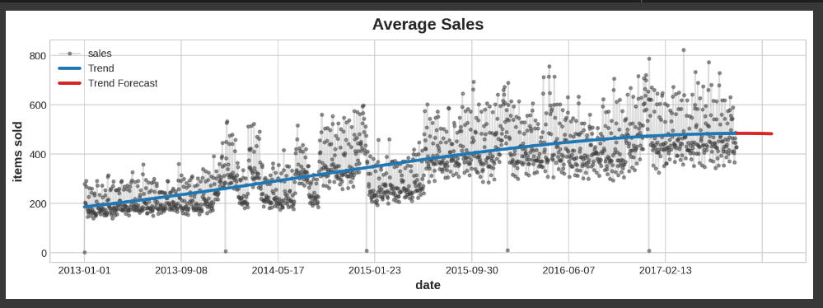
Trend Analysis and Forecast

Slide 23

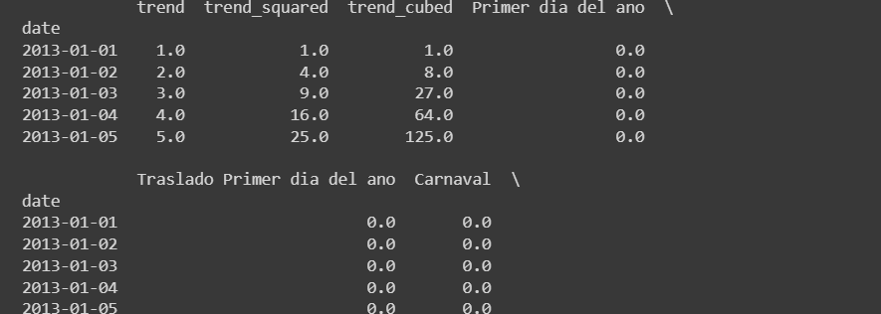
Joining Sales with Holiday Data

Slide 24
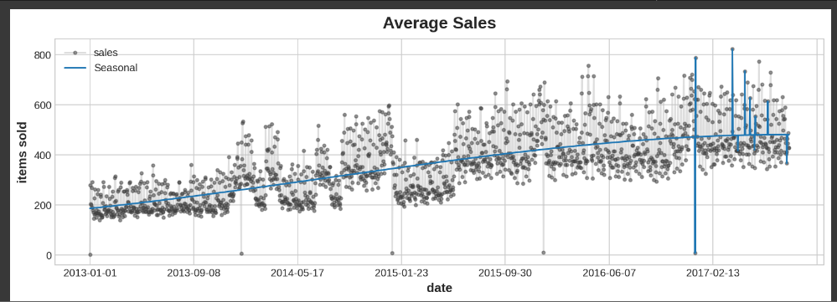
Regular and Seasonal Sales Analysis Chart

Slide 25
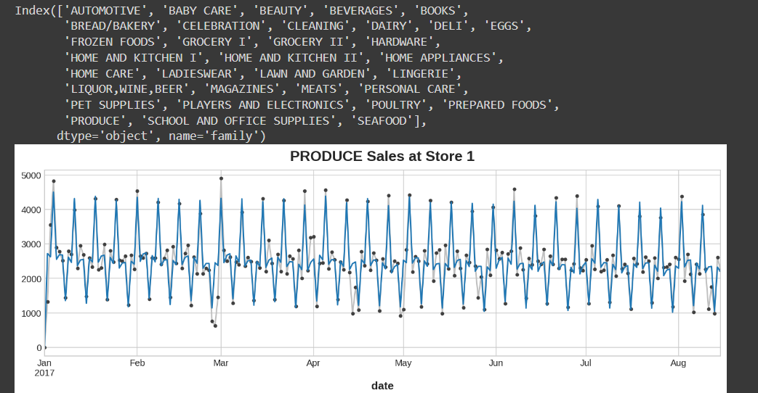
StoreWise Sales Analysis

Slide 26
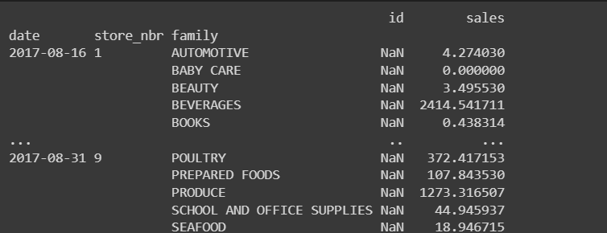
Sales Prediction Familywise Score

