Slide 1
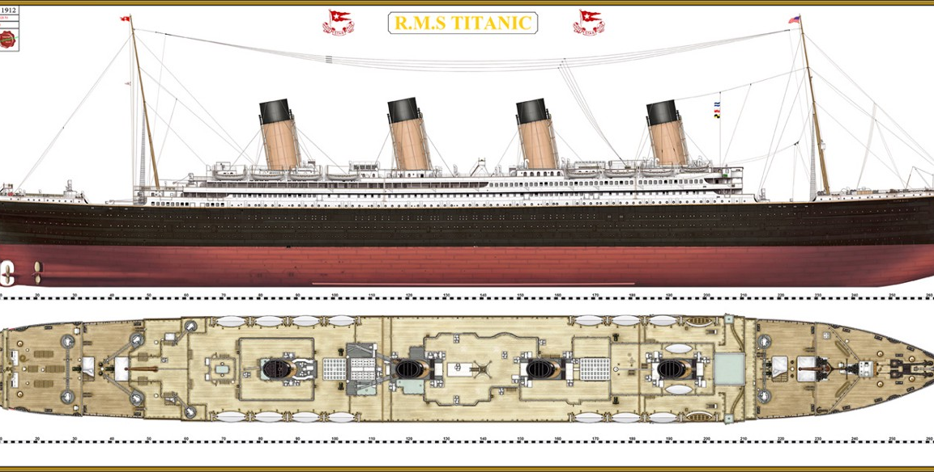
Titanic Dataset
Revan Thakkar 1001802099
DATA 3402-001 Dr. Farbin

Slide 2

PROJECT
IDEA
Predicting Survival of Passengers boarded at Titanic Ship

Slide 3
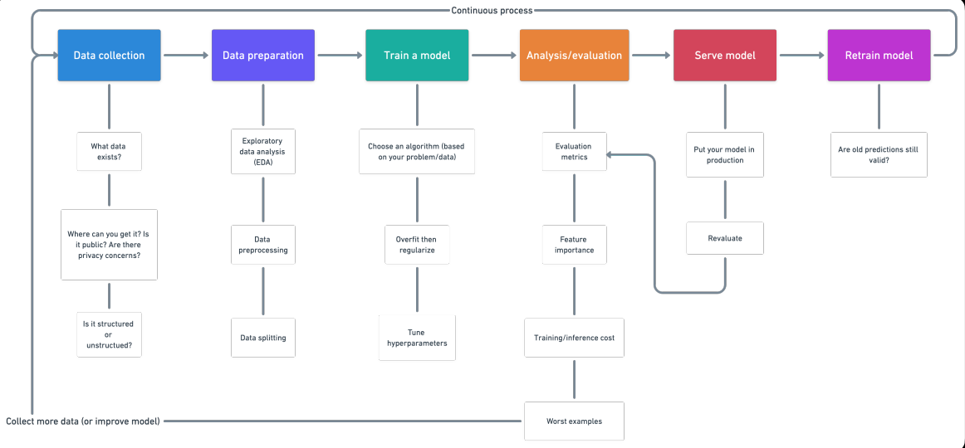
Working Steps for Machine Learning Algorithm

Slide 4
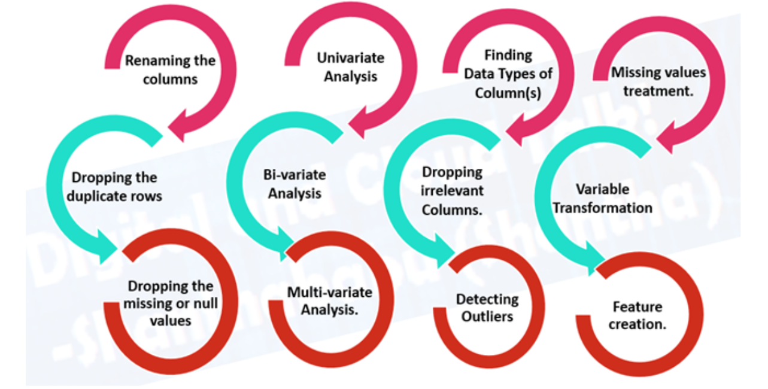
Feature Handling for Attributes in Dataset

Slide 5
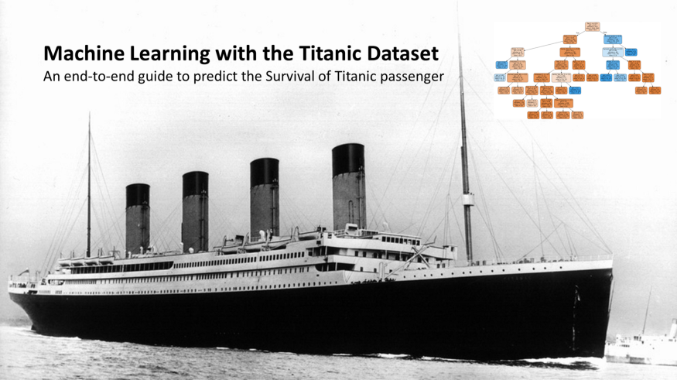
Project Idea
Titanic - Machine Learning from Disaster
The sinking of the Titanic is one of the most infamous shipwrecks in history.
On April 15, 1912, during her maiden voyage, the widely considered “unsinkable” RMS Titanic sank after colliding with an iceberg. Unfortunately, there weren’t enough lifeboats for everyone onboard, resulting in the death of 1502 out of 2224 passengers and crew.

Slide 6
Steps Performed By us on Training Dataset

Slide 7
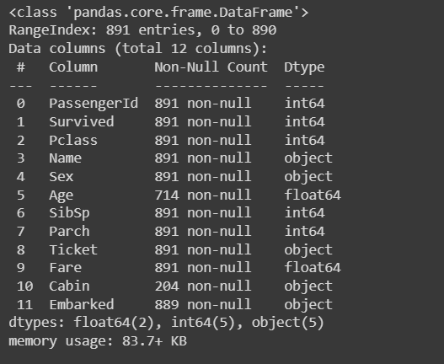
Overview of Dataset
The data has been split into two groups:
training set (train.csv) Shape of Dataset (891, 12)
test set (test.csv) Shape of Dataset (418, 11)
Columns of Dataset

Slide 8
Sample Data

Slide 9
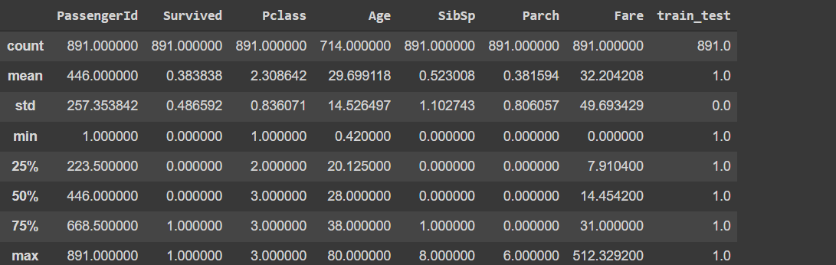
Statistical Information About Data

Slide 10
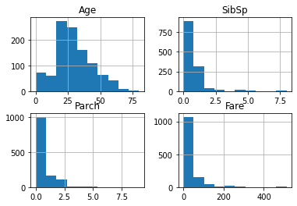
Histogram of Numeric Data

Slide 11
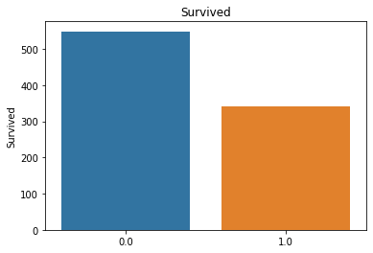
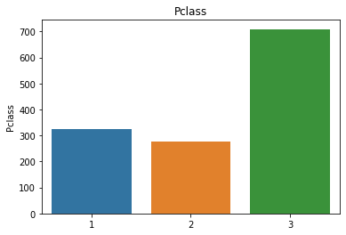
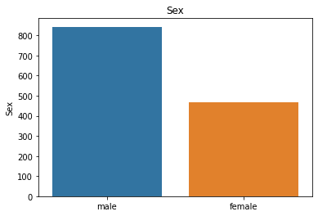
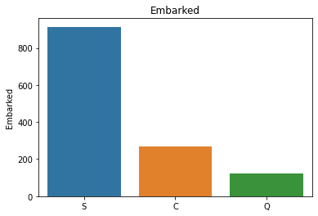
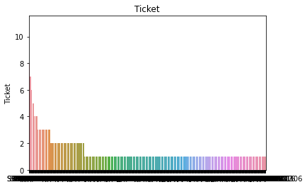
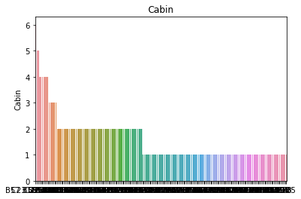
Value Count on certain attributes of dataset

Slide 12
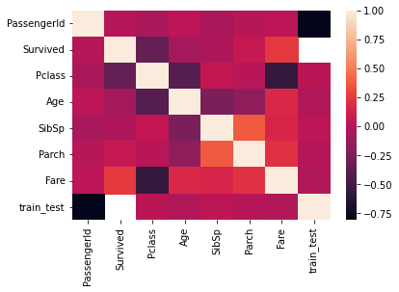
HeatMap of Correlation

Slide 13
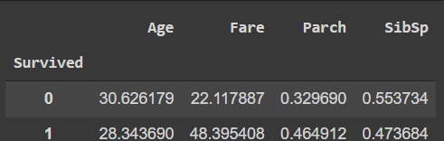
Pivot Table of Survived People on the following attributes

Slide 14
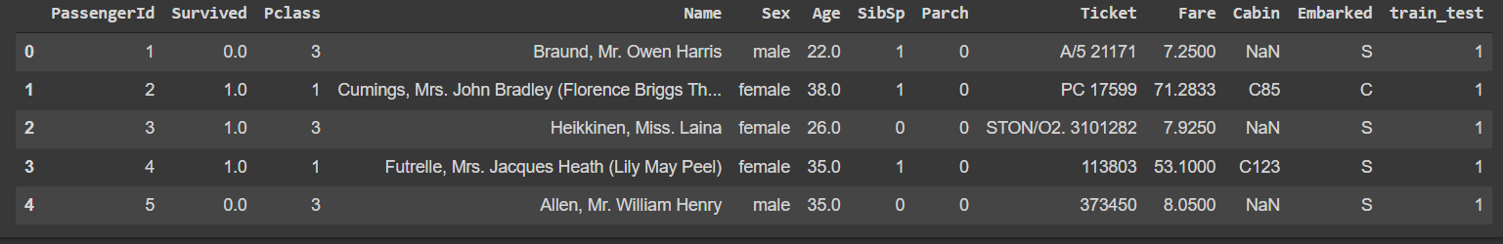
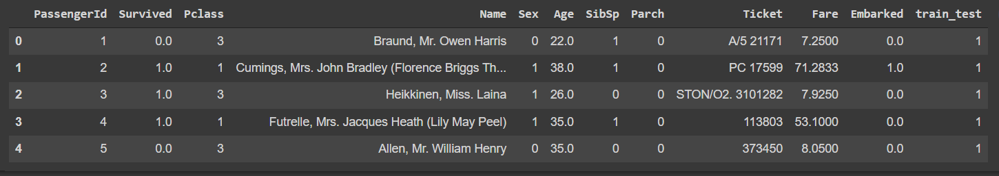
Original Data
Missing Value /Categorial/Drop Columns Data Handling on our attributes

Slide 15
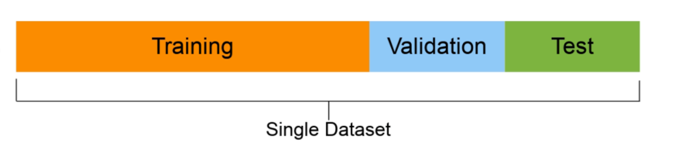
Data splitting
Training set (usually 70-80% of data): Model learns on this.
Validation set (usually 10-15% of data): Model hyperparameters are tuned on this
Test set (usually 10-15% of data): Models’ final performance is evaluated on this. If you have done it right, hopefully, the results on the test
set give a good indication of how the model should perform in the real world. Do not use this dataset to tune the model.
X_train, X_test, Y_train, Y_test = train_test_split(X,Y, test_size=0.2, random_state=2)

Slide 16
Our Proposed Model
DATA
PREPARATION
Collecting Data
VISUALIZATION
PREPROCESSING
LOGISTIC REGRESSION
KNN
SUPPORT VECTOR MACHINE
MODELING
TUNING HYPERPARAMETERS
MODEL IDENTIFICATION
PREDICTION
MODEL PREDICTION

Slide 17
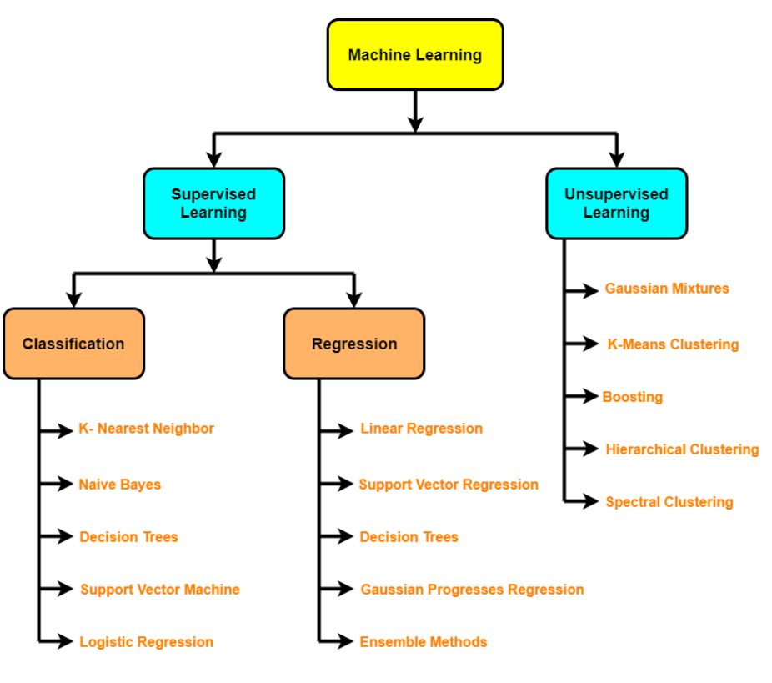

Slide 18
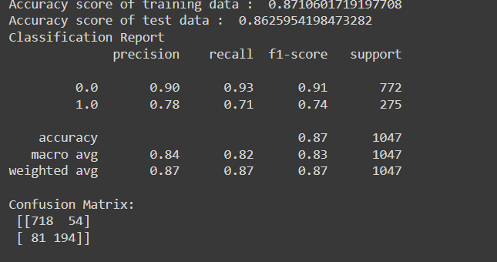
Logistic Regression Result

Slide 19
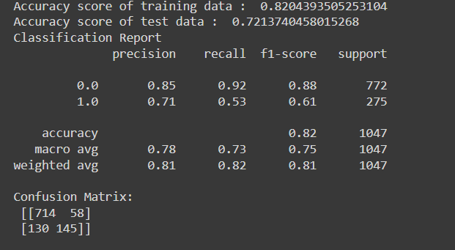
KNN Result

Slide 20
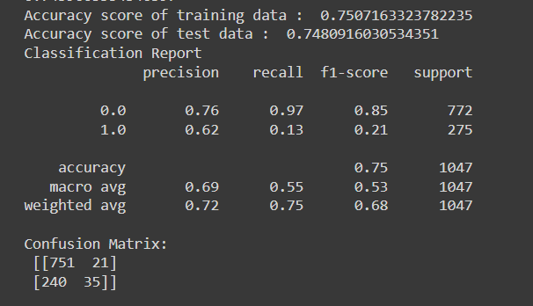
SVM Result

Slide 21
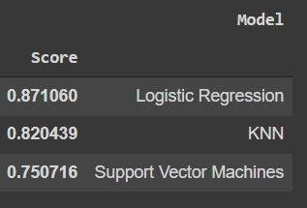
Accuracy Score Chart of Models

Slide 22
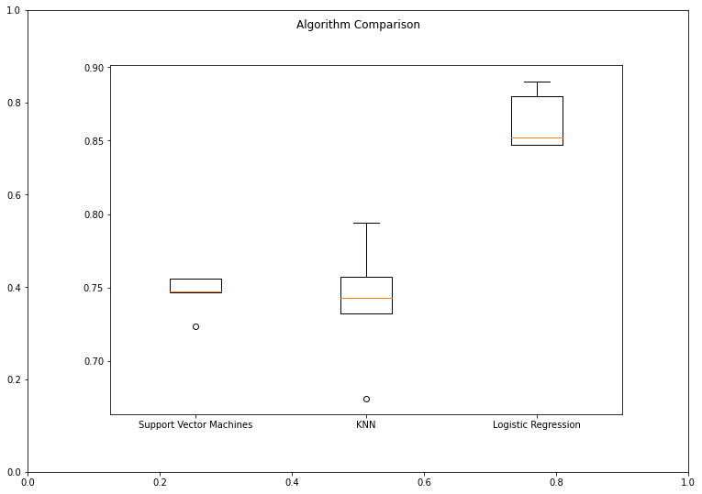
Box Plot of Accuracy Score of Models

