Slide 1
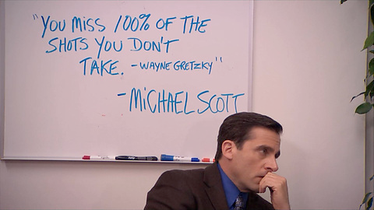
And about 50% of the shots you do take.

Slide 2
Kaggle Dataset
128000 rows and 21 columns
281 different players
Each row is a shot for an individual player

Slide 3
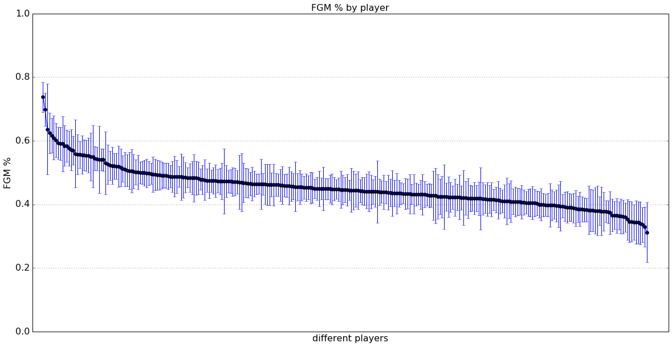
% FGM

Slide 4
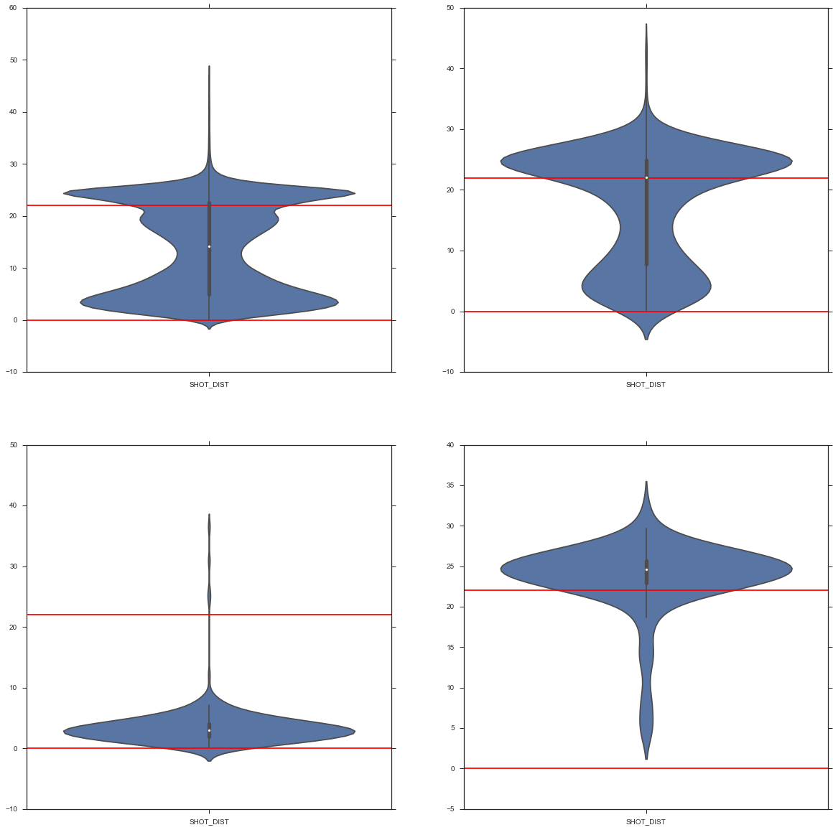
StingRay Plots of shot distance

Slide 5
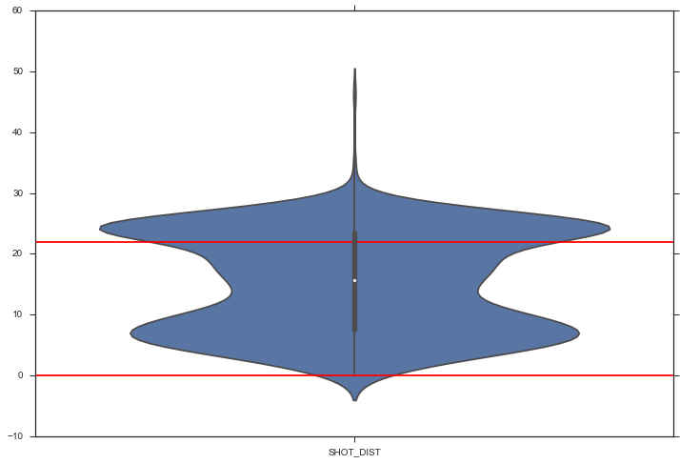
Average Joe

Slide 6
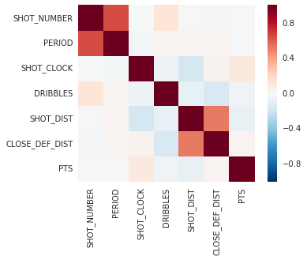
Heat Map

Slide 7
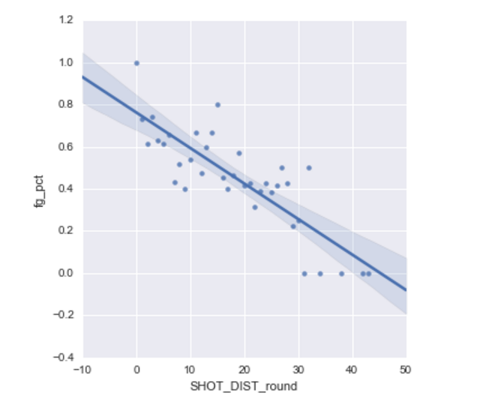
curry fg percentage based on shot dist

Slide 8
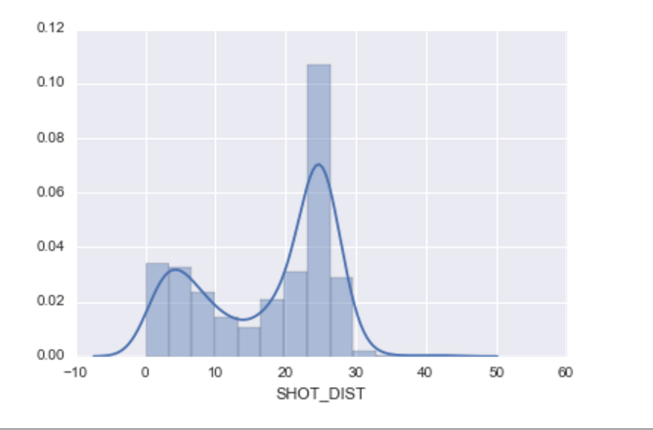
curry shot distribution by distance

