Slide 1

Effective Advertising Strategy
CENSORED
Raditya Fahritama

Slide 2
Business Objective
To classify whether an advertisement is good or bad based on some properties that are shown on the ads
​
To know what properties of an advertisement that are giving the most impact when it comes to effectiveness ​
To see pattern and trend on properties in the good advertisements

Slide 3
Business Queries
Can we classify good and bad advertisements based on the data that we have?
What is the smallest set of variables that need to be changed to maximize likelihood of the advertisement being categorized as good?
Can we recommend which set of attributes is the best based on the advertisement’s category?
Which form of advertisement format has a higher impact than other?

Slide 4
Data Collection: Dataset to be Used
Collected from MetrixLab – that includes Individual brands Advertisement information
UL 2022 GLOBAL META DATA FILE.xslx
Data from 2019-2022
Consists of total of 454 columns with 271 columns of the properties of the advertisements
Consists of 614 observations

Slide 5
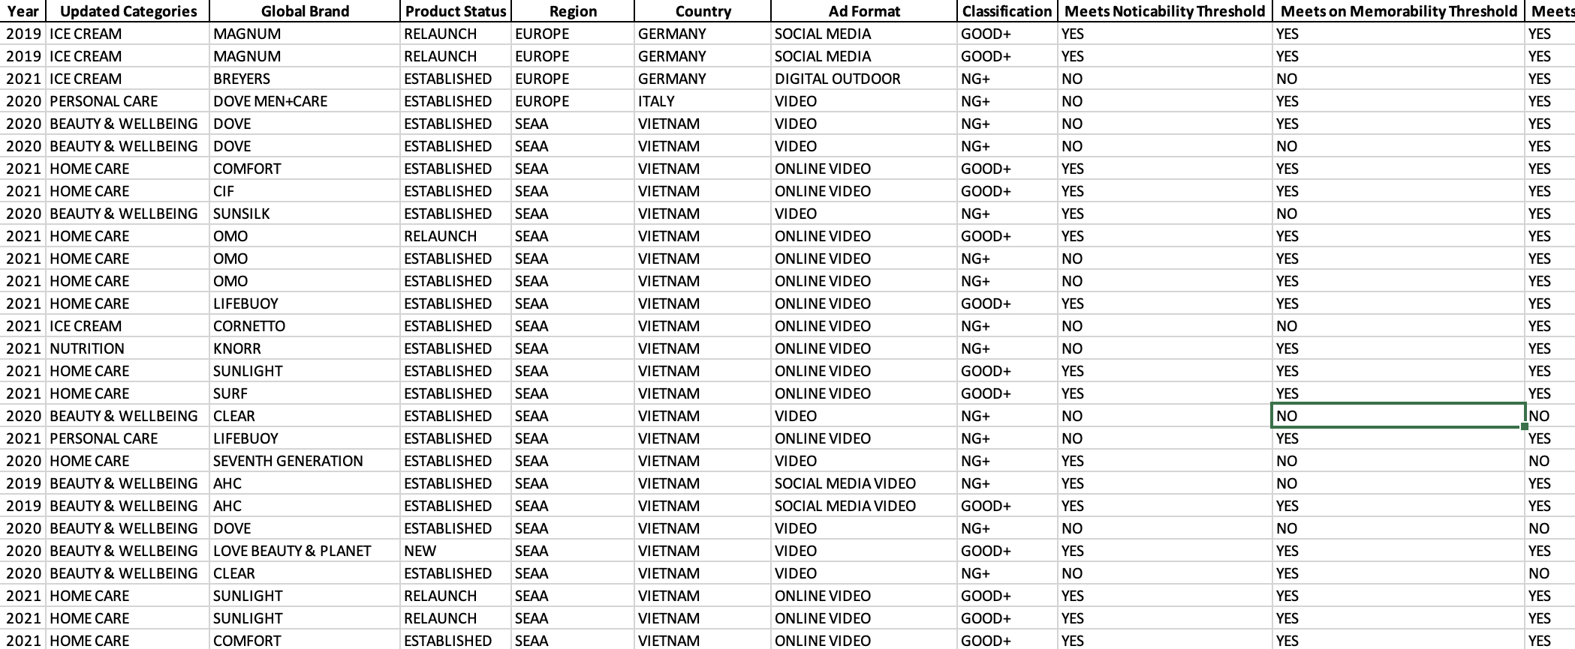

Slide 6
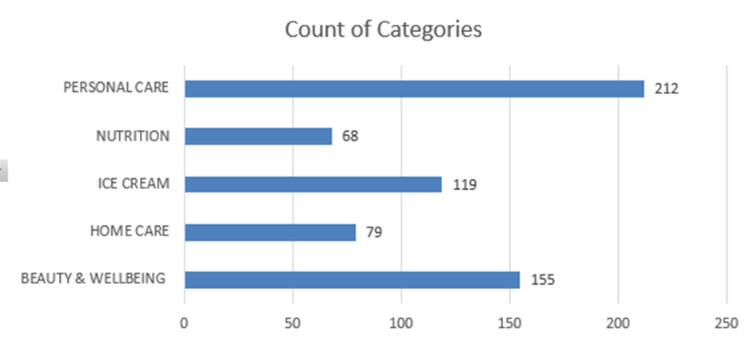
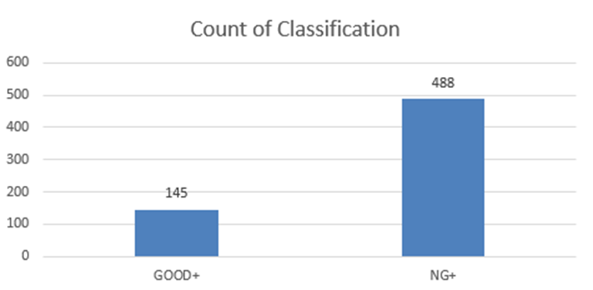
Observation

Slide 7
Initial Observation of the Data
We have Missing Values that are found in the data
Many of the values are Binary (yes/no) data
There's data bias

Slide 8
Planned Preparation Steps
There will be no data addition to the original dataset.
Our dataset is not clean enough for the analysis, data cleaning is required.
The original dataset is in excel format with some sheets. We need to re-structure the data to compatible format.
We plan to transform the values to the format that is relevant and standardized to prevent inconsistency in the analysis
Our dataset contains huge amounts of features. To handle that problem, we need to perform feature selection and dimensionality reduction

Slide 9
List of Preparation Steps
Data Cleaning
Handling missing values by filling them
Dropping unwanted characters, symbols, and whitespaces from categorical values
Checking outliers in the data for numerical values
Removing irrelevant observations
Data Structuring
Extracting the data from original dataset into separated CSV files
Data Transformation
Data Scaling/Normalization
Lower-casing text
Changing binary(yes/no) to binary(1/0)
Feature selection
Selecting feature that holds relevancy to the analysis
Filtering correlated features
Dimensionality Reduction
Creating compact projection of the data

Slide 10
Feature Selection
Due to lot of features, we need to pick those features which has high impact on Target variable
Categorical Data
Lable Encoding
Then we will Perform
Boruta
Correlation

Slide 11
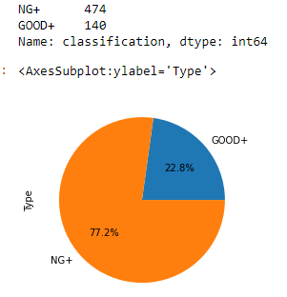
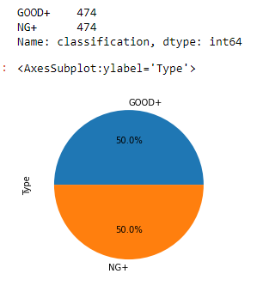
Data Modelling Steps
Data Upsampling
Before: After:

Slide 12
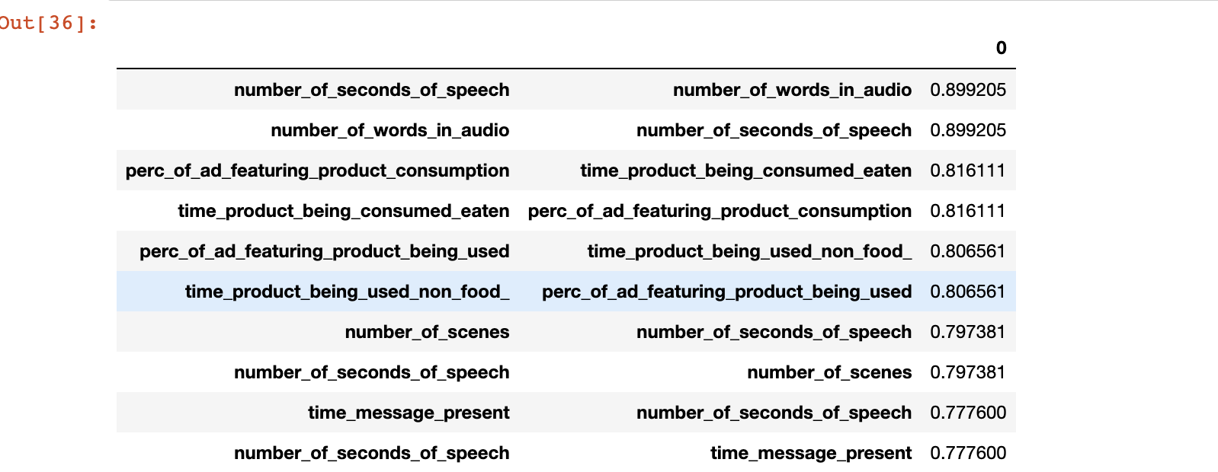
Correlation Result

Slide 13
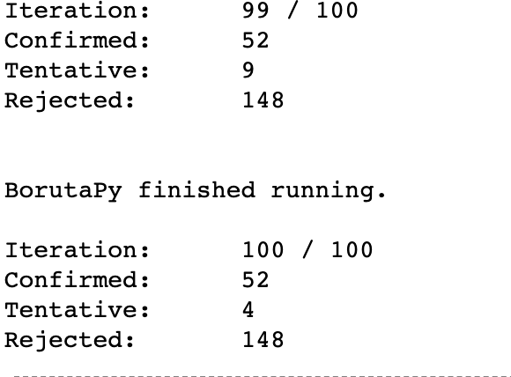
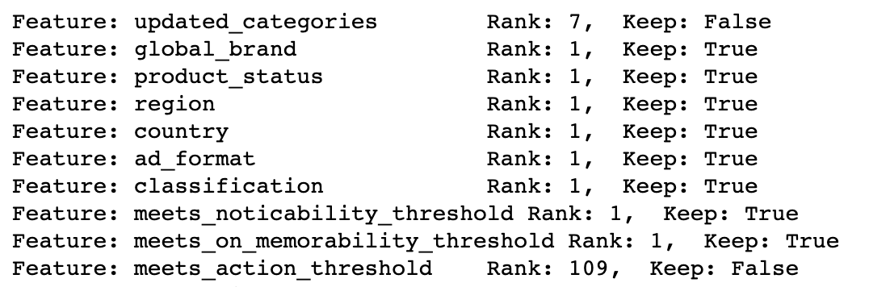
Boruta Feature Selection
Rejected 148 Features and Confirmed 52 Features

Slide 14
Modeling Preparation
Data was split into 80/20 ratio
Accuracies of algorithms were estimated with K-Fold Cross Validation
Hyperparameters were tuned to get the best result of the model
Models were evaluated in term of accuracy, recall, precision, f1, and confusion matrix

Slide 15
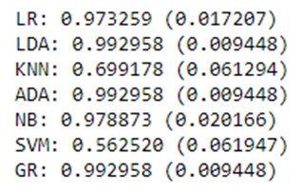
Validation
K-Fold Cross Validation
10-fold was used for the splitting number
Result:
Gradient Boosting (GR), Random Forest (LDA), and AdaBoost (ADA) give the best performance

Slide 16
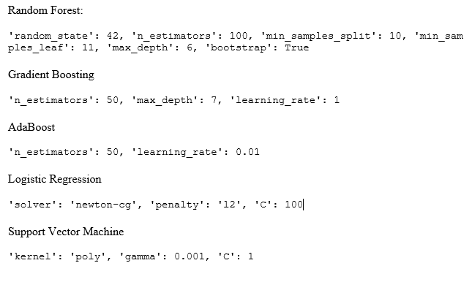
Hyper Parameter Tuning
Tuned with RandomizedSearchCV with 10-fold as the split number​
Result:

Slide 17
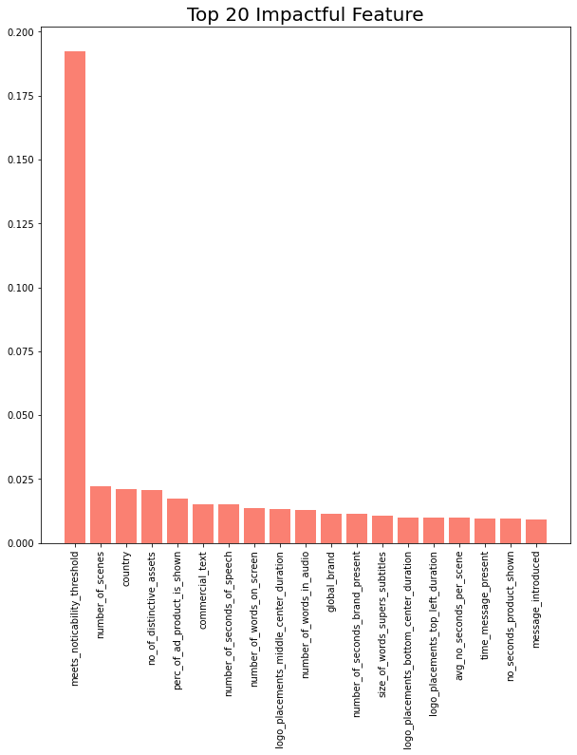
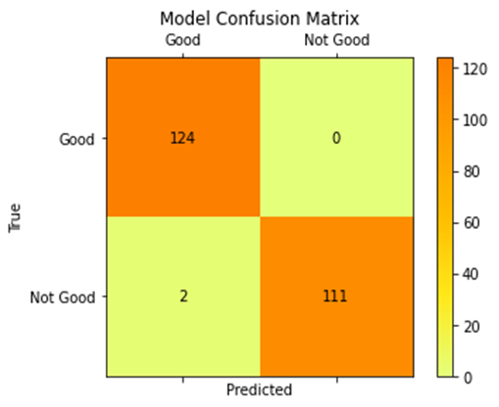
Model Result
Random Forest Model Feature Importance Rank:
Accuracy: 99%
F1 score: 99%
Recall: 99%
Precision: 99%

Slide 18
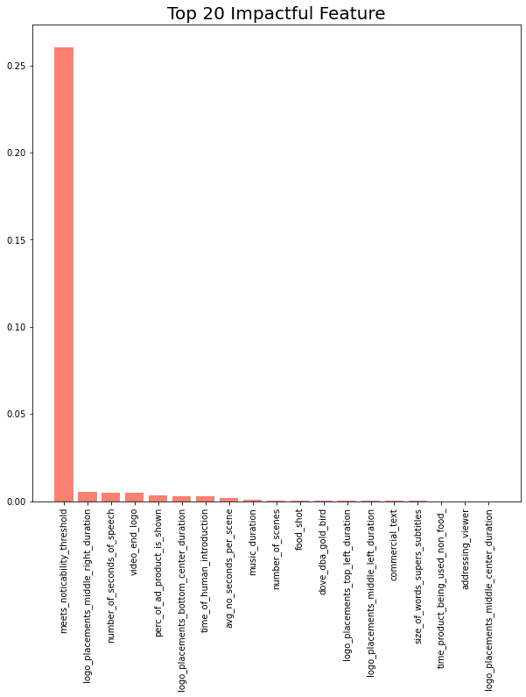

Model Result
Gradient Boosting Model Feature Importance Rank:
Accuracy: 99%
F1 score: 99%
Recall: 99%
Precision: 99%

Slide 19
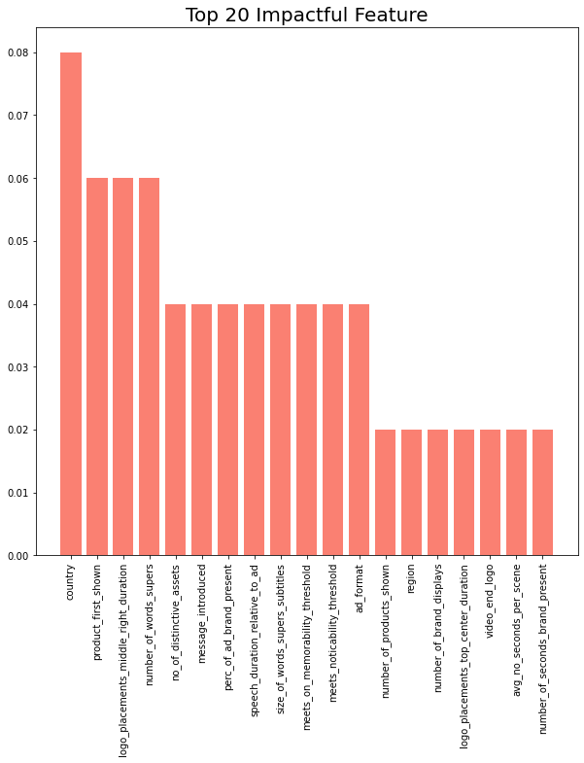
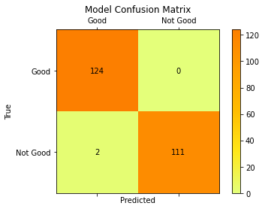
Model Result
AdaBoost Model Feature Importance Rank:
Accuracy: 99%
F1 score: 99%
Recall: 99%
Precision: 99%

Slide 20
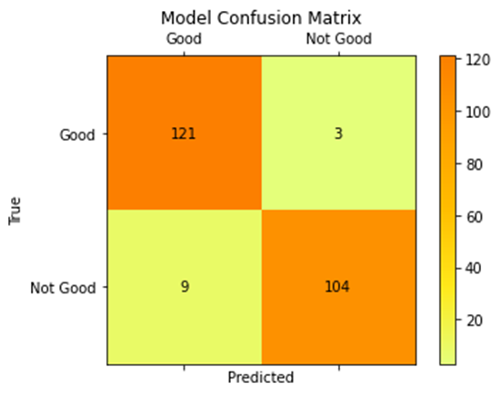
Model Result
Support Vector Machine
Accuracy: 95%
F1 score: 95%
Recall: 95%
Precision: 95%

Slide 21

Model Result
Logistic Regression Model
Accuracy: 97%
F1 score: 97%
Recall: 97%
Precision: 97%

Slide 22
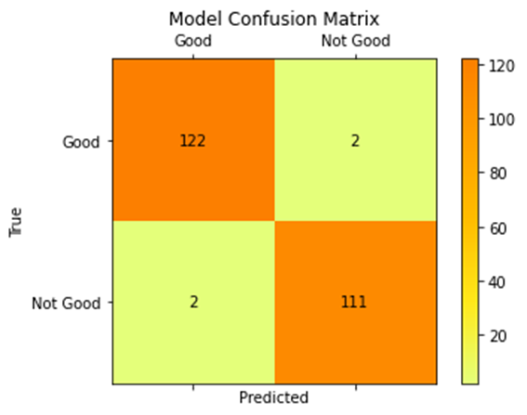
Model Result
Naive Bayes Model
Accuracy: 98%
F1 score: 98%
Recall: 98%
Precision: 98%

Slide 23
Business Query Answers
Can we classify good and bad advertisements based on the data that we have?
Yes we were able to classify the advertisement based on the features given
What is the smallest set of variables that need to be changed to maximize likelihood of the advertisement being categorized as good?
Can we recommend which set of attributes is the best based on the advertisement’s category?

Slide 24
Recommended Features
Random Forest: Noticability threshold, Number of Scenes, Country, Number of Distinctive assets, percentage of ad product shown
Gradient Boosting: Noticability threshold, duration of logo placement in middle right side, number of seconds of speech, logo in ending video, percentage of ad product shown
AdaBoost: Country, product first shown, duration of logo placement in middle right side, number of words shown in ad, Number of Distinctive assets
We conclude that these features are the most impactful in our data.

Slide 25
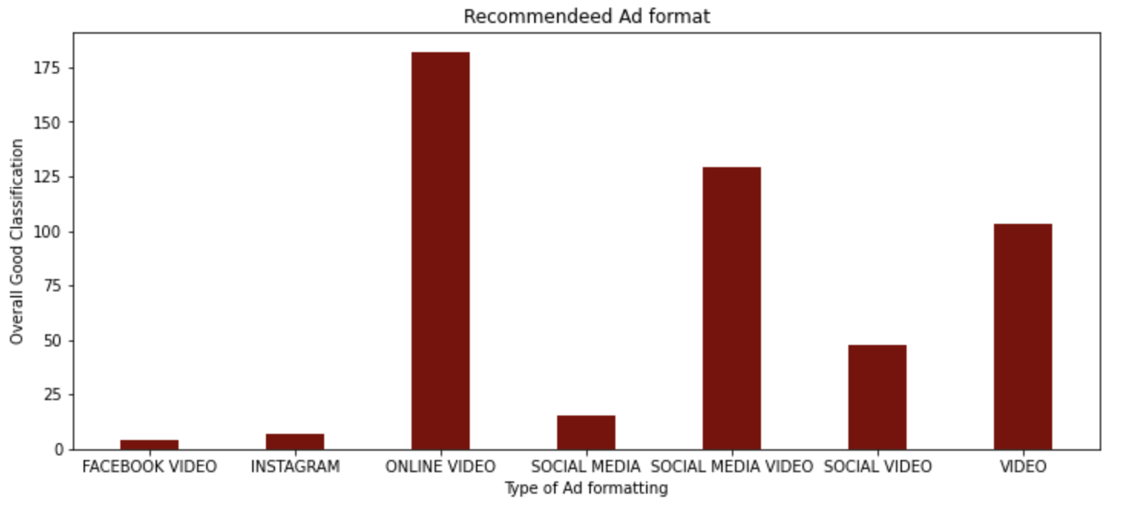
Business Query Answers
Which form of advertisement format has a higher impact than other?

Slide 26
Conclusion
Due to lack of data points, the results varied differently for every model – some models performed well and some did not.
Many features were present, which resulted in overfitting, hence we had to perform hyperparameter tuning.
Data was heavily imbalanced, hence up sampling was necessary.
Random Forest, Gradient Boosting, Adaboost models were the top performing model.

