Slide 1
The Design Core
Market Assessment
Specification
DETAIL
DESIGN
A vast subject. We will concentrate on:
Materials Selection
Process Selection
Cost Breakdown
Concept Design
Detail Design
Manufacture
Sell

Slide 2
Materials Selection with Shape
FUNCTION
SHAPE
SHAPES FOR TENSION,
BENDING, TORSION,
BUCKLING
--------------------
SHAPE FACTORS
--------------------
PERFORMANCE INDICES
WITH SHAPE
MATERIAL
PROCESS

Slide 3
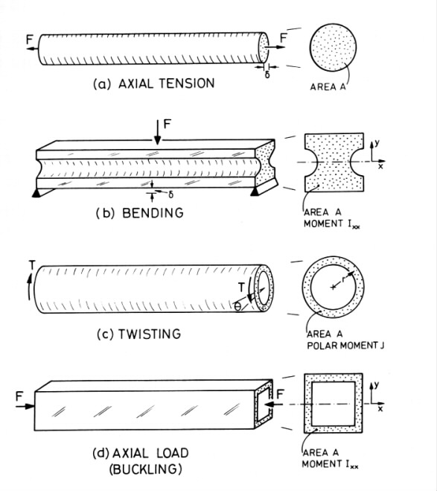
Common Modes of Loading

Slide 4
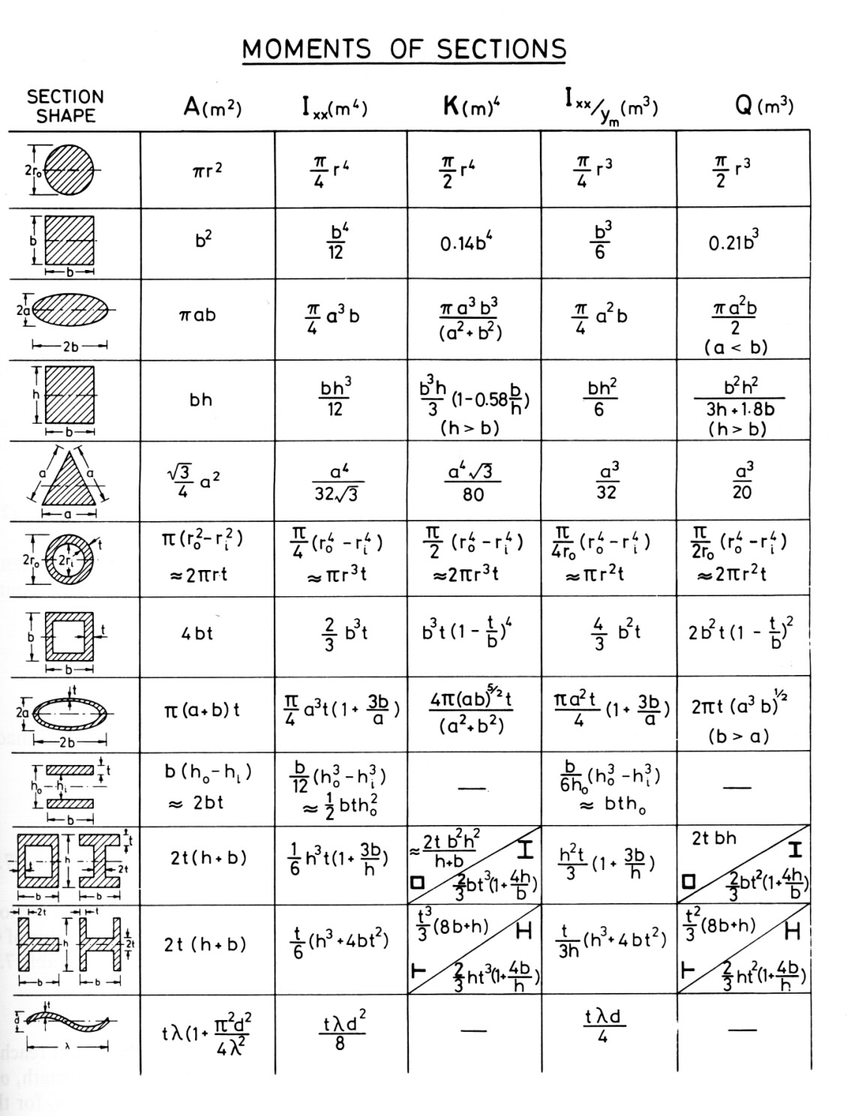








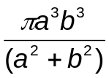


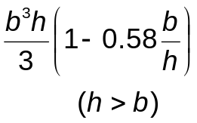

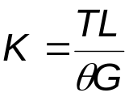

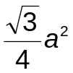
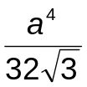
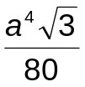
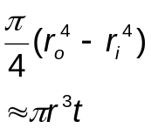
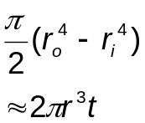
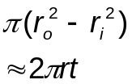
Moments of Sections: Elastic
Section Shape | A (m²) | I (m⁴) | K (m⁴)
A = Cross-sectional area
I = Second moment of area
where y is measured vertically
b_{y} is the section width at y
K = Resistance to twisting of section
(≡ Polar moment J of a circular section)
where T is the torque
L is the length of the shaft
θ is the angle of twist
G is the shear modulus

Slide 5

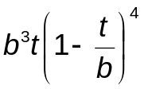

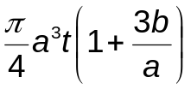
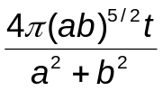

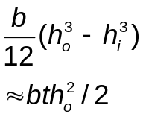

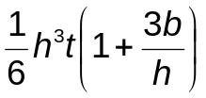
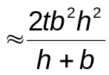
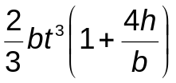


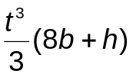
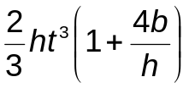
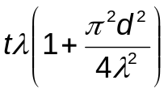

Moments of Sections: Elastic
Section Shape | A (m²) | I (m⁴) | K (m⁴)

Slide 6


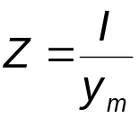



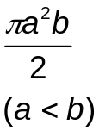

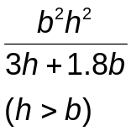
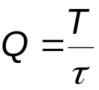


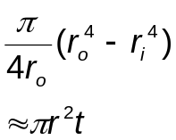
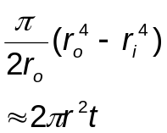
Moments of Sections: Failure
Section Shape | Z (m³) | Q (m³)
Z = Section modulus
where
y_{m} is the normal distance from the neutral axis to the outer surface of the beam carrying the highest stress
Q = Factor in twisting similar to Z
where
τ is the maximum surface shear stress

Slide 7

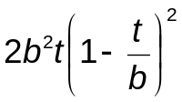
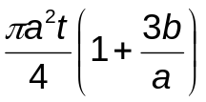
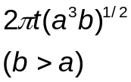
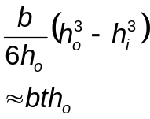
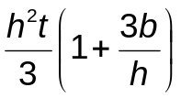






Moments of Sections: Failure
Section Shape | Z (m³) | Q (m³)

Slide 8
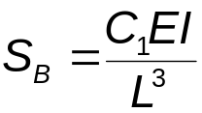
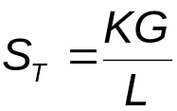
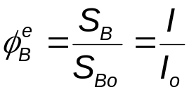
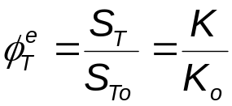
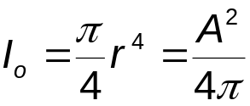
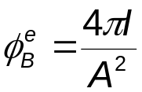
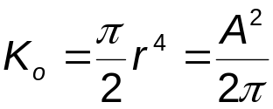
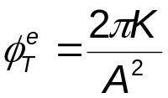
Shape Factors: Elastic
BENDING
TORSION
Bending stiffness of a beam
Torsional stiffness of a beam
where C₁ is a constant depending on the loading details, L is the length of the beam, and E is the Young’s modulus of the material
where L is the length of the shaft, G is the shear Modulus of the material.
Define structure factor as the ratio of the stiffness of the shaped beam to that of a solid circular section with the same cross-sectional area thus:
Define structure factor as the ratio of the torsional stiffness of the shaped shaft to that of a solid circular section with the same cross-sectional area thus:
so,
so,

Slide 9
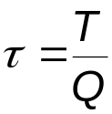
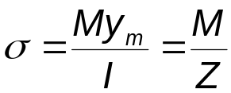


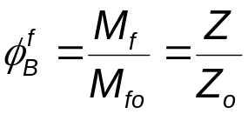
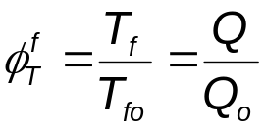
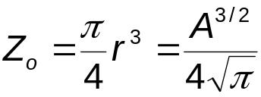
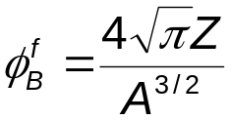
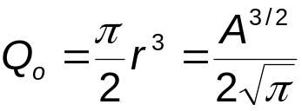
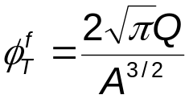
Shape Factors: Failure/Strength
BENDING
TORSION
The highest stress, for a given bending moment M, experienced by a beam is at the surface a distance y_{m} furthest from the neutral axis:
The highest shear stress, for a given torque T, experienced by a shaft is given by:
The beam fails when the bending moment is large enough for σ to reach the failure stress of the material:
The beam fails when the torque is large enough for τ to reach the failure shear stress of the material:
Define structure factor as the ratio of the failure moment of the shaped beam to that of a solid circular section with the same cross-sectional area thus:
Define structure factor as the ratio of the failure torque of the shaped shaft to that of a solid circular section with the same cross-sectional area thus:
so,
so,

Slide 10
Shape Factors: Failure/Strength
Please Note:
The shape factors for failure/strength described in this lecture course are those defined in the 2nd Edition of “Materials Selection In Mechanical Design” by M.F. Ashby. These shape factors differ from those defined in the 1st Edition of the book. The new failure/strength shape factor definitions are the square root of the old ones.
The shape factors for the elastic case are not altered in the 2nd Edition.

Slide 11
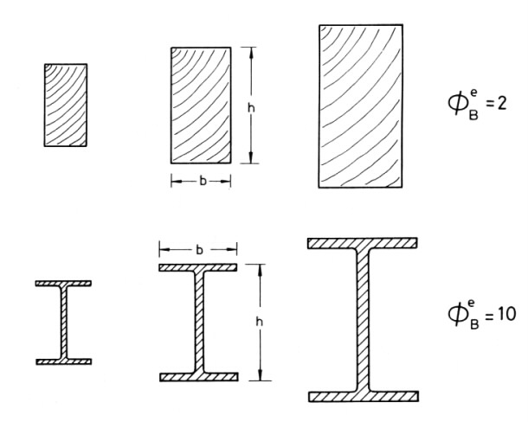
Comparison of Size and Shape
Rectangular sections
I-sections
SIZE →

Slide 12





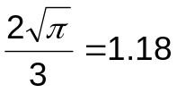












Shape Factors
Section Shape | Stiffness |  | Failure/Strength
1
1
1
1
0.88
0.74
0.77
0.62

Slide 13
























Shape Factors cont’d
Section Shape | Stiffness |  |  | Failure/Strength

Slide 14


Efficiency of Standard Sections
ELASTIC BENDING
Shape Factor:
Rearrange for I and take logs:
Plot logI against logA
: parallel lines of slope 2

Slide 15


Efficiency of Standard Sections
BENDING STRENGTH
Shape Factor:
Rearrange for I and take logs:
Plot logI against logA
: parallel lines of slope 3/2

Slide 16




Efficiency of Standard Sections
ELASTIC TORSION
TORSIONAL STRENGTH
N.B. Open sections are good in bending, but poor in torsion

Slide 17







Performance Indices with Shape
ELASTIC BENDING
ELASTIC TORSION
Bending stiffness of a beam:
Torsional stiffness of a shaft:
Shape factor:
so,
Shape factor:
so,
f1(F) · f2(G) · f3(M)
f1(F) · f2(G) · f3(M)
So, to minimize mass m, maximise
So, to minimize mass m, maximise

Slide 18







Performance Indices with Shape
FAILURE IN BENDING
FAILURE IN TORSION
Failure when moment reaches:
Failure when torque reaches:
Shape factor:
so,
Shape factor:
so,
f1(F) · f2(G) · f3(M)
f1(F) · f2(G) · f3(M)
So, to minimize mass m, maximise
So, to minimize mass m, maximise

Slide 19





Shape in Materials Selection Maps
EXAMPLE 1, Elastic bending
Performance index for elastic bending including shape,
can be written as
Ceramics
Search Region
Composites
Engineering Alloys
Φ=1
Woods
Φ=10
Engineering Polymers
A material with Young’s modulus, E and density, ρ, with a particular section acts as a material with an effective Young’s modulus
and density
Polymer Foams
Elastomers

Slide 20





Shape in Materials Selection Maps
EXAMPLE 1, Failure in bending
Performance index for failure in bending including shape,
can be written as
Ceramics
Composites
Search Region
Engineering Alloys
Woods
Φ=1
Engineering Polymers
A material with strength, σ_{f} and density, ρ, with a particular section acts as a material with an effective strength
and density
Φ=√10
Elastomers
Polymer Foams

Slide 21
Micro-Shape Factors
Material
Micro-Shape
Micro-Shaped Material, ψ
Up to now we have only considered the role of macroscopic shape on the performance of fully dense materials.
However, materials can have internal shape, “Micro-Shape” which also affects their performance,
e.g. cellular solids, foams, honeycombs.
+
=
=
+
Macro-Shape from
Micro-Shaped Material, ψφ
Macro-Shape, φ
Micro-Shaped Material, ψ

Slide 22









Micro-Shape Factors
Consider a solid cylindrical beam expanded, at constant mass, to a circular beam with internal shape (see right).
Stiffness of the solid beam:
On expanding the beam, its density falls from to , and its radius increases from to
Prismatic cells
Fibres embedded in a foam matrix
The second moment of area increases to
If the cells, fibres or rings are
parallel to the axis of the beam then
Concentric cylindrical shells with foam between
The stiffness of the
expanded beam is thus
Shape Factor:

Slide 23


Mats. Selection: Multiple Constraints
Function
Objective
Tie
Constraint
Beam
Minimum cost
Minimum weight
Maximum stored energy
Minimum environmental impact
Index
Stiffness
Strength
Fatigue
Geometry
Shaft
Column
Index
Mechanical
Thermal
Electrical…..

Slide 24






Materials for Safe Pressure Vessels
DESIGN REQUIREMENTS
Function | Pressure vessel =contain pressure p
Objective | Maximum safety
Constraints | Must yield before break Must leak before break Wall thickness small to reduce mass and cost
Yield before break
Leak before break
Minimum strength

Slide 25

Materials for Safe Pressure Vessels
Search
Region
Material | M₁ (m^{1/2}) | M₃ (MPa) | Comment
Tough steels Tough Cu alloys Tough Al alloys Ti-alloys High strength Al alloys GFRP/CFRP | >0.6 >0.6 >0.6 0.2 0.1 0.1 | 300 120 80 700 500 500 | Standard. OFHC Cu. 1xxx & 3xxx High strength, but low safety margin. Good for light vessels.
M₁ = 0.6 m^{1/2}
M₃ = 100 MPa

Slide 26

Multiple Constraints: Formalised
Express the objective as an equation.
Eliminate the free variables using each constraint in turn, giving a set of performance equations (objective functions) of the form:
where f, g and h are expressions containing
the functional requirements F, geometry M
and materials indices M.
If the first constraint is the most restrictive (known as the active constraint) then the performance is given by P₁, and this is maximized by seeking materials with the best values of M₁. If the second constraint is the active one then the performance is given by P₂ and this is maximized by seeking materials with the best values of M₂; and so on.
N.B. For a given Function the Active Constraint will be material dependent.

Slide 27










Multiple Constraints: A Simple Analysis
A LIGHT, STIFF, STRONG BEAM
The object function is
Constraint 1: Stiffness where so,
Constraint 2: Strength where so,
If the beam is to meet both constraints then, for a given material, its weight is determined by the larger of m₁ or m₂
or more generally, for i constraints
Choose a material that minimizes
Material | E (GPa) | σ_{f} (MPa) | ρ (kgm⁻³) | m₁ (kg) | m₂ (kg) | (kg)
1020 Steel 6061 Al Ti 6-4 | 205 70 115 | 320 120 950 | 7850 2700 4400 | 8.7 5.1 6.5 | 16.2 10.7 4.4 | 16.2 10.7 6.5

Slide 28

Multiple Constraints: Graphical
Construct a materials selection map based on Performance Indices instead of materials properties.
M₁ Limited Domain
The selection map can be divided into two domains in each of which one constraint is active. The “Coupling Line” separates the domains and is calculated by coupling the Objective Functions:
where C_{C} is the “Coupling Constant”.
A
log Index M₂
B
Materials with M₂/M₁>C_{C} , e.g. , are limited by M₁ and constraint 1 is active.
Materials with M₂/M₁<C_{C} , e.g. , are limited by M₂ and constraint 2 is active.
M₂ Limited Domain
A
Coupling Line M₂ = C_{C}·M₁
B
log Index M₁

Slide 29
Multiple Constraints: Graphical
A box shaped Search Region is identified with its corner on the Coupling Line.
Within this Search Region the performance is maximized whilst simultaneously satisfying both constraints. are good materials.
Changing the functional requirements F or geometry G changes C_{C}, which shifts the Coupling Line, alters the Search Area, and alters the scope of materials selection.
Now and are selectable.
C
A
C
M₁ Limited Domain
Search Area
M₁ Limited Domain
Search Area
A
A
C
C
C
log Index M₂
log Index M₂
B
B
Coupling Line M₂ = C_{C}·M₁
M₂ Limited Domain
M₂ Limited Domain
Coupling Line M₂ = C_{C}·M₁
log Index M₁
log Index M₁

Slide 30
Windings for High Field Magnets
B
DESIGN REQUIREMENTS
Function | Magnet windings
Objective | Maximize magnetic field
Constraints | No mechanical failure Temperature rise <150°C Radius r and length L of coil specified
N Turns
Current i
L
d
2r
d
Classification | Pulse Duration | Field Strength
Continuous Long Standard Short Ultra-short | 1 s - ∞ 100 ms-1 s 10 - 100 ms 10 - 1000 µs 0.1 - 10 µs | <30 T 30-60 T 40-70 T 70-80 T >100 T
Upper limits on field and pulse duration are set by the coil material.
Field too high ⇒ the coil fails mechanically
Pulse too long ⇒ the coil overheats

Slide 31





Windings for High Field Magnets
CONSTRAINT 1: Mechanical Failure
The field (weber/m²) is
where μ_{o} = the permeability of air, N = number of turns, i = current, λ_{f} = filling factor,
f(α,β) = geometric constant, α = 1+(d/r), β = L/2r
Radial pressure created by the field
generates a stress in the coil
σ must be less than the yield stress of the coil material σ_{y}
and hence
So, B_{failure} is maximized by maximizing

Slide 32




Windings for High Field Magnets
CONSTRAINT 1: Overheating
The energy of the pulse is (R_{e} = average of the resistance over the heating cycle, t_{pulse} = length of the pulse) causes the temperature of the coil to rise by
where Ω_{e} = electrical resistivity of the coil material
C_{p} = specific heat capacity of the coil material
If the upper limit for the change in temperature is ΔT_{max} and the geometric constant of the coil is included then the second limit on the field is
So, B_{heat} is maximized by maximizing

Slide 33



Windings for High Field Magnets
In this case the field is limited by the lowest of B_{failure} and B_{heat}: e.g.
Material | σ_{y} (MPa) | ρ (Mg/m³) | C_{p} (J/kgK) | Ω_{e} (10⁻⁸Ωm) | B_{failure} (wb/m²) | B_{heat} (wb/m²) | (wb/m²)
High conductivity Cu Cu-15%Nb composite HSLA steel | 250 780 1600 | 8.94 8.90 7.85 | 385 368 450 | 1.7 2.4 25 | 35 62 89 | 113 92 30 | 35 62 30
Pulse length = 10 ms
Thus defining the Coupling Line

Slide 34

Windings for High Field Magnets
Search Region:
Ultra-short pulse
Search Region:
short pulse
HSLA steels
Cu-Be-Co-Ni
Cu-Nb
Cu-Al₂O₃
Search Region:
long pulse
Material | Comment
Continuous and long pulse High purity coppers Pure Silver Short pulse Cu-Al₂O₃ composites H-C Cu-Cd alloys H-C Cu-Zr alloys H-C Cu-Cr alloys Drawn Cu-Nb comp’s Ultra short pulse, ultra high field Cu-Be-Co-Ni alloys HSLA steels | Best choice for low field, long pulse magnets (heat limited) Best choice for high field, short pulse magnets (heat and strength limited) Best choice for high field, short pulse magnets (strength limited)
Be-Coppers
Cu-Zr
Cu-4Sn
GP coppers
HC Coppers
Al-S150.1
Cu

