Slide 1
Digital Portfolio
STUDENT NAME: Durga R REGISTER NOAnd NM ID; DEPARTMENT: BCA 2nd YEAR
COLLEGE: COLLEGE/ UNIVERSITY : GOVERNMENT ARTS COLLEGE, CHIDAMBARAM,B.MUTLUR

Slide 2
PROJECT TITLE
HTML, CSS AND JAVASCRIPT.

Slide 3


AGENDA
Problem Statement
Project Overview
End Users
Tools and Technologies
Portfolio design and Layout
Features and Functionality
Results and Screenshots
Conclusion
Github Link
3/21/2024 Annual Review

Slide 4

PROBLEM STATEMENT
HTML, CSS, and JavaScript projects with source code on a portfolio website refer to web development projects built using these three core technologies, showcased on a personal website designed to display a developer’s skills and work.HTML, CSS, and JavaScript are the foundational technologies for building web pages and web applications. Each serves a distinct purpose in the “problem statement” of creating a functional and visually appealing website: HTML (HyperText Markup Language): The Structure.
HTML defines the content and structure of a web page. It uses elements and tags to
organize text, images, videos, forms, and other components. In the problem statement, HTML addresses the need for organizing information and defining the hierarchy of content on the page. CSS (Cascading Style Sheets): The Presentation.JavaScript adds dynamic behavior and interactivity to web pages. It enables features like animations, user input validation, data manipulation, and communication with servers. In the problem statement, JavaScript addresses the need for creating a dynamic and engaging user experience, allowing for user interaction and complex functionalities beyond static content.

Slide 5

PROJECT OVERVIEW
In a web development project, HTML, CSS, and JavaScript serve distinct but interconnected roles in building a functional and visually appealing user interface.
In essence, HTML provides the content, CSS styles that content, and JavaScript makes the content interactive and dynamic, working together to create a complete and engaging web application.

Slide 6

WHO ARE THE END USERS?
In projects utilizing HTML, CSS, and JavaScript, the end users are the individuals who interact directly with the web application or website.
More specifically, these end users include:
Website Visitors: Anyone browsing a public website built with these technologies.
Application Users: Individuals using a web-based application, such as an online banking portal, e-commerce site, or social media platform.
Clients/Customers: In business contexts, these are the individuals who use a company's web-based services or products.
These end users consume the content (HTML), experience the visual design (CSS), and interact with the dynamic and interactive elements (JavaScript) of the web project. Their experience and satisfaction are the primary focus of front-end development using these languages.

Slide 7

TOOLS AND TECHNIQUES
Tools:
VS Code: A popular, feature-rich editor with extensive extensions for HTML, CSS, and JavaScript development, including live server functionality for real-time preview.Sublime Text: A fast and highly customizable text editor favored by many developers.Atom: A hackable text editor built by GitHub, offering a wide range of packages for customization.Online Editors (e.g., CodePen, JSFiddle): Useful for quick prototyping, sharing code snippets, and experimenting with front-end technologies directly in the browser.
Techniques:
Semantic HTML: Using appropriate HTML5 tags
(e.g., <header>, <nav>, <main>, <footer>, <article>, <section>) to provide meaning and structure to web content, improving accessibility and SEO.HTML Boilerplate: Starting with a basic HTML structure that includes common elements
like <!DOCTYPE html>, <html>, <head>, and <<body>.CSS Preprocessors (e.g., Sass,
Less): Extending CSS with features like variables, nesting, and mixins for more organized and
maintainable stylesheets.DOM Manipulation: Using JavaScript to dynamically modify the
content, structure, and style of HTML elements.Event Handling: Responding to user
interactions (clicks, key presses, form submissions) to create dynamic and interactive
experiences.Asynchronous JavaScript (e.g., Fetch API, Async/Await): Handling operations that take time, such as fetching data from APIs, without blocking the main thread.JavaScript Libraries/Frameworks (e.g., React, Vue, Angular): Simplifying complex UI development and₇
managing application state for larger projects.

Slide 8
POTFOLIO DESIGN AND LAYOUT
HTML (HyperText Markup Language):
This provides the fundamental structure and content of the portfolio. It defines the different sections, such as "About Me," "Projects," and "Contact," and organizes the information within them using semantic tags
like <header>, <nav>, <section>, <footer>, <div>, <h1> to <h6>, <p>, <img>, and <a>.
CSS (Cascading Style Sheets):
CSS is responsible for the visual presentation and layout of the portfolio. It controls aspects like colors, fonts, spacing, alignment, responsiveness for different screen sizes (using media queries), and the overall
aesthetic. CSS is used to position elements, create visual hierarchies, and ensure a consistent and appealing
design.
JavaScript:
JavaScript adds interactivity and dynamic functionality to the portfolio. This can include features such as:Interactive navigation: Smooth scrolling, responsive navigation menus (e.g., hamburger menus for mobile).
Project filtering or sorting: Allowing users to filter projects by category or technology.
Animations and transitions: Adding visual flair to elements on hover or scroll.
Form validation: Ensuring contact forms are filled out correctly.
Carousels or image sliders: Showcasing multiple project images in a dynamic way.
8

Slide 9
FEATURES AND FUNCTIONALITY
HTML (HyperText Markup Language):
Features:> Provides the fundamental structure and content of a webpage. It uses elements and tags to define headings, paragraphs, images, links, lists, forms, and other content types.
Functionality:> Creates the semantic foundation of the page, organizing information and making it accessible.
CSS (Cascading Style Sheets):
Features:> Controls the visual presentation and layout of HTML elements. It defines styles such as colors, fonts, spacing, positioning, and responsiveness for various screen sizes.
Functionality:> Enhances the user experience by making the webpage visually appealing and easy to navigate. It separates content from presentation, allowing for consistent styling across multiple pages.
JavaScript:
Features:> Adds dynamic and interactive behavior to webpages. It can manipulate HTML and CSS, respond to user actions (clicks, hovers, form submissions), fetch data from servers, and create complex animations or applications.
Functionality:> Enables interactive elements like carousels, forms with validation, dynamic content updates, real-time data display, and single-page applications. It makes the webpage responsive and engaging for users.

Slide 10

RESULTS
HTML (HyperText Markup Language):
This provides the structure and content of the web page. It defines elements like headings, paragraphs, images, links, forms, and more, organizing the information presented to the user.
CSS (Cascading Style Sheets):
This controls the visual presentation and
styling of the HTML elements. It dictates aspects such as colors, fonts, layout, spacing, responsiveness for different screen sizes, and visual effects, making the page aesthetically pleasing and user-friendly.
JavaScript:
This adds interactivity and dynamic functionality to the web page. It enables
features like interactive forms, animations, real-time data updates, user input handling,
dynamic content loading, and complex user interface elements, transforming a static page
into a responsive and engaging application.
ual Review
3/21/2024 Ann
10

Slide 11

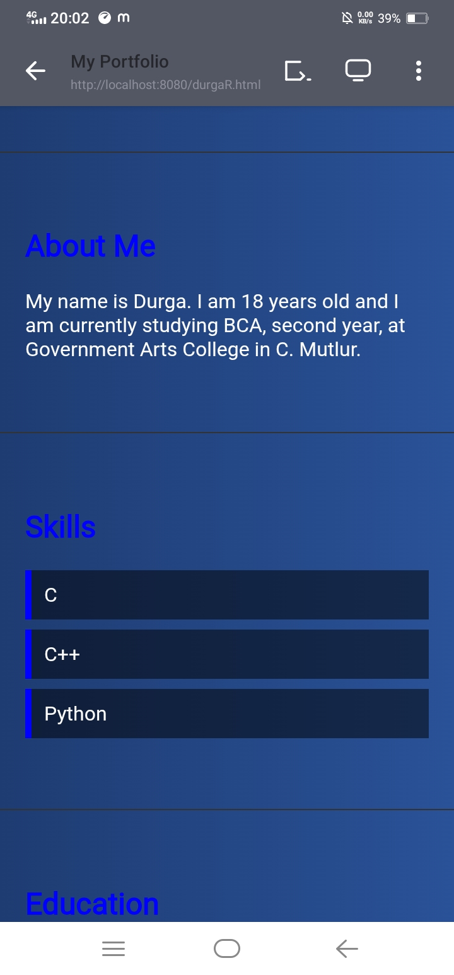
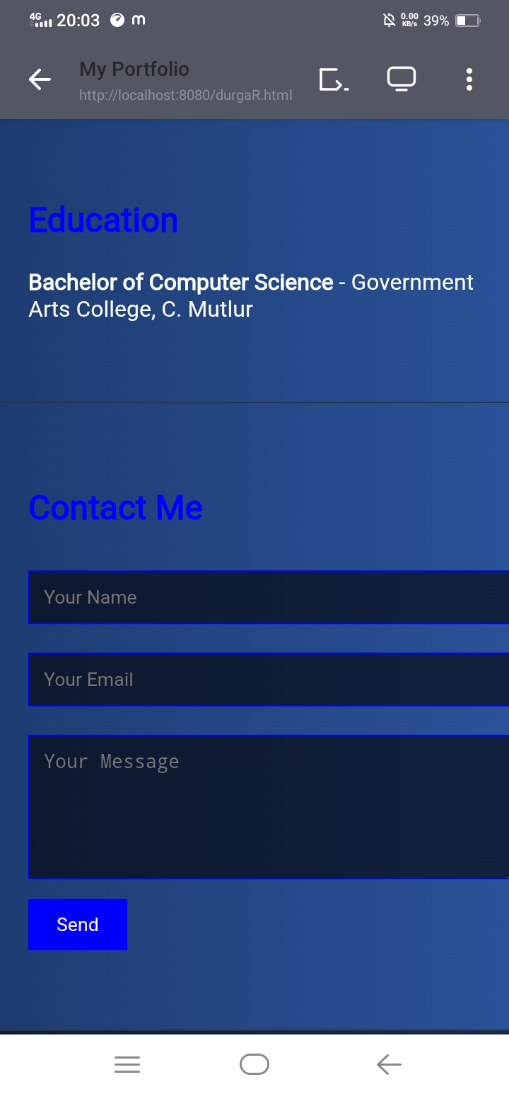
SCREENSHOTS

Slide 12
CONCLUSION
HTML:
The conclusion would emphasize HTML's foundational role in providing the structural backbone of the project. It outlines how HTML elements were used to organize and present content, creating the basic framework upon which the entire web application or page was built.
CSS:
The conclusion would then highlight CSS's contribution to the project's visual design and user experience. It explains how CSS was employed to style HTML elements, control layout, typography, colors, and overall aesthetics, ensuring a visually appealing and user-friendly interface. Responsiveness and adaptability to different screen sizes, if implemented, would also be mentioned here.
JavaScript:
Finally, the conclusion would focus on JavaScript's role in adding interactivity and dynamic functionality. It describes how JavaScript enabled features such as user input handling, data manipulation, dynamic content updates, animations, and other interactive elements that enhanced the user experience and brought the static HTML and CSS to life.
11

