Slide 1
CS106 Final Workshop
- Matt Zhou

Slide 2

FULL SCREEN IMAGE SLIDE
Overview
UFT
disambiguate
closure convert
knormalize
code generation
label elimination
V
Unambiguous
VScheme
FirstOrder Scheme
KNormalForm
AssemblyCode
ObjectCode
VScheme.def
ho
x
fo
kn
vs
vo
S-Expressions
Files
.scm files
.VS
.VO
loadfun
VMState
parse
SVM
unparse
Notes:
Credit nr

Slide 3
Highlights
Error Monad and Parsing Combinators
Garbage Collection
Stack Tracing

Slide 4
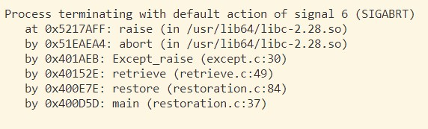
Stack Tracing
Goal:
When a run-time error occurs in the svm, produce a stack trace that gives the user the source code location of the error
Notes:
Mention that source code location means a line number, file name, function name

Slide 5
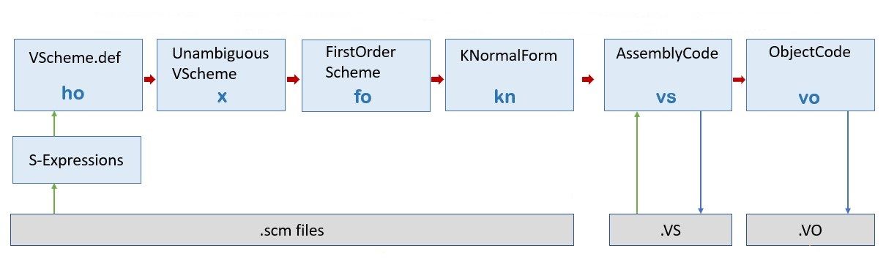
Stack Tracing
Hurdles (uft):
Source code location (file name & line number)
Get the filename
Get line number for call sites from the file
Propagate the locations through all the passes (ho-vo)
Function names
Keep the function name when translating to K-normal form
Propagate the name down the line to vo
Notes:
Why keep function names at knf? Because that’s when we lose the names of functions coming from cl

Slide 6
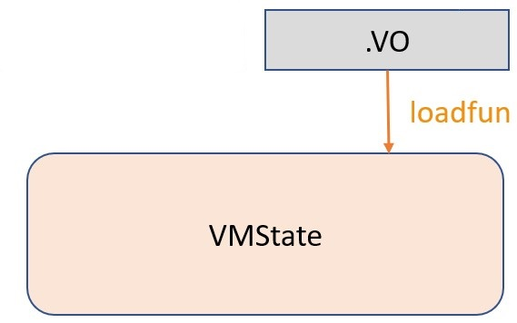
Stack Tracing
Hurdles (svm):
Load function names and source code locations from vo
Given a function, know its name and the source code location of its instructions
Retrieve location based on instruction

Slide 7
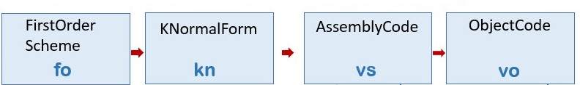
Stack Tracing
(define square (x) (* x x))
Background (uft - Function names):
structure ClosedScheme = struct
(*closed first-order scheme*)
datatype exp = ...
| CLOSURE of funcode * exp list
datatype def = ...
| DEFINE of name * funcode
structure KNormalForm = struct
datatype 'a exp
= ...
| FUNCODE of 'a list * 'a exp
(let ([r0 (lambda (r1) (* r1 r1))]) (set square r0))
structure AssemblyCode = struct
datatype instr
= ...
| LOADFUNC of O.reg * int * instr list
.loadfun r0 1
r0 := r1 * r1
return r0
el
%square := r0
Notes:
funcode = name list * exp
Int in asm is arity

Slide 8
Stack Tracing
Function Names
Change FUNCODE representation in knf
FUNCODE of 'a list * 'a exp
FUNCODE of name * 'a list * 'a exp
Change LOADFUNC representation in asm & obj
LOADFUNC of O.reg * int * instr list
LOADFUNC of O.reg * int * name * instr list
Now we preserve function names when translating
(C.DEFINE (name, funcode)) => K.FUNCODE (name, normalize funcode)
(C.CLOSURE (funcode, captured)) => K.FUNCODE ("(anonymous_fun)", …)
Notes:
Change funcode rep because that’s what ultimately generate a loadfun instruction, and that would be the optimal place to give functions their name

Slide 9
Stack Tracing
Function Names
(define square (x) (* x x))
KNormal form:
FUNCODE of 'a list * 'a exp
(let ([r0 (lambda (r1) (* r1 r1))]) (set square r0))
FUNCODE of name *'a list * 'a exp
(let ([r0 (lambda (r1) (* r1 r1))]) (set square r0))
Assembly:
LOADFUNC of O.reg * int * instr list
.loadfun r0 1
r0 := r1 * r1
return r0
el
%square := r0
LOADFUNC of O.reg * int * name * instr list
.loadfun r0 1 square
r0 := r1 * r1
return r0
el
%square := r0

Slide 10
Stack Tracing
Background (svm - Function names):
Function representation
struct VMFunction {
int arity; // number of args expected
int size; // number of instructions
int nregs; // …
Instruction instructions[];
};
.load module 1 (v number of instructions)
.load 0 function 1 2
(^ arity)
* 0 1 1
return 0
Add name field to function
struct VMFunction {
Name funname;
int arity; // number of args expected
int size; // number of instructions
int nregs; // …
Instruction instructions[];
};
.load module 1
.load 0 function square 1 2
* 0 1 1
return 0
Notes:
Tyoe Name -> Strings with constant-time equality test (pointer equality).

Slide 11
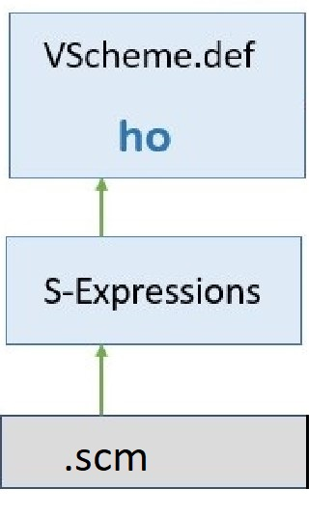
Stack Tracing
schemeOfFile
defs
Background (uft - Source code loc):
Lines + parse
val lines : TextIO.instream -> string list
structure VScheme = struct
type name = string
datatype exp
= LITERAL of value
| VAR of name
| SET of name * exp
| IFX of exp * exp * exp
| WHILEX of exp * exp
| BEGIN of exp list
| APPLY of exp * exp list
| LETX of let_kind * (name * exp) list * exp
| LAMBDA of lambda
val schemeOfFile : instream ->
VScheme.def list error
val parse : string list -> Sx.sx list Error.error
val defs : Sx.sx -> VScheme.def list Error.error
Language Specific Projection Functions

Slide 12
Stack Tracing
defs
Srcloc
New types for srcloc:
Lines + parse
type srcloc = string * int
(* file name * line number *)
type 'a located = 'a * srcloc
Extend parser with the new types:
val lines : TextIO.instream -> string list
val locatedLines : string -> TextIO.instream -> string located list
Accordingly:
val parse : string list -> Sx.sx list Error.error
val parse : string located list -> Sx.sx list Error.error

Slide 13
Stack Tracing
defs
Srcloc
val parse : string located list -> Sx.sx list Error.error
Lines + parse
datatype sx
= INT of int
| BOOL of bool
| SYM of string
| REAL of real
| LIST of sx list
type srcloc = string * int
type 'a located = 'a * srcloc
datatype sx
= INT of int
| BOOL of bool
| SYM of string
| REAL of real
| LIST of sx list
| MARK of sx located

Slide 14
Stack Tracing
defs
Srcloc
val defs : Sx.sx -> VScheme.def list Error.error
Lines + parse
structure VScheme = struct
type name = string
datatype exp
= LITERAL of value
| VAR of name
| SET of name * exp
| IFX of exp * exp * exp
| WHILEX of exp * exp
| BEGIN of exp list
| APPLY of exp * exp list
…
structure VScheme = struct
type name = string
datatype exp
= LITERAL of value
| VAR of name
| SET of name * exp
| IFX of exp * exp * exp
| WHILEX of exp * exp
| BEGIN of exp list
| APPLY of exp * exp list
| MAPPLY of srcloc * exp * exp list
…
Notes:
Note that we conditionally get the srcloc from marked forms, this way, we only get location for applys

Slide 15
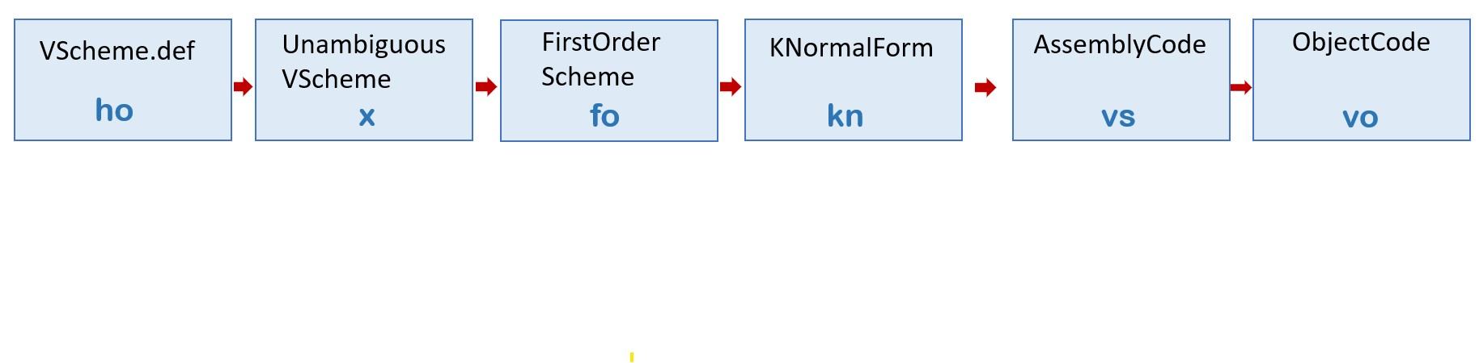
Stack Tracing
Ripple downstream
x & fo
datatype exp
= FUNCALL of exp * exp list
| MFUNCALL of srcloc * exp * exp list
| PRIMCALL of P.primitive * exp list
| MPRIMCALL of srcloc * P.primitive * exp list
…
kn
datatype ‘a exp
= MVMOP of srcloc * vmop * 'a list
| MVMOPL of srcloc * vmop * 'a list * literal
| MFUNCALL of srcloc * 'a * 'a list
…

Slide 16
Stack Tracing
Srcloc
vs & vo
datatype instr
= REGS of operator * reg list
| MREGS of srcloc * operator * reg list
| REGSLIT of operator * reg list * literal
| MREGSLIT of srcloc * operator * reg list * literal
…

Slide 17
Stack Tracing
Srcloc
.loadfun r0 1 square
r0 := r1 * r1 (sum_squares.scm - 2)
return r0
el
%square := r0
.loadfun r0 2 sum_squares
r3 := %square
r4 := r1
r3 := call r3 (r4, ..., r4) (sum_squares.scm - 5)
r4 := %square
r5 := r2
r4 := call r4 (r5, ..., r5) (sum_squares.scm - 6)
r0 := r3 + r4 (sum_squares.scm - 5)
return r0
el
%sum_squares := r0
r0 := %sum_squares
r1 := 10
r2 := 2
r0 := call r0 (r1, ..., r2) (sum_squares.scm - 8)
File: sum_squares.scm
1 (define square (x)
2 (* x x))
3 4 (define sum_squares (x y)
5 (+ (square x)
6 (square y)))
7 8 (sum_squares 10 2)
ho-vs

Slide 18
Stack Tracing
.loadfun r0 1 square
r0 := r1 * r1 (sum_squares.scm - 2)
return r0
el
%square := r0
.loadfun r0 2 sum_squares
r3 := %square
r4 := r1
r3 := call r3 (r4, ..., r4) (sum_squares.scm - 5)
r4 := %square
r5 := r2
r4 := call r4 (r5, ..., r5) (sum_squares.scm - 6)
r0 := r3 + r4 (sum_squares.scm - 5)
return r0
el
%sum_squares := r0
r0 := %sum_squares
r1 := 10
r2 := 2
r0 := call r0 (r1, ..., r2) (sum_squares.scm - 8)
.load module 8
.load 0 function square 1 2
.at sum_squares.scm 2 * 0 1 1
return 0
setglobal 0 string 6 ...
.load 0 function sum_squares 2 8
getglobal 3 string 6 ...
copy 4 1
.at sum_squares.scm 5 call 3 3 4
getglobal 4 string 6 ...
copy 5 2
.at sum_squares.scm 6 call 4 4 5
.at sum_squares.scm 5 + 0 3 4
return 0
setglobal 0 string ...
getglobal 0 string ...
loadliteral 1 10
loadliteral 2 2
.at sum_squares.scm 8 call 0 0 2
vs-vo
Notes:
Summarize the uft side a bit

Slide 19
Stack Tracing
Background (svm - srcloc):
Activation Record representation
Function representation
struct Activation {
// all relative to caller
...
struct VMFunction *fun;
int return_to;
}
struct VMFunction {
...
int size; // number of instructions
...
Instruction instructions[];
};
Stack representation
Error generation
struct VMState {
struct VMFunction* curr_prog;
...
int num_activations;
struct Activation stack[STACK_SIZE];
};
void typeerror(VMState state,
const char *expected, Value got, ...);
void runerror(VMState state,
const char *format, ...);
Notes:
Explain that since the error functions only take in the vmstate, and by extension, the stack, we want most information to be self-contained in the stack. That is, we should be able to find anything that we might need during stack trace on the stack. Most changed in code are geared to achieve this
Talk about how the stack work with the activation records, how the current function is not on the top of the stack

Slide 20
Stack Tracing
Srcloc
Store code location inside the function
typedef uint32_t Instruction;
.at sum_squares.scm 5 call 3 3 4
struct VMFunction {
...
int size;
Instruction instructions[];
};
Index | Line#
Instruction instructions[]:
call 3
srcloc
 |  |  | …. …. | Halt |  |  | ….
size + 1

Slide 21
Stack Tracing
Srcloc
Change in function representation
struct VMFunction {
GCMETA(VMFunction)
Name funname;
int arity; // number of args expected
int num_insturctions; // number of instructions in the function
int nregs; // one more than the number of highest register read or written
Instruction instructions[];
};

Slide 22
Stack Tracing
Background (svm - srcloc):
Activation Record representation
struct Activation {
// all relative to caller
...
struct VMFunction *fun;
int return_to;
}
Stack representation
struct VMState {
struct VMFunction* curr_prog;
...
int num_activations;
struct Activation stack[STACK_SIZE];
};

Slide 23
Stack Tracing
Srcloc
Changes in Activation record
struct Activation {
// all relative to caller
...
struct VMFunction *fun;
int return_to;
}
struct Activation {
/*caller*/
...
int return_to;
/*callee*/
struct VMFunction *fun;
/*tailcall identifier*/
uint8_t tailcall_info;
};
Changes on the Stack
struct VMState {
...
int num_activations;
struct Activation stack[STACK_SIZE];
};
struct VMFunction* curr_prog;

Slide 24
Stack Tracing
Fun1
struct Activation {
/*caller*/
…
int return_to;
/*callee*/
VMFunction *fun2;
…
};
Fun2
Srcloc
Call site?
Fun1
Getting the call sites
Allows us to index into the Instructions array to retrieve the location
Fun1
Fun2
= pc + 1
We need the current PC!
struct VMFunction {
Name funname;
int arity;
int num_insturctions;
int nregs;
Instruction instructions[];
};
struct Activation {
…
/*callee*/
VMFunction *fun1;
…
};

Slide 25
Stack Tracing
if (num_args != arity) {
runerror(vm, pc, "fun %s expected %d args, but got %d args",
nametostr(newfun->funname), arity, num_args);
}
Srcloc
Getting the call sites
Allows us to index into the Instructions array to retrieve the location
Error generation
void typeerror(VMState state,
const char *expected, Value got, ...);
void runerror(VMState state,
const char *format, ...);
void typeerror(VMState state, int pc,
const char *expected, Value got, ...);
void runerror(VMState state, int pc,
const char *format, ...);

Slide 26
Stack Tracing
Demos
File: unzip_ho.error
1 (define list1 (x) (cons x '()))
2 (define list2 (x y) (cons x (list1 y)))
3 (define cadr (xs)
4 (car
5 (cdr xs)))
6 (define map (f xs)
7 (if (null? xs)
8 ‘()
9 (cons (f (car xs))
10 (map f (cdr xs)))))
11 12 (define unzip (ps)
13 (if (null? ps)
14 '(() ())
15 (list2 (map car ps)
16 (map cadr ps))))
17 18 19 (check-expect (unzip '((I Magnin) (U ) (E Coli)))
20 '((I U E) (Magnin Thant Coli)))

Slide 27
Stack Tracing
Demos
File: tailcall_ho.error
1 (define child3 (x)
2 (car x))
3 4 (define child2 (x)
5 (child3 x))
6 7 (define child1 (x)
8 (child2 x))
9 10 (define mother (x)
11 (child1 x))
12 13 (mother 5)
struct Activation {
/*caller*/
int dest;
Value* window_start;
int return_to;
/*callee*/
struct VMFunction *fun;
/*tailcall identifier*/
uint8_t tailcall_info;
};

Slide 28
Stack Tracing
Reflections
What can I lean on when writing code
uft (sml) => Types
svm (c) => Invariants
Notes:
Adding features to an existing system, what serves as the guide when modifying, the difference between svm and uft

Slide 29
Stack Tracing
Reflections
Types
Types I have
Types I want
Rest should fall in naturally

Slide 30
Stack Tracing
Reflections
defs
schemeOfFile
Types
Lines + parse
val parse : string list -> Sx.sx list Error.error
val parse : string located list -> Sx.sx list Error.error

Slide 31
Stack Tracing
Reflections
schemeOfFile
defs
Types
Lines + parse
val parse : string list -> Sx.sx list Error.error =
emap L.tokenize_line >> ! List.concat >=> ...
token list list error
val concat = 'a list list -> 'a list
val tokenize_line : string -> token list Error.error
fun emap f = map f >> Error.list where
val Error.list : 'a error list -> 'a list error
Notes:
After emap tokenize line, get (* token list list error *)
After List.concat, get (* token list error *)

Slide 32
Stack Tracing
Reflections
schemeOfFile
defs
Types
Lines + parse
val parse : string located list -> Sx.sx list Error.error =
emap L.tokenize_line >> ! List.concat >=> ...
token located list list error
val tokenize_line : string -> token list Error.error

Slide 33
Stack Tracing
Reflections
schemeOfFile
defs
Types
Lines + parse
val parse : string located list -> Sx.sx list Error.error =
emap L.tokenize_line >> ! List.concat >=> ...
token located list list error
val _ : string located -> L.token located list Error.error

Slide 34

Stack Tracing
Reflections
schemeOfFile
defs
Types
Lines + parse
val parse : string located list -> Sx.sx list Error.error =
emap L.tokenize_line >> ! List.concat >=> ...
token located list list error
val _ : string located -> L.token located list Error.error
fun tokWithLoc (line, loc) =
let fun mktlpair tks = succeed (map (fn t => (t, loc)) tks)
in
L.tokenize_line line >>= mktlpair
end

Slide 35
Stack Tracing
Reflections
Invariants
Am I changing any invariant?
Am I obeying all relevant invariants?

Slide 36
Stack Tracing
Reflections
Changes in Activation record
struct Activation {
// all relative to caller
int dest;
Value* reg_window;
struct VMFunction *fun;
int return_to;
}
struct Activation {
/*caller*/
int dest;
Value* window_start;
int return_to;
/*callee*/
struct VMFunction *fun;
/*tailcall identifier*/
uint8_t tailcall_info;
};
Changes on the Stack
struct VMState {
...
int num_activations;
struct Activation stack[STACK_SIZE];
};
struct VMFunction* curr_prog;
INVARIANT: current function is always
at the "top" of the stack

Slide 37
Stack Tracing
void vmrun(VMState vm, struct VMFunction *fun) {
. . .
struct VMFunction *curr_fun = fun;
// INVARIANT: current function is always at the "top" of the stack
struct Activation new_Act = {-1, reg0, pc+1, curr_fun, 0};
vm->stack[vm->num_activations++] = new_Act;
. . .
case Call:{
...
struct VMFunction* newfun = …; // push the new function on stack, maintain
invaraint since we're running it
struct Activation new_Act = {…, newfun, …};
vm->stack[vm->num_activations++] = new_Act;
...
}
. . .
}
Reflections

Slide 38
Stack Tracing
Reflections
case Call:{
...
struct VMFunction* newfun = …; // push the new function on stack, maintain
invaraint since we're running it
struct Activation new_Act = {…, newfun, …};
vm->stack[vm->num_activations++] = new_Act;
...
}
case Tailcall:{
struct VMFunction* newfun = ...;
...
/* updating fun while we go, maintain invariant */
struct Activation top_act =
vm->stack[(vm->num_activations -1)];
top_act.fun = newfun;
...
vm->stack[(vm->num_activations - 1)] = top_act;
}
}

Slide 39
Stack Tracing
Reflections
Invariants
Am I changing invariants?
Am I obeying all relevant invariants?
Safely make changes without introducing bugs

Slide 40
Thank you!

