Slide 1
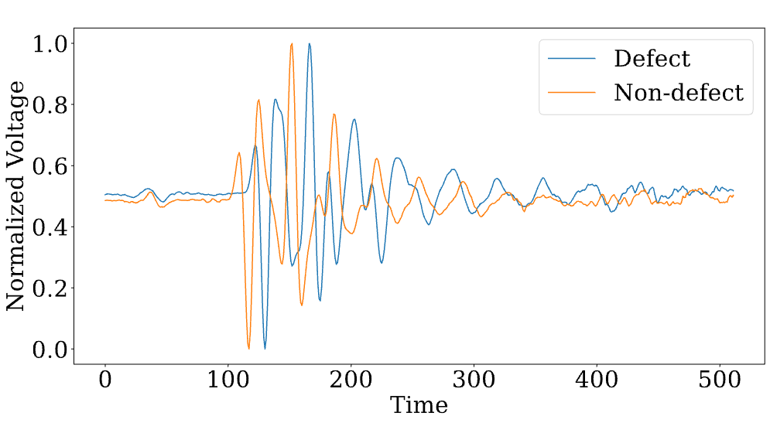
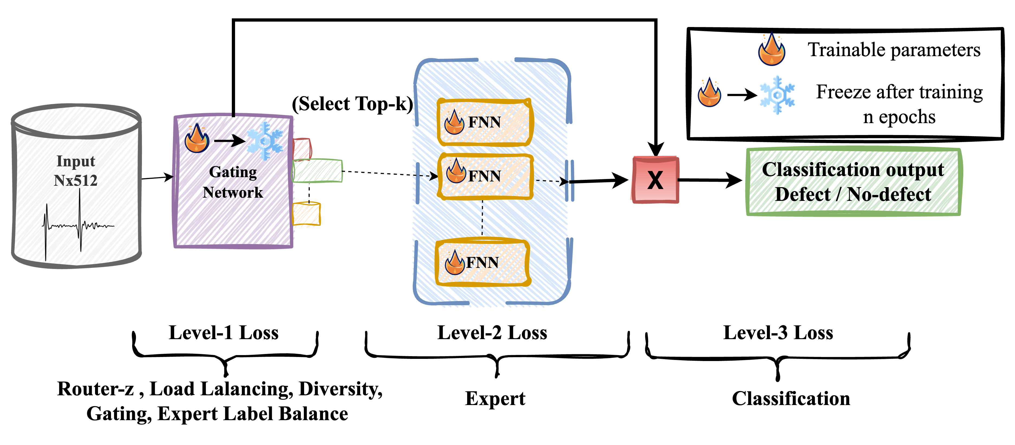
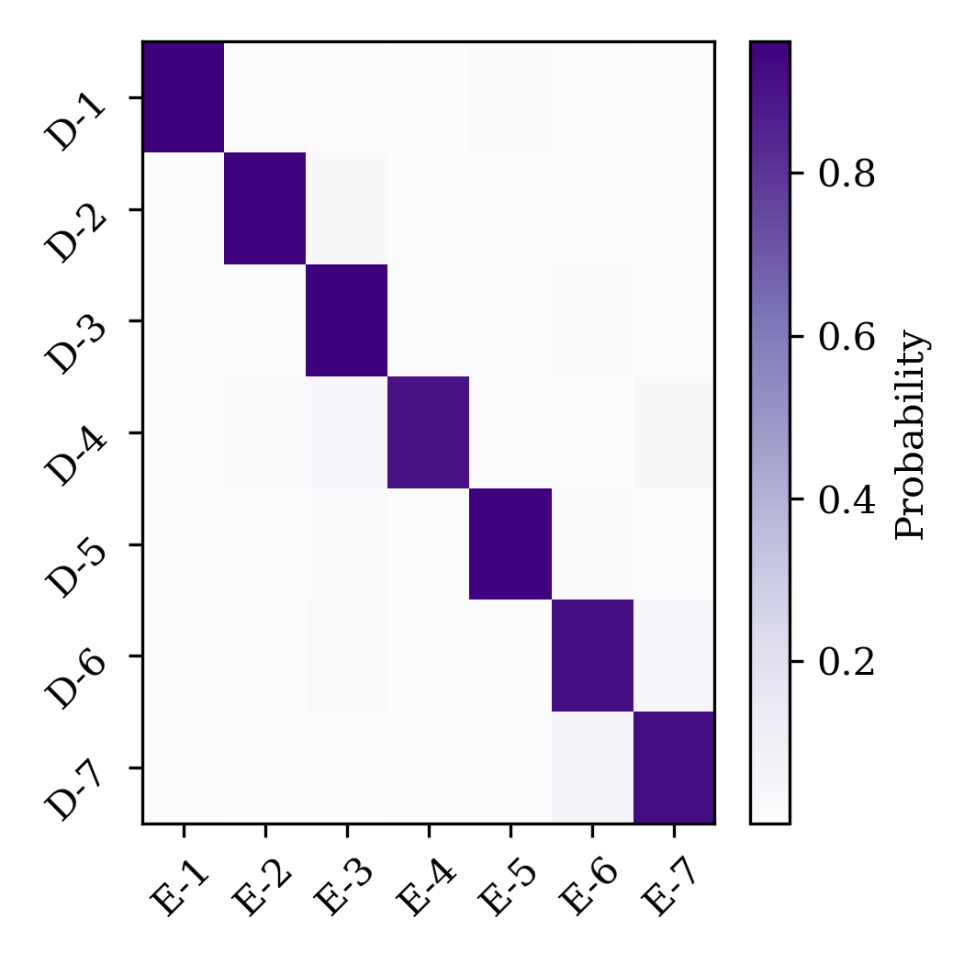
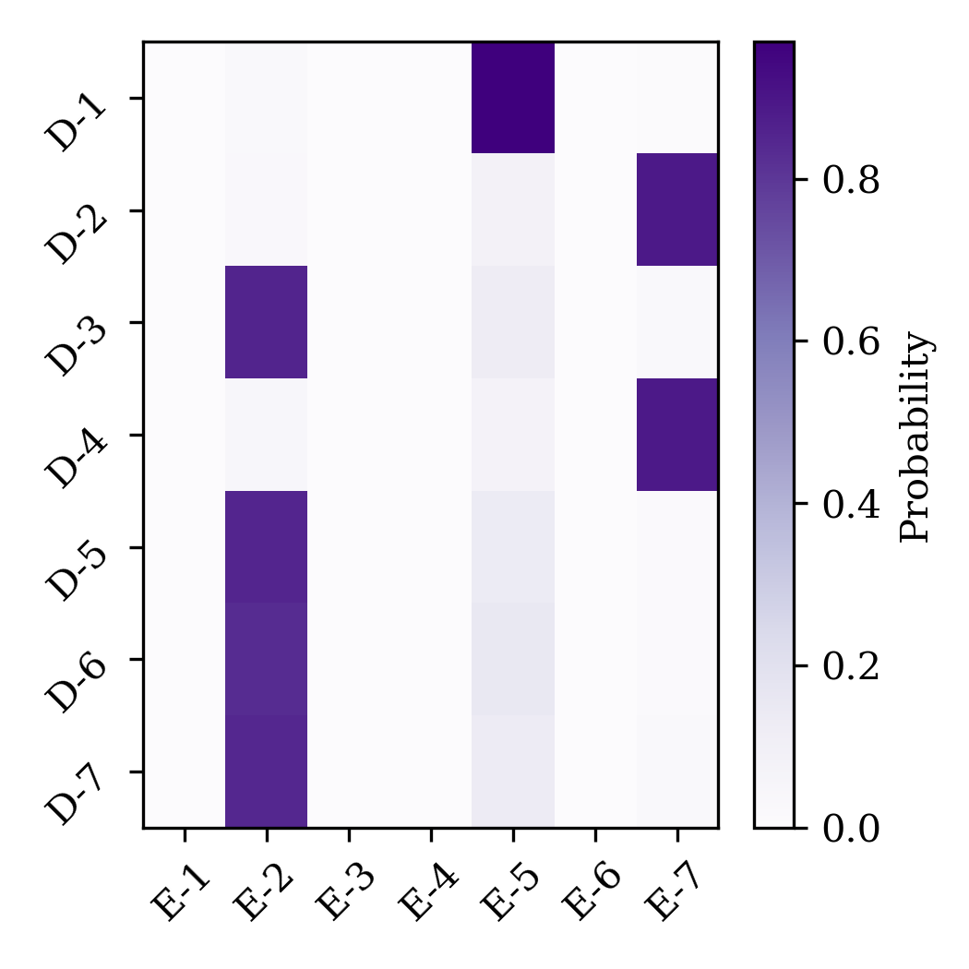
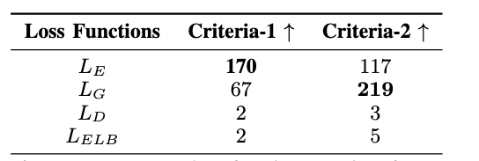
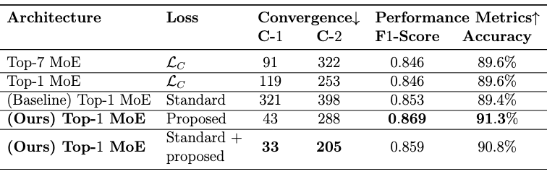

Mixture-of-Experts for Multi-Domain Defect
Identification in Non-Destructive Inspection
Venkata Devesh Reddy Seethi¹, Ashiqur Rahman¹, Austin Yunker², Rami Lake¹, Zachary Kral³, Rajkumar Kettimuthu², Hamed Alhoori¹ Northern Illinois University¹, Argonne National Laboratory², Spirit AeroSystems³
Data
Methodology
Proposed Training Objectives:
Proposed Training Objectives:
Research Goal
Expert Loss (L_{E}):
Defect classification loss at each expert
Gating Loss (L_{G}):
Domain classification
loss at the gating network
Diversity Loss (L_{D}):
Encourage high variance
in gating logits
How to enable domain-aware gating and explore its role in improving the efficiency of mixture-of-expert (MoE) models
Standard Training Objectives:
Classification Loss (L_{C}):
Binary defect classification loss
Router-z Loss (L_{RZ}):
Penalize large logits or experts
Expert Label Balance Loss (L_{ELB}):
Ensure each expert receives equal defect and non-defect classes
Load Balancing Loss (L_{LB}):
Ensure each expert receives a balanced number of samples
Screenshot 2024-12-10 at 00.02.54
Ablations
Criteria-1: We remove one loss function at a time from proposed + standard losses and compute an increase in epochs towards convergence to checkpoint-1
Criteria-2: We add one loss function at a time from top-1 MoE to the standard loss functions and compute drop in epochs for convergence to checkpoint-1
Interpretation: More (↑) the better for both criteria-1 and 2
Results
Standard losses: L_{C} + L_{LB} + L_{RZ} , Proposed losses: L_{G} + L_{E} + L_{D} + L_{ELB}
Interpretation: Lesser (↓) is better for convergence, and more (↑) is better for performance metrics
Checkpoint-1 (C-1): Epoch where validation F1-Score is 0.85 (early stopping)
Checkpoint-2 (C-2): Epoch where validation F1-Score is maximum in 400 epochs
Acknowledgements
Code
This work was supported in part by the U.S. Department of Energy, Office of Science, under contract DE-AC02-06CH11357.

