Slide 1
Soccer Game Outcome Modelling
Rıdvan Sözen
İsa Tayyip Alan
Mehmet Mücahit Sayar
Yavuz Selim Uçar

Slide 2
Source of Data
European Soccer Database
https://www.kaggle.com/hugomathien/soccer
https://www.football-data.co.uk/data.php
Scores, Lineups, Team Formation and Events Data
http://football-data.mx-api.enetscores.com/
Players and Teams Attributes from EA Sports FIFA Games
http://sofifa.com/

Slide 3
Features
home_or_away : Which team is home team
home_player_overall(1-11) : Home players’ overall ratings
home_player_defenders : How many defence player does home team have
home_player_forwards : How many forward player does home team have
Last_5_match_win_home : How many wins does home team have in its last 5 matches
Last_5_match_goal_diff_home : Goal difference that home team has in its last 5 matches
Last_5_match_card_home : Home team’s card score in its last 5 matches
Last_5_match_faul_home : How many fauls does home team commit in its last 5 matches
Last_5_match_corner_home : How many corners does home team have in its last 5 matches
Last_5_match_shout_total_home : How many shouts does home team have in its last 5 matches
Last_5_match_shout_rate_home : Shout accuracy of home team in its last 5 matches
Last_5_match_shout_on_home : How many accurate shout does home team have in its last 5 matches
Team_variance_home : Variance of home team’s players
Last_5_match_btw_home : How many wins does home team have against away team

Slide 4
Features
away_player_overall(1-11) : Away players’ overall ratings
away_player_forwards : How many forward player does away team have
away_player_defenders : How many defence player does away team have
Last_5_match_win_away : How many wins does away team have in its last 5 matches
Last_5_match_goal_diff_away : Goal difference that away team has in its last 5 matches
Last_5_match_card_away : Away team’s card score in its last 5 matches
Last_5_match_faul_away : How many fauls does away team commit in its last 5 matches
Last_5_match_corner_away : How many corners does away team have in its last 5 matches
Last_5_match_shout_total_away : How many shouts does away team have in its last 5 matches
Last_5_match_shout_rate_away : Shout accuracy of away team in its last 5 matches
Last_5_match_shout_on_away : How many accurate shout does away team have in its last 5 matches
Team_variance_away : Variance of away team’s players
Last_5_match_btw_away : How many wins does away team have against away team

Slide 5
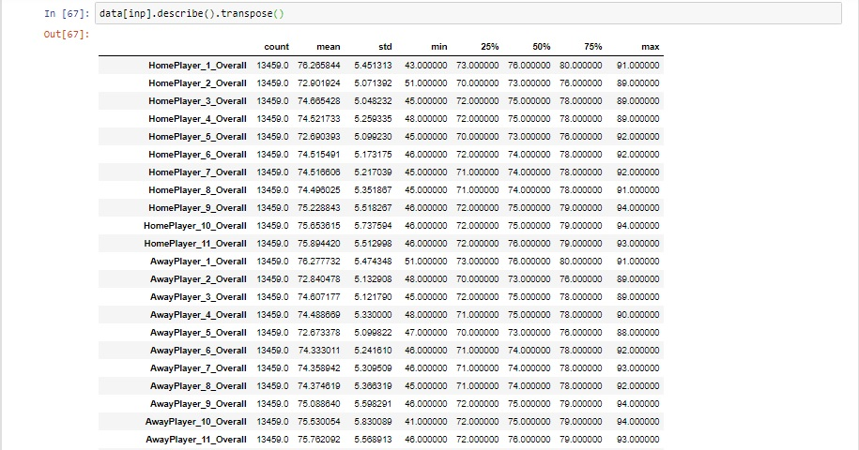
Statistical Exploration of Features

Slide 6
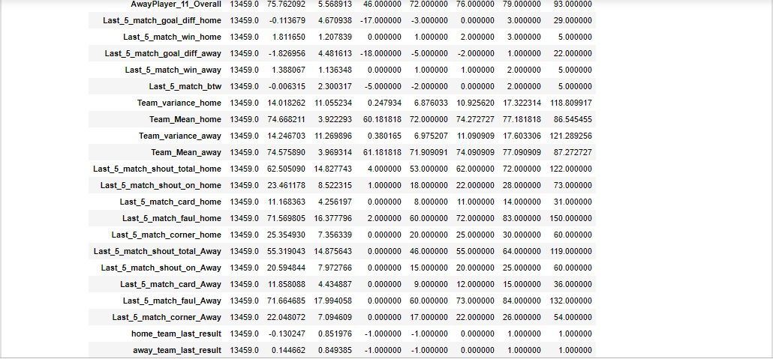
data.describe cont’

Slide 7
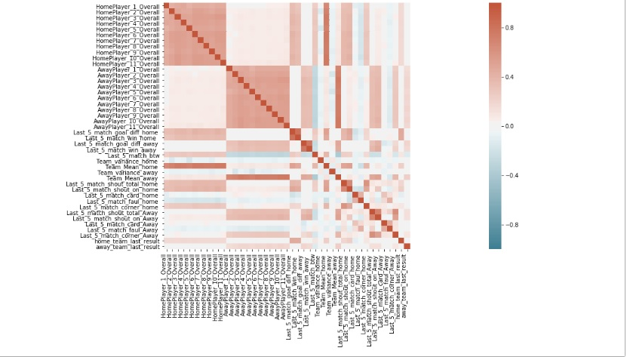
correlations w/ heatmap

Slide 8
ML Methods
XGBoost
We use ensemble approach which consist of superwised learning meta algorithms for predicting output target feature by aggregating individual learning algorithms to lower their variance error source or by boosting sequantially built once to simultaneously lower their squared biased error and variance error sources.

Slide 9
ML Methods
Artificial Neural Network
We use multi-layer perceptron method which consists of superwised network based on learning algorithms for predicting output target feature by dynamically processing output target and imput predictors data through multi-layer network of optimally weighted connections of nodes.

Slide 10
ML Methods
Support Vector Machine
It consists of superwised boundary based learning algorithm for predicting output target feature by seperating output target and input predictor features data into optimal hiperplanes.

