Slide 1

Tic Tech Toe’26
Team Name : Prognosis
Problem Statement Number : PS 3
Domain: E – Commerce and Machine Learning
Team Lead : Prachi Parmar

Slide 2
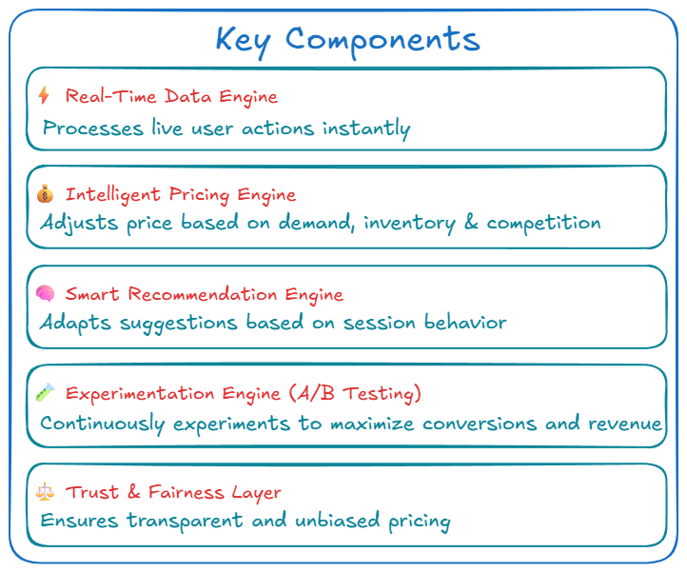
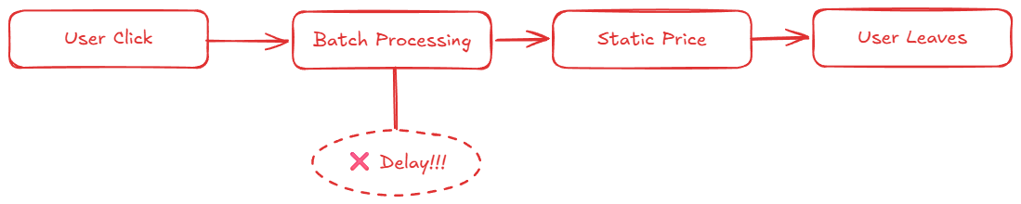

Description of Idea
Problem (Traditional Systems)
Pricing updates are delayed, missing real-time demand shifts
Recommendations remain static and ignore user’s current intent
Businesses lose conversions due to slow, outdated decisions
Our Solution (FLOWPRICE AI)
Capture user behavior instantly using real-time event processing
Dynamically adjust pricing based on demand, inventory, and competition
Deliver session-aware recommendations that adapt within seconds
One live loop
User Behaviour → AI Decisions → Pricing → Recommendations → Conversion
“The system learns and adapts instantly within the same user session.”
Real-time. Adaptive. Revenue-driven.

Slide 3
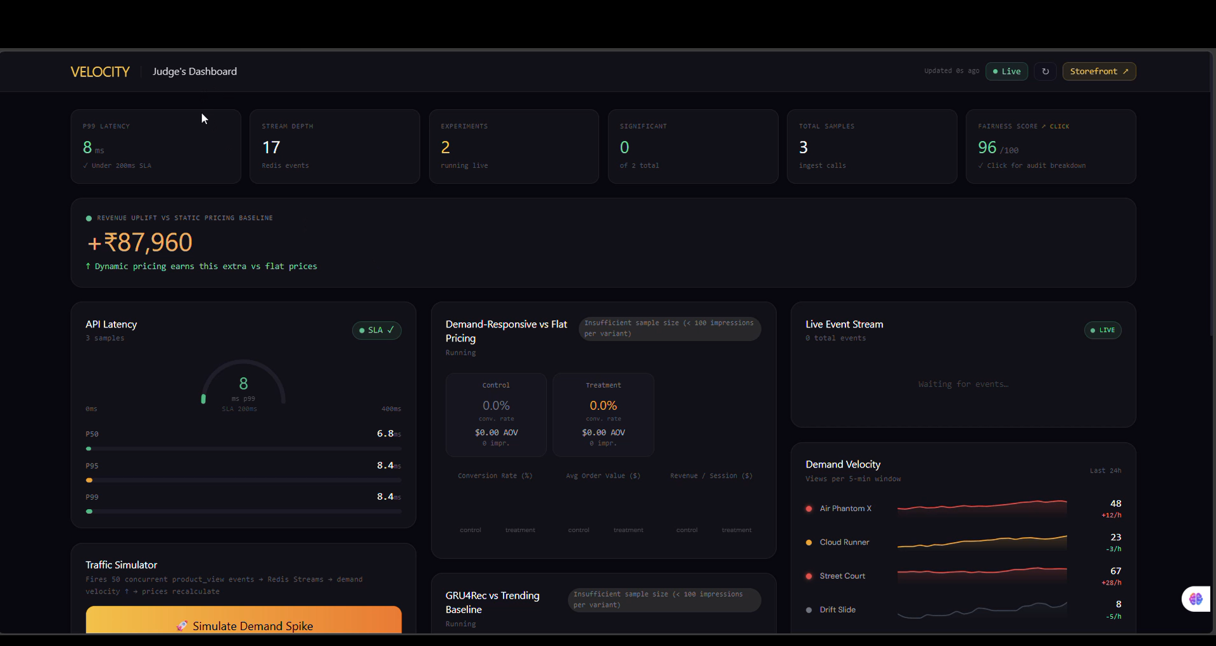
Objective & Prototype
End-to-end real-time pipeline
1
Event Ingest
2
Feature Store
3
Pricing Engine
4
Rec. Engine
5
API / Frontend
page views • search • cart(Redis+Docker)
→
session score • intent • affinity(Redis, low memory)
→
demand velocity • inventory • margin
→
GRU4Rec + collaborative filtering
→
sub-second response
(< 200ms Response)
Real-Time Feature Engineering
Live System Dashboard (Prototype)
“Real-time dashboard showing pricing, recommendations, and system performance.”
User Intent → purchase probability
Sub-10ms latency (real-time system)
Session Score → engagement level
+₹87K revenue uplift vs static pricing
Live A/B testing for pricing strategies
Category Affinity → preference signal
Demand Velocity → product popularity
System Behaviour
Real-time event streaming (no batch delays)
Session signals drive pricing & ranking updates
In-memory features ensure low-latency response
Explainable decisions for user trust
Real-Time
<200ms Latency
Explainable AI

Slide 4
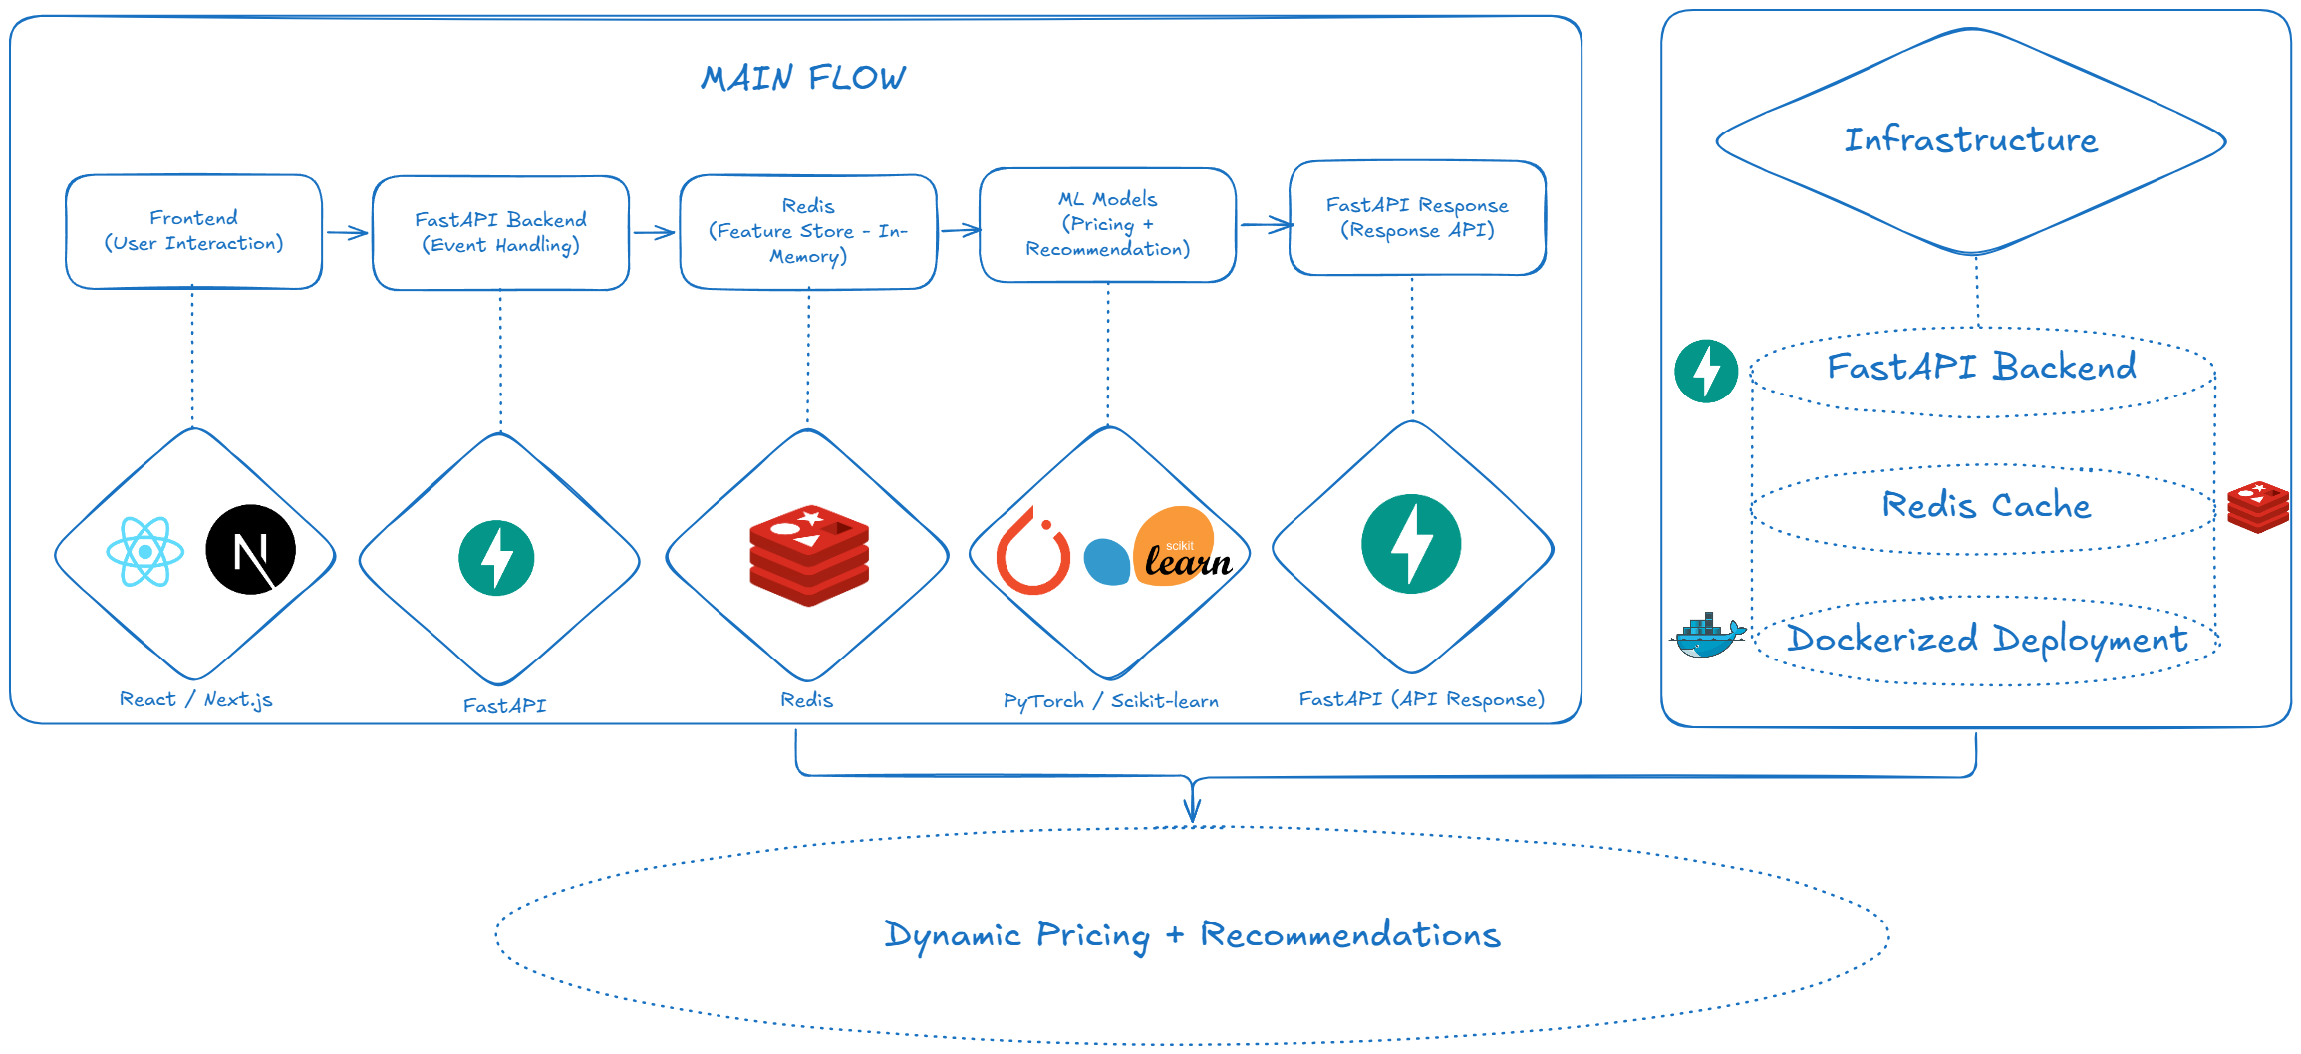
Feasibility & Flow
Why This System Is Production-Ready
1
Data readiness
2
Open-source stack
3
Control rules
• Synthetic clickstream: 10M+ events
• Product catalog: 5,000+ SKUs, 50 categories
• Competitor price feeds + user segments
• Redis Streams for streaming
• FastAPI for serving
• PyTorch + scikit-learn for ML
• Minimum margin protection
• Maximum discount cap
• Price parity + fairness checks
Latency plan
Cache the latest features in Redis, keep model inference lightweight, and return only the final price + top recommendations in the request path.
fast cache read
rank model
final response
p99 < 200ms
business safe
explainable

Slide 5
Uniqueness
Why Flow Price AI Wins
Evaluation map
Traditional Systems
Flow Price AI (Ours)
Hit rate
Recommendation quality
Pricing style
Static, batch based
Real-time, demand aware
NDCG
Rank relevance
Recommendation
Homepage popularity only
Session aware + hybrid
Revenue uplift
Pricing success
Decision speed
Minutes / hours
Sub-second
p99 < 200ms
Speed target
Governance
Limited visibility
Fairness + explanation + A/B tests
Fairness audit
Bias control
The system wins only when it is fast, measurable, and fair.

Slide 6
Team Member Details
Build focus
Real-time ML system + backend architecture + interactive demo
Member Name​ | Role​ | Degree​ | Semester​
Prachi Parmar​ | Team leader​ | B. E.​ | 4​
Preksha Sanghadia​ | Frontend developer​ | B. E.​ | 4​
Dipak Raval​ | ML + Backend Engineer | B. E.​ | 8​
Manan Shah​ | Data Engineer​ | B. E.​ | 8​
Divy Jani​ | Backend Engineer​ | B. E.​ | 8​
What we will demo
Closing message
• A live event stream updates user intent in the session.
• The price engine reacts to demand and inventory changes.
• The recommendation engine reorders products instantly.
• A/B testing compares strategies, while fairness checks stay on.
A real-time, intelligent system transforming user behavior into business decisions.
Real-time
Personalized
Fair

