Slide 1
AAIoT
Advanced Medical
Connectivity for every AAI in
Rural India.
C-DAC ACTs

Slide 2
Contents
Introduction
Architecture
Software
Hardware
Flow of System
Future Scope
Conclusion
C-DAC ACTs

Slide 3

Introduction
In this country of roughly 1 billion people, where women have, on average, about three children, some 440 women die of maternity-related complications for every 100,000 live births.
The Internet of Things (IoT) enabled connectivity has the potential to catapult this ailing healthcare system into an integrated, efficient and patient-centric system.

Slide 4
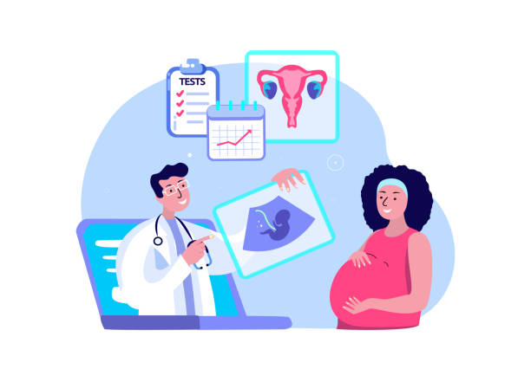
Introduction
Remote Pregnancy Health Monitoring System to diagnose and monitor the health condition and status of a pregnant women.
Giving care and health assistance at critical stages with advanced medical facilities and connectivity in rural areas.
Sensor-equipped IoT devices are used to collect real-time data. Deployment of medical resources and staff at different locations can also be analyzed real time.

Slide 5
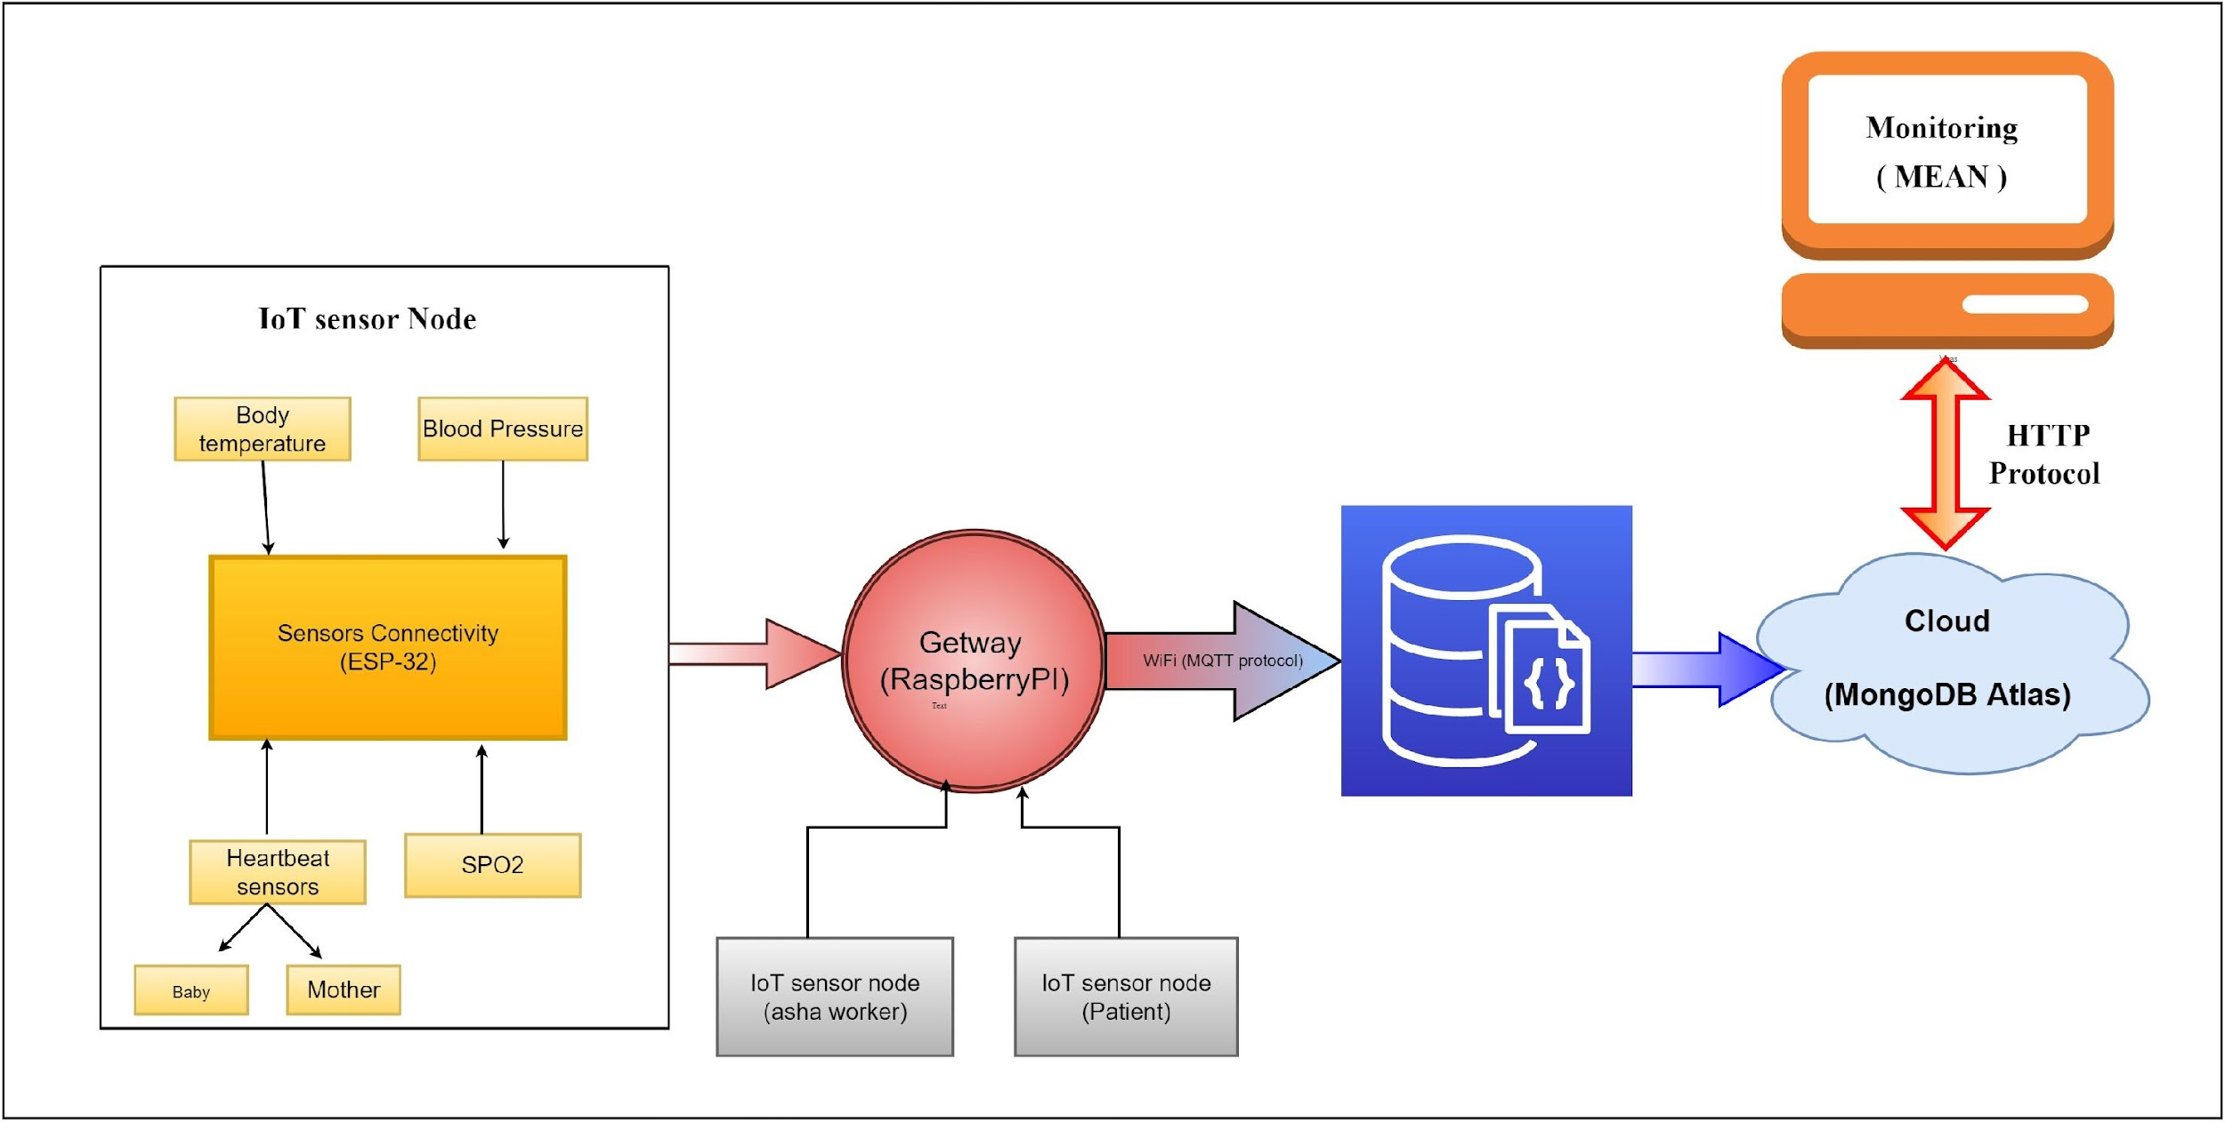
Architecture
C-DAC ACTS

Slide 6


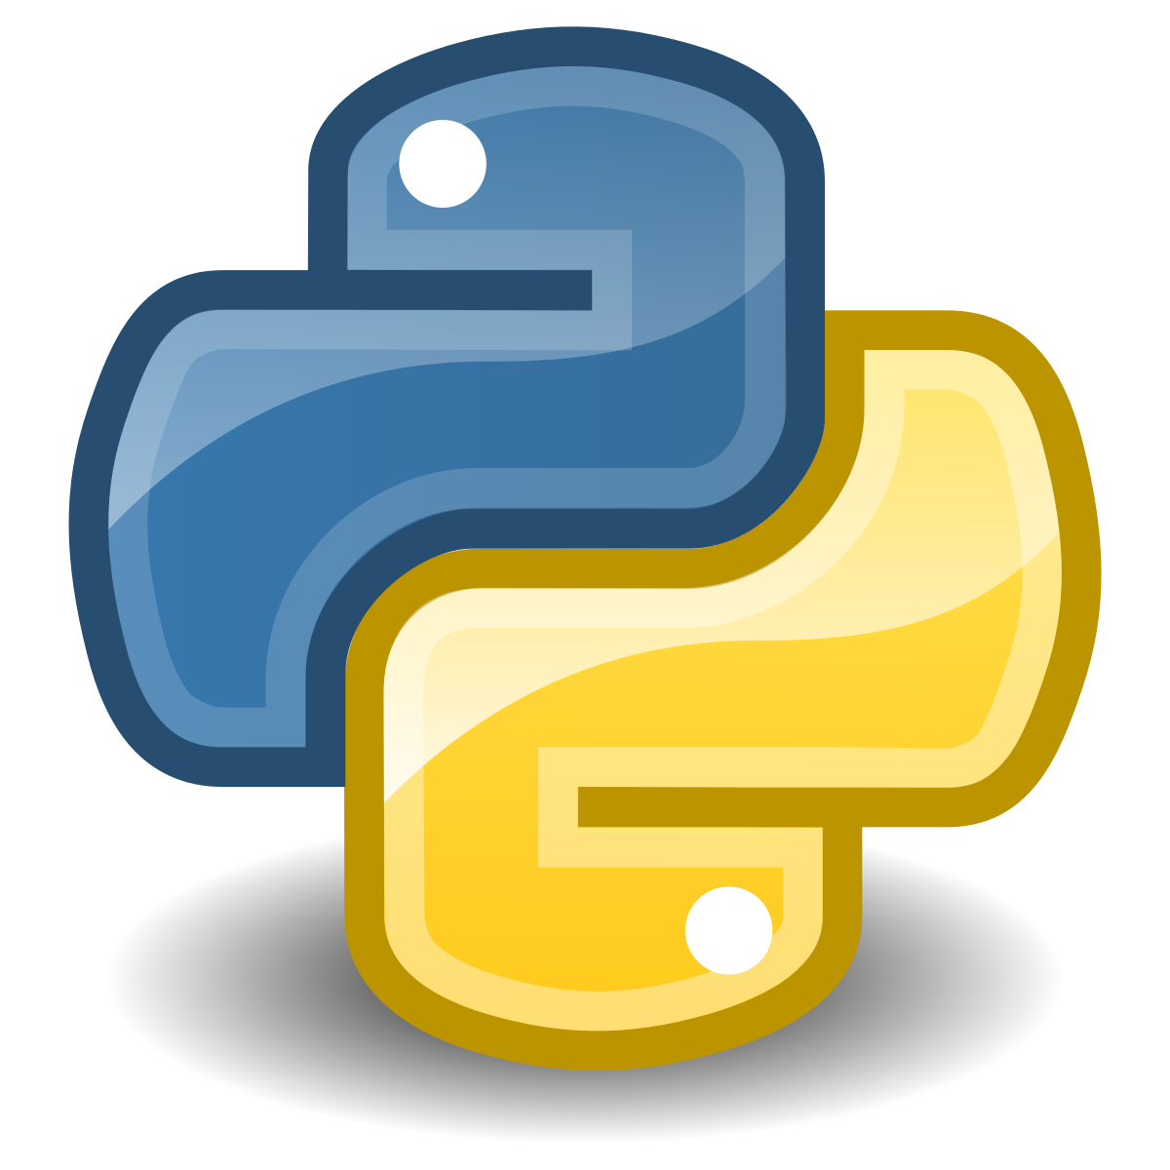

Software
Angular
Nodejs
Python
MongoDB
C-DAC ACTs
Single Page Application
Back End Connectivity
Sensor Connectivity
Database

Slide 7
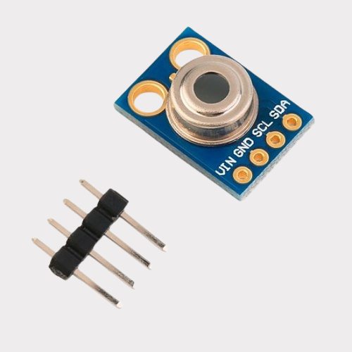
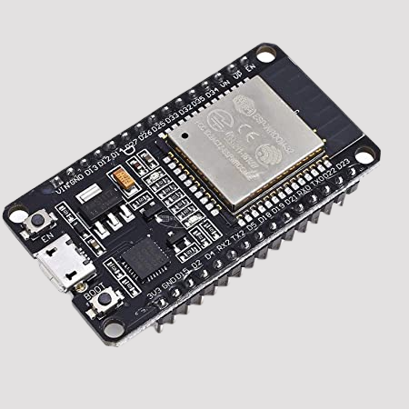
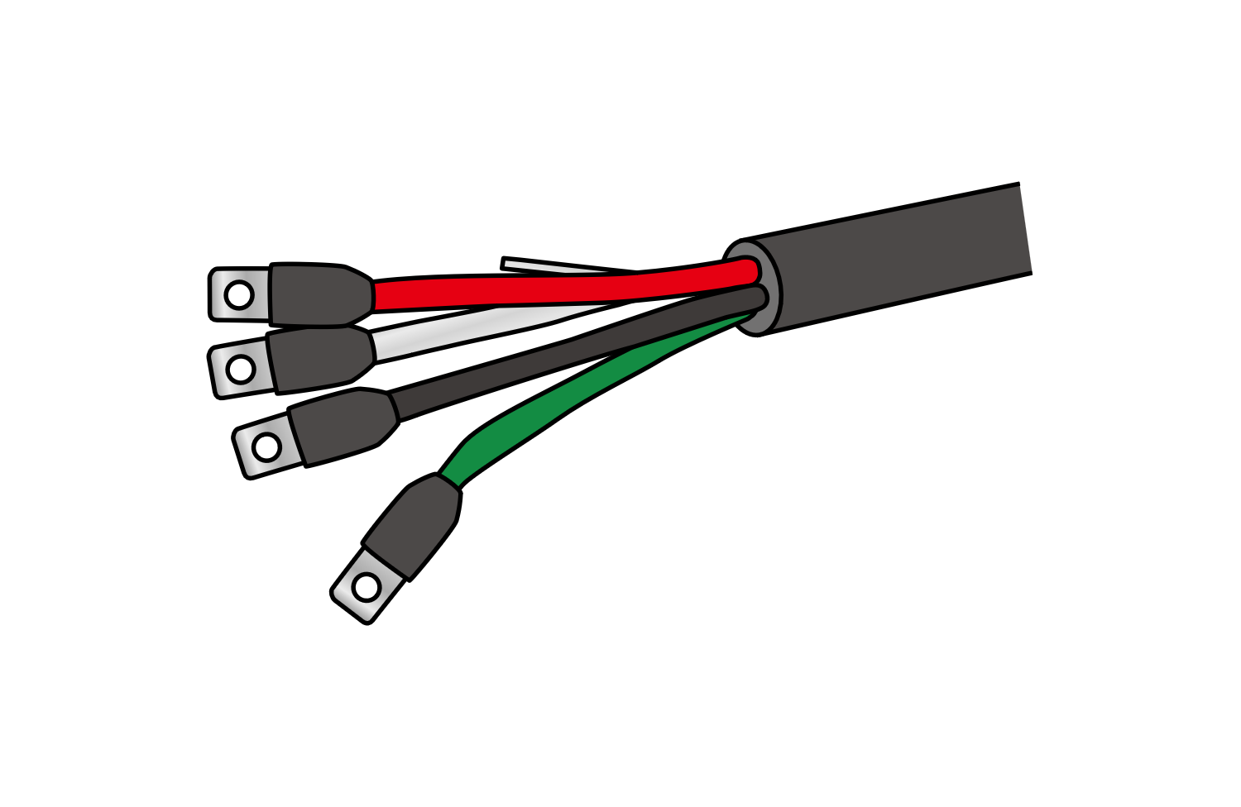
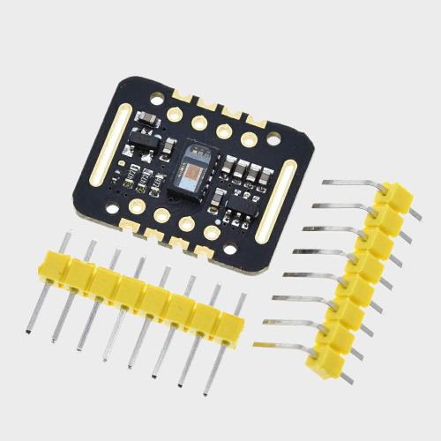
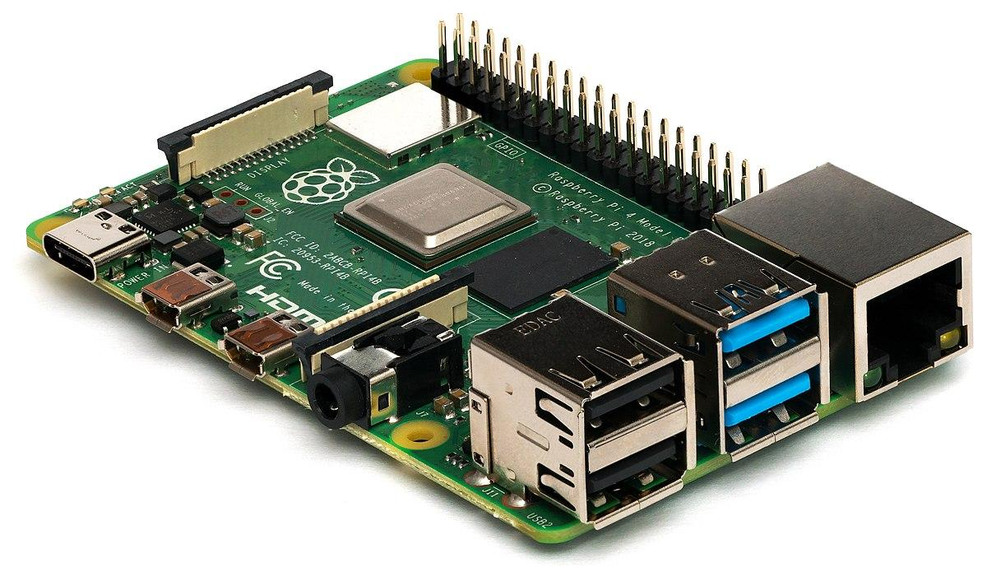
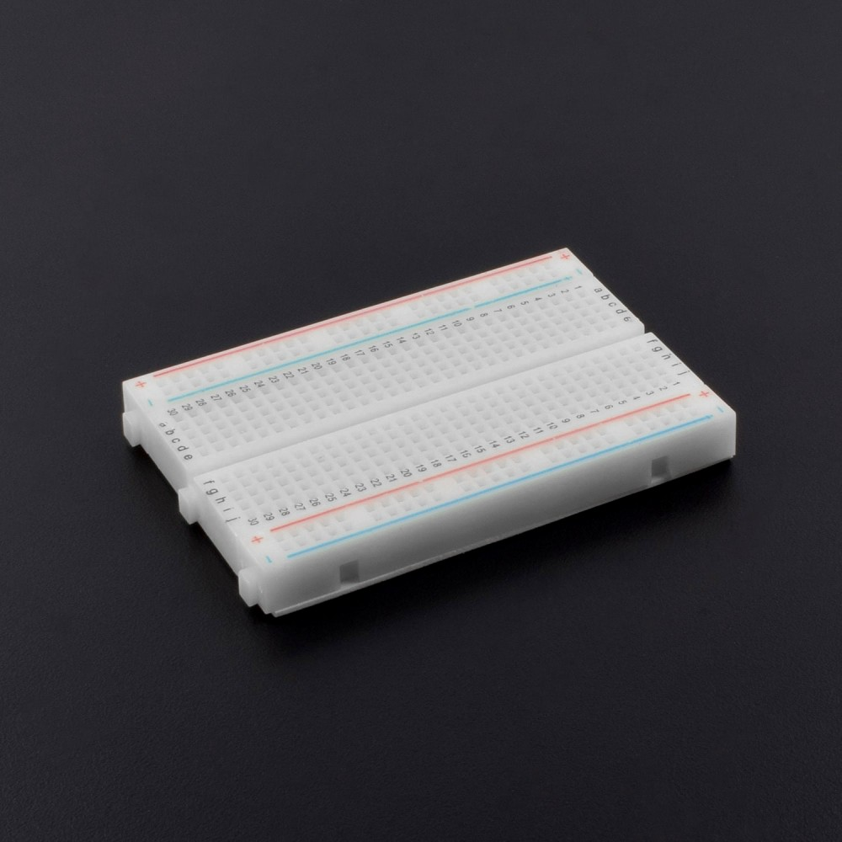
Hardware
Sensors:
C-DAC ACTs
MLX90614
MAX30102
Others:
ESP32
Raspberry
Pi
Breadboard

Slide 8
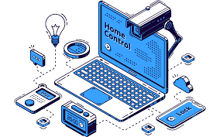

Hardware Flow
Publisher: Sensors
Publisher who generate and send data to the MQTT broker.
Subscriber: Database
(Mongo DB)
Subscriber is a component which subscribes to a certain kind of messages coming from publishers.
Broker: Mosquitto
Broker which is like a server to collect the messages from all publishers, save the data and distribute the data messages to the right subscribers.
C-DAC ACTs

Slide 9
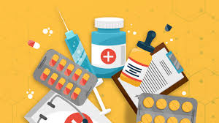
Future Scope
More than half of pregnant women in rural India are deprived of quality healthcare.
Stating that there is an urgent need for radical expansion of quality health care close to home.
Digital shift drives progress in rural maternal health. There is a lot of potential in using IoT to improve maternal and child health outcomes.
The need for IoT in healthcare is huge and it can help the industry immensely. It can reach every patient from all over the world and connect doctors with patients. There is no denying that IoT has already made a huge impact and is only set to grow further.

Slide 10
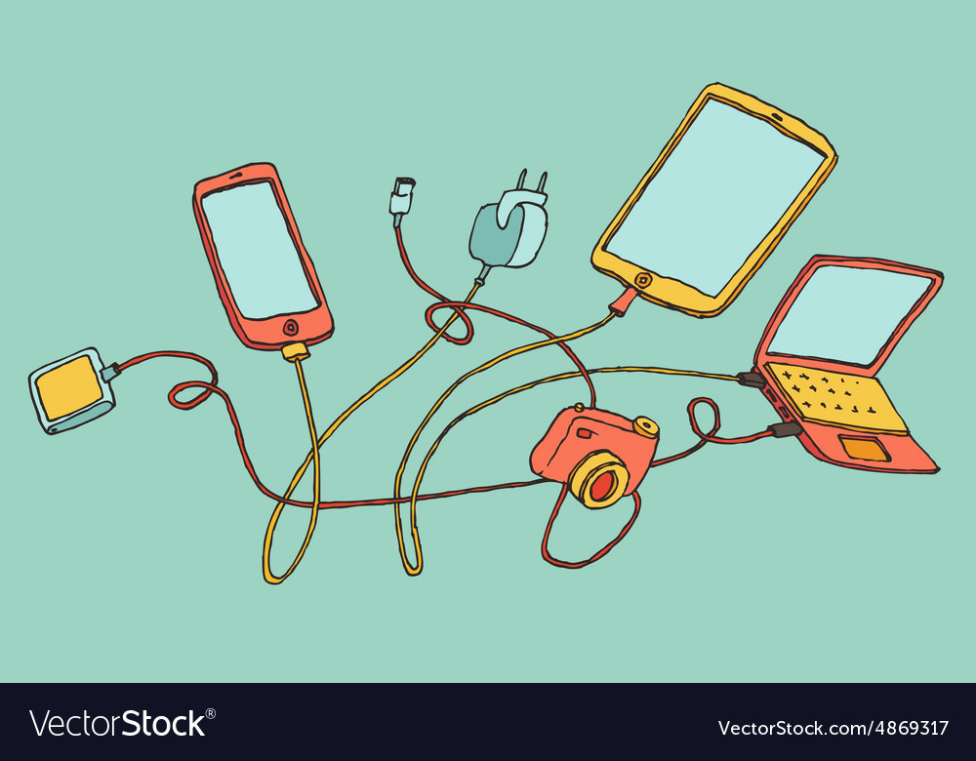
Future Scope
Future Scope
This model can future be expanded by connecting more hospitals and doctors with patients by taking real time data at large scale.
Expanding database by processing real time data in more efficient.
Adding Health-monitoring of mother and baby prenatal and postnatal.
Smart devices with more accurate sensor data and advance sensors.
Using data to expand logistical support to create a efficient health system to manage patients.

Slide 11

Conclusion
IoT ’s focus is to help perform the treatment of different Health cases precisely.
It makes the doctors job easier by minimising risks and increasing the overall performance.
By using this technology, doctors can easily detect changes in critical parameters of the patient.
This information-based service opens up new healthcare opportunities as it moves towards the best way of an information system to adapt world-class results as it enables improvement of treatment systems in the hospital.

Slide 12
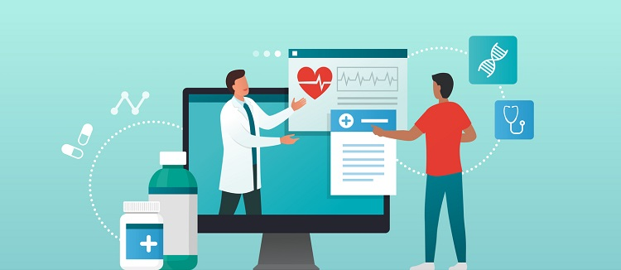
Thank You !!

Slide 13
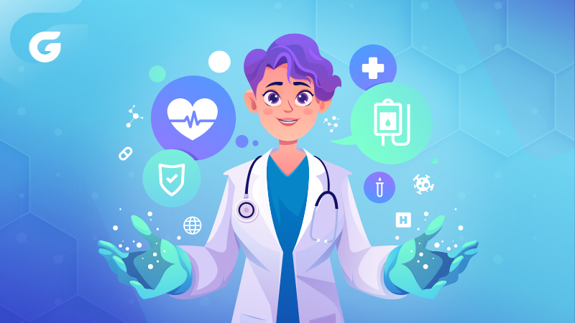
Conclusion
Medical students can now be better trained for any health issue detection and well guided for the future course of action.
IoT’s proper usage can help correctly resolve different medical challenges like speed, price, and complexity.
It can easily be customised to monitor treatment according to the patient. This digitally controlled health management system can improve the overall performance of healthcare.

