Slide 1
Sudoku Solver
Rundong Zhao
Notes:
A study of Discrete Domain CSP, specifically Sudoku.

Slide 2
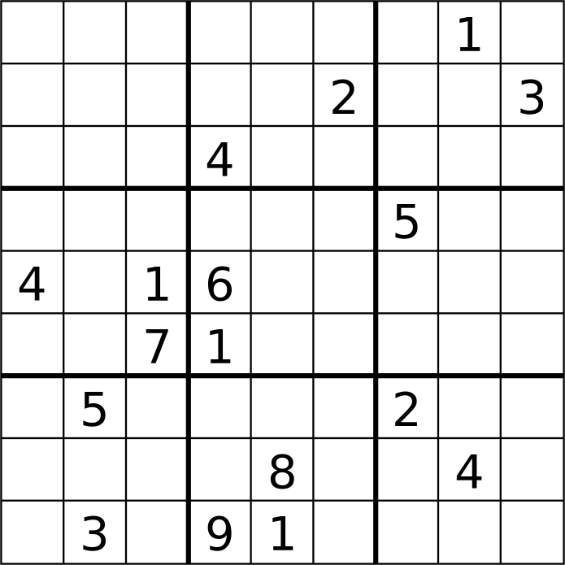
Sudoku
9 x 9 gird
Each column, row and 3 x 3 sub-grid should contain all numbers from 1 – 9
Only admit exactly 1 solution
Notes:
Introduce basics of Sudoku

Slide 3
Algorithms
Simple search without Heuristics
Search with Minimum Remaining Value (MRV) Heuristic
SAT encoding
Notes:
Scan the 9 x 9 grid left to right, top to bottom until a blank is found. Then launch several search branches based on potential values that is fit for the blank.
Always launch search branches from the blank with minimum number of potential values.

Slide 4
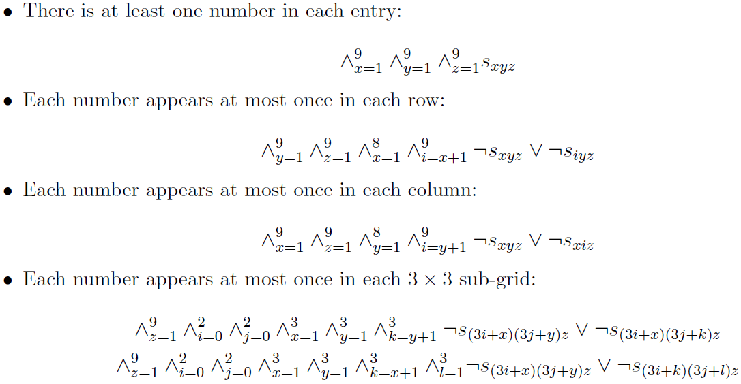
SAT Encoding
Notes:
Introduce SAT encoding

Slide 5

Inference Techniques
Resolution:
2 restricted forms of resolution: Unit Propagation and Failed Literal Rule.
Notes:
Basics of resolution.
Major techniques are using 2 restricted forms of resolution: Unit propagation, Fail literal rule.

Slide 6
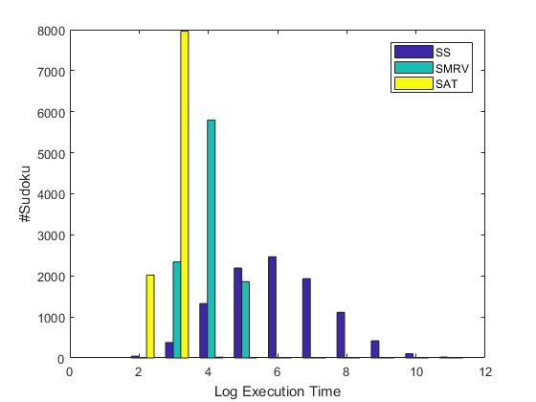
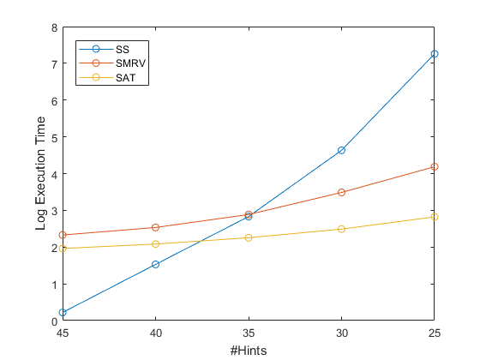
Results
Notes:
Test sets:
5 groups of Sudokus, each of which has 10000 instances. The number of hints are 45, 40, 35, 30, 25 for different groups, representing the difficulty.
Left:
the group with 25 hints. We can see that the SAT has beat the other 2 search algorithms.
Right:
Execution time plot for different groups. For simple Sudokus, naiive search method is faster than MRV heuristic, just like for sorting array with less than 20 elements.
The procedure to find the blank with MRV will introduce overhead.
When the Sudoku becomes harder, execution time for naiive search will increase very fast. The other two methods will remain fast.

Slide 7
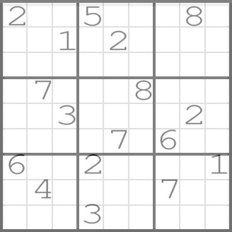
An Evil Sudoku
Search based methods cannot return solution within reasonable time.
SAT encoding find solution in 130 milliseconds.
Notes:
In order to further distinguish the efficiency of MRV heuristic and SAT Encoding, we test them on evil sudokus.
Here is an example, the search based methods cannot give a result in a reasonable amount of time. But SAT encoding can.

Slide 8
Conclusion
SAT encoding is extremely fast.
The inference techniques will try to exploit every inference to reduce search space.
It is always recommend transferring Finite Domain CSPs to SAT problem.

