Slide 1

Stop reranking your way out of a bad representation
DATAGEEKS · 27 OCTOBER 2026
Retrieval as an algebra over one textual space, with the model doing the understanding
Edward C. Zimmermann · CoreQuarry · edz@CoreQuarry.com
Notes:
Open with the thesis in three beats: you probably don’t need a frontier model for your Q&A bot, you probably don’t need a giant embedding model, and rerankers exist because we assumed retrieval gets one shot. Then ask the room why an agent would ever need one shot. Talk is 30 minutes plus questions, about 21 slides.

Slide 2

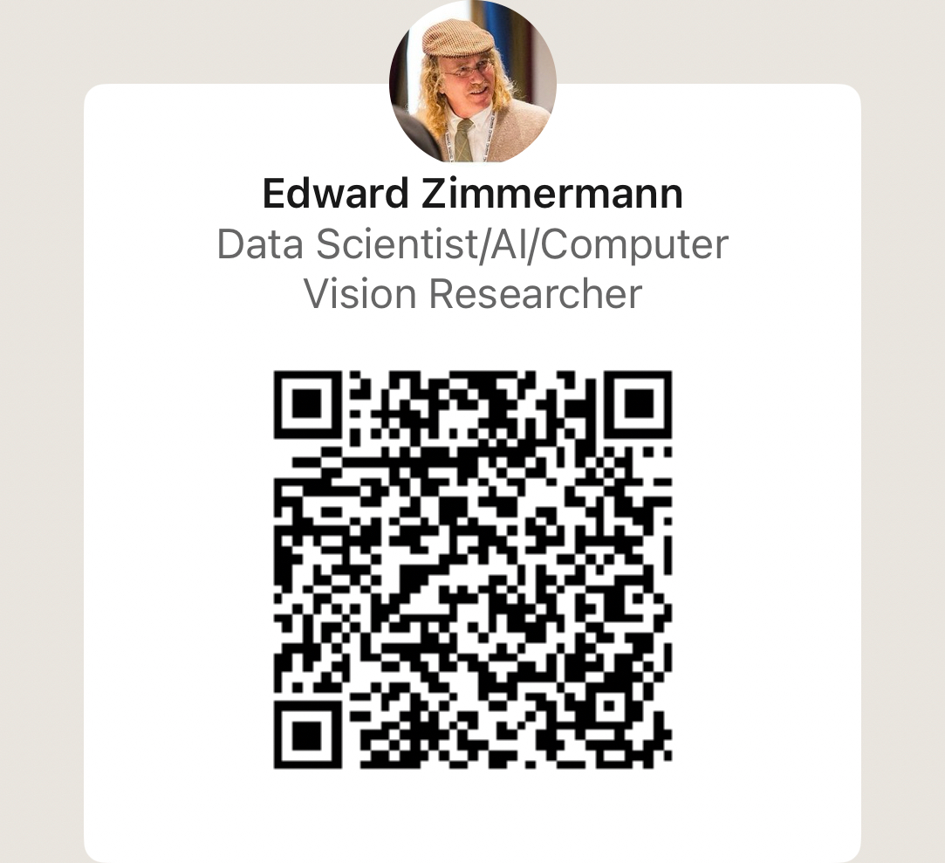
https://www.linkedin.com/in/edwardzimmermann

Slide 3
You don’t need a hyper-scaler to search a library.
656,519
Patents (XML), 2 billion words, 324 fields, multiple data-types indexed in 48 minutes on a 2021 laptop
Notes:
Open here. Patents 1985–1990 (CLEF-IP): 656,519 records, 2,021,312,071 words, 2,861 s on an M1 Pro with 16 GB, source on an external NVMe disk. Peak resident 6.8 GB, no swapping. Caveat for Q&A: this is indexing, not a query-quality benchmark; it says what the hardware floor is, nothing about relevance.

Slide 4
Our Local-First Aims
Prioritize data sovereignty, low-latency execution, cost predictability, and absolute user privacy.
Squeeze maximum structural intelligence, deterministic precision, and state-of-the-art neural intent out of local, edge, and consumer hardware (the hardware people have).
100% Open Source (Apache 2.0 licence).

Slide 5

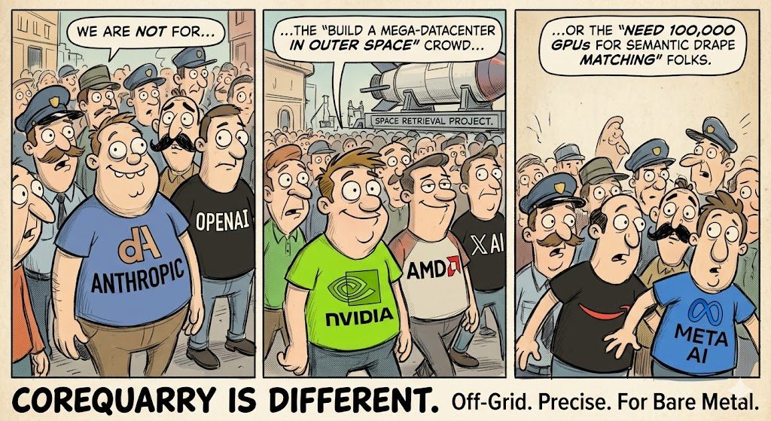

Slide 6

IR Beyond Chunks
DATAGEEKS · 27 OCTOBER 2026
CoreQuarry · corequarry.com
Notes:
Thirty minutes plus questions. Open with the claim slide, not with this one: say who you are, then go straight to “you don’t need a hyper-scaler”.

Slide 7
Four systems to repair one flattened record.
THE PROBLEM
BM25
Embeddings
RRF
Reranker
words, per record
meaning, per chunk
glue the two lists
a model to undo the damage
Each stage exists because the stage before it threw structure away.
Notes:
The standard stack: lexical index, vector index, fusion, cross-encoder reranker. Do not mock it; it works. The point is where each stage comes from: the record is the unit, the chunk is a guess at a boundary, and the reranker pays at query time to recover what indexing discarded. Careful with ColBERT: say it is the exception that keeps token-level information, at a storage and compute cost.

Slide 8
Retrieval is viewed as one shot. Agents need a conversation.
THE PROBLEM - OUR CONJECTURE
TODAY
WHAT AN AGENT NEEDS
query → top-k chunks → LLM
search → narrow → widen → follow
The model can’t say “narrow it to the claims” or “only 1988”. It can only ask again, in words.
With an algebraic language it can compose, with answers that come back places it can go next.
Notes:
This is the setup for the span idea. The “one-shot” complaint is about the interface, not the quality of any single ranking. HyDE and rerankers improve the one shot; they do not give the caller a way to constrain it. Keep this slide to two minutes: the next section shows what composing looks like.

Slide 9
Rewriting the query is a patch on the index.
THE PROBLEM
HyDE
An LLM writes a fake answer so the vector lands nearer the real one.
Query rewrite
An LLM guesses the words the document might have used.
Reranker
A cross-encoder re-reads the candidates it was handed.
Every patch costs a model call, and none of them can reach a part of a record the index never kept track of.
Notes:
Keep this fair: these techniques help, and the audience uses them. The claim is that they all sit on top of a representation that already lost the structure. Do not claim they are unnecessary in general; claim they are compensating, and that compensation costs latency and GPU time on every query. If asked about ColBERT: it keeps token vectors, so it recovers more, at a much larger index and compute cost.

Slide 10
The lesson everyone took from BEIR: BM25 beats embeddings.
HOW WE MEASURE
“Fine-tuned semantic vector models excel on in-domain data, but their performance drastically degrades in zero-shot environments … the classic lexical baseline (BM25) systematically beat state-of-the-art dense vector models due to semantic drift.”
The usual retelling of Thakur, Reimers, Rücklé, Srivastava & Gurevych, BEIR (2021), arXiv:2104.08663
Repeated until “beats” sounds like a measurement.
Notes:
Be careful with attribution: the quoted sentences are a common summary, not the paper’s own wording; the phrase “semantic drift” does not appear in BEIR. The BEIR authors are Thakur, Reimers, Rücklé, Srivastava and Gurevych (the version you pasted lists only four names and leaves out Rücklé and Srivastava; check the arXiv listing before putting names on a slide). Say “the usual retelling” out loud so nobody thinks you are misquoting the authors. The next slide takes it apart using the paper’s own text.

Slide 11
There is no “beats”.
HOW WE MEASURE
UNJUDGED RESULTS IN THE TOP 10 (BEIR §6)
The abstract’s winner isn’t BM25.
BM25
6.4%
Re-ranking and late-interaction models score best on average, at high computational cost. BM25 is “a robust baseline”.
ANCE
14.4%
TAS-B
31.8%
Robust is not better.
Unjudged counts as wrong. In the authors’ words, this can give “an unfair disadvantage to non-lexical approaches.”
A tuned model leaves its domain. BM25 never had one to leave.
Words and meaning are different evidence.
Ask what each one tells you, not which one wins.
Notes:
Take it apart in this order. (1) The paper’s own Section 6, on annotation selection bias, says many BEIR datasets show a lexical bias that disfavours approaches that do not rely on lexical matching. Hole@10 is the share of top-10 results with no relevance judgment: the text I read gives BM25 6.4% (docT5query 2.8%), ANCE 14.4% and TAS-B 31.8%. Before you show these, open the PDF and check which dataset or average the table covers and the exact definition; I read the figures from a text extraction and could not tell which datasets they cover. The bars are drawn to scale (6.4 to 61 px, 31.8 to 305 px). (2) The abstract’s conclusion is that re-ranking and late-interaction models achieve the best zero-shot results on average, at high computational cost, and that BM25 is a robust baseline, which is a different claim from “beats embeddings”. (3) The robust-versus-better point is an argument, not a finding: a method with no training has no domain shift to suffer. (4) The last point ties back to the talk: both are evidence over the same spans, and the engine can intersect them instead of choosing. Be fair in Q&A: on several datasets in the paper BM25 does outscore the dense retrievers tested; you are disputing the conclusion drawn, not the table.

Slide 12
The benchmark rewards the stack it was built around.
HOW WE MEASURE
Pooled judgments
Flattened schema
Encoder-sized documents
Only documents some system already returned were ever judged. A method that finds something new is scored as wrong.
Title and text become one string. Fields, structure and hierarchy are not part of the task.
Inputs fit a 512-token window, so long records are not what is being tested.
Notes:
One slide, then move on; do not let this become the talk. Say “biased toward”, not “fraud”. Pooling bias: judgments come from the pools of the systems that took part, so unjudged documents count as non-relevant. Be explicit that we are not claiming a BEIR score; we are saying the benchmark does not measure what this engine does, which is addressing and structure over very large records. Expect a question on why not just run BEIR; the honest answer is that it can be run, and the result would say little about this design.

Slide 13
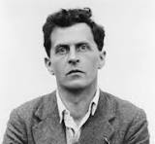
Structure defines meaning
"Nur der Satz hat Sinn; nur im Zusammenhange des Satzes hat ein Name Bedeutung.”
"Only the proposition has sense; only in the context of a proposition has a name meaning."
— Tractatus Logico-Philosophicus, 3.3
"Das Satzzeichen besteht darin, daß sich seine Elemente, die Wörter, in ihm auf eine bestimmte Art und Weise zueinander verhalten.” — 3.14.
“"A propositional sign consists in the fact that its elements—the words—stand in a determinate relation to one another in it.” — 3.14

Slide 14
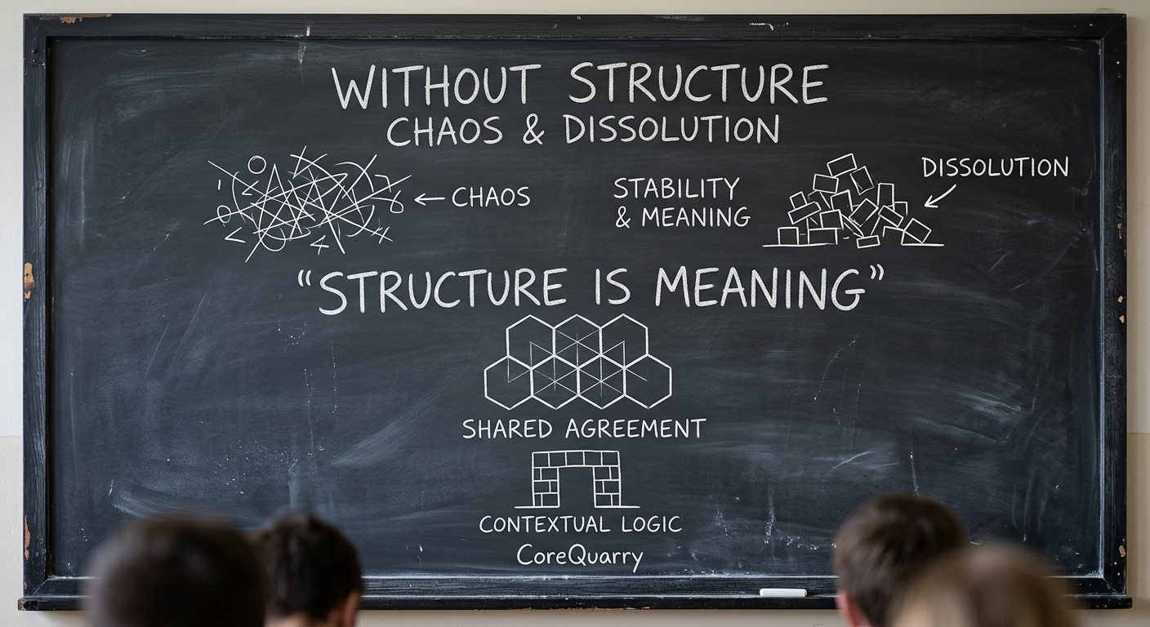

Slide 15

Meaning (Semantics) is not divorced from the VISUAL FORM INTO WHICH IT IS ENCODED. CONTEXT IS PINNED TO STRUCTURAL CONSTRUCTS.

Slide 16
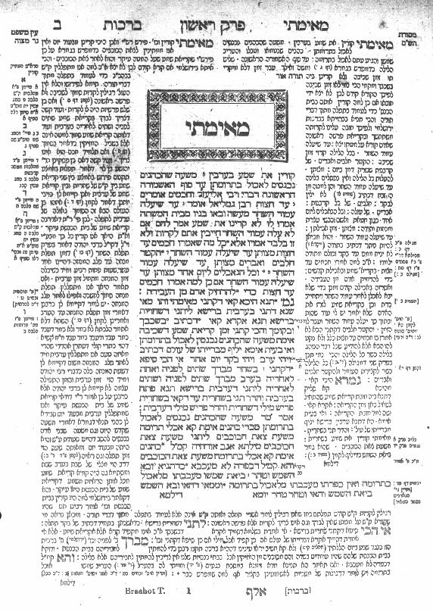
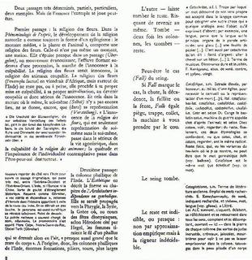
Structure

Slide 17
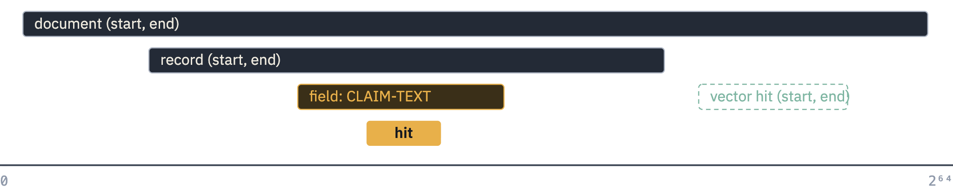
One address space. Everything else is a span.
THE IDEA
Structure is arithmetic on intervals. A vector hit is just another interval.
Notes:
This is the core slide. Every document, record and field is a pair of byte offsets in one global, monotonic address space, so “inside”, “overlapping” and “near” are comparisons of integers, not joins. A semantic hit, when its sentence was embedded with its global address as the id, comes back as a span too, so it composes with everything else. Be ready to say that the textual graph is real: containment and adjacency are implicit edges, no edge list is stored. Limits for Q&A: 32-bit index id (24-bit record, 8-bit slot), 16M records per physical index, 64-bit global addressing across a virtual database.

Slide 18
An old idea, continued.
THE IDEA
PAT arrays
Gonnet: index every text position, search by prefix on the raw string.
Region algebras
Queries as operations on intervals: inside, containing, followed by.
HyTime
Addressing by location, not by copying content.
CoreQuarry
One global address space, fields as spans, vector hits as spans, on commodity hardware.
"Dynamic units of retrieval: spans, evidence regions, and the algebra an agent actually needs."
Notes:
Credit the lineage plainly; none of the pieces is new, the combination and the engineering are the contribution. Gonnet's PAT arrays and the region-algebra literature give the query model; HyTime gives the addressing idea; the SIS cache is yours. If someone asks “isn’t this just Lucene with spans”, the answer is that Lucene’s unit is the document and its postings are per field, whereas here a field is only an interval in the same address space, so there is no per-field index to build or choose in advance.

Slide 19
Patricia Arrays
Gonnet, G. H., Baeza-Yates, R., & Snider, T. (1992). New indices for text: PAT trees and PAT arrays. In Information Retrieval: Data Structures & Algorithms (pp. 66-82). Prentice-Hall, Inc.
Baeza-Yates, R., Barbosa, E. F., & Ziviani, N. (1996). Hierarchies of indices for text searching. Information Systems, 21(6), 497-514. https://doi.org/10.1016/0306-4379(96)00025-7

Slide 20
Patricia Arrays: Basic Idea
Byte Address: | 0 | 1 | 2 | 3 | 4 | 5 | 6 | 7 | 8 | 9 | 10 | 11 | 12 | 13 | 14 | 15 | 16 | 17 | 18 |
Character: | l | o | c | a | l | [ ] | s | e | a | r | c | h | [ ] | e | n | g | i | n | e |
Tokenization: \______ "local" ________/ \__________ "search" ________/ \_________ "engine" ____________/
A "Semi-Infinite String" is simply a pointer to a starting byte address, viewing the data from that byte all the way to the end of the buffer.
The array of addresses is then sorted alphabetically.

Slide 21
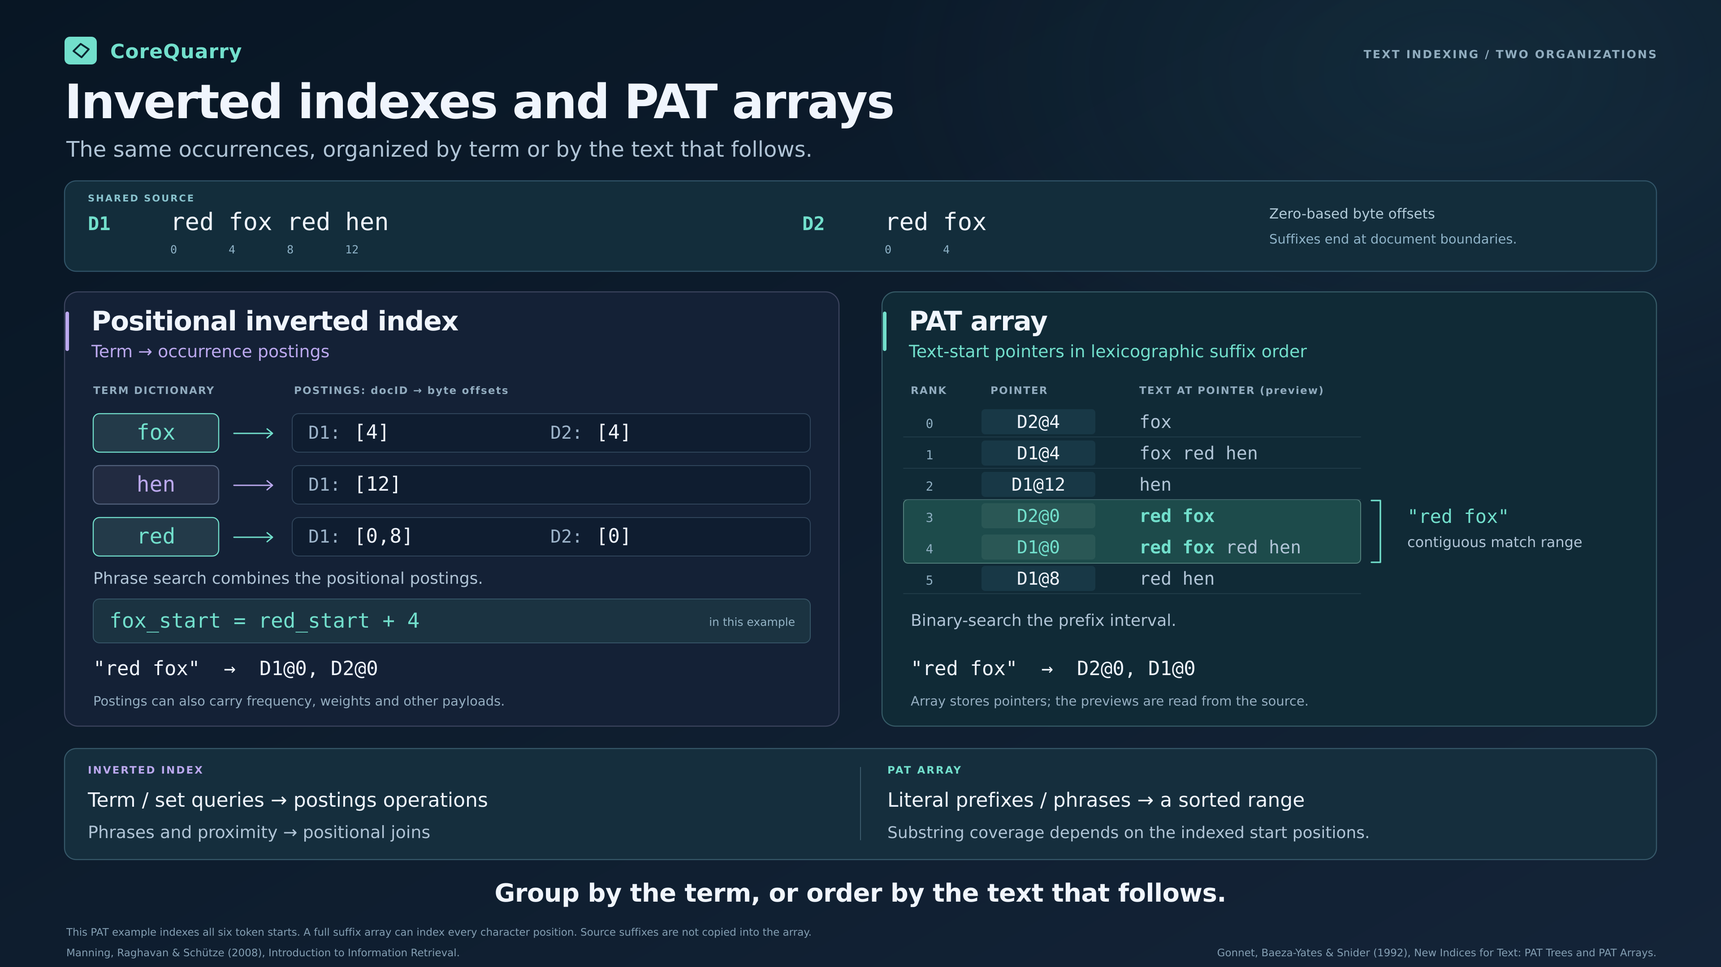

Slide 22
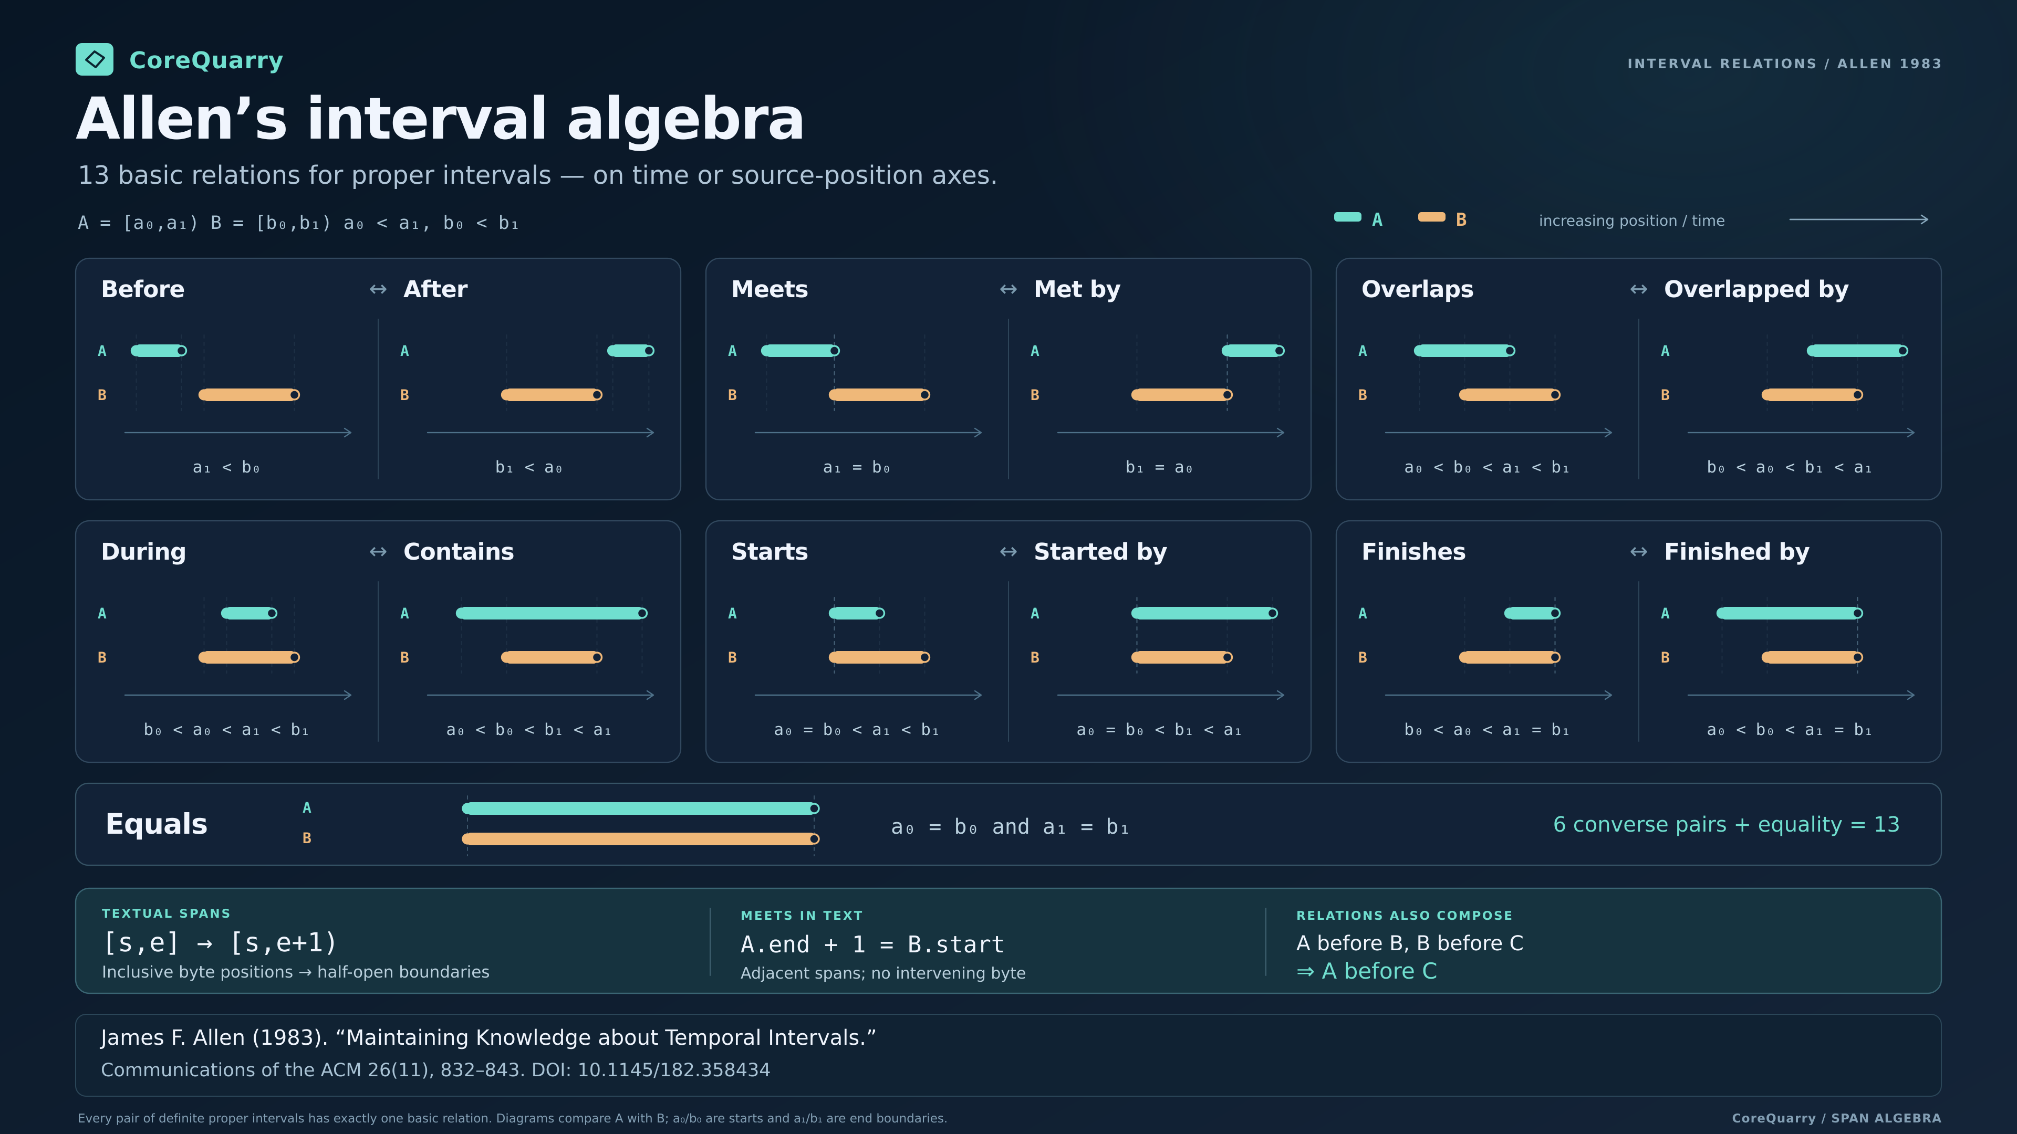

Slide 23
Patricia Trees and Pat Arrays Fell Out of Favor in the 1990s because of hardware:
Pointer chasing is catastrophically cache-unfriendly— every node traversal is a potential cache miss.
On 1990s hardware, a cache miss meant going to main memory at 60–80ns, and with tiny caches (L1 was 8–16KB) misses were constant.
The inverted index, despite its bulk, had more predictable, sequential access patterns that could be optimized with careful disk layout.
Patricia trees also consumed significant RAM for pointers — precious in an era of $50,000/GB RAM.
Worst case pointer density: a tree over a million terms might have millions of pointer pairs, each potentially a cache miss during traversal

Slide 24
Its 2026. Not 1999. What Contemporary Hardware Means for Information Retrieval.
The most dramatic difference isn't raw speed — it's random I/O latency and IOPS, which is exactly what database queries and information retrieval hammers hardest.
A full-table scan that took 10 minutes on a 90s SCSI array takes seconds on NVMe.
A database query requiring 10,000 random disk reads: 90s machine takes 80–120 seconds just in I/O wait; modern NVMe does it in ~10–50 milliseconds.
The entire working dataset that required careful buffer pool management in the 90s (because RAM was scarce) now fits entirely in RAM on a modern system — eliminating disk I/O almost entirely for hot data.
Memory bandwidth improvements mean in-memory analytics (columnar stores, etc.) can process data ~750× faster even if latency is similar.

Slide 25
Cache hierarchies have transformed things
Cache | High End 1996 Size | COTS 2026 Size | Improvement
L1 | 8–16 KB | 32–64 KB | ~4×
L2 | 256 KB (rare) | 512 KB–1 MB per core | ~4–8×
L3 | Nonexistent/tiny | 64–256 MB (Threadripper) | ∞ → huge
RAM | 256MB–4GB | 128GB–2TB | ~500×

Slide 26
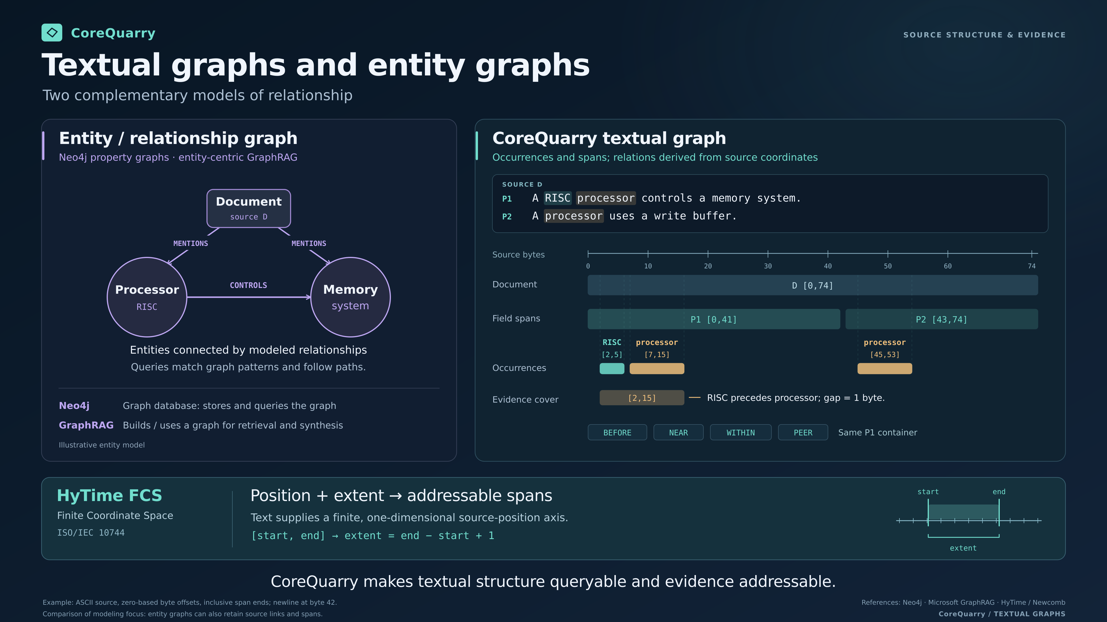

Slide 27
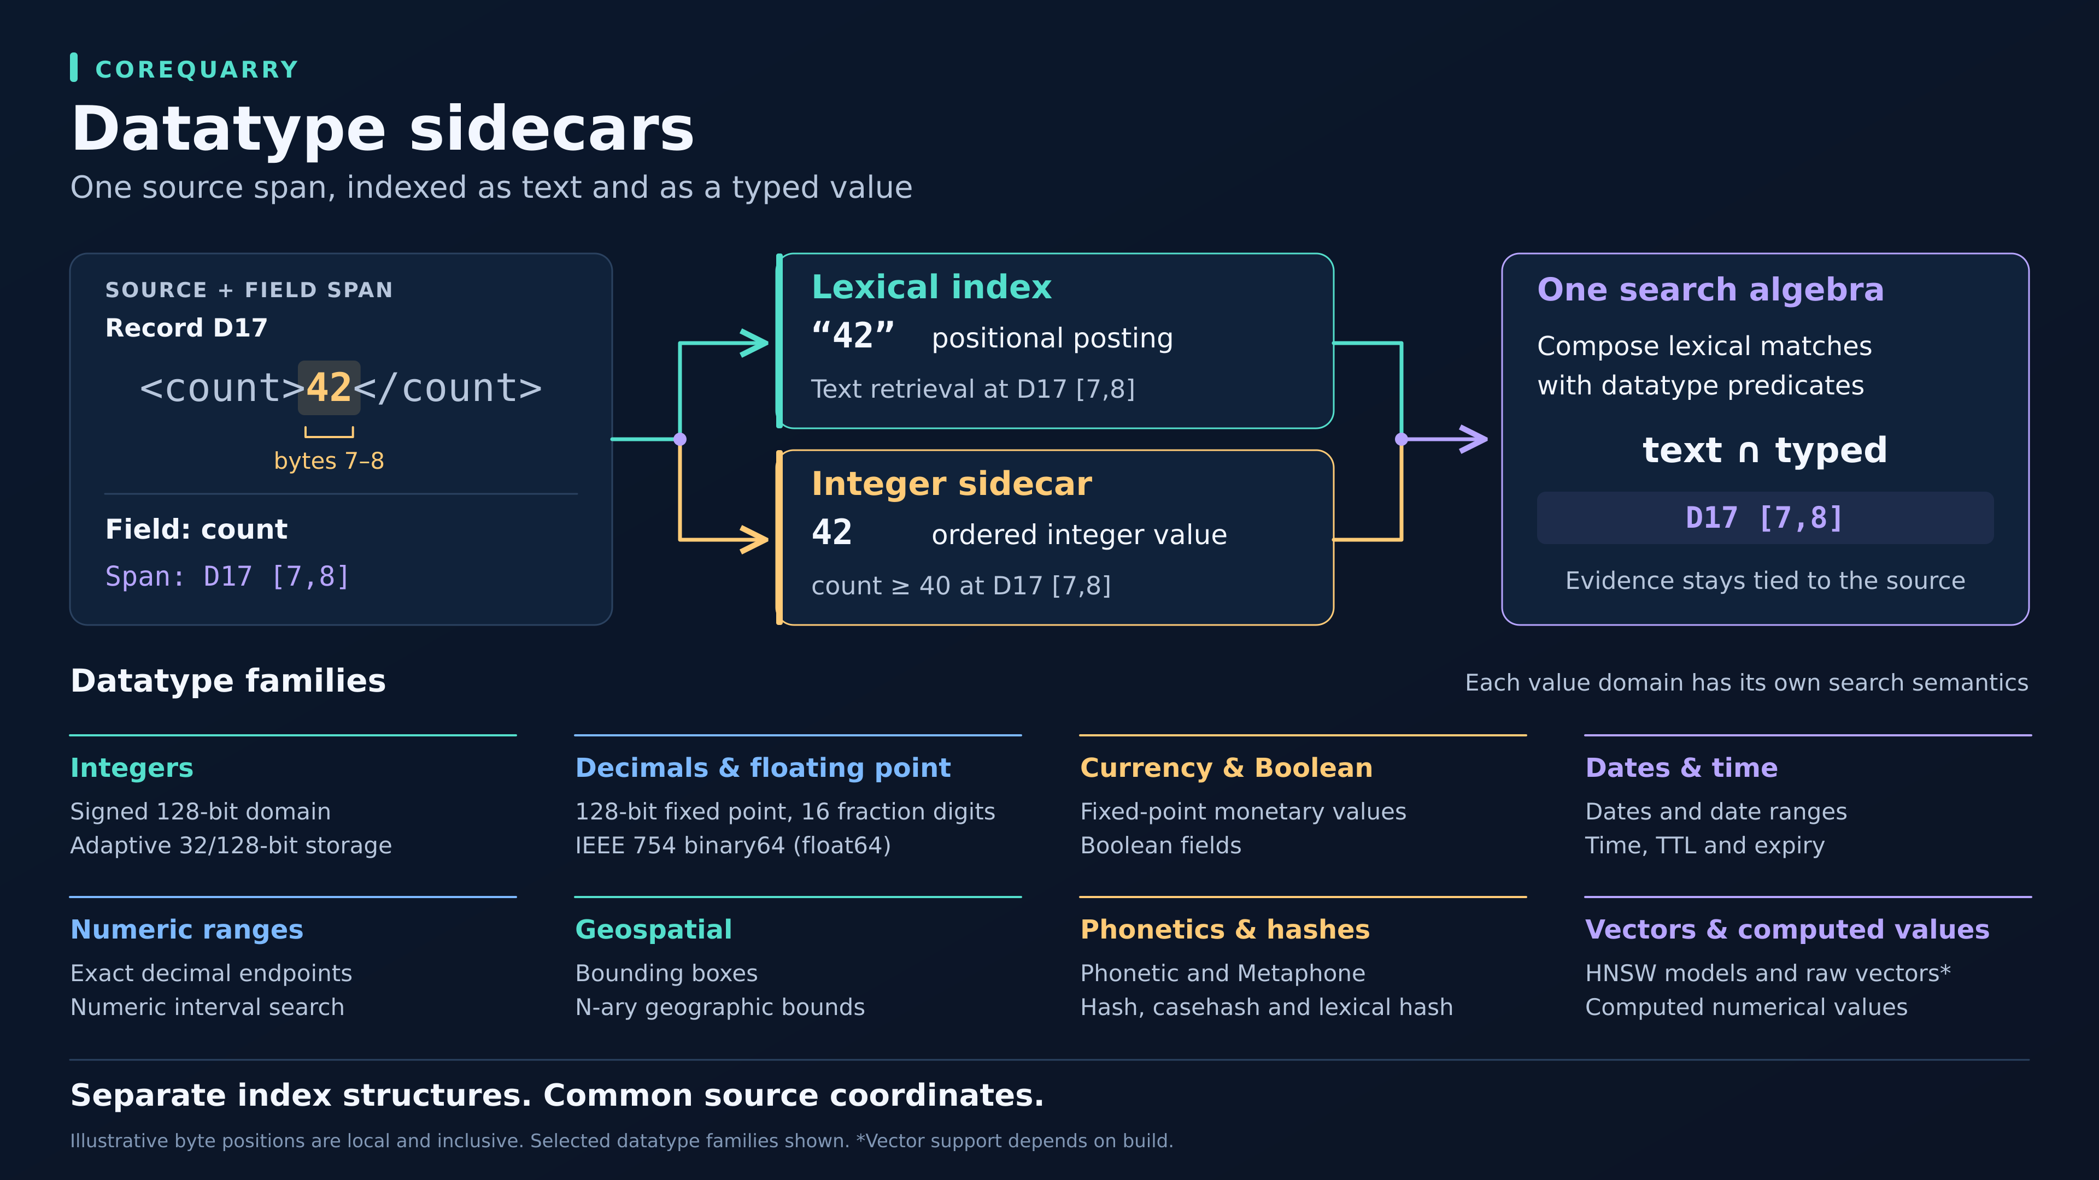

Slide 29
Stopwords are words. Search the phrase.
DEMO · SHAKESPEARE
$ Isearch -d SHAKESPEARE -show “to be or not to be"
Query: "to be or not to be"
1 record of 37 matched your query, 1 record displayed.
Score File
1. 100 /Volumes/Celeritas/CoreQuarry/ib/data/shakespeare.xml
`The Tragedy of Hamlet, Prince of Denmark’
Evidence: [PLAY\ACT\SCENE\SPEECH\LINE] To be, or not to be: that is the question:
~10 ms
every word of it a stopword somewhere else
The index is 22,945 entries and about 0.67 MB.
Notes:
Live demo if the machine behaves; otherwise this slide is the fallback. The command line is a sketch of the call, so copy the exact invocation from your terminal before the talk. The query is all stopwords, which is the classic place where stopword-stripped indexes return nothing useful. Numbers: about 10 ms for the phrase; Shakespeare SIS cache is 22,945 entries, about 0.67 MB at X=20, with one overflow word, honorificabilitudini*. Iutil -check passes in 2.4 s. Caveat: tiny corpus, so the timing shows the model works, not that it scales; the scale slides do that.

Slide 30
Phrase search
DEMO · WIKIPEDIA (a 2 million record ES Bulk Dump)
$/Isearch -d /Volumes/D50/indexes/WIKI_ALL -show is an error
Isearch [Info]: Phrase "is an error" uses all common words (131340 > 10000 : 500000) [0]. Using alternative search heuristic: "is" "an" #< "error" #<
CPU Process time: 469 ms. (3) Search: 466 ms.
Query: "is an error"
290 records of 2065536 matched your query, 290 records displayed.
Score File
1. 100 /Volumes/D50/Wikidata/afwiki-20251229-cirrussearch-general.json
`Citation/ CS1'
Evidence: [SOURCE_TEXT] age.
See also coins_cleanup().
Output of this function is an error message that identifies the character or the
Unicode group
Notes:
Live demo if the machine behaves; otherwise this slide is the fallback. The command line is a sketch of the call, so copy the exact invocation from your terminal before the talk. The query is all stopwords, which is the classic place where stopword-stripped indexes return nothing useful. Numbers: about 10 ms for the phrase; Shakespeare SIS cache is 22,945 entries, about 0.67 MB at X=20, with one overflow word, honorificabilitudini*. Iutil -check passes in 2.4 s. Caveat: tiny corpus, so the timing shows the model works, not that it scales; the scale slides do that.

Slide 31
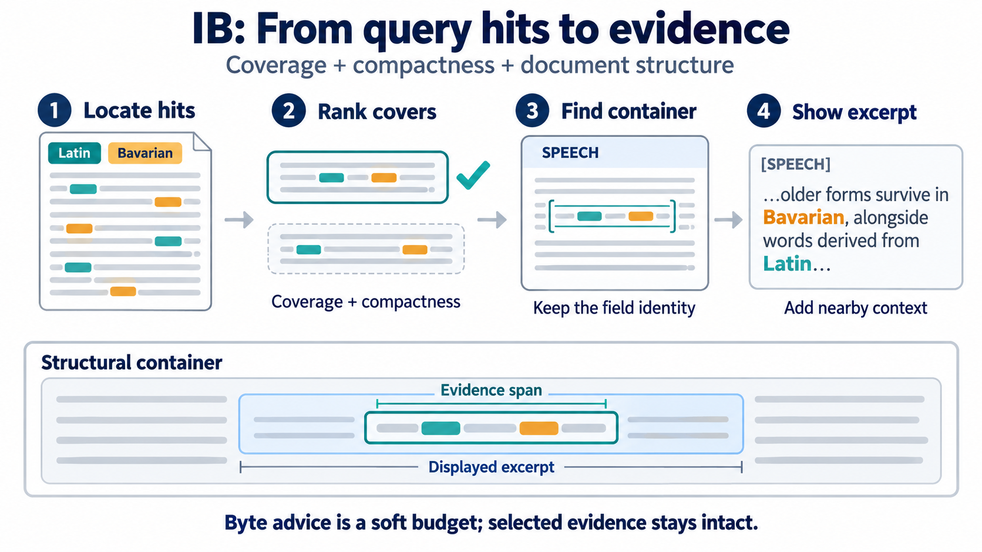

Slide 32
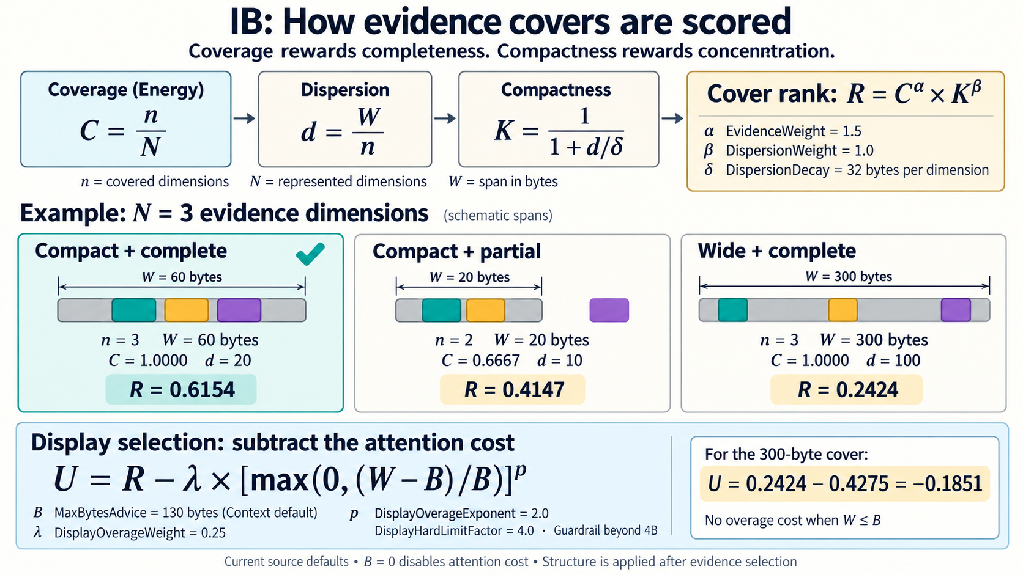

Slide 33
Same evidence, two extents.
DEMO · SHAKESPEARE
EXTENT: THE LINE
EXTENT: THE SPEECH
[query + top hit]
[same query, wider extent, top hit]
`The Tragedy of Hamlet, Prince of Denmark'
[1] "speech: <SPEAKER>HAMLET</SPEAKER>
<LINE>To be, or not to be: that is the question:</LINE>
<LINE>Whether 'tis nobler in the mind to suffer</LINE>
<LINE>The slings and arrows of outrageous fortune,</LINE>
<LINE>Or to take arms against a sea of troubles,</LINE>
<LINE>And by opposing end them? To die: to sleep;</LINE>
<LINE>No more; and by a sleep to say we end</LINE>
Which extent counts is a choice at query time, not an index you had to build first.
Notes:
PLACEHOLDER: fill both panels with the real Shylock query and its top hit at each extent (FOCUS and REDUCE are the two knobs; use the exact commands from your terminal). The claim is that “record” is not fixed at indexing time: because fields and records are spans, the same words can be scored over a speech or over a whole play. Caveat for Q&A: the evidence score is a heuristic (energy and dispersion), separate from the structural match, and is not claimed to be optimal ranking.

Slide 34
Structure on demand, not in advance.
DEMO · SHAKESPEARE
$ [query constrained to a speaker or a scene]
Isearch -d SHAKESPEARE -XML -P speech/speaker to be or not
→
[the spans returned, with their start–end addresses]
Speech was never indexed as a record. Line, speech, scene and act are just spans (intervals), so the engine just does a comparison of spans to reconstruct in this case the tree (graph) connect to a hit.
'ACT' 'EPILOGUE' 'FM' 'GRPDESCR' 'INDUCT' 'LINE' 'P' 'PERSONA' 'PERSONAE' 'PGROUP' 'PLAY' 'PLAYSUBT' 'PLAY\ACT' 'PLAY\ACT\EPILOGUE' 'PLAY\ACT\EPILOGUE\SPEECH' 'PLAY\ACT\EPILOGUE\SPEECH\LINE' 'PLAY\ACT\EPILOGUE\SPEECH\SPEAKER' 'PLAY\ACT\EPILOGUE\STAGEDIR' 'PLAY\ACT\EPILOGUE\SUBTITLE' 'PLAY\ACT\EPILOGUE\TITLE' 'PLAY\ACT\PROLOGUE' 'PLAY\ACT\PROLOGUE\SPEECH' 'PLAY\ACT\PROLOGUE\SPEECH\LINE' 'PLAY\ACT\PROLOGUE\SPEECH\SPEAKER' 'PLAY\ACT\PROLOGUE\SPEECH\STAGEDIR' 'PLAY\ACT\PROLOGUE\SPEECH\SUBHEAD' 'PLAY\ACT\PROLOGUE\STAGEDIR' 'PLAY\ACT\PROLOGUE\TITLE' 'PLAY\ACT\SCENE' 'PLAY\ACT\SCENE\SPEECH' 'PLAY\ACT\SCENE\SPEECH\LINE' 'PLAY\ACT\SCENE\SPEECH\LINE\STAGEDIR' 'PLAY\ACT\SCENE\SPEECH\SPEAKER' 'PLAY\ACT\SCENE\SPEECH\STAGEDIR' 'PLAY\ACT\SCENE\SPEECH\SUBHEAD' 'PLAY\ACT\SCENE\STAGEDIR' 'PLAY\ACT\SCENE\SUBHEAD' 'PLAY\ACT\SCENE\TITLE' 'PLAY\ACT\TITLE' 'PLAY\FM' 'PLAY\FM\P' 'PLAY\INDUCT' 'PLAY\INDUCT\SCENE' 'PLAY\INDUCT\SCENE\SPEECH' 'PLAY\INDUCT\SCENE\SPEECH\LINE' 'PLAY\INDUCT\SCENE\SPEECH\SPEAKER' 'PLAY\INDUCT\SCENE\SPEECH\STAGEDIR' 'PLAY\INDUCT\SCENE\STAGEDIR' 'PLAY\INDUCT\SCENE\TITLE' 'PLAY\INDUCT\SPEECH' 'PLAY\INDUCT\SPEECH\LINE' 'PLAY\INDUCT\SPEECH\SPEAKER' 'PLAY\INDUCT\STAGEDIR' 'PLAY\INDUCT\TITLE' 'PLAY\PERSONAE' 'PLAY\PERSONAE\PERSONA' 'PLAY\PERSONAE\PGROUP' 'PLAY\PERSONAE\PGROUP\GRPDESCR' 'PLAY\PERSONAE\PGROUP\PERSONA' 'PLAY\PERSONAE\TITLE' 'PLAY\PLAYSUBT' 'PLAY\PROLOGUE' 'PLAY\PROLOGUE\SPEECH' 'PLAY\PROLOGUE\SPEECH\LINE' 'PLAY\PROLOGUE\TITLE' 'PLAY\SCNDESCR' 'PLAY\TITLE' 'PLAY\' 'PROLOGUE' 'SCENE' 'SCNDESCR' 'SPEAKER' 'SPEECH' 'STAGEDIR' 'SUBHEAD' 'SUBTITLE' 'TITLE'
Notes:
PLACEHOLDER: use the real demo query that constrains by speaker, scene or act (WITHIN or AND:field in your syntax; remember the parser rewrites WITHIN:field to FIELD/term). The point to land: there is no per-field index to plan for, and a new constraint needs no reindex. If the real demo differs from this framing, change the headline rather than the demo. Do not claim anything about ranking quality here.

Slide 36
Words miss paraphrase. Vectors don’t.
DEMO · SHAKESPEARE
WORD SEARCH
VECTOR SEARCH
[paraphrase query] → [miss]
Query: "whether" "it" || "is" || "better" || "to" || "live" || "or" || "die" || FOCUS:8
30 records of 37 matched your query, 30 records displayed.
Score File
1. 100 /Volumes/Celeritas/CoreQuarry/ib/data/shakespeare.xml
`The Tragedy of Richard the Third'
Evidence: [PLAY\ACT\SCENE\SPEECH\LINE] O sir, it is better to be brief than tedious. Show
2. 96 /Volumes/Celeritas/CoreQuarry/ib/data/shakespeare.xml
`Measure for Measure'
Evidence: [PLAY\ACT\SCENE\SPEECH\LINE] Unfit to live or die: O gravel heart!
[same query] → [the line, as a span
[default32]> search whether it is better to live or die
- [score=0.848796, sid=793, label=792, tokens=[0,28]] Shakespeare's Hamlet pondered whether to be or not to be, that is the question in the most famous soliloquy in English literature examining existence, suffering, and mortality itself.
- [score=0.828010, sid=769, label=768, tokens=[0,24]] Socrates declared that the unexamined life is not worth living, emphasizing the importance of self-reflection and philosophical inquiry in achieving a meaningful human existence.
- [score=0.827503, sid=384, label=383, tokens=[0,7]] Better safe than sorry in dangerous situations.
- [score=0.815082, sid=795, label=794, tokens=[0,30]] Henry David Thoreau advised to go confidently in the direction of your dreams and live the life you have imagined, encouraging individuals to pursue authentic existence over conformity and convention.
- [score=0.811914, sid=773, label=772, tokens=[0,27]] Benjamin Franklin observed that in this world nothing can be said to be certain except death and taxes, wryly commenting on life's unavoidable realities with characteristic wit.
[default32]>
Both answers are spans in the same address space, so you can intersect them.
Notes:
PLACEHOLDER: fill in the real toy paraphrase from your vector demo (the query that fails on words and the line the embedding finds). This is the bridge into the semantic section. Be honest that the vector toy is a toy: a small corpus, one encoder. Embedding latency on the M1 Pro with Metal: MiniLM-L12 f32 about 4 ms for 11 tokens and 15 ms for 137; bge-large q8_0 about 15 ms and 35 ms.

Slide 41
Vector search performance
Speed matters because RAG pipelines are dominated by retrieval latency.
Model Name: MacBook Pro
Model Identifier: MacBookPro18,1
Model Number: MK183D/A
Chip: Apple M1 Pro
Total Number of Cores: 10 (8 performance and 2 efficiency)
Memory: 16 GB
System Firmware Version: 11881.140.96
OS Loader Version: 11881.140.96

Slide 42
Vector search performance
Measured on the M1Pro (so the search time itself is marginal)
System | Approx QPS (768d) | Notes
Qdrant | ~1k–3k | depends heavily on HNSW tuning
Milvus | ~2k–5k | heavier infra
FAISS | ~5k–10k | optimized C++ but limited system features
Elasticsearch | usually <2k | heavy overhead
Quarry HNSW | 13k | C++.

Slide 43
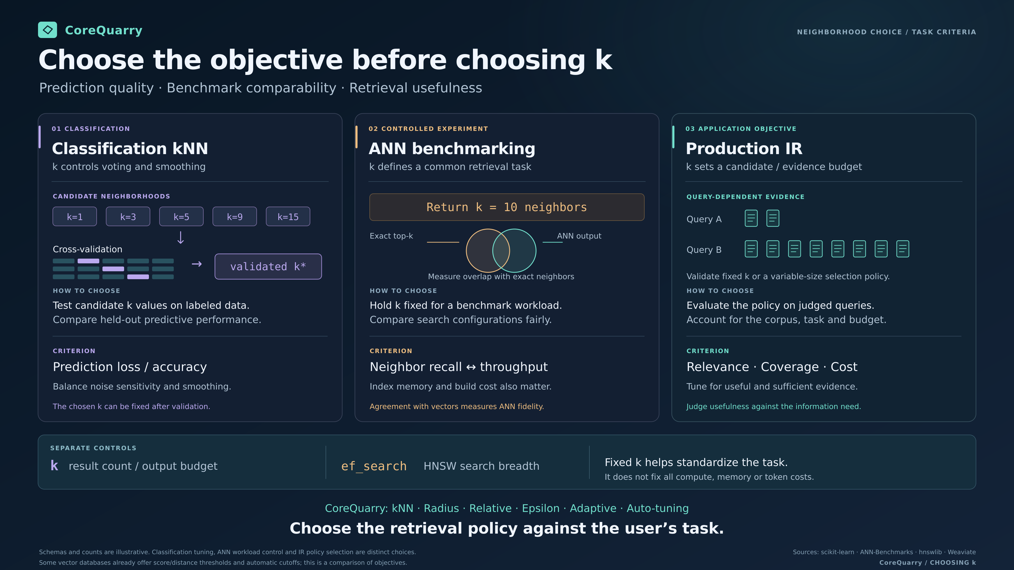

Slide 44
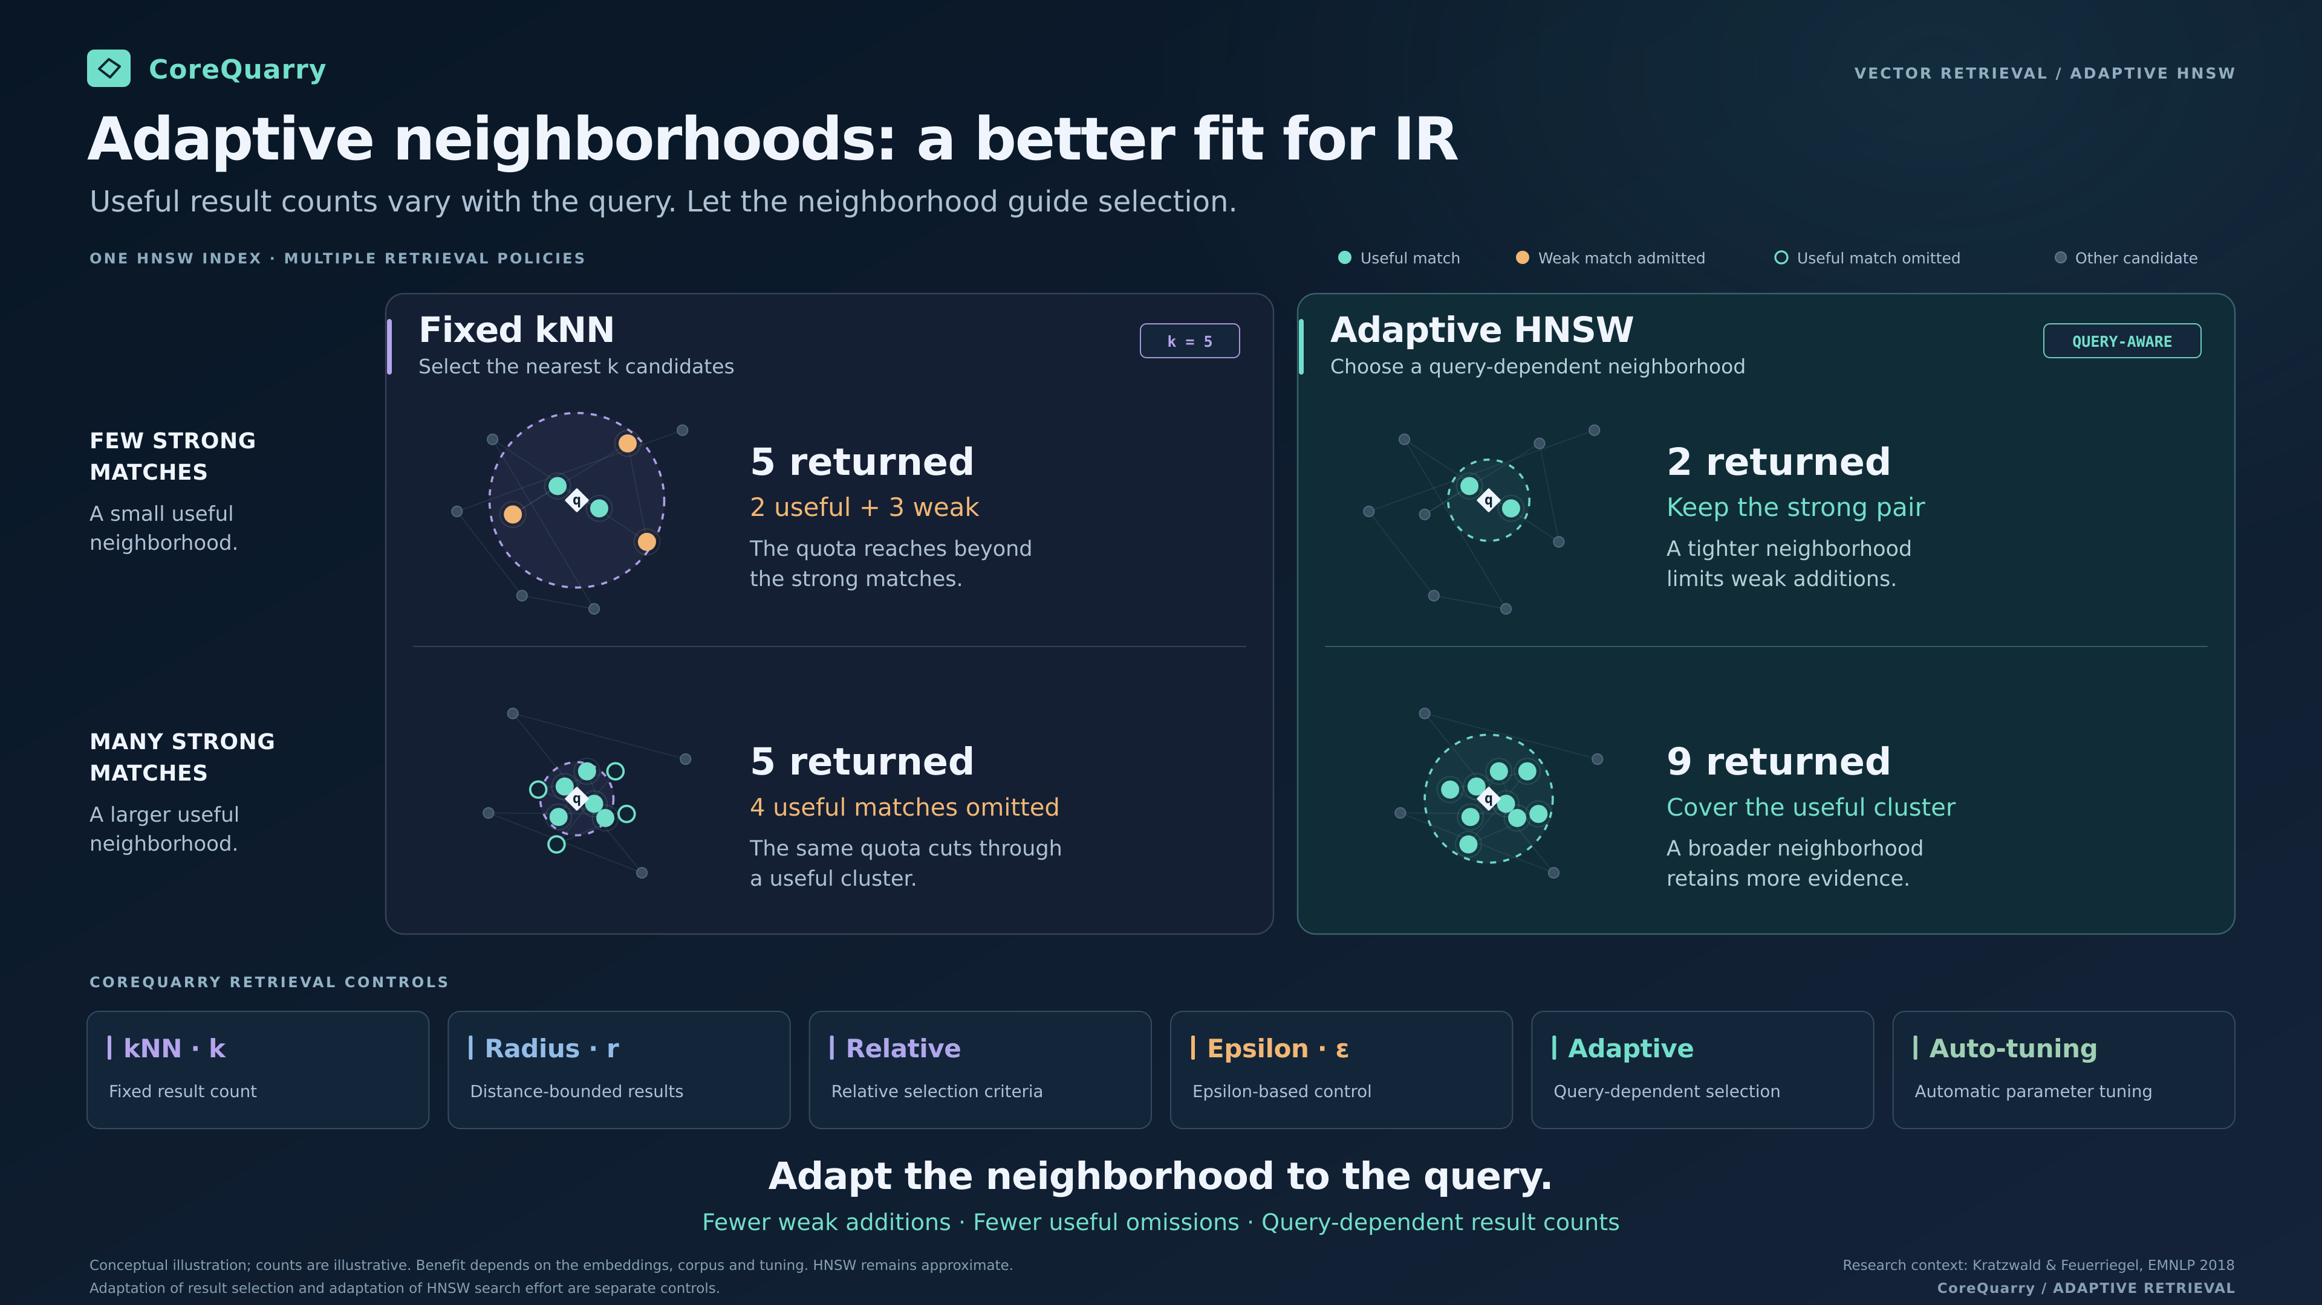

Slide 45
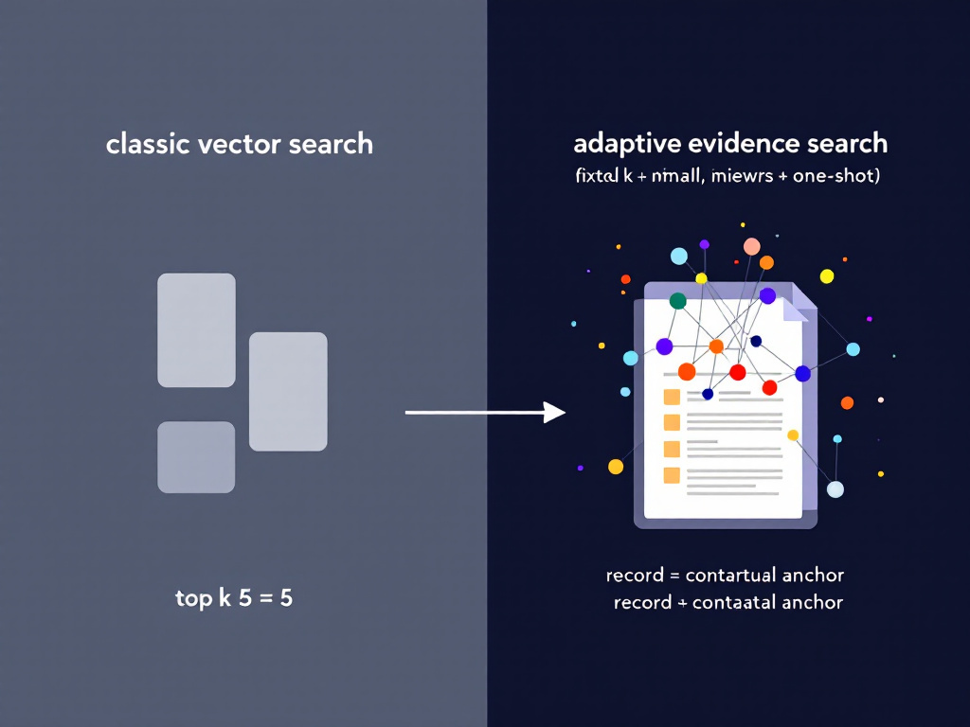

Slide 46
Bare Metal, Sovereign, COTS Hardware
(The hardware you have sitting in front of of you)
The benchmarks are mainly on this machine— the one I’m presenting on:
Apple M1Pro, 16GB RAM, external NVME disk (WD SN750 2TB) using APFS and connected with Thunderbolt 3.
The M1Pro has 200 GB/s memory bandwidth. Max SSD (even another disk) 2,500 – 2,800 MB/s.
M5 Max (40-Core GPU Variant): Features a unified memory bandwidth of 614 GB/s and it can get as high as 6,000 to 6,500 MB/s SSD throughput.
Threadripper PRO 9000 WX-Series: 409 GB/s and SSD as high as 14,000 to 14,900 MB/s.
The new MS Surface (GB10) is 300 GB/S but has ~14,500 MB/s disk I/O.

Slide 47
Two billion words, one pass, one laptop.
SCALE · PATENTS
656,519
2.02 B
48 min
6.8 GB
records
words
2,861 s to index
peak resident, no swap
M1 Pro, 16 GB, 2021. Source on an external NVMe disk over Thunderbolt 3.
Notes:
CLEF-IP patents 1985–1990. All figures are from your runs: 656,519 records, 2,021,312,071 words, 2,861 s, peak resident 6.8 GB with zero swaps. The earlier all-years run took 3,136 s before the merge-order fix. Also mention Wikipedia in one breath: 2,065,536 records (about 1.03 M real documents, because half the records are bulk action lines), 753,423,571 words, 1,459 s. Do not quote the 1985-only numbers unless asked (86,755 records, 201 s). Caveat: indexing throughput only; the machine is not a server, which is the point.

Slide 48
Two words, 656,519 patents, one claim.
SCALE · PATENTS
$
49 ms
Isearch -d PATENTS -show -max 1 risc matrix PEER
1 record of 656519 matched your query
PEER: the engine finds the field
Evidence: [CLAIM-TEXT]
ors, including said RISC
20–27 ms
processor and said transfer processor, said m memory
sources and said switch matrix, including said lin
AND:CLAIM-TEXT: you name it. Same claim.
PEER asks for both words in the same field and names it. If you already know the field, saying so is about twice as fast.
Notes:
Your run from 24 October on the full patents index (656,519 records): 49 ms CPU process time, 47 ms of it search, 23.6 ms per term; one record matched; the evidence is shown from CLAIM-TEXT, named in brackets by the display-evidence step. This replaces the earlier figures (PEER 460 ms against AND:CLAIM-TEXT 19 ms), which came from before your recent changes; I don't know whether the gap was a cold cache or code, so do not quote the old 24-times ratio. Same build, same index, same night: AND:CLAIM-TEXT took 20 ms CPU, 19 ms of it search, 9.4 ms per term. A second run of AND:CLAIM-TEXT a minute later took 27 ms (25 search, 12.6 ms per term), so the honest range is 20 to 27 ms and the ratio to PEER's 49 ms is roughly 1.8 to 2.4: say about twice as fast. Both queries match exactly one record of 656,519, EP-0429733-A2, and display the same CLAIM-TEXT evidence, so it is fine to say they find the same claim. Also available: immunoglobulin flu, and risc processor at 4 ms from the earlier run, which may also have changed. Caveat: these are warm repeats. In your session log the first PEER run of risc matrix took 187 ms (CPU) and the next took 49 ms, and the same pattern shows for risc processor (391 then 111 ms) and virus reduction (2,001 then 675 ms). So if someone asks, say the first run after a cold start is several times slower while the field tables are paged in, and say about 50 ms for a warm query.

Slide 49
The second query is the one that matters.
SCALE · WIKIPEDIA (2 million record ES Bulk Dump)
editors
defaultsort/editors
6 ms
4 ms
300 hits, capped: the word is everywhere
one record: the field that was asked for
An agent that sees a flood can narrow with one more query, and each query costs milliseconds.
Notes:
Wikipedia index (2,065,536 records, about 1.03 M real documents; half the records are bulk action lines, so say “records” not “articles”). “editors” 28 ms with a 300 cap; “defaultsort/editors” 4 ms, one record. Also available: the German word für returns 217,420 records in 391 ms, a good answer to “does it handle UTF-8”. The point is the interaction model, not the raw latency. Caveat: the 300 cap is the advice limit (-advice N, -1 = no cap), so do not say 300 is the number of matches.

Slide 50
Show the passage that fits the reader, not the record.
DISPLAY EVIDENCE
1
Choose the evidence. Covers and single hits compete; each extra byte past the budget costs more.
$
Isearch -d /tmp/P -show -max 2 patent
2 records of 86755 matched · 24 ms
Evidence: [P]
2
Find where it lives. One structural probe at a word inside it, then its ancestors.
graphic emulsions used in
such methods are described in U.S. Patent Nos. 2,456,953,
3
Fit the budget. Whole container if it fits; otherwise pad around the evidence, but never past the container.
2,497,875, 2,497,876, 2,497,917, 2,507,154,
[P] is the paragraph the hit sits in. The record is 86,755 patents’ worth of XML.
Structure is presentation, not evidence. It never competes with the words that matched.
Notes:
The output is your run on the 1985 patents index (86,755 records): query patent, two records shown, 24 ms CPU. The bracket is ContainerName and the text is the DisplayExtent from GetDisplayEvidence. The budget is MaxBytesAdvice (the -advice option; -1 for no cap, and 0 means unbounded: keep the strongest cover and still report the container). Utility = rank minus 0.25 × over², with over = (bytes − budget) / budget, and a hard limit at 4× the budget, so evidence may overspend when it earns it. Structure does not enter the score: a container that fits the budget is used outright; one that is too big only bounds the padding, so a 130-byte excerpt of a 400-byte SPEECH cannot spill into the next speech; unfielded text, such as flat Wikipedia, falls back to a budgeted window around the evidence. Keep this as the answer to why an agent needs far fewer tokens: the engine decides what to show before the model reads anything. Caveat: the parameters are hand-set and not tuned against user studies. There is no measurement here of reader or model benefit.

Slide 51
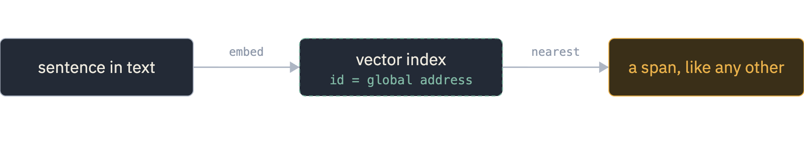
Semantic search is a view, not a second database.
SEMANTIC SEARCH
Because the hit is an address, it can be intersected with fields, records and word matches.
Notes:
Mechanics: the vector side is a bert.cpp fork with HNSW; the sentence store bridges to the engine so that, when a sentence is embedded, its id is its global address. A nearest-neighbour result therefore needs no lookup table. Chunking is internal to the vector store and is not part of the text index. INT4 storage is available. Tokenizer note, for the aside: WordPiece versus SentencePiece is detected by probing the vocabulary. Caveat: I have no recall or quality number for the vector side; present it as an integration, not as a retrieval result.

Slide 52
A single vector can’t return every combination of documents.
SEMANTIC SEARCH
THE PROOF
THE TEST: “WHO LIKES QUOKKAS?”
The number of top-k sets a d-dimensional embedding can return is bounded by d. Some pairs of documents can never be returned together, for any query.
10.0
18.9
Gemini Embed, 3072-d, recall@100
Promptriever, 4096-d, recall@100
Weller, Boratko, Naim & Lee, On the Theoretical Limitations of Embedding-Based Retrieval, 2025 (ICLR 2026)
50,000 documents, 1,000 one-attribute queries. A cross-encoder solved all 1,000.
A vector is a lossy view. Keep the exact evidence beside it.
Notes:
The paper’s result is about capacity, not about logical operators. Theory (Section 3): the number of top-k subsets that can be returned is at most (1 + 1/γ)^d, so for n documents and k results the dimension must grow with log of n-choose-k; some combinations cannot be returned for a given d, no matter the query. The authors call their bound extreme and a lower bound; they show with free, test-set-optimised embeddings that it holds empirically. LIMIT (Section 5.2): documents are people with liked attributes, queries are single-attribute (“who likes X”), 50,000 documents and 1,000 queries; the text says models struggle to reach even 20% recall@100, and I read Table 5 as Gemini Embed (3072-d) at 10.0 and Promptriever (4096-d) at 18.9; check both in the PDF before showing them. Also check the text against Table 4 on recall@20: they appear to disagree. They also report it is not domain shift: training on LIMIT’s own training split did not help. Alternatives in the paper: a cross-encoder (Gemini-2.5-Pro) solved all 1,000 queries in one forward pass; multi-vector models show promise; BM25 scores very high on LIMIT but drops sharply on a synonym variant, and the authors leave hybrid sparse and dense methods to future work. That last point is your opening: words and vectors fail in different places. Do not say the paper proves vectors are “flawed” or that AND, OR and NOT break them; it does not analyse those operators. What it says is that a single vector has limited capacity. The step to your engine is an argument, not a result of the paper: an address range can name any subset of documents, so results that a vector cannot express can still be intersected from exact evidence.

Slide 53
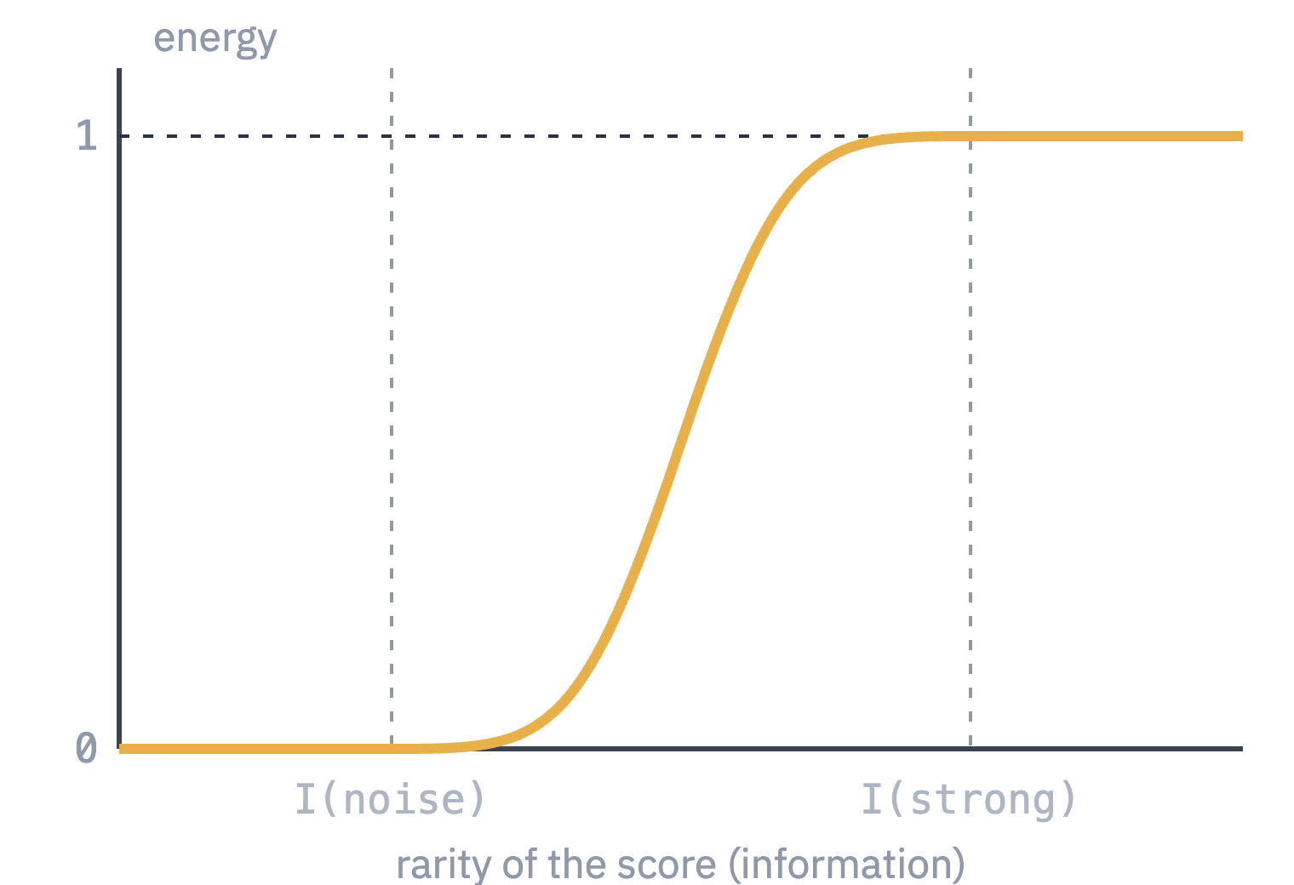
Every kind of evidence becomes energy before it is combined.
HYBRID EVIDENCE
WORDS
energy = found / possible
Two of three query terms inside the span: energy 0.67. A fraction of the evidence the query asked for.
VECTORS
tail = (N − rank + 1) / (N + 1)
information = −log(tail)
A cosine score means nothing alone. How rare is it against a sampled background for this model and field?
Rarity is not relevance. It only gives vectors and words a common, bounded scale.
Notes:
Source: result.cxx for the lexical side (Energy = evidence / possibleEvidence, where possibleEvidence comes from AuxCount, at least the number of distinct lexical sources) and HybridEnergy.md for the vector side. I only saw the end of HybridEnergy.md, so this is what it says there: a background table gives rank tails with a pseudocount so unseen tails stay finite; information = -log(tail); lookup interpolates adjacent entries in O(1); a smoothstep maps information between I(VectorNoise) and I(VectorStrong) to bounded evidence; the table is parsed once per result set, and invalid tables fall back to fixed score anchors. The curve is a sketch of a smoothstep, with no numeric anchors shown because I have none. Calibration is per model and per field, sampled with vector_background.py / vector_background.cpp. Say the document's own caveats out loud: random corpus pairs only approximate a background; ANN picks extreme scores from many candidates, so rarity alone does not establish relevance; sample size limits tail resolution; this is a calibration mechanism, not a fitted model, and anchors and fusion weights still need validating on judged searches.

Slide 54
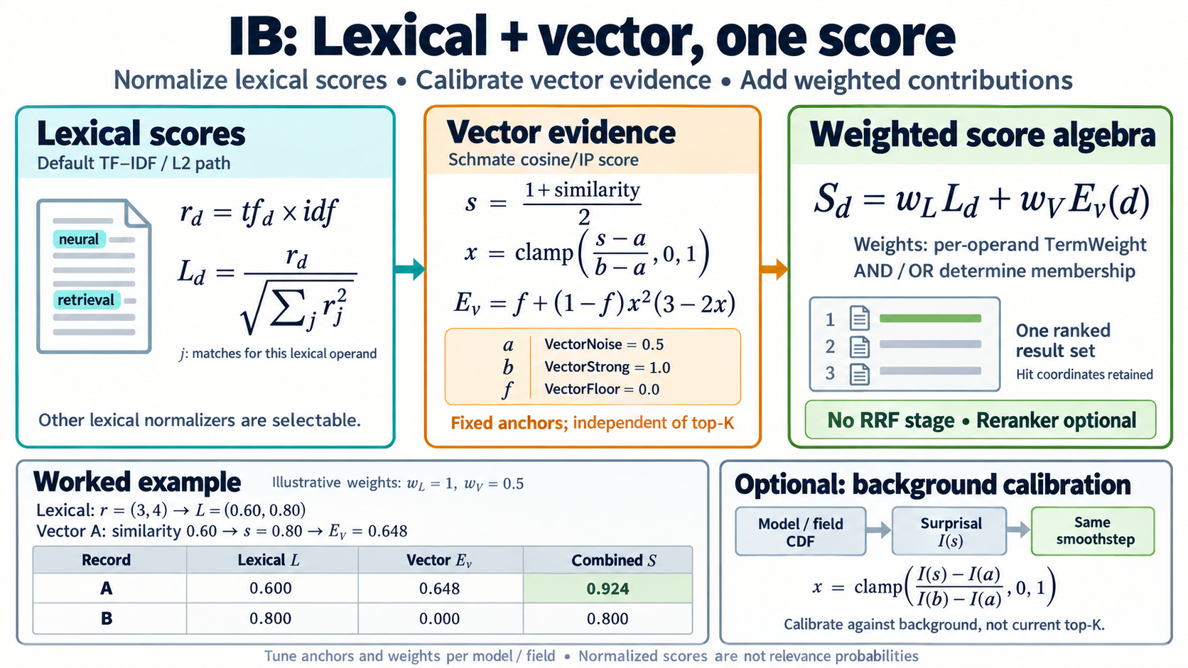

Slide 55
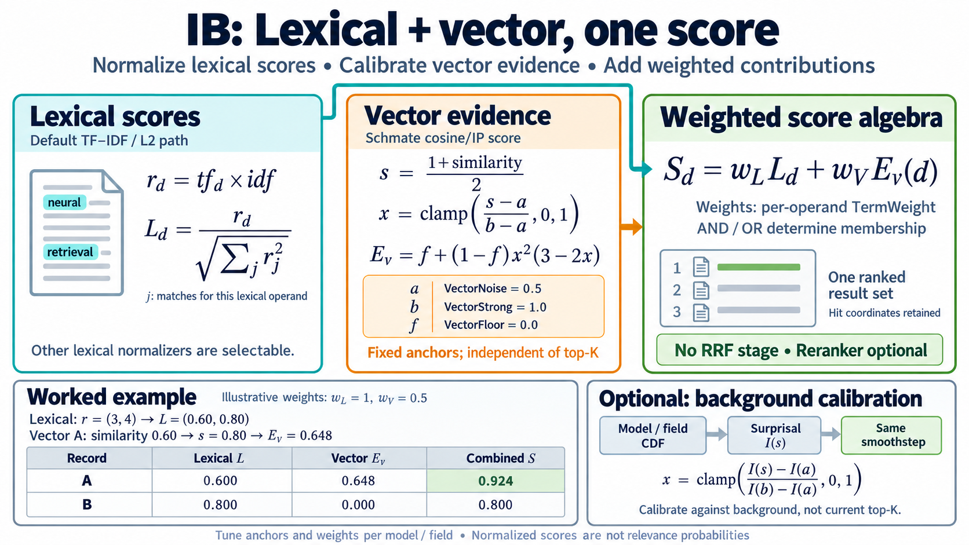

Slide 56
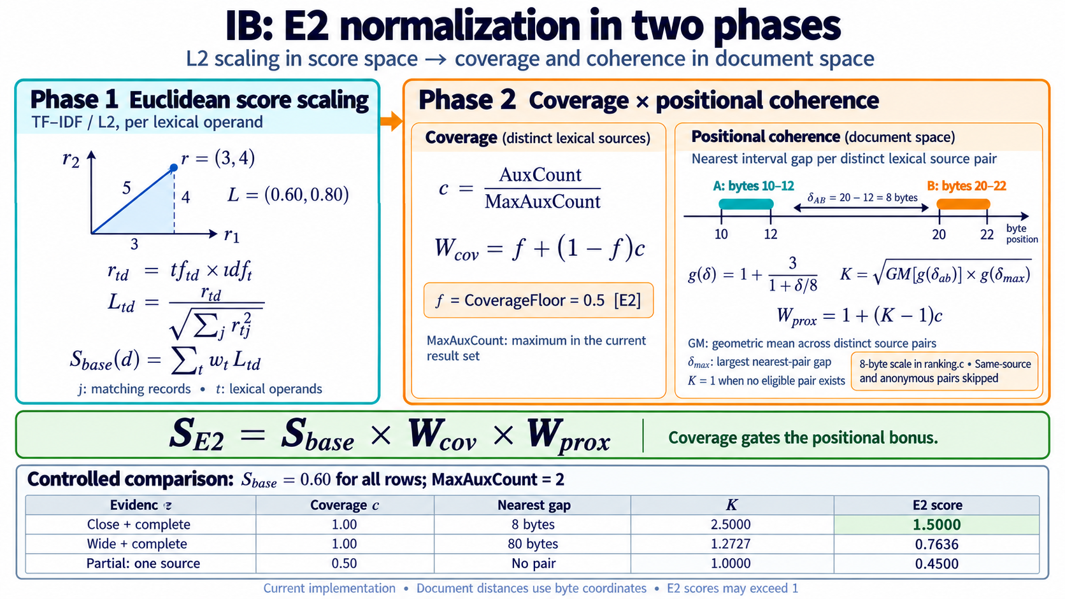

Slide 57
A cover wins by holding more evidence in less space.
HYBRID EVIDENCE
rank = energy
× 1 / (1 + dispersion / 32)
dispersion = extent width in bytes ÷ evidence items
0.62
0.28
0.14
both terms within 40 bytes
one term, 8 bytes
both terms spread over 400 bytes
Worked example for a two-term query, computed from the formula. Illustration, not a measurement.
Notes:
Straight from result.cxx: EvidenceWeight 1.5 (the comment says it was 1.0), DispersionWeight 1.0, DispersionDecay 32. A cover is a minimal window holding K distinct query terms, found by a sliding window over hits ordered by start address; a vector or date hit (no lexical source id) can join a lexical cover as one extra evidence dimension, and extent is the union. The three numbers are computed: A has energy 1 and dispersion 40/2 = 20, so 1 / (1 + 20/32) = 0.615; the single term has energy 0.5, so 0.5^1.5 = 0.354, dispersion 8, compactness 0.8, giving 0.283; the loose pair has dispersion 400/2 = 200, compactness 0.138. Say plainly that the parameters are hand-set first experimental values (the code comment says so), not fitted to judgments. This is a heuristic for choosing which passage to show and how to order covers, and it is separate from the structural match.

Slide 59
Similar is not the same as true.
SEMANTIC SEARCH
query
who won the 2016 election
default32]> search who won the 2016 election
- [score=0.897411, sid=9, label=8, tokens=[0,9]] Donald Trump won the election for President against Clinton
- [score=0.884343, sid=10, label=9, tokens=[0,6]] Biden won the election against Trump
- [score=0.880801, sid=8, label=7, tokens=[0,8]] Hilary Clinton lost the election against Donald Trump
- [score=0.876038, sid=491, label=490, tokens=[0,23]] The 2016 presidential election shocked political observers when Donald Trump defeated Hillary Clinton despite losing the popular vote by nearly three million ballots.
- [score=0.871397, sid=507, label=506, tokens=[0,27]] Joe Biden defeated Donald Trump in the 2020 presidential election with over seven million more votes and 306 electoral votes in a contest marked by record turnout.
[default32]>
A vector finds text about the question. It does not know which text answers it.
Notes:
PLACEHOLDER: paste the real result list from your run into the second box. The claim is narrow: nearest neighbours are topical, and a fact question needs the text that states the fact, which is often a short, specific span that a word or field constraint can find and an embedding ranks no better than any other election text. This is the honest limit of semantic search and it is why the engine keeps both views. Do not claim words would have answered it without checking on the same corpus.

Slide 60
Similar is not the same as true.
SEMANTIC SEARCH
who won the 2016 election
0.897
Donald Trump won the election for President against Clinton
0.884
Biden won the election against Trump
0.881
Hilary Clinton lost the election against Donald Trump
0.876
The 2016 presidential election shocked political observers when Donald Trump defeated Hillary Clinton…
0.871
Joe Biden defeated Donald Trump in the 2020 presidential election…
Rank 2 gets the winner wrong, and the only sentence that says “2016” ranks fourth.
Notes:
Real output from your vector tool: search who won the 2016 election, five best of a toy set of about 800 sentences. Scores are cosine, INT4-quantised. Rank 1 is right, rank 3 is a correct paraphrase, rank 2 (Biden won the election against Trump, 0.884) is wrong for 2016, and rank 4, the sentence that actually mentions 2016, is below it. Rank 5 is the 2020 election. The claim is narrow: nearest neighbours are about elections and Trump, not about which election or who won. Embeddings can place paraphrases together but have little sense of year or of who beat whom. Do not claim words would have done better without testing it on this same set; plausibly a word match on 2016 finds the fourth sentence, but I have not seen that run. One query, one small set, one model: say so.

Slide 61
In high dimensions, some vectors are everyone’s neighbour.
VECTOR SCALE
HUBNESS
HNSW RUNS ON THEM
“Popular” nearest neighbors: a few points appear in far more neighbour lists than the rest, and the skew grows with dimension.
Hubs act as highways that route queries early in the search. The hierarchy was supposed to do that job.
d < 32
Radovanović, Nanopoulos & Ivanović, Hubs in Space, JMLR 2010
is where the hierarchy helped. Our embeddings are 384 to 4096.
Munyampirwa, Lakshman & Coleman, The ‘H’ in HNSW Stands for “Hubs”, ICML 2025 workshop
The thing that makes the graph fast is the same thing that makes some vectors show up for everything.
Notes:
Sources checked: the JMLR abstract defines hubness as points with very high k-occurrence that “effectively represent popular nearest neighbors”, with a distribution that becomes considerably skewed as dimensionality increases, an inherent property of high-dimensional data. The ICML 2025 workshop paper (Munyampirwa, Lakshman, Coleman) finds that the hierarchy of HNSW gives no clear benefit on high-dimensional datasets, that a flat graph matched HNSW on latency and recall with less memory, and that hubs, well-connected nodes heavily traversed early in a search, play the highway role. They tested 13 datasets from 1M to 100M vectors; on synthetic data the hierarchy sped up search only for d below 32. The embeddings in this talk: MiniLM-L12 is 384-d, bge-large 1,024-d; Gemini and Promptriever in the LIMIT paper are 3,072 and 4,096. The last sentence on the slide is the inference: a hub is close to many points, including irrelevant ones. That is my reading of what “popular neighbour” means for retrieval, not a result of the HNSW paper. Caveat: their memory comparison involves two codebases.

Slide 62
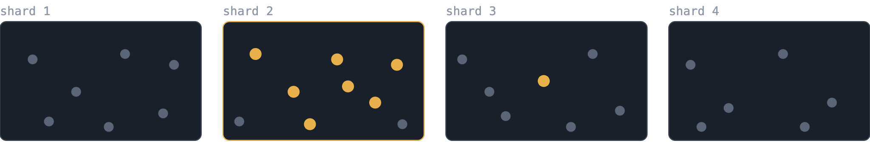
Sharding bounds the graph. It doesn’t spread the answer.
VECTOR SCALE
WHY SHARD
WHY IT ISN’T ENOUGH
183 GB
Each shard returns its own top-k. Here k = 5: shard 2 holds seven relevant vectors and loses two, while three shards return five non-answers each.
peak memory to build a 100M-vector HNSW graph (BigANN, hnswlib)
Notes:
The 183 GB is from the HNSW-hubs paper’s Table 6 (BigANN, 100M vectors, 128-d, hnswlib; FlatNav needed 113 GB); the authors caution that part of the memory gap may come from implementation differences, but the 183 GB figure is a real peak. That is the argument for sharding: the graph and its build have to fit in RAM. The picture is an illustration, not data: eight relevant vectors, seven in one shard. How sharding spreads data decides what goes wrong. Random sharding gives every shard a slice of every topic, so each returns a few relevant results among noise and the per-shard cut is arbitrary. Sharding by source, date or collection concentrates the relevant vectors in one or two shards, and a fixed per-shard k either cuts relevant results (the shard that holds them) or fills the merge with non-answers (the others). Either way, a fixed k is the wrong budget; that ties back to the adaptive-k point. The usual workaround is to over-fetch per shard and merge, which costs latency. This is my reasoning, not a measurement.

Slide 63
Keep shards small: about 50,000 vectors.
VECTOR SCALE
50k
100k
>100k
comfortable
still OK, the ceiling
quality and latency fall off in our tests
[Your measurements here: recall@10 and latency at 50k, 100k and 200k vectors, same model, same machine]
1,000,000 vectors is 20 shards. A rule like that only works if you can say which shards to ask.
Notes:
Be clear this is a rule of thumb from your own tests on commodity hardware, with the model, dimension and machine you used, not a published benchmark and not a vendor recommendation. Many systems run far larger indexes per segment or shard; I haven't checked current vendor figures, so don't cite any. If asked why so small: this is tuned for commodity hardware and low, predictable latency. Arithmetic you can use, computed: 1,000,000 / 50,000 = 20 shards, 100,000,000 / 50,000 = 2,000. The payload of one 50,000-vector shard is small: 50,000 × 384 dimensions × 4 bytes is about 77 MB in float32 (MiniLM-L12) and about 9.6 MB at INT4 (half a byte per dimension); for a 1,024-dimension model such as bge-large, about 25.6 MB at INT4. That excludes the graph links. A possible reason for the knee, which I have not tested: past some size the working set stops fitting in cache; if your numbers show a knee, compare it with your machine’s cache size before saying so. Fill in the dashed box with real numbers or delete it; I can chart them if you send them. The last line links to the previous slides: many small shards means fan-out, so you need adaptive k per shard and lexical or typed narrowing to decide where to look.

Slide 64
Context anchors a vector. It doesn’t solve scale.
VECTOR SCALE
WHAT OTHERS PUBLISH
Milvus, manual partitions
~20–100K rows
OUR RULE OF THUMB
50k–100k
Weaviate, flat → HNSW
10,000 objects
Weaviate, flat-search cutoff
40,000
vectors per shard, from our own tests on commodity hardware
Weaviate, before enabling PQ
10K–100K per shard
Qdrant, binary quantization
up to 32× smaller
Embeddings crowd into a narrow cone (anisotropy). Cookie-cutter text like abstracts should crowd them further, so the one sentence that carries the finding hides among look-alikes. Our own top-5 scores for one query span 0.897 to 0.871.
Notes:
Numbers, as published and read from vendor documentation: Milvus guidance of about 20–100K rows per manually created partition (Milvus “shards” are write channels, so don’t compare those); Weaviate’s dynamic index switches from flat to HNSW at 10,000 objects by default, its flat-search cutoff defaults to 40,000, and its docs say to have 10,000 to 100,000 vectors per shard before enabling PQ (these are thresholds, not recommended maximums; Weaviate sets no maximum shard size); Qdrant lists binary quantization as up to 32× memory reduction, best suited to models with 1,024 or more dimensions. The point to make: your numbers sit in the same range as the published small-index thresholds, while vendors stress scale through quantisation and large partitions. The last line rests on the anisotropy literature: embeddings tend to occupy a narrow cone, so cosine scores bunch together and there is little contrast between near and far (see Ethayarajh 2019, arXiv 1909.00512, on contextual word representations, and Su et al. 2021, arXiv 2103.15316, which whitens sentence embeddings as a remedy). The proper term is high anisotropy, or low isotropy; the fixes in the literature are whitening and fine-tuning. Those papers study BERT-style representations, and contrastively trained retrieval models may be less affected, so say that your claim is about your own model. That abstracts, being homogeneous, pack the embeddings even tighter is your hypothesis, not a result. The 0.897 to 0.871 figure is the top five for who won the 2016 election in your toy set (0.897, 0.884, 0.881, 0.876, 0.871); the live-or-die query gave 0.849 down to 0.812. A cheap measurement for the Q&A: the average cosine between random pairs of your sentences. If it sits near 0.8 rather than near 0, that is anisotropy on your own model. Anchoring each sentence to its record and field tells you where it lives, but it doesn’t shrink the crowd of look-alikes. If you have a test (say, abstracts against mixed text at the same shard size), that would turn this into a result; until then, say it is what you expect and what you have seen informally.

Slide 65
IVF scales. It also needs a plan.
VECTOR SCALE
Train first
Uneven cells
Tuned probing
Drift
Cluster centres have to be learned from the data before anything can be added.
Lists end up very different sizes, so query cost depends on which cells a query lands in.
Recall depends on how many cells you visit. Neighbours across a boundary are missed unless you probe more.
When the collection changes, the centres go stale and the index has to be rebuilt.
That suits a managed cluster. It is harder to ask of a laptop that appends documents all day.
Notes:
This is your position, so flag it as such: IVF, and especially IVF with product quantisation, is mainstream and widely used at very large scale (FAISS), and DiskANN is the other well-known route to disk-based scale. The slide is not claiming IVF fails; it is arguing that its requirements (a training pass, balanced cells, tuned probe counts, retraining when the data drifts) sit badly with bare-metal, commodity hardware and an index that grows incrementally. The four points are general properties of cluster-based indexes, not measurements of your engine; I have not benchmarked IVF against HNSW here and no number is on the slide on purpose. If someone asks why not IVF, the honest answer is: it is a reasonable choice at larger scale, and the slide is about the cost of operating it on the hardware you already own.

Slide 66
Exact search has no hubs.
BACK TO THE START
A word hit is a fact about the text. A typed field, a date or a number is exact. Neither has a popularity bias or a capacity limit.
risc matrix AND:CLAIM-TEXT
656,519 → 1
So use them to say where to look, and let the vector say what is similar inside it.
patents, narrowed to the claim in about 17 ms
The vector hit is a span too, so the two intersect without a second database.
Notes:
The loop back to the thesis. Everything on the vector side (hubness, a capacity limit per vector, fixed k, shards that concentrate answers) is a property of approximate similarity. Lexical and typed search is exact and positional, so it has none of these. The measured example is the earlier patents run: risc matrix with AND:CLAIM-TEXT narrows 656,519 records to one in about 20 to 27 ms, warm. Be precise about what is built: vector hits come back as spans with global addresses, so intersecting them with word and field matches is already how the engine combines evidence. I have not seen a pre-filter that restricts the vector search itself to the narrowed span set, so do not claim one unless it exists; say the two result sets intersect. Close by returning to the division of labour: the engine locates, the model understands.

Slide 67
A 198 MB table in front of two billion words.
FOOTPRINT
ONE ENTRY, 29 BYTES
6,817,829
1
20 bytes of word
8 bytes: position
entries in the patents table, about 197.7 MB
Fixed stride, sorted by unsigned byte comparison. A word longer than 20 bytes is marked with * and only its posting range goes back to the text.
7.9%
of entries overflow (538,047)
Notes:
SIS = the sorted string table the word lookup goes through. Entry size is 1 + X + 8 with X = 20 by default, configurable up to 56, so 29 bytes: 6,817,829 × 29 is about 197.7 MB; confirm with ls -l before the talk. Overflow entries (marked *) record the posting range and only that range goes back to the text, so a long word costs a scan of its own postings, not the table. Wikipedia for comparison: 5,783,701 entries, about 168 MB at the same stride (computed, not measured). Tools: sisdump prints a table; sislearn shows how many entries fit in a given width. Caveat: this is the lookup structure, not the whole index; the postings are separate files.

Slide 68
Tiered Index Cache (Why it works):

Slide 69
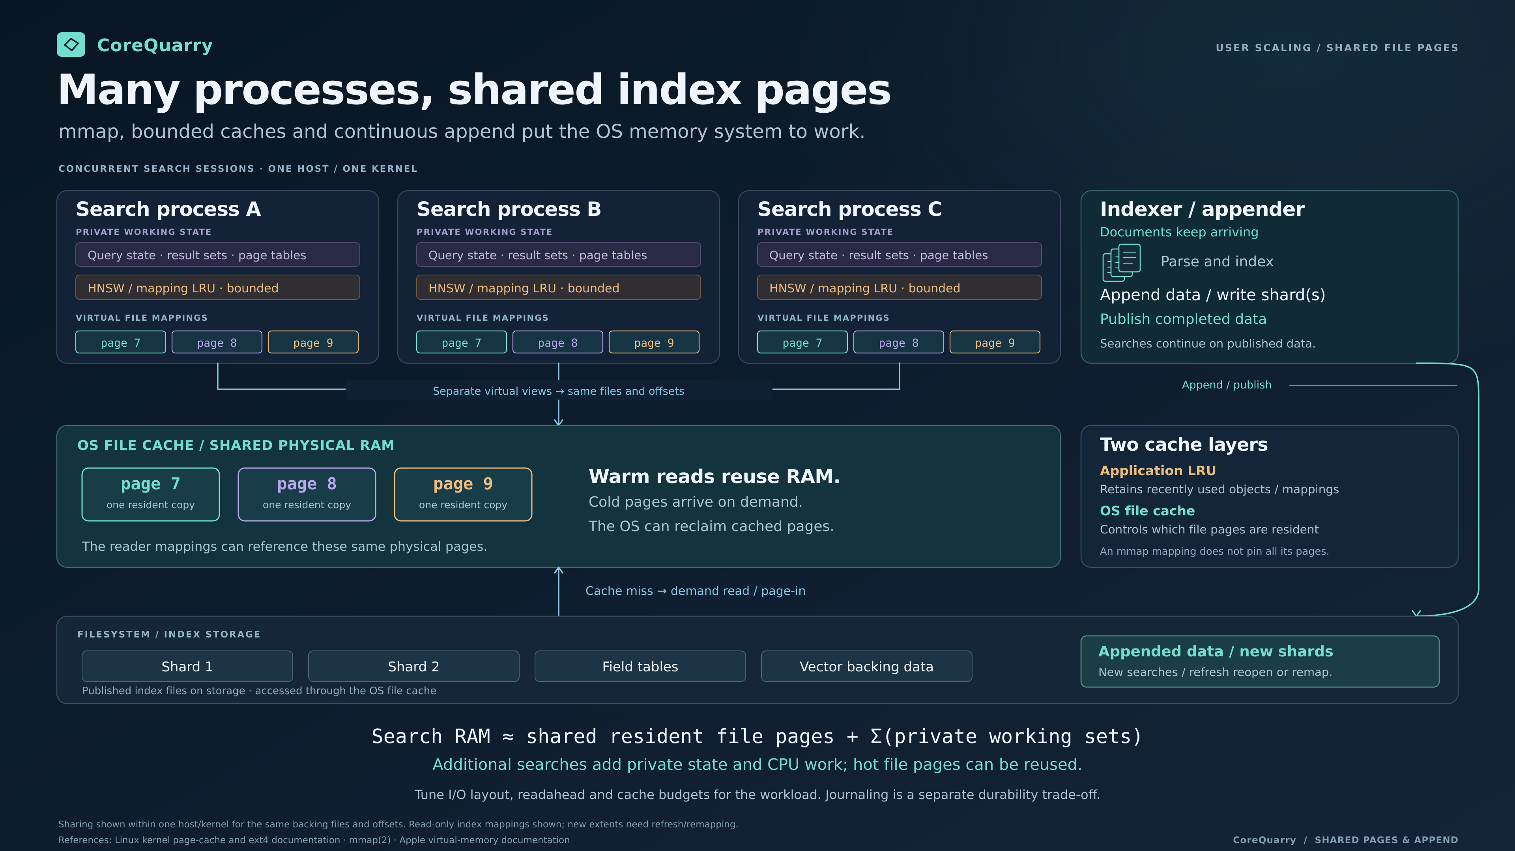

Slide 70
Develop on the floor, not the ceiling.
FOOTPRINT
EMBEDDING ONE QUERY, M1 PRO (METAL)
THE FLOOR
MiniLM-L12, f32
4 ms · 15 ms
A 2021 laptop built the patents index with no swapping. If it works there, a bigger machine is a bonus, not a requirement.
bge-large, q8_0
15 ms · 35 ms
First figure: 11 tokens. Second: 137 tokens.
[Other machines we benchmark: M3 Pro, M4 Pro, AGX Orin, RTX 50 laptop, 2× GTX 1080]
Notes:
Philosophy: build on the slowest machine you intend to support, so every speed-up elsewhere is free; sovereign edge AI and a distributed commons of nodes on hardware people already own. The embedding latencies are measured on the M1 Pro with Metal. The other machines (M3 Pro, M4 Pro, AGX Orin, Dell RTX 50, MSI GT73 with 2× GTX 1080) have no numbers yet, so either collect a single comparable index time and embedding latency for each, or delete the bracketed line; do not describe them as faster without data.

Slide 71
Vectorization performance
Loading /Users/edz/Downloads/bge-large-en-v1.5-q8_0.gguf on accelerated backend (threads=6)...
Model: bge-large-en-v1.5 arch=bert n_embd=1024 load=220 ms
Warmup=5 iters, measure=50 iters
== latency by input length (batch=1) ==
very-short tok= 11 bs= 1 | mean= 14.82 ms med= 14.82 p95= 14.94 min= 14.60 max= 15.05 | 742 tok/s 67.5 seq/s
short tok= 38 bs= 1 | mean= 20.79 ms med= 20.71 p95= 20.98 min= 20.47 max= 22.99 | 1828 tok/s 48.1 seq/s
medium tok=137 bs= 1 | mean= 38.63 ms med= 38.62 p95= 38.74 min= 38.54 max= 38.86 | 3546 tok/s 25.9 seq/s
long tok=263 bs= 1 | mean= 67.24 ms med= 67.21 p95= 67.38 min= 67.12 max= 67.55 | 3911 tok/s 14.9 seq/s
max tok=512 bs= 1 | mean= 116.45 ms med= 116.62 p95= 117.12 min=115.65 max=117.53 | 4397 tok/s 8.6 seq/s
== throughput by batch size (tok=128) ==
bs=1 tok=137 bs= 1 | mean= 38.63 ms med= 38.61 p95= 38.80 min= 38.49 max= 39.08 | 3546 tok/s 25.9 seq/s
bs=4 tok=137 bs= 4 | mean= 135.44 ms med= 135.41 p95= 135.74 min=135.21 max=136.05 | 4046 tok/s 29.5 seq/s
bs=8 tok=137 bs= 8 | mean= 266.41 ms med= 266.36 p95= 266.81 min=266.07 max=266.91 | 4114 tok/s 30.0 seq/s
bs=16 tok=137 bs= 16 | mean= 530.99 ms med= 529.86 p95= 536.17 min=529.20 max=539.27 | 4128 tok/s 30.1 seq/s
bs=32 tok=137 bs= 32 | mean=1069.06 ms med=1067.57 p95=1074.02 min=1066.46 max=1085.44 | 4101 tok/s 29.9 seq/s

Slide 72
Performance on embedded hardware (Orin64)
Loading /Users/edz/Downloads/bge-large-en-v1.5-q8_0.gguf on accelerated backend (threads=6)...
CUDA Device 0: Orin (65.85 GB VRAM)
bert: using CUDA backend (full get_rows support)
Model: bge-large-en-v1.5 arch=bert n_embd=1024 load=1014 ms
Warmup=5 iters, measure=50 iters
== latency by input length (batch=1) ==
very-short tok= 11 bs= 1 | mean= 9.97 ms med= 8.59 p95= 14.95 min= 7.27 max= 20.27 | 1103 tok/s 100.3 seq/s
short tok= 38 bs= 1 | mean= 9.72 ms med= 9.81 p95= 10.02 min= 9.21 max= 10.31 | 3911 tok/s 102.9 seq/s
medium tok=137 bs= 1 | mean= 16.37 ms med= 16.33 p95= 16.53 min= 15.66 max= 17.54 | 8368 tok/s 61.1 seq/s
long tok=263 bs= 1 | mean= 27.97 ms med= 28.00 p95= 28.27 min= 27.18 max= 29.45 | 9402 tok/s 35.8 seq/s
max tok=512 bs= 1 | mean= 46.53 ms med= 46.43 p95= 47.57 min= 45.86 max= 48.14 | 11004 tok/s 21.5 seq/s
== throughput by batch size (tok=128) ==
bs=1 tok=137 bs= 1 | mean= 16.16 ms med= 16.24 p95= 16.64 min= 15.59 max= 18.18 | 8477 tok/s 61.9 seq/s
bs=4 tok=137 bs= 4 | mean= 55.13 ms med= 55.10 p95= 55.39 min= 54.70 max= 56.46 | 9941 tok/s 72.6 seq/s
bs=8 tok=137 bs= 8 | mean= 113.15 ms med= 112.92 p95= 114.58 min=112.46 max=115.63 | 9686 tok/s 70.7 seq/s
bs=16 tok=137 bs= 16 | mean= 215.03 ms med= 214.71 p95= 216.90 min=214.31 max=218.90 | 10194 tok/s 74.4 seq/s
bs=32 tok=137 bs= 32 | mean= 427.06 ms med= 427.35 p95= 428.06 min=425.14 max=428.74 | 10265 tok/s 74.9 seq/s

Slide 73
Indexing Performance (Example).
FOOTPRINT
~700,000
1,459 s
0
words per second, 2 million words. 656519 Patents
Wikipedia, 753 million words. 90666 articles
swaps on the runs
Global counters assign every address as the text streams past, then sorted runs are merged. No cleaning, no schema, no second pass.
Notes:
Rate is computed: 2,021,312,071 words / 2,861 s is about 706,000 words per second. Wikipedia: 753,423,571 words in 1,459 s with a 4,096 MB pool; peak resident was about 9.7 GB there, so do not say memory use is small on that run, say it completed. Patents peaked at 6.8 GB resident with no swaps. Be candid that the merge-ordering bug (sources appearing out of order after CollapseIndexFiles) and a 32-bit truncation in RECORD were found and fixed while preparing these runs; the rebuilt index verifies at 656,519 records. That is a reason to trust the final numbers, not to hide them.

Slide 74
What it will not do, and where it stops.
HONEST LIMITS
HARD CEILINGS
NOT CLAIMED
16 million records per physical index (24-bit record id). [Max 160 HNSW shards if 100k 1:record]
A relevance score on a public benchmark.
Evidence ranking is a heuristic, separate from structure.
255 indexes per virtual database (8-bit slot).
Addresses are 64-bit across all of it.
Case folding is complete for common scripts, not all of Unicode,
(*) To keep some perspective: the SEC has only 1.2-1.7 million fillings per year (~4500/day)
The USPTO gets around 600,000 formal patent applications each year. The NYT publishes about 50-70k pieces of journalism each year.
Notes:
Say these before the audience does. Arithmetic ceiling: 2^24 records times 255 slots is about 4.28 billion records in one virtual database. The identifier is 32 bits (24-bit record, 8-bit slot). Unicode: the two-phase fold covers the cases tested, including für; known gaps are Georgian, capital ẞ and Latin Extended-B, to be fixed after the talk. The SIMD sort is stubbed and not used, so do not mention SIMD as a feature. Not claimed: any BEIR-style score, or that evidence ranking is optimal.

Slide 75
Main Character Sets not yet supported
Samaritan
Mandaic
Syriac Supplement
Devanagari Extended
Devanagari
Bengali
Gurmukhi Gujarati
Oriya
Tamil
Telugu
Kannada
Malayalam
Sinhala
Thai
Lao
Tibetan
Myanmar
Georgian (old range)
Hangul Jamo
Ethiopic
Ethiopic Supplement
CherokeeUnified Canadian Aboriginal Syllabics
Ogham
Runic
Tagalog / Hanunoo / Buhid / Tagbanwa
Khmer
Mongolian
Unified Canadian Aboriginal Syllabics Ext
Limbu

Slide 76
AI Security/Governance (FOSDEM ’24)
https://archive.fosdem.org/2024/schedule/event/fosdem-2024-2079-fortify-ai-against-regulation-litigation-and-lobotomies/
“Fortify AI against regulation, litigation and lobotomies”
AI models, particularly LLMs, readily and sometimes unwittingly may plagiarize content—what constitutes acceptable use is currently not fully resolved— opening their users to copyright tort and other forms of litigation. For society an immanent danger is also in how easily they can be poisoned or lobotomized to propagate disinformation. It is also difficult to uncover and address sources of bias. The later is of particular legislative concern—see emerging regulations such as the EU’s AI Act as a prototype for whats to come. Without traceability for data with clear license expressions and provenance, AI models are easy targets.

Slide 77
Prompt injection is a retrieval problem too.
AN OPEN ISSUE
CHUNK RAG
SPANS
Any text that matches goes into the prompt, whoever wrote it, whichever part of the page it came from.
Every passage has an address and a field. Ask only for the claim text, or only for one author’s lines, and nothing else is fetched.
It narrows what can reach the model. It does not make text safe.
Notes:
Keep this last and short; it is an idea, not a result. The argument: injection works because retrieval returns text with no provenance. When every hit is a span inside a known field of a known record, the caller can restrict retrieval to fields it trusts and can show where each passage came from. Limits, said plainly: an instruction inside a permitted field still reaches the model; there is no test, no attack corpus and no measurement behind this yet. If asked for evidence, say none yet, and that it is the next thing to build. Good Q&A slide to leave on screen.

Slide 78
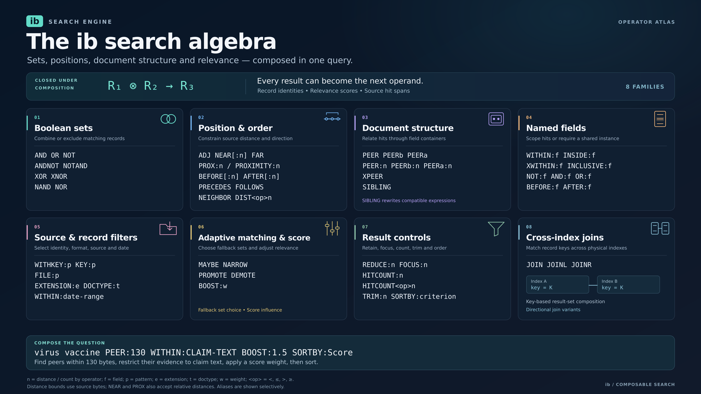

Slide 79
The engine locates. The model understands.
DIVISION OF LABOUR
A search and retrieval engine for humans and agents, built to run on the hardware you already own.
CoreQuarry · corequarry.com
Questions
Notes:
Land the tagline and stop. Then take questions. Keep the prompt-injection slide one step back if you want it ready, and have the limits slide at hand for the BEIR and benchmark questions. Likely questions: why not run BEIR; what about recall for the vector side; how does it scale past 16M records; is the evidence ranking tunable.

Slide 80






Slide 82
Architectural & Competitive Breakdown
Competitor Tier / Paradigm | Representative Systems | Architectural Tax | Language / Runtime Issues | CoreQuarry's Advantage
Classical Inverted IR | Apache Lucene, Elasticsearch, Solr, Tantivy | Immense RAM burn for memory-resident FST term dictionaries; I/O-heavy background segment merges. | Java JVM fragmentation and unpredictable Garbage Collection stalls (Lucene/Solr). | PatArray Architecture: Elimination of traditional inverted dictionary bloat via cache-contiguous, virtual memory-mapped pointer tracking layouts.
Hybrid & Vector First DBs | Weaviate, Qdrant, Milvus | Vectors-first focus leaves them with weak lexical capabilities; require separate post-filtering cycles or cross-index stitching. | Go runtime memory isolation lag; massive multi-node infrastructure dependencies (Kubernetes). | Hardware-Fused Co-Execution: Unifies hard lexical masks and soft tensor weights natively inside single-pass graph traversal runs.
Specialized Vector Backends | FAISS, ScaNN, Baseline HNSWlib | No native transactional CRUD (FAISS/ScaNN); Baseline HNSWlib forces unquantized float32 bloat that exhausts CPU L3 cache pipelines. | Monolithic build matrices (ScaNN/Bazel); lack of native metadata layer capabilities. | Turbo-Quantization Primitives: Blistering, explicitly unrolled ARM Neon/SVE2 kernels driven by compact, low-bit block quantization layouts.
Embedded Databases | SQLite (with extensions), DuckDB | Row-store overhead/serialization penalties (SQLite); analytical column matrices entirely lack structural proximity and linguistic IR paths (DuckDB). | C++ native but bound to isolated virtual table bridges or transient batch-ingestion models. | In-Process Fusion: Zero serialization delays. Text boundaries, sequence configurations, and tensor spaces execute concurrently inside the host app process.
RAG Orchestration | LlamaIndex, LangChain | The "Abstraction Tax." Massive performance degradation by shifting core document segmentation and data mapping to Python object layers. | Python/TypeScript runtime speed ceilings; rely completely on network I/O or external cluster storage engines. | Bare-Metal Efficiency: Fuses the entire ingestion, parsing, tensor quantization, and hybrid discovery lifecycle into a single native runtime.
Structural Lexical Search | MarkLogic | Heavy enterprise server monolith; massive memory-resident cache footprints (List/Range Caches). | Proprietary closed-source distribution; completely un-optimized for embedded edge execution topologies. | Gonnet/Baeza-Yates Inspired Lineage: Elevates early structured text principles to modern silicon. Uses branchless SIMD and MSD Radix sorting over fixed-width 64-character compilation horizons.

Slide 83
CoreQuarry Lexical Index:

Slide 84
CoreQuarry Lexical Index:

