Slide 1
Ghidra AI Chat
Minhazul Rimon , Nutan Panta
April 21, 2026
CEG 7420
Software Reverse Engineering and Program Analysis

Slide 2
Content
Problem
Solution Overview
How It Works
Architecture
Context Collection and LLM
Demo
Technical Implementation
Code structure
Limitation
Future Plans
Conclusion

Slide 3
Problem
Complex & time-consuming
Large codebases
No source code visibility
Manual analysis is error-prone
Need fast contextual answers

Slide 4
Solution Overview
AI assistant inside Ghidra
Context-aware responses
Conversation history
Multiple LLM support
Real-time updates
Flexible context collection

Slide 5
How It Works
Load binary
Launch chat
Navigate code
Ask questions
Receive AI responses

Slide 6
Architecture

Slide 7
Context Collection
Program info
Current location
Decompiled + assembly
Strings, imports, xrefs

Slide 8
LLM Integration
OpenRouter
Google Gemini
Groq (planned)

Slide 9
Demo
Load binary
Run script
Ask function questions
Show AI responses

Slide 10
Technical Implementation
Jython
Ghidra API
JSON storage
HTTP APIs

Slide 11
Code Structure
Modular folders:
ui
context
llm
prompts
store

Slide 12
Limitations
Context limit
Too much redundant data sent
Not efficient
Redundent data received

Slide 13
Future Plans
Template 1 - Find Location information - Codes
Template 2 - Find all from and to from all func. - Codes
Template 3 - Find the password - Codes
Template 4 - Generate the function tree - Codes

Slide 14
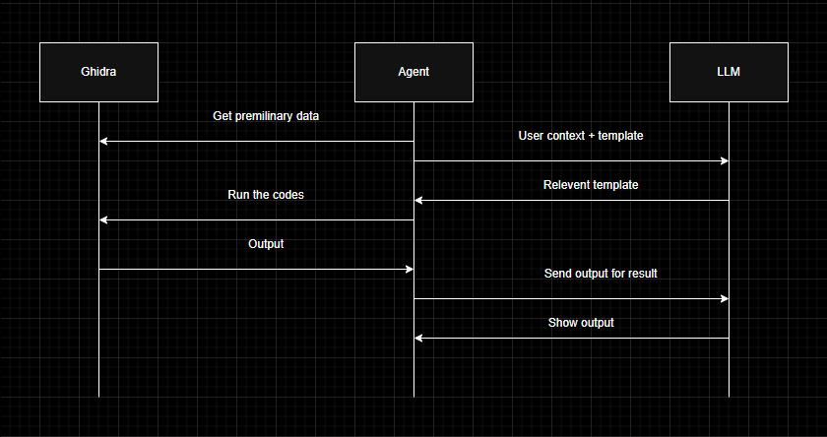
Future Plans

Slide 15
Conclusion
Faster analysis
Better accuracy
Higher productivity
AI-assisted reverse engineering

Slide 16
Thank you!!!

