Slide 1
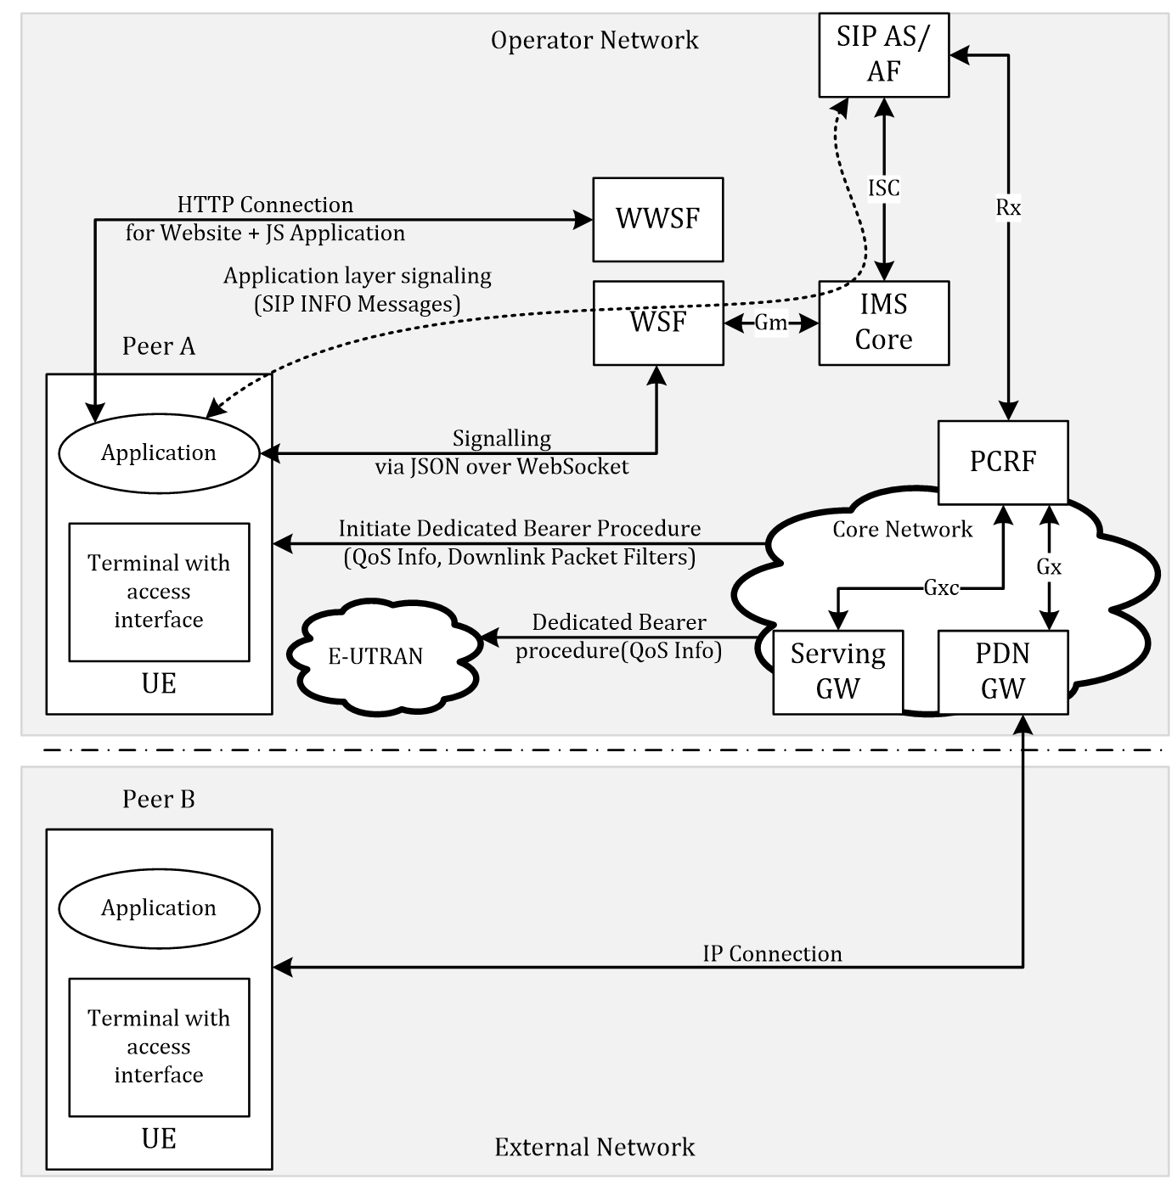

Slide 2
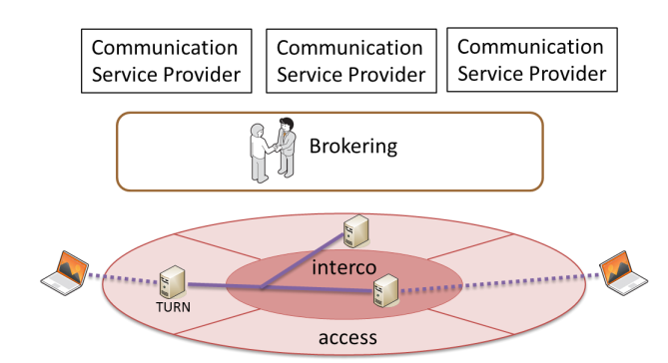
Last Hop Connectivity Broker
LHCB

Slide 3
Broker
AF
LHCB
Traffic Filter Template
TURN server @
TURN
LHCB

Slide 4
Architecture 1
Web Server
AF
getStats info
Broker
PCRF
UE
App
PDN Gateway
dedicated bearer

Slide 5
Architecture 2
Web Server
Broker (AF)
PCRF
UE
App
PDN Gateway
TDF
@TURN
TURN
dedicated bearer

Slide 6
Architecture 3 (for mobile connected devices)
Receive Information from Application (getStats) + TDF
TDF optional
Broker requests QoS parameters via the specific Connectors to each domain
WebrRTC/Web Server
Network Hyperty
Broker
getStats info
AF (Connector)
Backend QoS
Function (Connector)
PCRF
UE
App
dedicated bearer
PDN Gateway
TDF
TURN
Data Plane Traffic
TURN
Other Peer

Slide 7
Architecture 4 (for mobile+fixed connected devices)
Receive Information from Application (getStats) + TDF
TDF optional
Broker requests QoS parameters via the specific Connectors to each domain
WebrRTC/Web Server
Network Hyperty
Broker
getStats info
AF (Connector)
Backend QoS
Function (Connector)
PCRF
UE
App
dedicated bearer
PDN Gateway
TDF
TURN
Data Plane Traffic
TURN
Other Peer
HGW (DSCP Marking)
QoS for Fixed (Connector)

