Slide 1
Architecture (for mobile+fixed connected devices)
WebrRTC/Web Server
Network Hyperty
Data Plane Traffic
Signalling Plane
PeerConnection.getStats() Information
Broker
PeerConnection.getStats() Information
Connector: EPS Application Function
Connector: Backend TURN Network
Mobile Network
UE
App Network Hyperty
PCRF
Traffic Detection Function(s)
Dedicated Bearer
PDN Gateway
TURN
Connector: Fixed Line Access
TURN
UE
App
Network Hyperty
Home/Fixed Network
Other Peer
Traffic Detection Function(s)
HGW (DSCP Marking)
Direct or TURN Server Path

Slide 2
Architecture (for mobile+fixed connected devices)
Stepy by step and interfaces
WebrRTC/Web Server
Network Hyperty
Data Plane Traffic
Signalling Plane
PeerConnection.getStats() Information
Broker
PeerConnection.getStats() Information
Connector: EPS Application Function
Connector: Backend TURN Network
Last Hop Connectivity Broker
LHCB
Mobile Network
UE
App Network Hyperty
PCRF
Traffic Detection Function(s)
Dedicated Bearer
PDN Gateway
TURN
Connector: Fixed Line Access
TURN
UE
App
Network Hyperty
Home/Fixed Network
Other Peer
Traffic Detection Function(s)
HGW (DSCP Marking)
Direct or TURN Server Path

Slide 3
Proposed QoS Categories
QoS Level | GBR | Jitter | Delay | Loss | Comment
No QoS | Best Effort | BE | BE | BE | No guarantees at all
Parameterised QoS (baed on network parameters for direct comm.) | Guaranteed with parameters | Low | < 150ms; (e.g. for audio) | Low | As requested by Hyperties, Enforced on each technological domain; M2M Use Cases applicable
Redirected Path for better QoS (run via TURN servers); | Guaranteed with pre-defined parameters | Low | Pre-defined ~ < 150ms | Low | Detection via TDF Pre-defined network routes via well established network routes (e.g. TURN); H2H/H2M RTC Use Cases applicable

Slide 4
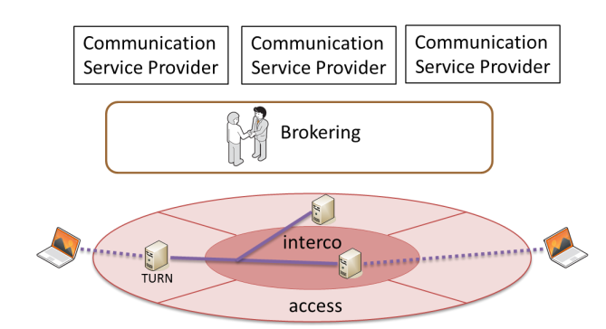
Last Hop Connectivity Broker
Last Hop Connectivity Broker
LHCB

