Slide 1
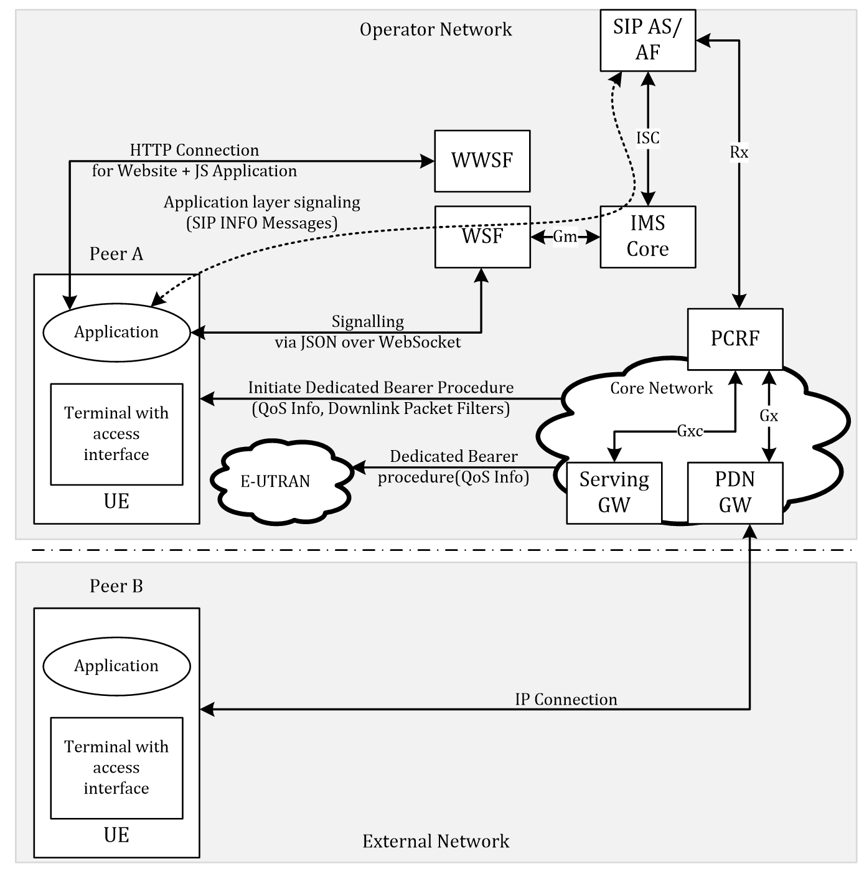

Slide 2
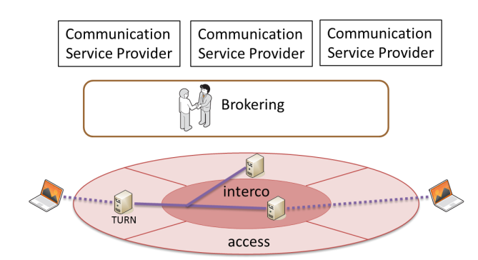
Last Hop Connectivity Broker
LHCB

Slide 3
Broker
AF
LHCB
Traffic Filter Template
TURN server @
TURN
LHCB

Slide 4
Architecture 1
Web Server
AF
getStats info
Broker
PCRF
UE
App
PDN Gateway
dedicated bearer

Slide 5
Architecture 2
Web Server
Broker (AF)
PCRF
UE
App
PDN Gateway
TDF
@TURN
TURN
dedicated bearer

Slide 6
Architecture 3 (for mobile connected devices)
Receive Information from Application (getStats) + TDF
TDF optional
Broker requests QoS parameters via the specific Connectors to each domain
WebrRTC/Web Server
Network Hyperty
Broker
getStats info
AF (Connector)
Backend QoS
Function (Connector)
PCRF
UE
App
dedicated bearer
PDN Gateway
TDF
TURN
Data Plane Traffic
TURN
Other Peer

Slide 7
Architecture 4 (for mobile+fixed connected devices)
Receive Information from Application (PC.getStats()) + TDF
TDF optional
Broker requests QoS parameters via the specific Connectors to each domain
WebrRTC/Web Server
Network Hyperty
Data Plane Traffic
Signalling Plane
PeerConnection.getStats() Information
Broker
PeerConnection.getStats() Information
Connector: EPS Application Function
Connector: Backend TURN Network
UE
App Network Hyperty
+
LHCB
PCRF
Mobile Network
Connector: Fixed Line Access
Dedicated Bearer
PDN Gateway
TURN
TURN
UE
App
Network Hyperty
+
LHCB
Home/Fixed Network
Other Peer
Traffic Detection Function(s)
HGW (DSCP Marking)
Direct or TURN Server Path

Slide 8
Proposed QoS Categories
QoS Level | GBR | Jitter | Delay | Loss | Comment
No QoS | Best Effort | BE | BE | BE | No guarantees at all
Parameterised QoS (based on network parameters for direct comm.) | Guaranteed with parameters | Low | < 150ms; (e.g. for audio) | Low | As requested by Hyperties, Enforced on each technological domain; M2M Use Cases applicable
Redirected Path for better QoS (run via TURN servers); | Guaranteed with pre-defined parameters | Low | Pre-defined ~ < 150ms | Low | Detection via TDF Pre-defined network routes via well established network routes (e.g. TURN); H2H/H2M RTC Use Cases applicable

