Slide 1
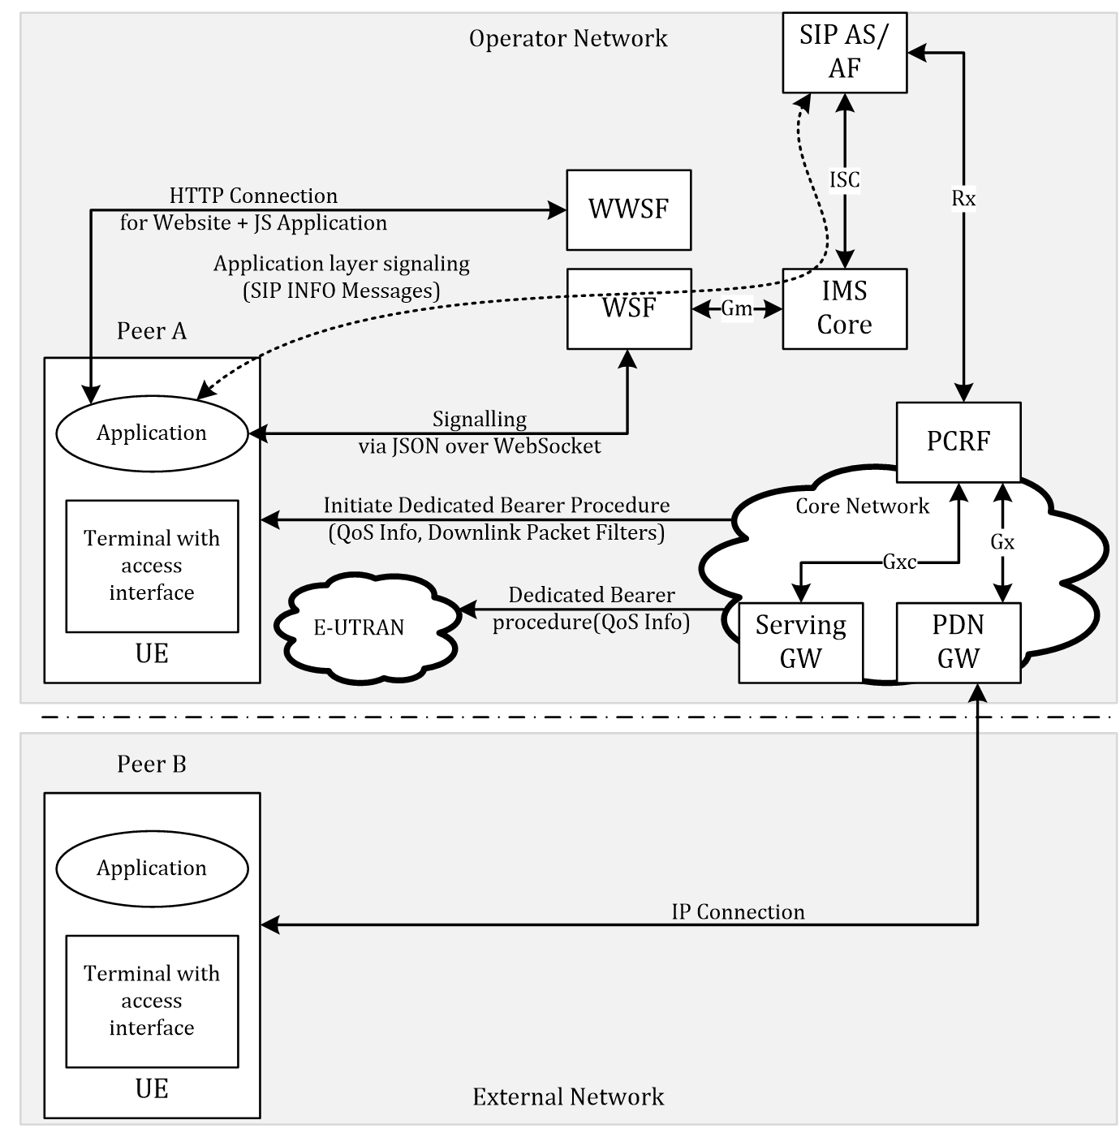

Slide 2
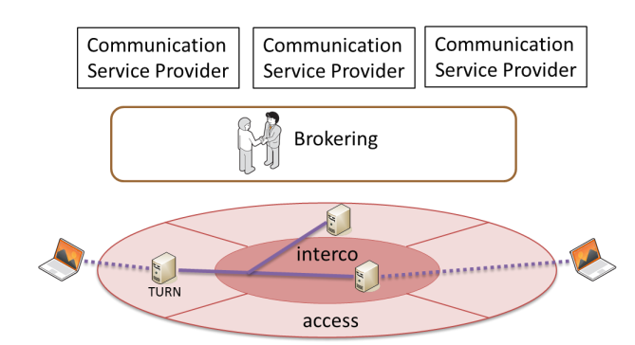
Last Hop Connectivity Broker
LHCB

Slide 3
Broker
AF
LHCB
Traffic Filter Template
TURN server @
TURN
LHCB

Slide 4
Architecture 1
Web Server
AF
getStats info
Broker
PCRF
UE
App
PDN Gateway
dedicated bearer

Slide 5
Architecture 2
Web Server
Broker (AF)
PCRF
UE
App
PDN Gateway
TDF
@TURN
TURN
dedicated bearer

Slide 6
Architecture 3 (for mobile connected devices)
Receive Information from Application (getStats) + TDF
TDF optional
Broker requests QoS parameters via the specific Connectors to each domain
WebrRTC/Web Server
Network Hyperty
Broker
getStats info
AF (Connector)
Backend QoS
Function (Connector)
PCRF
UE
App
dedicated bearer
PDN Gateway
TDF
TURN
Data Plane Traffic
TURN
Other Peer

Slide 7
Architecture 4 (for mobile+fixed connected devices)
Receive Information from Application (PC.getStats()) + TDF
TDF optional
Broker requests QoS parameters via the specific Connectors to each domain
WebrRTC/Web Server
Network Hyperty
Data Plane Traffic
Signalling Plane
PeerConnection.getStats() Information
Broker
PeerConnection.getStats() Information
Connector: EPS Application Function
Connector: Backend TURN Network
UE
App Network Hyperty
+
LHCB
PCRF
Mobile Network
Connector: Fixed Line Access
Dedicated Bearer
PDN Gateway
TURN
TURN
UE
App
Network Hyperty
+
LHCB
Home/Fixed Network
Other Peer
Traffic Detection Function(s)
HGW (DSCP Marking)
Direct or TURN Server Path

Slide 8
Proposed QoS Categories
QoS Level | GBR | Jitter | Delay | Loss | Comment
No QoS | Best Effort | BE | BE | BE | No guarantees at all
Parameterised QoS (based on network parameters for direct comm.) | Guaranteed with parameters | Low | < 150ms; (e.g. for audio) | Low | As requested by Hyperties, Enforced on each technological domain; M2M Use Cases applicable
Redirected Path for better QoS (run via TURN servers); | Guaranteed with pre-defined parameters | Low | Pre-defined ~ < 150ms | Low | Detection via TDF Pre-defined network routes via well established network routes (e.g. TURN); H2H/H2M RTC Use Cases applicable

Slide 9
QoS Broker
Tasks to accomplish
Offer the most feasible TURN Server for a particular connection
Push Probe targets to create an overlay AN-TURN Network
Calculate paths costs

Slide 10
Example
TURN + Agent
BROKER
UE1
AN1
AN2
TURN + Agent
AN3
TURN + Agent
AN4
UE4
TURN + Agent
TURN + Agent

Slide 11
Example
BROKER
AN1
Agent
TURN + Agent
UE1
AN1
AN2
Agent
AN2
Registering TURN Agent at Broker
AN3
Agent
AN3
TURN + Agent
TURN + Agent
AN4
Agent
AN4
UE4
TURN + Agent
TURN + Agent

Slide 12
Example
BROKER
List of AN(x) Agents
AN1
Agent
TURN + Agent
UE1
AN1
AN2
Agent
AN2
AN3
Agent
AN3
TURN + Agent
TURN + Agent
AN4
Agent
AN4
UE4
TURN + Agent
TURN + Agent

Slide 13
Example (Probing TURN 1)
BROKER
AN1
Agent
Ping Probing
TURN + Agent
UE1
AN1
Ping Probing
AN2
Agent
Ping Probing
AN2
Ping Probing
AN3
Agent
AN3
TURN + Agent
TURN + Agent
AN4
Agent
AN4
UE4
TURN + Agent
TURN + Agent

Slide 14
Example (Probing TURN 1)
BROKER
AN1
Agent
15ms
TURN + Agent
UE1
AN1
20ms
AN2
Agent
50ms
AN2
80ms
AN3
Agent
AN3
TURN + Agent
TURN + Agent
AN4
Agent
AN4
UE4
TURN + Agent
TURN + Agent
Pushing probe results to Broker

Slide 15
Example (Probing TURN 2)
BROKER
AN1
Agent
TURN + Agent
UE1
AN1
AN2
Agent
150ms
AN2
20ms
AN3
Agent
AN3
20ms
TURN + Agent
60ms
AN4
Agent
AN4
UE1
TURN + Agent
TURN + Agent
Pushing probe results to Broker

Slide 16
Example (Probing TURN 3)
BROKER
QoS avail.
QoS avail?
AN1
Agent
TURN + Agent
UE1
AN1
30ms
AN2
Agent
AN2
80ms
AN3
Agent
AN3
TURN + Agent
QoS
Agent?
AN4
Agent
10ms
AN4
UE4
10ms
TURN + Agent
TURN + Agent
Pushing probe results to Broker

Slide 17
Calculate best TURN Server
Access Network | TURN 1 | TURN 2 | TURN 3 | …
AN 1 | 15 | 150 | 30
AN 2 | 20 | 20 | 80
AN 3 | 50 | 20 | 10
AN 4 | 80 | 60 | 10
All values in ms
Peer A at AN 1 wants to communicate with Peer B at AN 4
Path combinations to consider:
AN 1 to TURN 1 (15ms) + TURN 1 to AN 4 (80ms) = 95ms
AN 1 to TURN 2 (150ms) + TURN 2 to AN 4 (60ms) = 210ms
AN 1 to TURN 3 (30ms) + TURN 3 to AN 4 (10ms) = 40ms
QoS Broker proposes IP address / user credentials of Turn Server 3 for that particular PeerConnection.

Slide 18
Calculate best TURN Server
All values in ms
Access Network | TURN 1 | TURN 2 | TURN 3 | …
AN 1 | 15 | 150 | 30
AN 2 | 20 | 20 | 80
AN 3 | 50 | 20 | 10
AN 4 | 80 | 60 | 10
Calcuations AN 1 to AN4 | 95 | 210 | 40
Peer A at AN 1 wants to communicate with Peer B at AN 4
Path combinations to consider:
AN 1 to TURN 1 (15ms) + TURN 1 to AN 4 (80ms) = 95ms
AN 1 to TURN 2 (150ms) + TURN 2 to AN 4 (60ms) = 210ms
AN 1 to TURN 3 (30ms) + TURN 3 to AN 4 (10ms) = 40ms
QoS Broker proposes IP address / user credentials of Turn Server 3 for that particular PeerConnection.

Slide 19

Open Points
How to find out, which AN the User is connected to
LHCB?
Fixed entry at session setup?
Via the CSP?
How to probe correctly between AN and TURN Agents
Proposal to still use Access Network Connectors for setting up QoS at Access Network Level (e.g. on mobile networks with LTE/EPS Bearers, DSCP on fixed networks)
Update current existing developed QoS Broker and Agent
Caching the proposed path for a certain time
Accounting of consumed data
Figure out Use Cases which require optimized TURN Servers, which Use Cases require additional QoS
Add a usage metric to the proposed path costs e.g.
$${costs}_{Turn x}=pathdelay (1+e^{\frac{{currentUsage}_{Turn x}}{{maxUsage}_{Turn x}}})$$

Slide 20
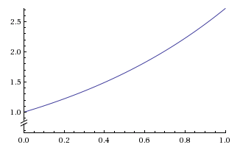

Open Points (2)
Example
$${costs}_{Turn x}=pathdelay (1+e^{\frac{{currentUsage}_{Turn x}}{{maxUsage}_{Turn x}}})$$
e.g.
$${costs}_{Turn 3}=40 ms\left(1+e^{\frac{10}{50}}\right)=88.8 ms=89 ms$$
http://www.wolframalpha.com/input/?i=e%5Ex%2C+x%3D0+to+1

