Slide 1
WP-3 Task 3: LHCP
Marc Emmelmann (Fraunhofer FOKUS)
Confidentiality: This document is internal to reTHINK and may not be made available outside the scope of the project consortium

Slide 2
LHCB Design Principles
Align with agreed interface concepts in reTHINK
Reusability of interface implementations / hyperties
Ease of deployment
Extensibility
Initial design based on getter() primitives to access information from the LHCB about clients‘ connectivity attributes
Consider (native) support for notification-upon-attribute-change
Clients may be constrained devices

Slide 3
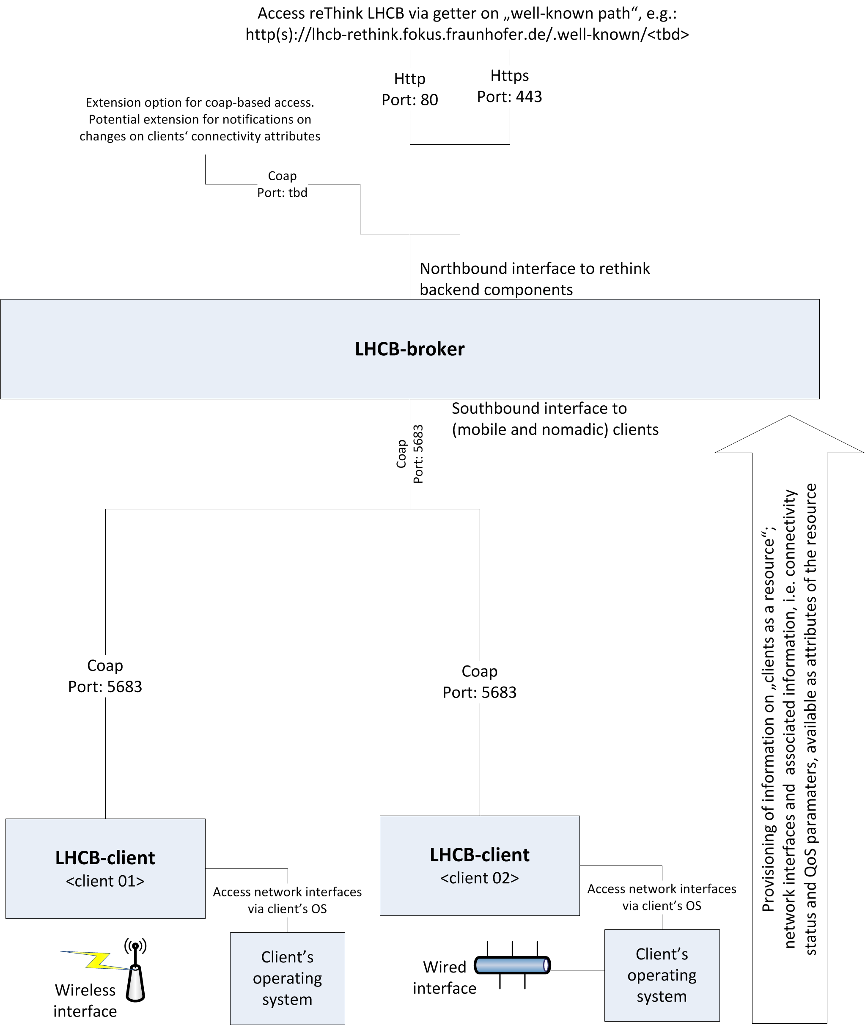
LHCB Architecture
Two components
LHCB-broker
LHCB-client
Broker
Accumulates information from client and exposes them to other rethink backend components
Getter()-based read access (http(s) request on well-known path)
Potential extension towards coap to allow for subscriptions and write-access to attributes
Client
Provides representation of client / interfaces as a resource with attributes
Attributes contain information on connectivity status

Slide 4
LHCB Status of Implementation
Broker
Initial framework analyzed
Implementation of broker core started
Open: definition of well-known path for accessing information about client
Client
Evaluation of different frameworks as we might not have a one-fits-all implementation (clients have different operating systems)
Definition of resource model

Slide 5
LHCP Discussion Points
RO vs. RW access from backend
Do we need to convey information back to the client (i.e. back-end component may issue whish that client connects via a certain interface type)?
RO based on http(s); RW to be based on coap
Needs to be reflected early in the data model for the stored information
Data model
Well-known path descriptor needed
What information is required from the client?
How do the entry access keys look like (first part of well known path)?
Are we interested in the connectivity information of a given client device or in information how to access a user (potentially via different devices)?

Slide 6


Contact
Links:
www.fuseco-playground.org
www.sc-playground.org
www.fuseco-forum.org
www.openmtc.org
www.openepc.net.
Marc Emmelmann
Senior Researcher
Next Generation Network Infrastructures
Fraunhofer Institute for Open Communication Systems
Kaiserin-Augusta-Allee 31 | 10589 Berlin | Germany
Phone +49 30 3463 - 7268
marc.emmelmann@fokus.fraunhofer.de
www.fokus.fraunhofer.de/go/ngni
Any Questions

