Slide 1
A Research on Computer Science Students’ Cognition and Usage Patterns
of Generative Models
June 6th, 2024
School of Computer Science and Engineering
Group2

Slide 2
CONTENT
01
Introduction
04
Results & Discussion
02
Literature Review
05
Conclusion
03
Method
Notes:
框改斜线

Slide 3
Introduction

Slide 4





Introduction
Background: Generative AIs are becoming more and more popular
Existing Question: Current research on generative AI mostly focuses on the public level
Focus: computer science students cognition level, user patterns and usage tricks of generative AIs
Our Research: mixed methods; abundant data analysis; evidence-based conclusion
A Research on Computer Science Students’ Cognition and Usage Patterns of Generative Models
Notes:
Ok, it’s the introduction part now. The background is that generative AIs like chatgpt, kimi, spark, tongyiqianwen and doubao are becoming more and more popular. Though there exists many research of user patterns and recognition level of generative models. Most of them focus on the public level rather than specific group. So, in our research, we focus on the computer science students’ cognition level, user patterns and usage tricks of generative Ais. Our research mixed methods to fetch data. And apply abundant data analysis, give the evidence-based conclusion. Then let’s come to the next part.

Slide 5
Literature Review

Slide 6
Literature Review
Data generation & Natural language processing
Generative models have emerged as a pivotal concept in the realm of computer science, with a particular focus on the utilization of models like ChatGPT.
It is essential for computer science students to grasp the intricacies of generative models, considering their significance in various applications.
mental comprehension
application trends
A Research on Computer Science Students’ Cognition and Usage Patterns of Generative Models

Slide 7

Literature Review
Ruthotto and Haber (Ruthotto & Haber, 2021) offered an introduction to deep generative modeling, focusing on three popular approaches.
Normalizing flows
Variational autoencoders
Generative adversarial networks
Ruthotto, L., & Haber, E. (2021). An introduction to deep generative modeling. GAMM‐Mitteilungen, 44(2), e202100008.
These models are particularly influential in natural language processing, where they can generate human-like text (Brown et al., 2020).
Brown, T., Mann, B., Ryder, N., Subbiah, M., Kaplan, J. D., Dhariwal, P., ... & Amodei, D. (2020). Language models are few-shot learners. Advances in neural information processing systems, 33, 1877-1901.
A Research on Computer Science Students’ Cognition and Usage Patterns of Generative Models

Slide 8
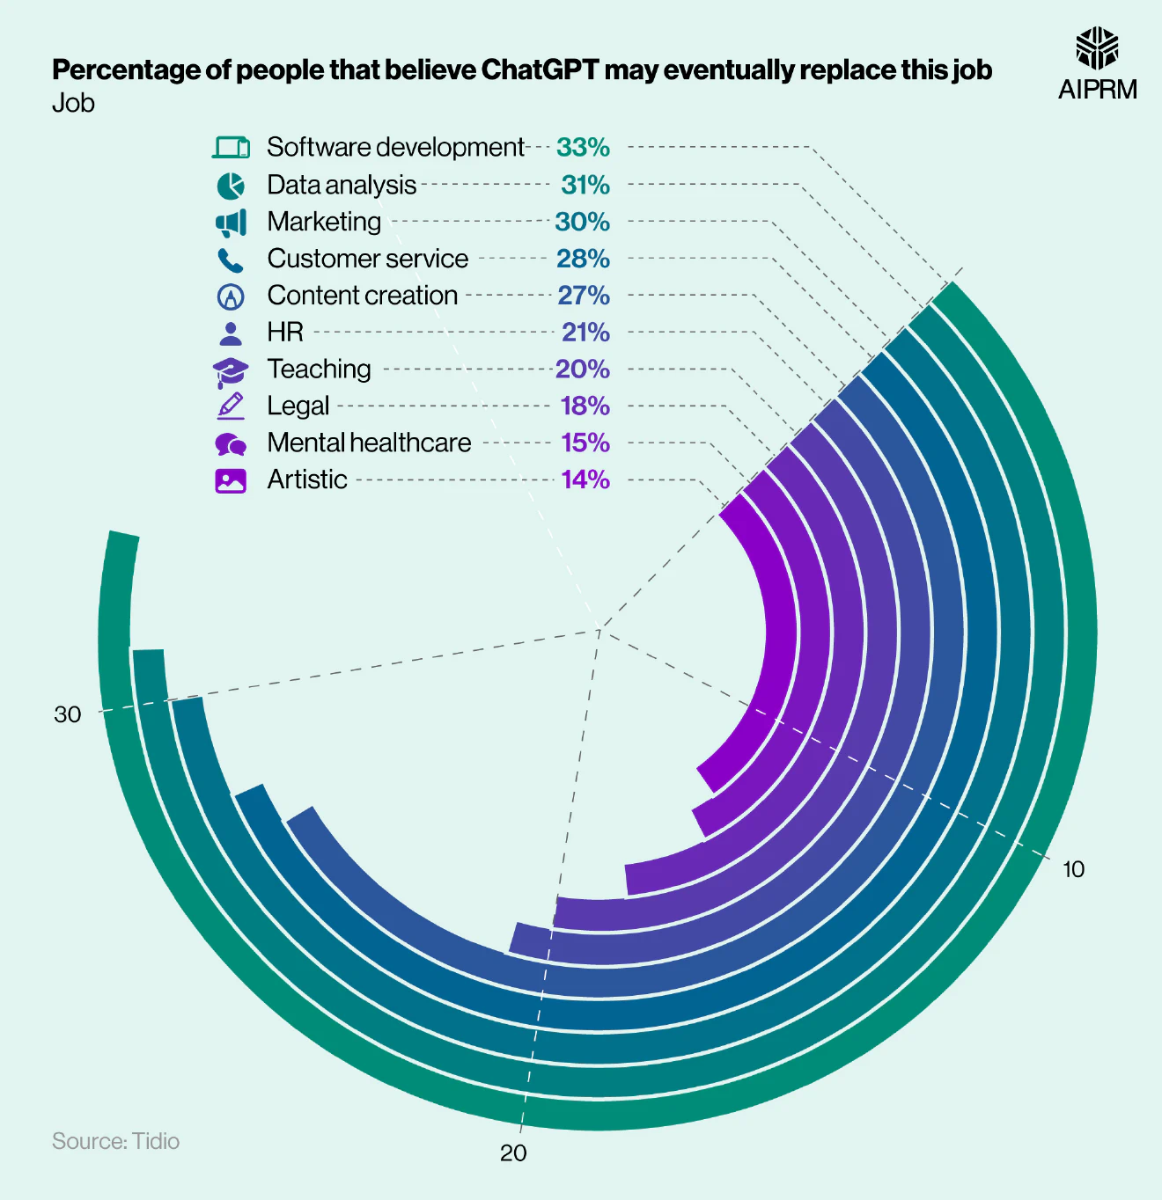
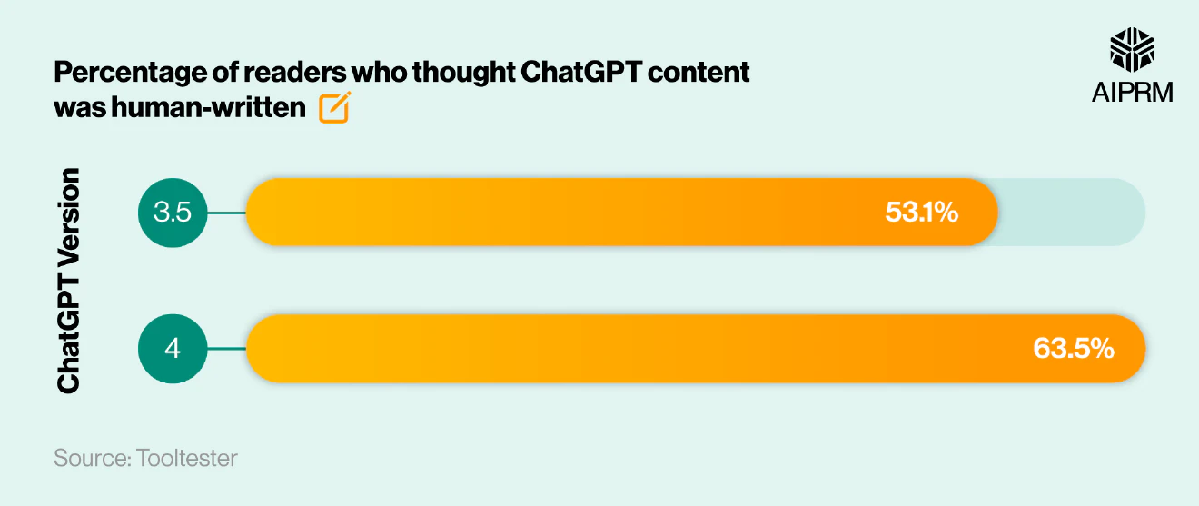
Literature Review
The controversy surrounding generative models
Author: Wang
Year: 2023
Topic: The complex public perceptions of ChatGPT
A Research on Computer Science Students’ Cognition and Usage Patterns of Generative Models

Slide 9
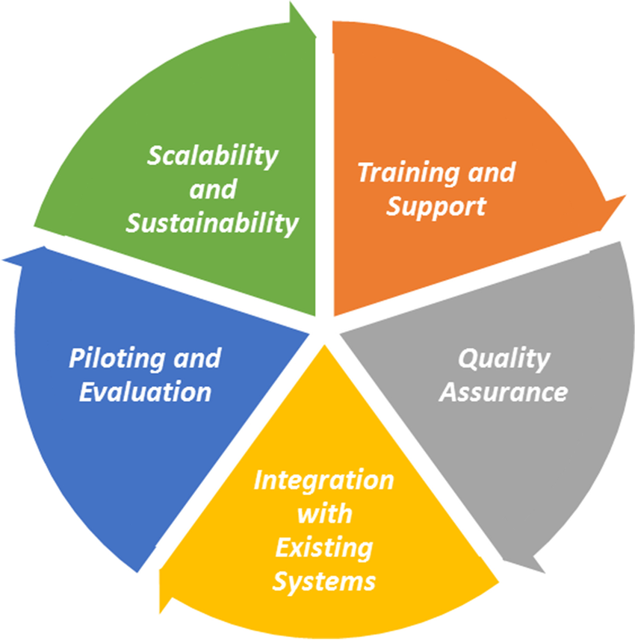
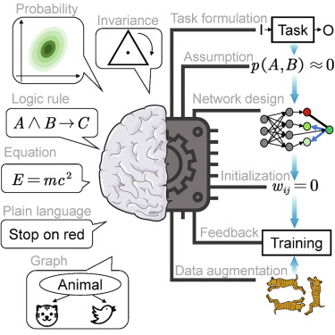
Literature Review
Author: Zhao
Year: 2024
Topic: Improvement of the efficiency and quality of learning.
Author: Su and Zhou
Year: 2024
Topic: The integration of ChatGPT into education
A Research on Computer Science Students’ Cognition and Usage Patterns of Generative Models

Slide 10
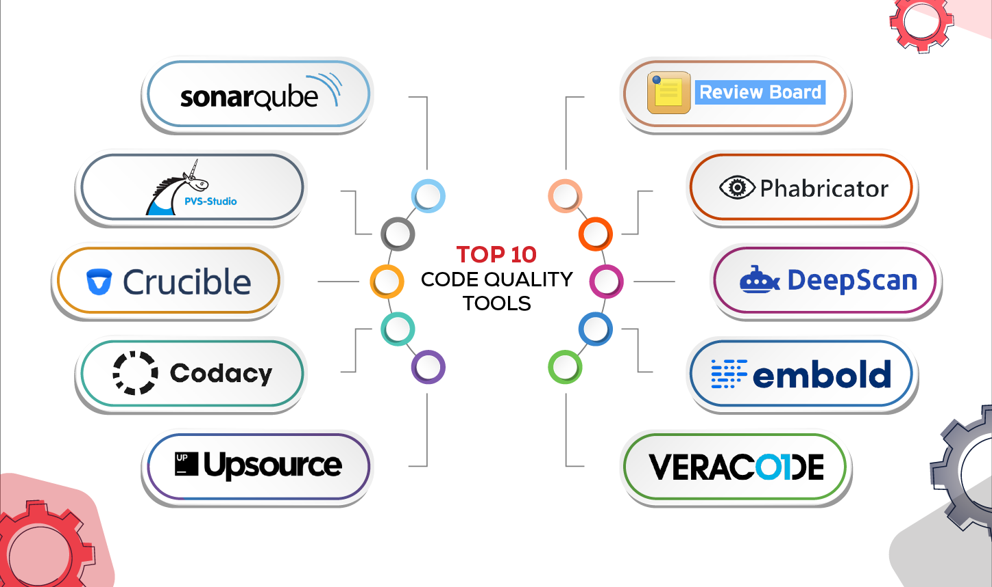
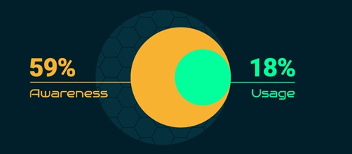
Literature Review
Author: White
Year: 2023
Topic: Improving code quality and software design
Author: Krichen'
Year: 2024
Topic: Students’interest in AI applications
A Research on Computer Science Students’ Cognition and Usage Patterns of Generative Models

Slide 11
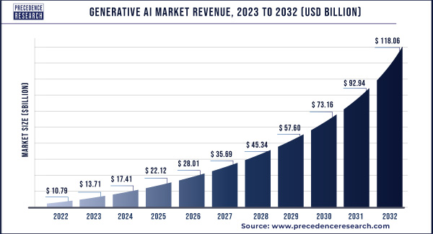
Literature Review
Summary
Growing importance of generative models across various domains
A Research on Computer Science Students’ Cognition and Usage Patterns of Generative Models

Slide 12
Method

Slide 13
Method
Overview
Mixed-methods
Quantitative Questionnaires
Qualitative In-depth Interviews
Providing insights into
individual experiences and perceptions
Quantify the data at a macro level
A Research on Computer Science Students’ Cognition and Usage Patterns of Generative Models

Slide 14
Method
Sample and Participants
Participants
Undergraduate and graduate computer science
students at universities in China
Questionnaire
About 200 students were randomly selected
Sample
in
in-depth
interview
5 students majoring in computer science at Southeast University
A Research on Computer Science Students’ Cognition and Usage Patterns of Generative Models

Slide 15
Method
Data Collection
The survey questionnaire was distributed electronically to participants through an ONLINE platform.
1. Basic Information
gender, grade level, and study background…
Survey
Questionnaire
2. Generative Model Cognition Survey
basic concepts, perceptions of use, and legal and ethical norms…
3. Generative Model Usage Survey
frequency, purpose, attitude, and opinion…
NOTE：The specific survey questionnaire will be shown in the RESULT section.
A Research on Computer Science Students’ Cognition and Usage Patterns of Generative Models

Slide 16
Method
Data Collection
The interview were semi-structured, allowing the interviewer the flexibility to ask questions.
1. How students use generative modeling to aid their
1. research and learning.
In-depth Interview
2. Challenges and solutions that students encountered
1. in using generative modeling.
3. Students’views and expectations about the future
1. development of generative modeling
A Research on Computer Science Students’ Cognition and Usage Patterns of Generative Models

Slide 17
Method
Data Analysis
The data were cleaned and coded, and then analyzed it to understand the basic usage and perception levels.
Questionnaire
The relationship between different variables was explored through correlation and regression analysis.
The audio recordings of the interviews were first transcribed into text.
in-depth
interview
The categorized themes were analyzed and interpreted in depth to reveal the specific contexts
A Research on Computer Science Students’ Cognition and Usage Patterns of Generative Models

Slide 18
Method
Ethical Considerations
All participants participated in the survey on a completely voluntary basis and were informed about the purpose of the study, the process, and their rights.
All information about the participants was kept confidential and used only for the purpose of the study.
A Research on Computer Science Students’ Cognition and Usage Patterns of Generative Models

Slide 19
Result & Discussion

Slide 20
Result & Discussion ⭐Basic Information
Total Number:
167
A Research on Computer Science Students’ Cognition and Usage Patterns of Generative Models

Slide 21
Result & Discussion ⭐Cognitive survey
Widely used
Diverse application scenarios
A Research on Computer Science Students’ Cognition and Usage Patterns of Generative Models

Slide 22
Result & Discussion ⭐Cognitive survey
Important !
But limited understanding !
5
1
High Level → Low Level
A Research on Computer Science Students’ Cognition and Usage Patterns of Generative Models

Slide 23
Result & Discussion ⭐Usage survey
High Frequency
Student’s Keen Interest&
Maturity of Technology
Widely Mixed &
Foreign Preference
User’s Adaptability
Single Preference
Functional Overlap
A Research on Computer Science Students’ Cognition and Usage Patterns of Generative Models

Slide 24
Result & Discussion ⭐Usage survey
Mainly for Academic research and Coursework
Matching Educational Priorities.
Inconsistent performance & data quality issues
Outlined Improvement Directions
A Research on Computer Science Students’ Cognition and Usage Patterns of Generative Models

Slide 25
Result & Discussion ⭐Usage survey
Widespread Acclaim
Superior Model Performance&
High User Satisfaction
Overwhelming optimism
Wide Application Prospect&
Technological Innovation
5
1
High Level → Low Level
A Research on Computer Science Students’ Cognition and Usage Patterns of Generative Models

Slide 26
Conclusion

Slide 27
Conclusion
The study on the cognition and usage patterns of generative models among computer science students at Southeast University has shed light on the multifaceted engagement with these advanced AI tools. The findings from both the quantitative survey and qualitative interviews have provided a comprehensive overview of the current state of generative model usage, the challenges faced, and the optimistic future outlook among the student cohort.
Findings: a significant portion of students learn about generative models through formal education, with peer communication being a major source of information. The respondents' high valuation of generative models, particularly in data generation and processing tasks, reflects their perceived utility in computer science. However, a moderate understanding of the legal and ethical frameworks suggests an educational gap that needs addressing. The preference for foreign models and the frequent use of single modal models indicate areas for domestic model improvement and a potential shift towards multimodal applications.
Limitations: a focus on a specific demographic - > may not be fully representative of all computer science students.
Future research: compare domestic and foreign models' effectiveness and explore the development of multimodal models.
In conclusion, the generative models' integration into academic work is evident, and the optimistic future outlook can stimulate further exploration in AI. It is imperative for educational programs to keep pace with these developments, ensuring students are equipped with the knowledge and skills necessary to navigate the ethical and technical landscape of generative models effectively.
A Research on Computer Science Students’ Cognition and Usage Patterns of Generative Models
Notes:
he study on the cognition and usage patterns of generative models among computer science students at Southeast University has shed light on the multifaceted engagement with these advanced AI tools. The findings from both the quantitative survey and qualitative interviews have provided a comprehensive overview of the current state of generative model usage, the challenges faced, and the optimistic future outlook among the student cohort.
Our findings highlight that a significant portion of students learn about generative models through formal education, with peer communication being a major source of information. The respondents' high valuation of generative models, particularly in data generation and processing tasks, reflects their perceived utility in computer science. However, a moderate understanding of the legal and ethical frameworks suggests an educational gap that needs addressing. The preference for foreign models and the frequent use of single modal models indicate areas for domestic model improvement and a potential shift towards multimodal applications. While the study provides a snapshot of current perceptions and usage, its limitations include a focus on a specific demographic, which may not be fully representative of all computer science students. Building on these findings, future research should aim to compare domestic and foreign models' effectiveness and explore the development of multimodal models. Additionally, longitudinal studies could offer a more dynamic view of how students' interactions with generative models evolve over time.
In conclusion, the generative models' integration into academic work is evident, and the optimistic future outlook can stimulate further exploration in AI. It is imperative for educational programs to keep pace with these developments, ensuring students are equipped with the knowledge and skills necessary to navigate the ethical and technical landscape of generative models effectively.

Slide 28
Acknowledgement
Sections:
Abstract & Conclusion: Zhou Yunlian;
Introduction: Wang Xudong;
Literature Review: Li Junru; Liu Likai;
Method: Kan Dong;
Results & Disucssion: Zheng Weihuang; Yu Shicheng;
Other specific work:
Questionnaire Design: Kan Dong;
Interview: Zhou Yunlian; Kan Dong;
Questionnaire Collection: Wang Xudong; Li Junru; Liu Likai;
Data Analysis: Zheng Weihuang; Yu Shicheng
A Research on Computer Science Students’ Cognition and Usage Patterns of Generative Models

Slide 29
Q
A
问答
&

Slide 30
THANKS

