Slide 1
Hallucination Detection
Natural Language Processing Project
- Hanna Müller, Theresa Brucker, RITA SELIMI, REA KASUMI

Slide 2
Content
Problem Statement
Baselines
Comparison of Baselines
Additional Approaches
Feature-Based Classifier
Bert Score
Merging Approach

Slide 3
What are hallucinations?
“Content that is nonsensical or unfaithful to the provided source content” (Ji et al. 2023)
„Fluent but incorrect output.“ (Mickus et al., 2024)
“We focus on cases of fluent overgeneration. […] if an output cannot be inferred from its semantic reference, then it contains some information that is not present in the reference.” (Mickus et al., 2024)

Slide 4
Different Tasks
Machine Transation (MT)
Hyp: Tom bought a new piano.
Definition Modelling (DM)
Hyp: (idiomatic) A wake-up call.
Paraphrase Generation (PG)
Hyp: I pity for you.
Tgt: Tom bought himself a new piano.
Tgt: A telephone call to awaken someone at a certain time, especially one requested by the person while staying at a hotel.
Src: She requested a five a.m. <define> wake - up call.
Src: I feel sorry for you

Slide 5
Annotations
Task: "Does the following AI output only contain information supported by the Reference?“
→ No Hallucination if Output of Model does not generate more than it should.
Can we trust the annotations?
MT:
Model Output: Mary fell asleep again.
Correct Output: Mary overslept again.
Annotation: Not Hallucination
DM
Model Output: (intransitive) To become regular.
Correct Output: To make or become regular; regularize.
Annotation: Hallucination
DM
Model Output: Perfect in every way.
Correct Output: (archaic) Wholly perfect.
Annotation: Hallucination

Slide 6
Baselines
Naive Bayes
In combination with TF-IDF vectorization
For class imbalance we applied SMOTE (Synthetic Minority Oversampling Technique)
Assumes that words are conditionally independent
Simple to understand
Vectara
Has advanced semantic understanding
Is already pretrained for hallucination detection in NLP
BiLSTM
Bidirectional Context
Improved Performance in NLP

Slide 7
Comparison of Baselines
Vectara
Overall Performance is better than Naive Bayes
Works better in scenarios where the semantic understanding played a big role
Naive Bayes
We sometimes observed a better performance when negation is involved
Better performance when sentence structure in the target column differs greatly from the hypothesis
Thanks to independence assumption for Naive Bayes

Slide 8
Comparison of Baselines
Vectara
Naive Bayes
Overall Accuracy | 0.70
 | Precision | Recall | F1-Score
Hallucination | 0.79 | 0.67 | 0.73
Non-Hallucination | 0.61 | 0.73 | 0.66
Overall Accuracy | 0.59
 | Precision | Recall | F1-Score
Hallucination | 0.75 | 0.58 | 0.65
Non-Hallucination | 0.42 | 0.62 | 0.5

Slide 9
Comparison of Baselines
Vectara outperformed Naive Bayes when semantics were important
Model Output: (anatomy) Relating to the diaphragm.
Correct Output: (medicine) Below the diaphragm.
Correct Label: Hallucination
Vectara struggles when sentence structure is different
Model Output: People generally greet each other by shaking hands in my country.
Correct Output: In my country, people usually welcome each other by hand
Correct Label: Not Hallucination

Slide 10
Comparison of Baselines
Naive Bayes classified wrongly as Hallucination although reference and output were very similar
Model Output: In the middle of a scream.
Correct Output: The midpoint of a scream.
Correct Label: Not Hallucination
Both had problems when the reference and the output had different lengths
Model Output: (countable) A particular instance of something.
Correct Output: An incident, action, or time period standing out by itself, but more or less connected with a complete series of events.
Correct Label: Not Hallucination

Slide 11
Additional Approaches
Feature Classifier
BERTScore

Slide 12
Feature-based Classifier (1)
Feature Extraction
1. Word Overlap: Comparing words (lemmas) in output with words (lemmas) in reference
2. BLEU-Score with Smoothing function: computes n-gram overlap
3. Named Entity Overlap: Comparing named entities between output and reference
4. Semantic Similarity: Cosine Similarity after semantic encoding with model ‚all-MiniLM-L6-v2‘
"Does the following AI output only contain information supported by the Reference?“

Slide 13
Feature-based Classifier (2)
Model Training
Train Model on labeled training data with extracted features
Selected Machine Learning Model: Random Forest
Model Testing
Test Model on test data
Best result with all features included
Overall Accuracy | 0.75
 | Precision | Recall | F1-Score
Hallucination | 0.82 | 0.8 | 0.81
Non-Hallucination | 0.62 | 0.64 | 0.63

Slide 14
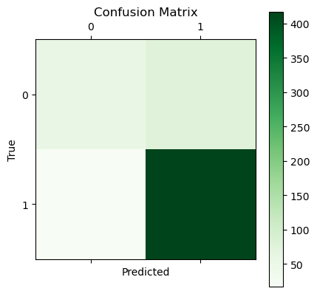
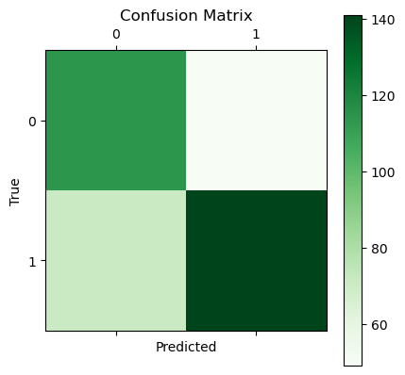
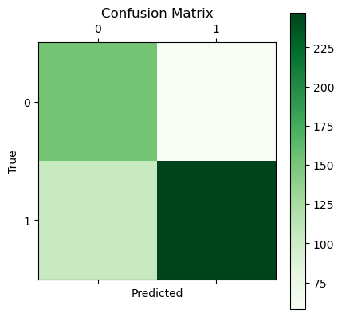
Feature-based Classifier (3)
DM
PG
MT

Slide 15
Feature-based Classifier (4)
Reasons for wrong classifications:
High similarity between sentences but different meaning
Problems with annotations
Model Output: Does it make sense to do it?
Correct Output: Does it make sense to fix this? Correct Label: Not Hallucination
Model Output: You know why they stopped talking? Correct Output: Do you know why they stopped talking?
Correct Label: Hallucination

Slide 16
Feature-based Classifier (5)
Words in context have different meanings than usual
Not catching negations
Model Output: I'm actually seeing someone.
Correct Output: I'm actually dating someone.
Correct Label: Not Hallucination
Model Output: I am familiar with you.
Correct Output: I'm not familiar with you.
Correct Label: Hallucination

Slide 17
BERTScore Overview
"Does the following AI output only contain information supported by the Reference?“
What is BERTScore?
Leverages pre-trained transformers to measure semantic similarity between hypotheses and references.
Compares embeddings instead of raw words, capturing deeper semantic relationships.
Our Approach with BERTScore:
Pre-trained Model: Initially evaluated using the pre-trained RoBERTa-large model.
Fine-tuned Model: Fine-tuned RoBERTa-base on hallucination datasets to further align it with the specific task.
Results: Fine-tuning improved detection slightly, particularly in scenarios involving subtle semantic mismatches.

Slide 18
BERTScore Results - Summary
Steps:
Process datasets: Load and preprocess hypotheses (hyp) and references. Convert the label column to binary values.
Fine-tune the model: Fine-tune the roberta-base model using a training dataset. Class imbalance is handled by applying custom class weights.
Evaluate on validation set:
Compute BERTScore (Precision, Recall, F1) between hypotheses and references.
Use the validation set to determine the best threshold for F1-score.
Test the model:
Apply the determined threshold to classify test predictions as "Hallucination" or "Not Hallucination."
Evaluate performance using metrics such as accuracy, precision, recall, F1-score, and confusion matrix.
PG:
Overall Accuracy | 0.72
 | Precision | Recall | F1-Score
Hallucination | 0.4 | 0.2 | 0.26
Non-Hallucination | 0.76 | 0.9 | 0.83
MT:
Overall Accuracy | 0.66
 | Precision | Recall | F1-Score
Hallucination | 0.72 | 0.25 | 0.37
Non-Hallucination | 0.65 | 0.93 | 0.77
DM:
Overall Accuracy | 0.62
 | Precision | Recall | F1-Score
Hallucination | 0.60 | 0.77 | 0.67
Non-Hallucination | 0.65 | 0.46 | 0.54

Slide 19
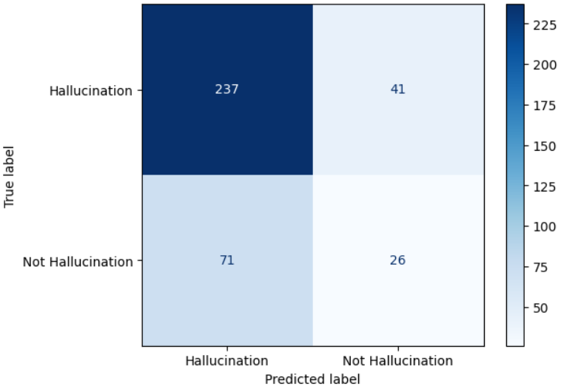
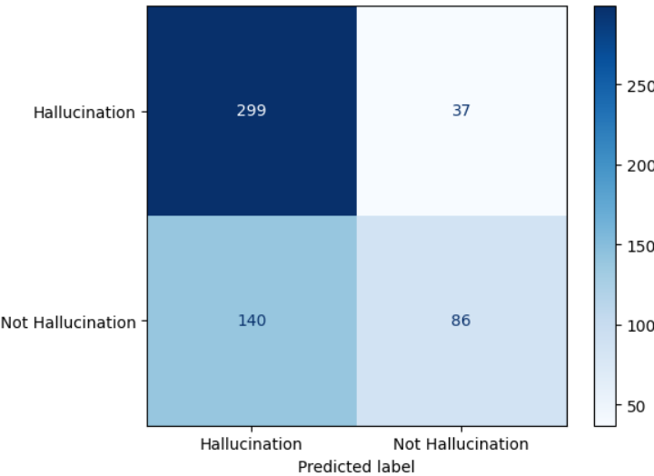
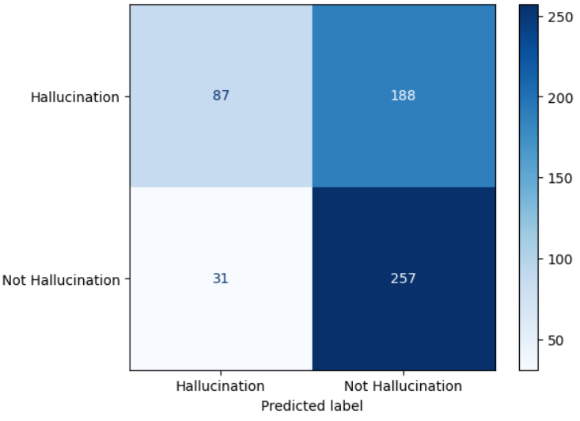
BERTScore Results - Confusion Matrices
PG:
MT:
DM:

Slide 20
Insights from BERTScore - PG
False Positives: Mainly caused by minor wording or phrasing changes, reflecting sensitivity to paraphrasing.
False Negatives: Result from missing key contextual words or semantic mismatches.
HYP: you in need cash
SRC: are you in want of cash
Reason: Wording issue – synonyms ("need" vs. "want") and grammatical structure differences
HYP: you in need cash
SRC: are you in want of cash
Reason: Wording issue – synonyms ("need" vs. "want") and grammatical structure differences
HYP: and nobodys going to know
SRC: and no one will know
Reason: Paraphrasing – "nobodys" vs. "no one" and minor structural differences
HYP: and nobodys going to know
SRC: and no one will know
Reason: Paraphrasing – "nobodys" vs. "no one" and minor structural differences
HYP: i uh would prefer that officers
SRC: i would uh i would prefer not to officers
Reason: Missing critical words ("not") changes the meaning significantly
HYP: i became troubled
SRC: i became sick with worry
Reason: Semantic gap – "troubled" is a weaker sentiment than "sick with worry"

Slide 21
Insights from BERTScore - MT
False Positives: Wording/Paraphrasing or Grammatical Variations
False Negatives: Sentiment Misinterpretation or Semantic Gaps
HYP: you in need cash
SRC: are you in want of cash
Reason: Wording issue – synonyms ("need" vs. "want") and grammatical structure differences
HYP: that is why a brilliant idea came to mind
REF: tom had a bright idea
Reason: Sensitivity to paraphrasing and different subjects – "a brilliant idea" vs. "a bright idea" and subject mismatch
HYP: and nobodys going to know
SRC: and no one will know
Reason: Paraphrasing – "nobodys" vs. "no one" and minor structural differences
HYP: tom did it for you
RED: did tom make this for you
Reason: Lack of semantic equivalence recognition in phrasing – "did it" vs. "make this for you."
HYP: forgive me
REF: farewell
Reason: Semantic gap – "forgive me" and "farewell" have different meanings
HYP: do not you dare make another cup of coffee when I am around
REF: would you mind making an extra cup of coffee when I am here
Reason: Opposing sentiment – "do not you dare" vs. "would you mind"

Slide 22
Insights from BERTScore - DM
False Positives: Contextual Nuances and Paraphrasing Sensitivity
False Negatives: Taxonomic/Contextual Mismatches and Semantic Gaps
HYP: you in need cash
SRC: are you in want of cash
Reason: Wording issue – synonyms ("need" vs. "want") and grammatical structure differences
HYP: one who shops
REF: someone who goes to a shop to make purchases
Reason: Wording issue – "one who shops" and "someone who goes to a shop" are semantically equivalent, but phrasing differs
HYP: and nobodys going to know
SRC: and no one will know
Reason: Paraphrasing – "nobodys" vs. "no one" and minor structural differences
HYP: a device for blowing smoke out of a chimney
REF: a diagnostic tool that blows smoke through pipes
Reason: Semantic gap – While closely related, "chimney" vs. "pipes" creates slight semantic differences
HYP: obsolete the act of conscripting
REF: obsolete the act of sleeping or of lulling to sleep
Reason: Semantic mismatch – "conscripting" vs. "sleeping" are entirely unrelated
HYP: rare a hallucination
REF: a person who is hallucinating
Reason: Contextual mismatch – "a hallucination" vs. "a person hallucinating" represent different concepts

Slide 23

Merged Model
Each Model has advantages and disadvantages
Solution: Majority voting of our best models
Pretrained Vectara
Feature-based Classifier
Finetuned BertScore
Scores are added: “Hallucination” if two models vote for it

Slide 24
Merged Model - Summary
Overall Accuracy | 0.74
 | Precision | Recall | F1-Score
Hallucination | 0.49 | 0.48 | 0.49
Non-Hallucination | 0.82 | 0.82 | 0.82
PG:
MT:
Overall Accuracy | 0.73
 | Precision | Recall | F1-Score
Hallucination | 0.69 | 0.61 | 0.65
Non-Hallucination | 0.76 | 0.82 | 0.79
DM:
Overall Accuracy | 0.61
 | Precision | Recall | F1-Score
Hallucination | 0.57 | 0.95 | 0.72
Non-Hallucination | 0.84 | 0.26 | 0.39

Slide 25
Comparison ML vs. DL
Examples | Label | Predictions
 |  | Bert | Vectara | Feature-based Classifier
HYP: This formula is based on theory | 1 | 0 | 0 | 1
TGT: This formula is the basis of the theory
HYP: not stained | 1 | 0 | 0 | 1
TGT: not starched
HYP: in a pretending manner | 0 | 1 | 0 | 1
TGT: So as to pretend
HYP: extremely tyrannical | 0 | 0 | 1 | 1
TGT: Extraordinaryily tyrannical; of utmost tyranny

Slide 26
Final Remarks
More advanced models or features are needed to also capture semantic similarities
Feature-based classifier included both simple but also advanced features and performed well
Each model has advantages and disadvantages
combination of model can include advantages from all models
here the combination of models did not work better
Limitations:
only Hallucination detection by comparing reference to model output
data labels can be criticised

