Slide 1
AI Drug Review Prediction System
- Business objective: classify patient condition from drug reviews.
- Target classes: Depression, High Blood Pressure, Type 2 Diabetes.
- Recommendations use drug ratings, review counts, and useful counts.

Slide 2
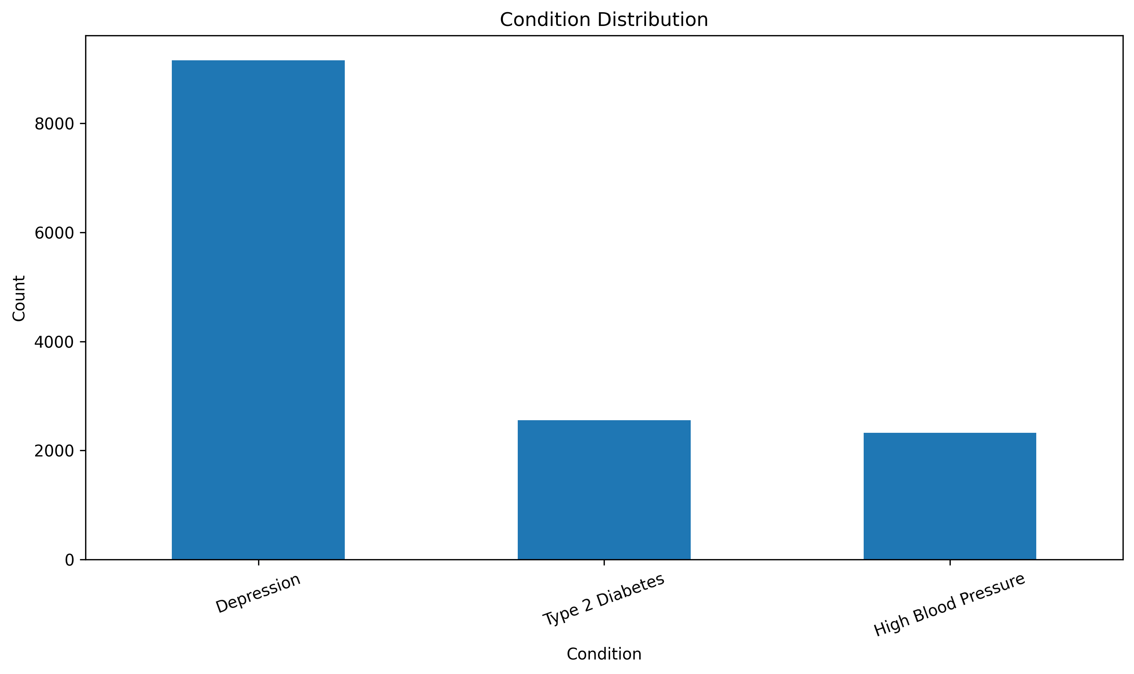
Dataset and Assignment Features
- drugName groups reviews by medication.
- condition is the target label.
- review text provides the predictive language signal.
- rating and usefulCount support effectiveness ranking.
- date supports trend analysis over time.

Slide 3
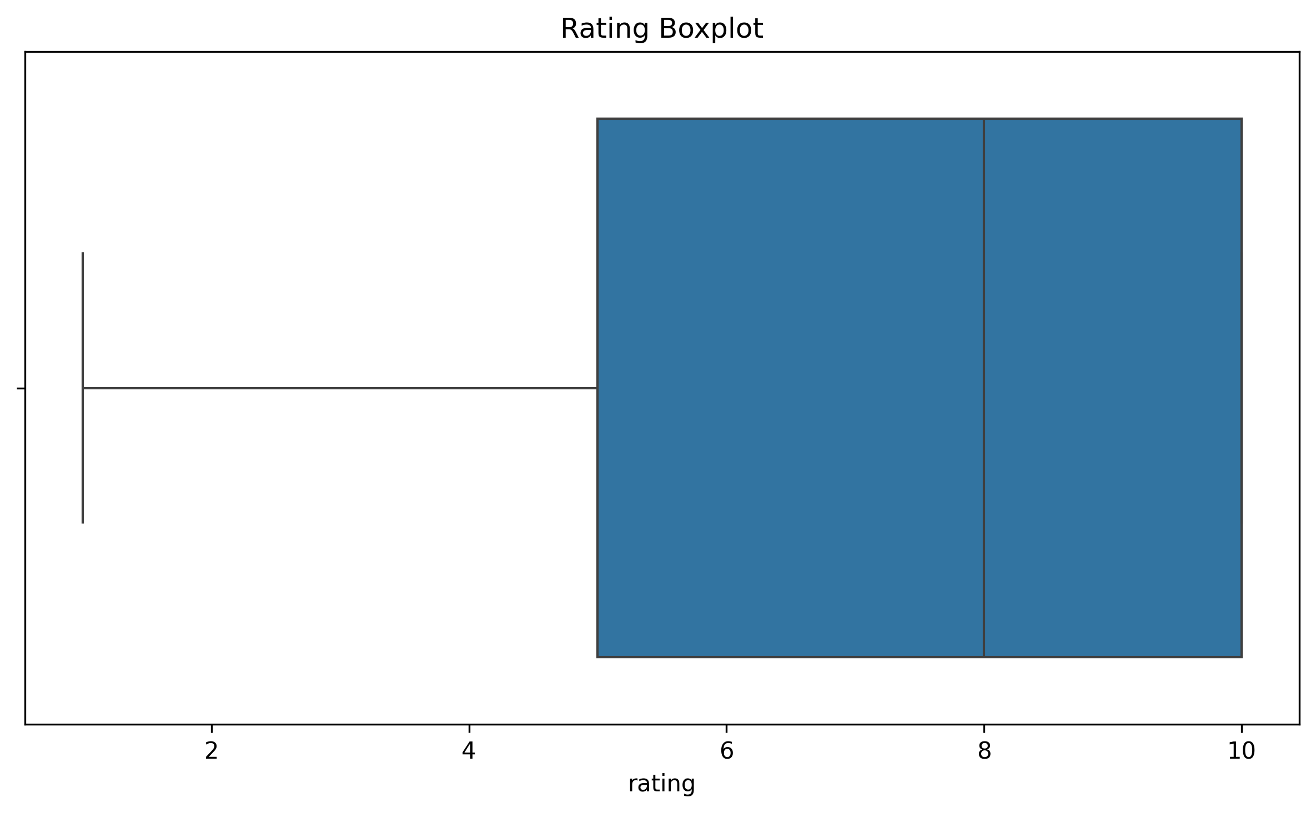
Data Cleaning
- Removed rows missing condition, review, or rating.
- Removed duplicates.
- Validated rating range from 1 to 10.
- Converted review dates to datetime.
- Saved data quality and outlier counts to CSV.

Slide 4
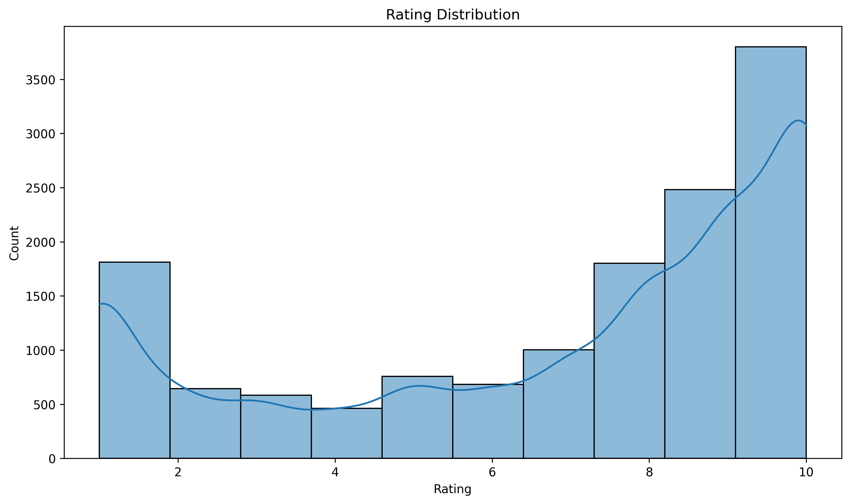
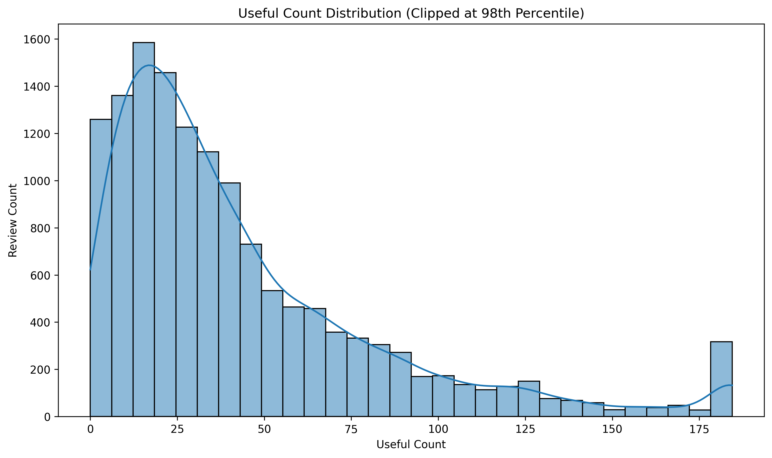
Descriptive Analysis
- Created condition distribution.
- Created rating distribution.
- Created useful count distribution.
- Created top drugs by average useful count.

Slide 5
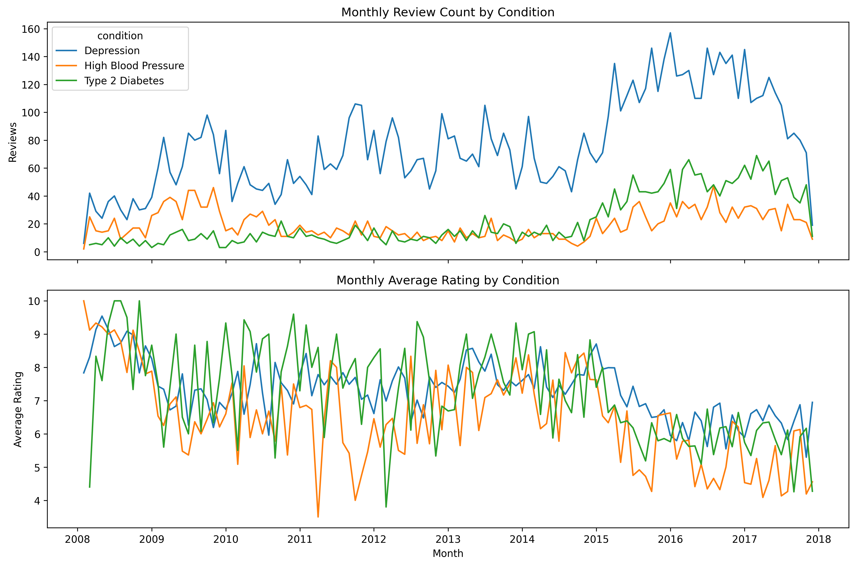
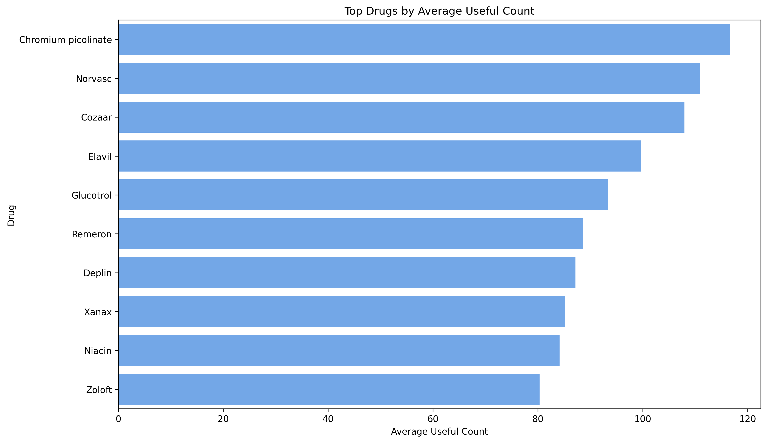
Date and Usefulness Insights
- Monthly trend analysis shows review volume by condition.
- Monthly rating trend shows satisfaction changes over time.
- Useful count helps identify reviews/drugs with stronger evidence.

Slide 6
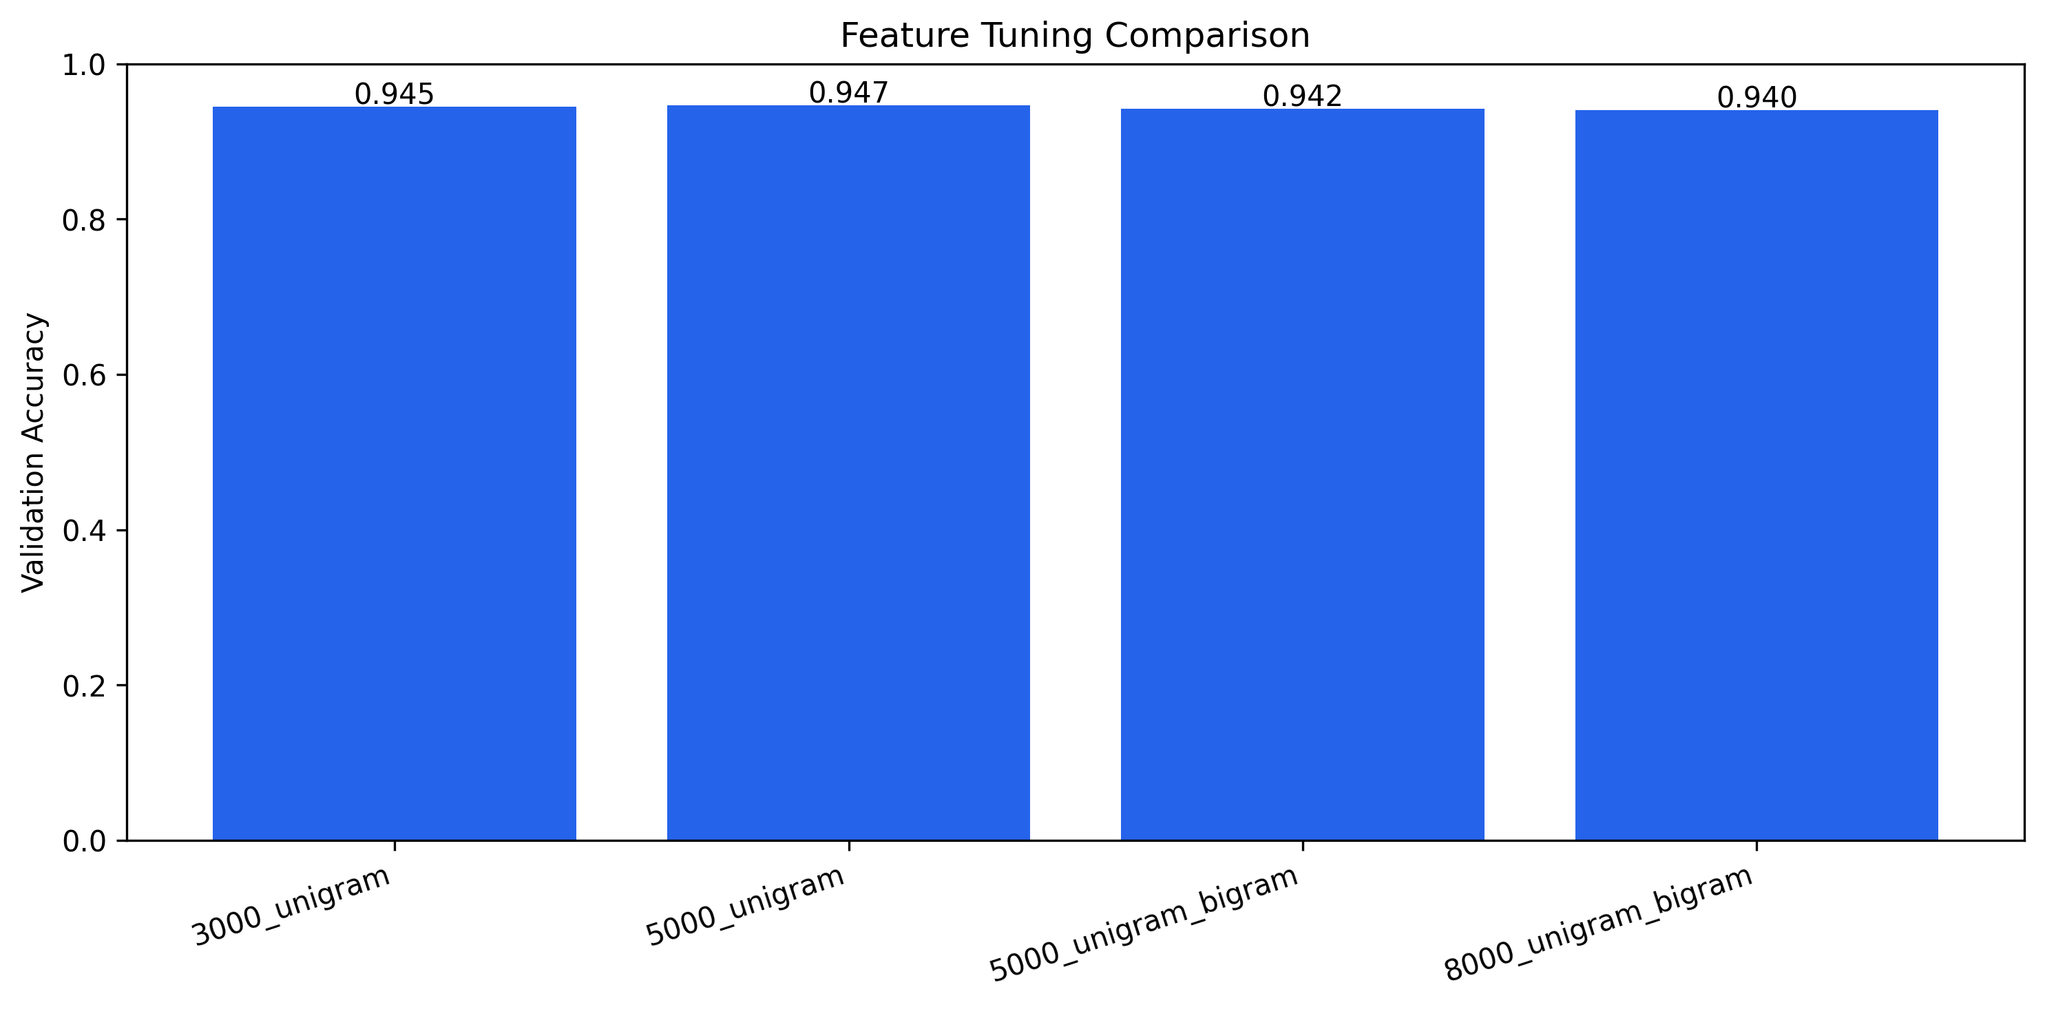
Preprocessing and Feature Tuning
- Text cleaning uses lowercase, punctuation removal, tokenization, and stopword removal.
- TF-IDF converts reviews into numerical features.
- Feature tuning compared unigram and unigram+bigram settings.
- Best configuration: 5,000 unigram TF-IDF features.

Slide 7
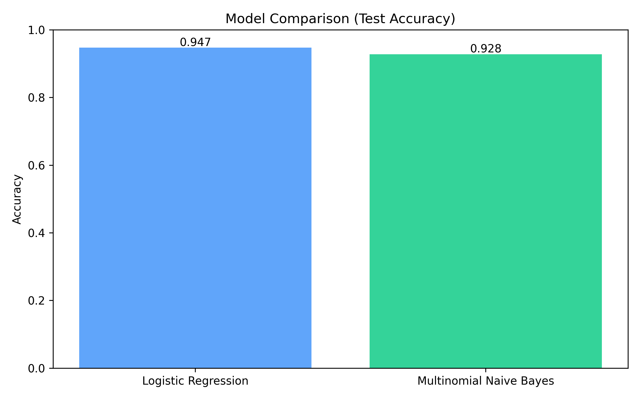
Model Determination
- Compared Logistic Regression and Multinomial Naive Bayes.
- Both are strong baselines for sparse TF-IDF text classification.
- Model choice was based on validation, cross-validation, and test accuracy.

Slide 8
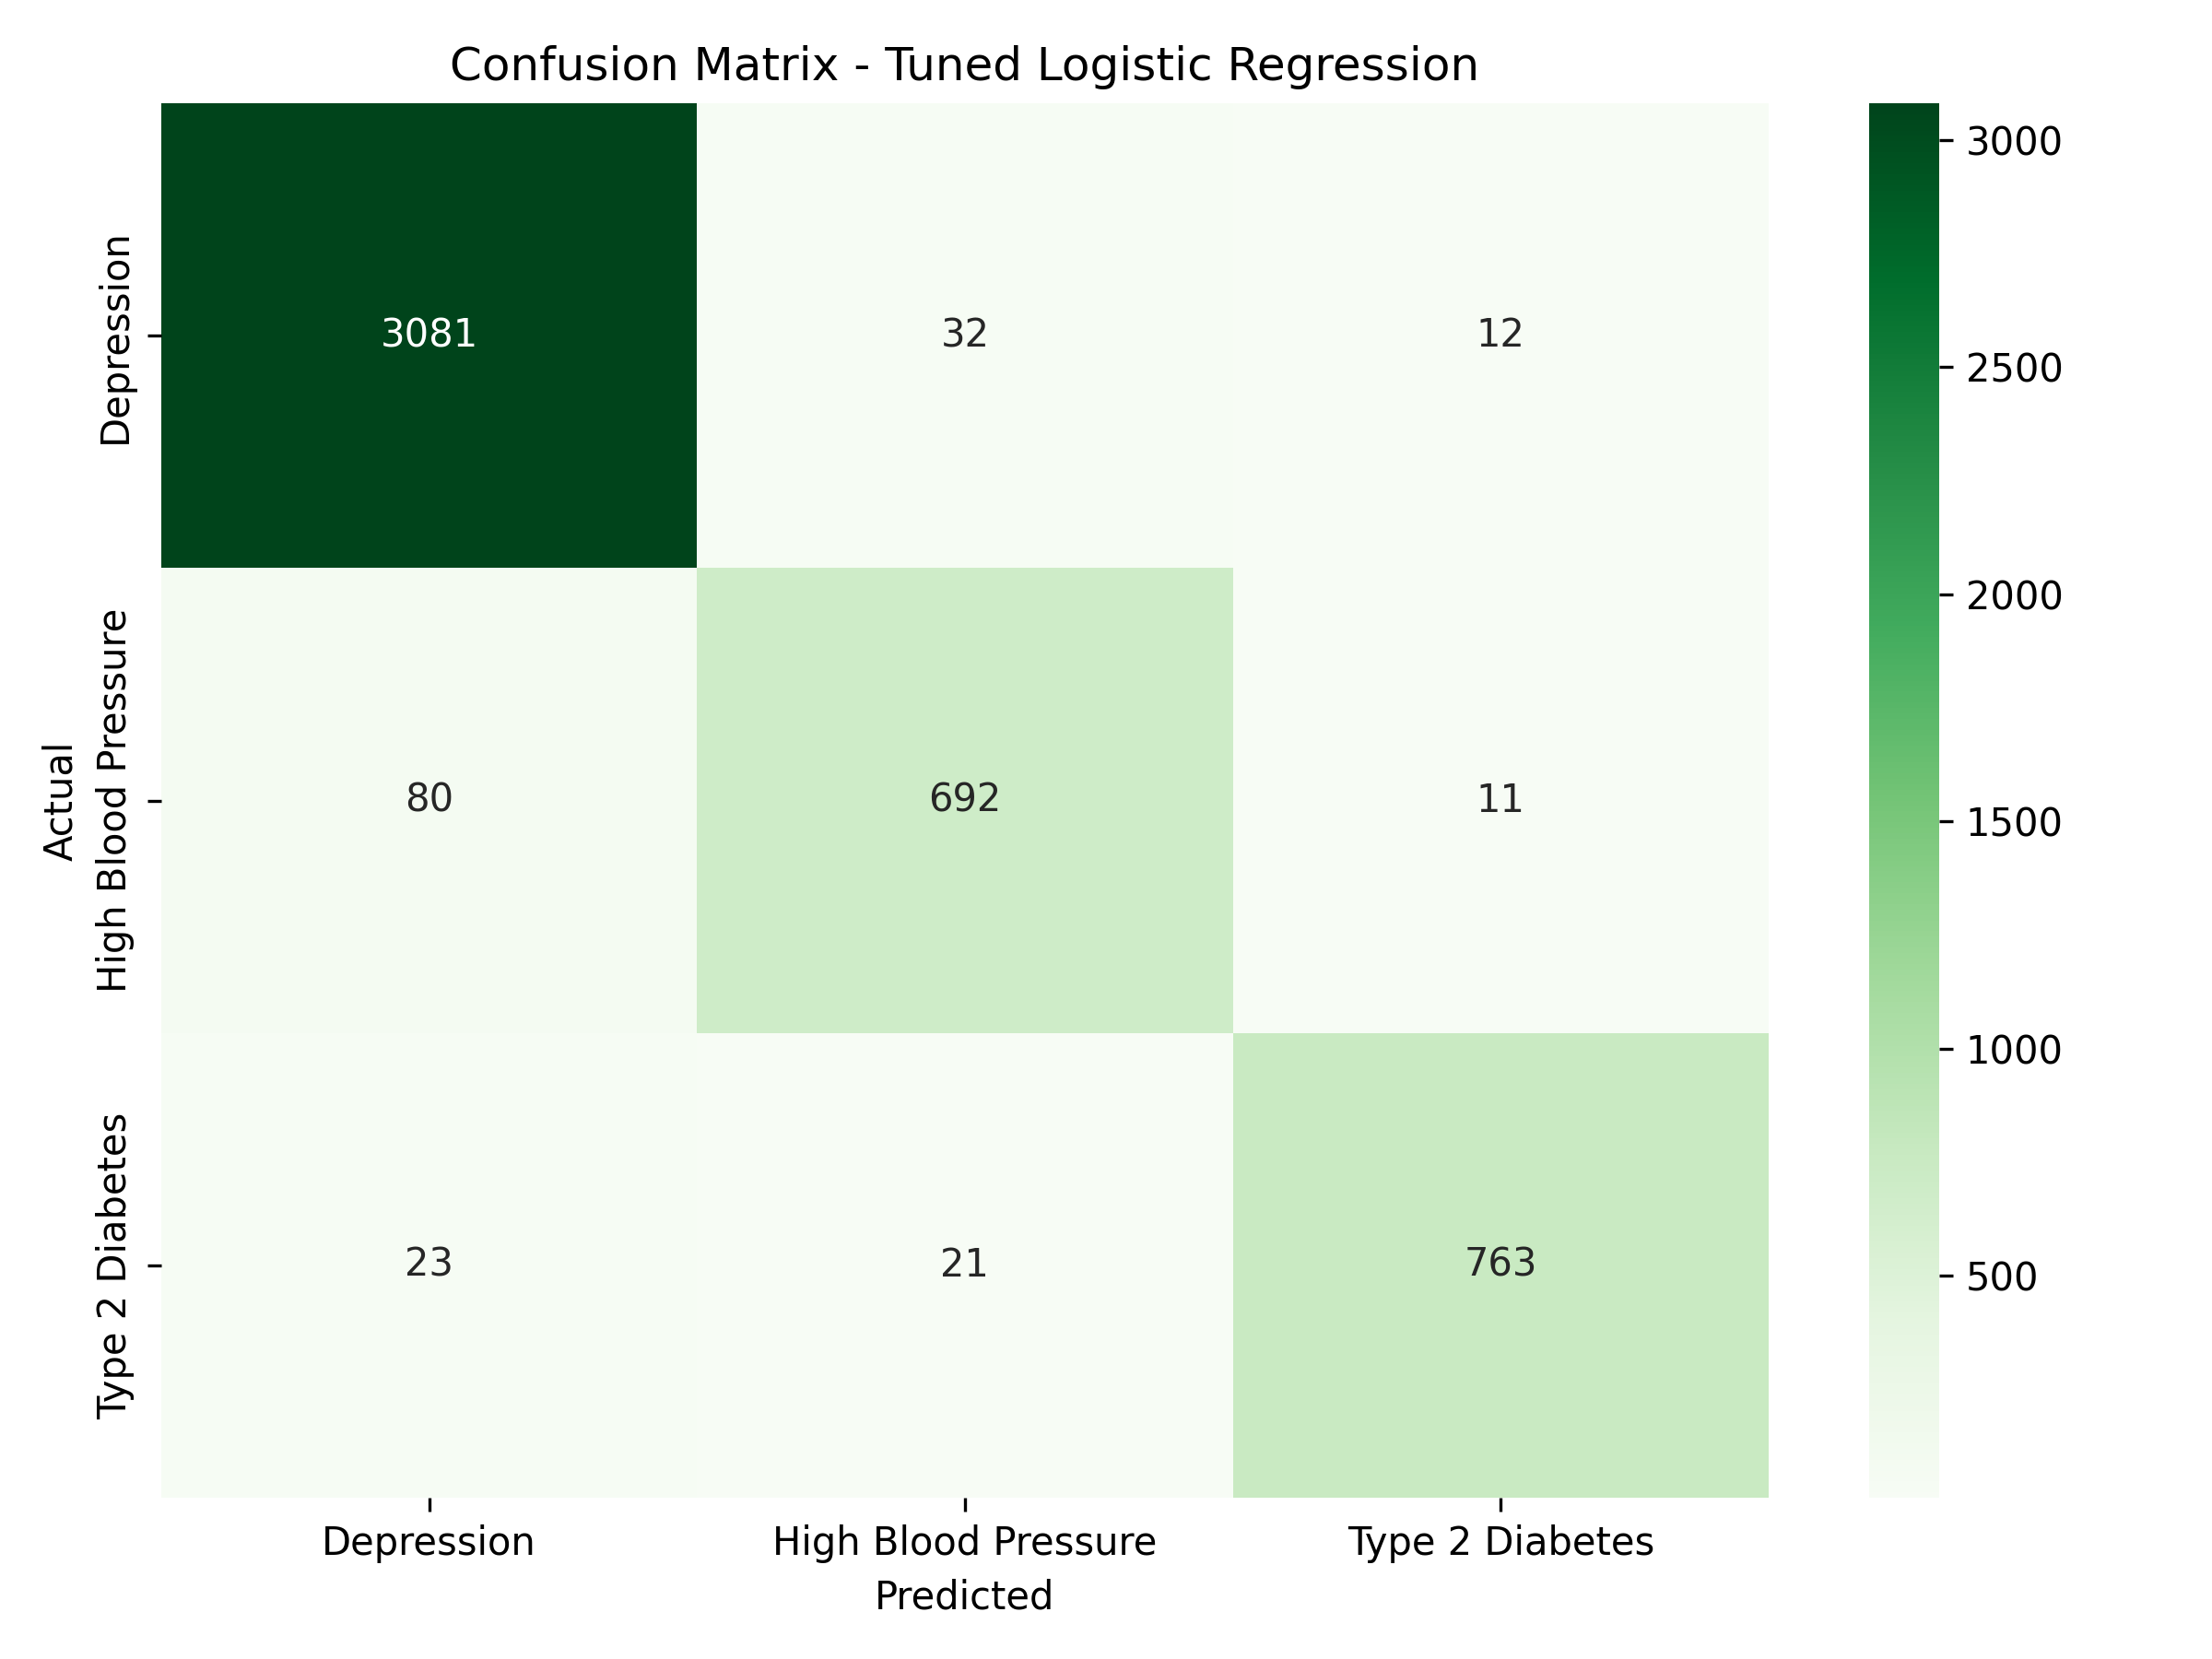
Model Performance
- Best tuned model: Logistic Regression.
- Tuned test accuracy: 96.2%.
- Class reports and confusion matrices are saved under artifacts.
- The model is ready for out-of-sample presentation testing.

Slide 9
Prediction Dashboard
- React dashboard accepts symptoms/review text.
- Dashboard also accepts a known patient condition.
- Backend forwards requests to the AI inference service.
- Results include condition, confidence, sentiment, recommendations, and rating chart.

Slide 10
System Architecture and Deliverables
- Frontend: React and Vite on port 8501.
- Backend API: FastAPI on port 8000.
- AI service: FastAPI inference service on port 5000.
- Deliverables include README, model creation file, trained model, artifacts, and presentation deck.

