Slide 1
Dec 28
Class Employee{
int id;
String name;
}
Class Manager extends Employee{
}
Class TeamLead extends Employee{
}
“is-a” relationship
Manager is a Employee
TeamLead is a Employee
Inheritance
Composition
Association
Aggregation
Polymorphism
Encapsulation
Abstraction
Access modifiers
Method Overloading
Method overriding
Parent-Child relationship
Attributes and Methods

Slide 2
Laptop
Motherboard
Laptop has a Motherboard
Tight coupling – Composition
Outer object
Inner Object
If outer object is terminated or killed, then inner object also dies.
Laptop
Mouse
Weak linking
If laptop dies, mouse can be used elsewhere.
Aggregation.
Class Motherboard
Class Laptop{
Motherboard m1 = new Motherboard();
}
Laptop l1 = new Laptop();
l1=null; //m1 will die
Above is composition – tight coupling
Class Motherboard
Class Laptop{
Motherboard m1;
}
Laptop l1 = new Laptop();
l1=null; //m1 will not die
Above is aggregation – weak linking

Slide 3
Encapsulation
Keeping methods and attributes together encapsulation.
Data hiding – Hide the data from other classes using access modifiers.
Private, protected, public
Polymorphism – Method overloading, overriding
Class Employee{
int taxRate(){
return 10%;
}
}
Class Manager extends Employee{
//method overriding
int taxRate(){
return 20%;
}
//overloading – same method, but diff arguments.
int taxRate(int slabcode){
}
int computePf(){
}
}
Interface – Not cooked
Abstraction – semi cooked food
Class - Fully cooked

Slide 4
Write java code for all the OOPS concepts.
Inheritance
Composition
Association
Aggregation
Polymorphism
Encapsulation
Abstraction
Access modifiers
Method Overloading
Method overriding

Slide 5
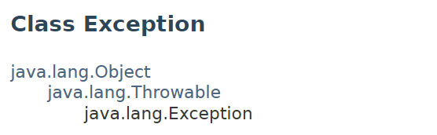
Jan 04
Compile time exceptions
Runtime exceptions
classes
Error
Throwable
Exception
RuntimeException
keywords
throw
throws

Slide 6
Write a method to throw DataInvalidException if the input is negative number.
Class Account{
public void processBalance(double balance) throws DataInvalidException{
if(balance < 0){
//throw exception
throw new DataInvalidException();
}
}
public void checkInputs(){
processBalance(10.76);
}
}
Class DataInvalidException extends Exception{
public String getMessage(){
return “error found”;
}
}
try – catch – finally (or) try with resources

Slide 7
Try{
} catch(DataInvalidException e){
}
Finally{
//clean up code
}
Try(readers opened){
}catch(){
}
Auto closeable logic

Slide 8
Class Account{
}
Class CreditCardAccount extends Exception{
}
is-a
m1() throws Account{
}
m1() throws CreditCardAccount{
}
Write a method to throw DataInvalidException if the input is negative number.

Slide 9
File Handling – Jan 17 2024
48 GB text file.
16GB RAM
Buffering / chunk
Streams
Size . Array of 128KB
258KB
End of file
Open the file
Read the file
Put the contents in some data structure
Write the data structure to file
Flush the file.
Repeat the process
Close the fie.
Text files
Binary files
Reader
Writer
Input
Output
Mode
R
W
RW
Main memory – Java applications run here.
.txt file – saved in hard disk or ssd or etc tc.
Once opened, the contents will be in main memory.

Slide 10
File class java.io
Copy any folder to c:\temp
Read any text file line by line, add “success” word at the end and write the resulting string to another text file.
For example. If input file has Karthik,10
The output should be Karthik,10,success

Slide 11
Jan 31 2024
Enums, Generics, Lambda, Streams, Aggregate functions, ForEach
Default method in interface
{TN, KA, KL, AP, TS}
ENUM – ENUMERATION – FIXED SET OF VALUES
Generics – Specifics
?
K
V
E
T

Slide 12
June 05 2023
Fundamentals of web application
EAR
WAR
Jar
Servlets

Slide 13
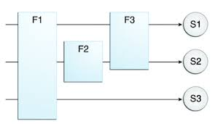
June 09 2023
Filters
Internationalization
JSTL tags
Scriptlets
Servlet life cycle

Slide 14
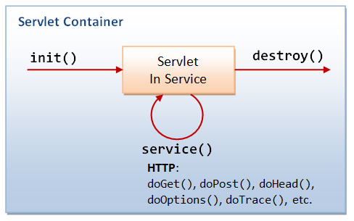

Slide 15
Assignment:
Put token attribute in all the HTML forms. Use input type hidden
Write a filter to check for token in the request parameter.
Map this filter to two servlets
Student search by location.
Use JSTL foreach tag to display the students.
Remember to include jstl jar file in the web-inf lib folder.
Include Student salary column. Format the student salary in USD, INR, EUR. Use JSTL format tag.
Solve quicksort algo in java.
Use the above student search in tamil language.

Slide 16
CreateServlet
CreateController
CreateBusiness
CreateDao
HTML form submit from browser
create
create
create
JDBC code
ResultSet
JSP page response to browser

Slide 17
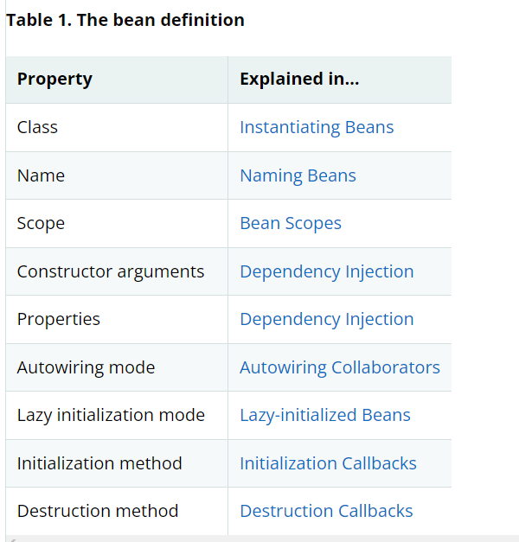
June 16 2023
Spring bean definition file

Slide 18
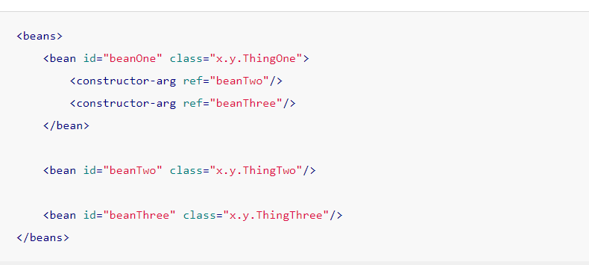
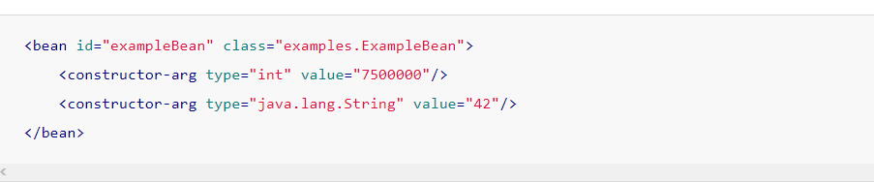
Dependency injection, instantiating

Slide 19
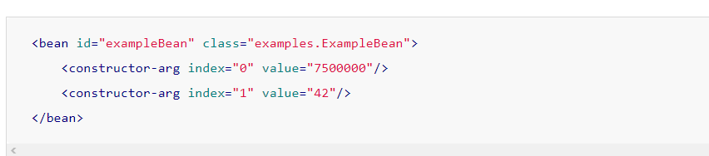
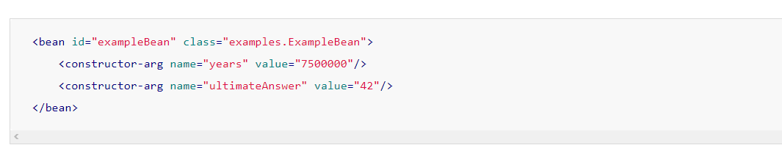

Slide 20
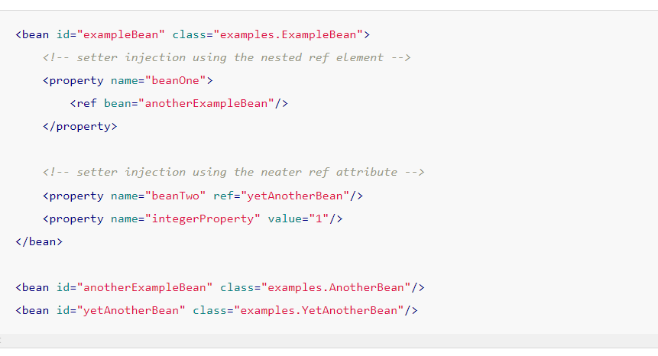

Slide 21
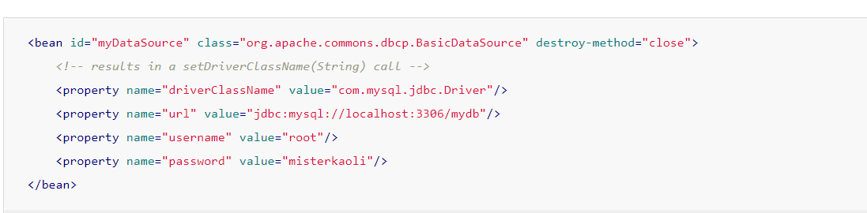
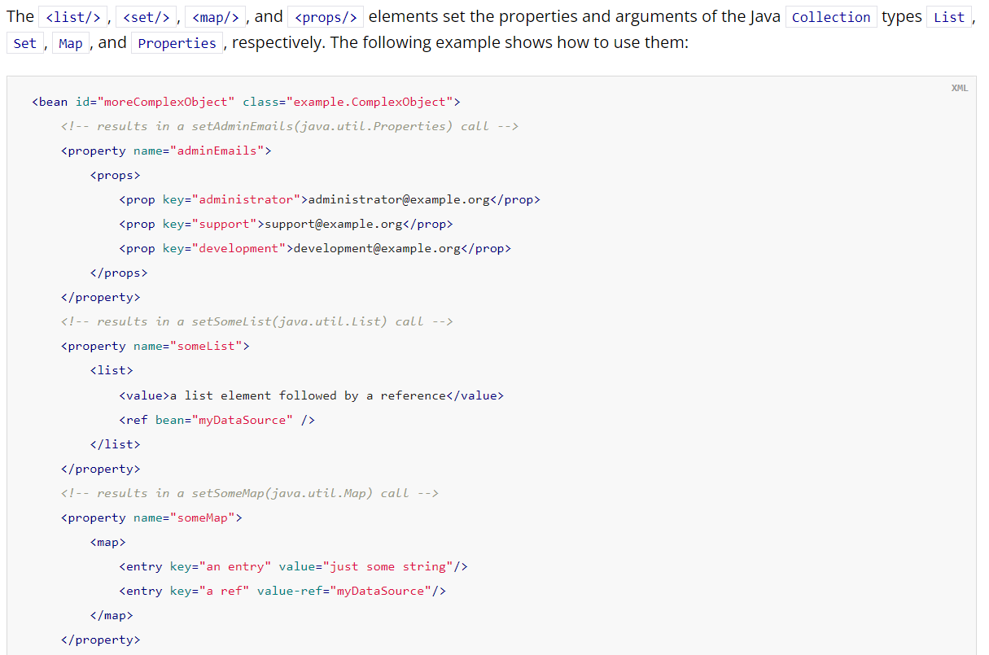

Slide 22
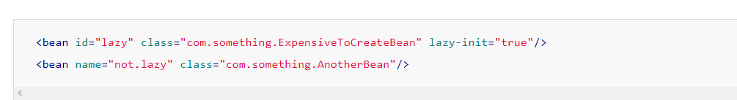
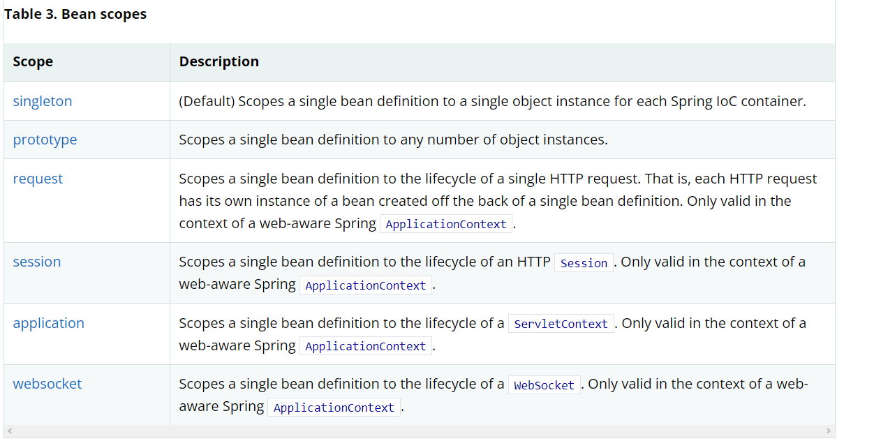

Slide 23
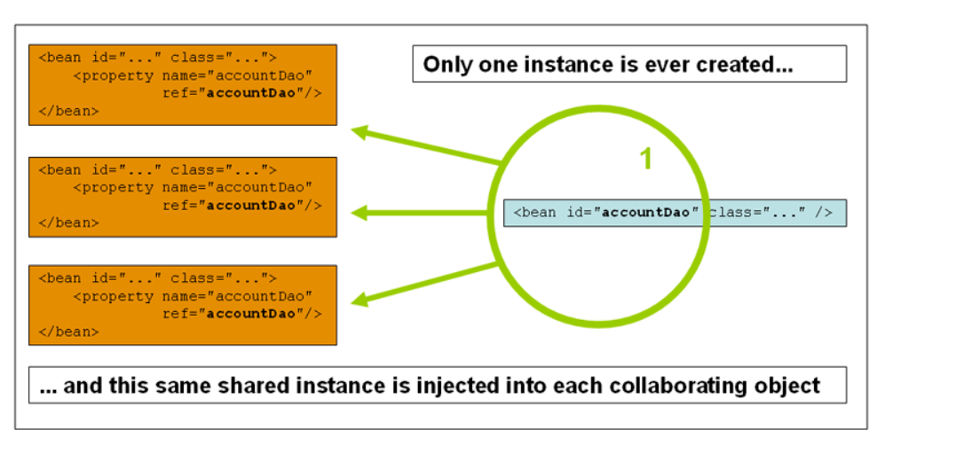

Slide 24
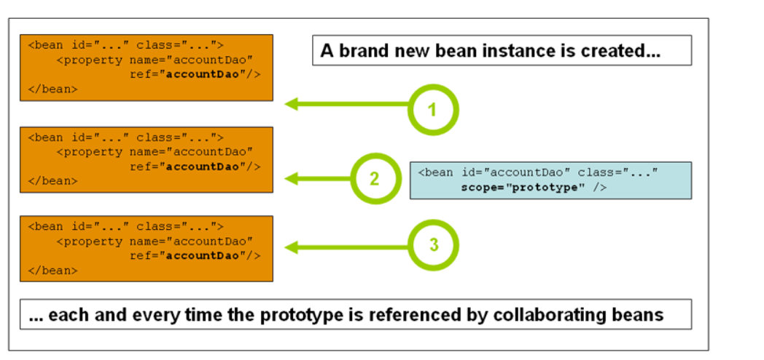

Slide 25
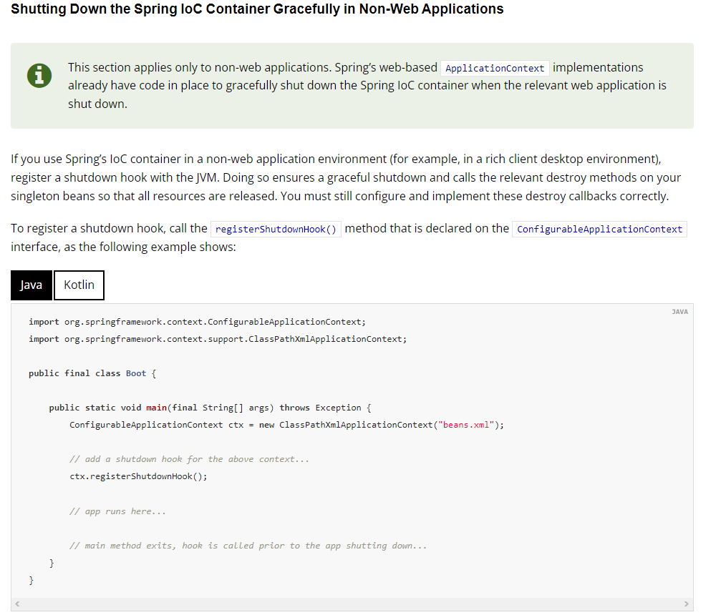

Slide 26
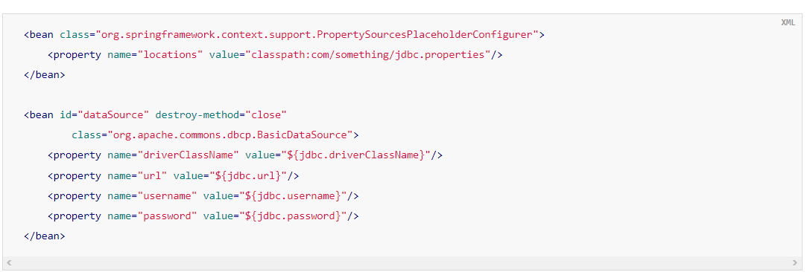
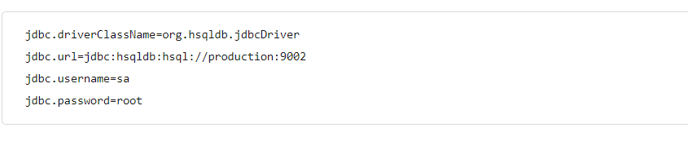

Slide 27
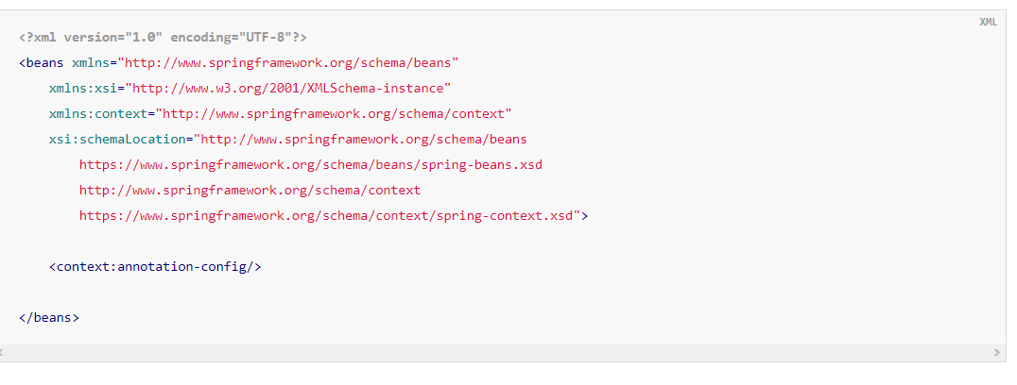

Slide 28
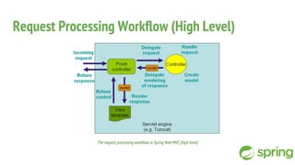
Spring MVC
DispatcherServlet
ViewResolvers

Slide 29
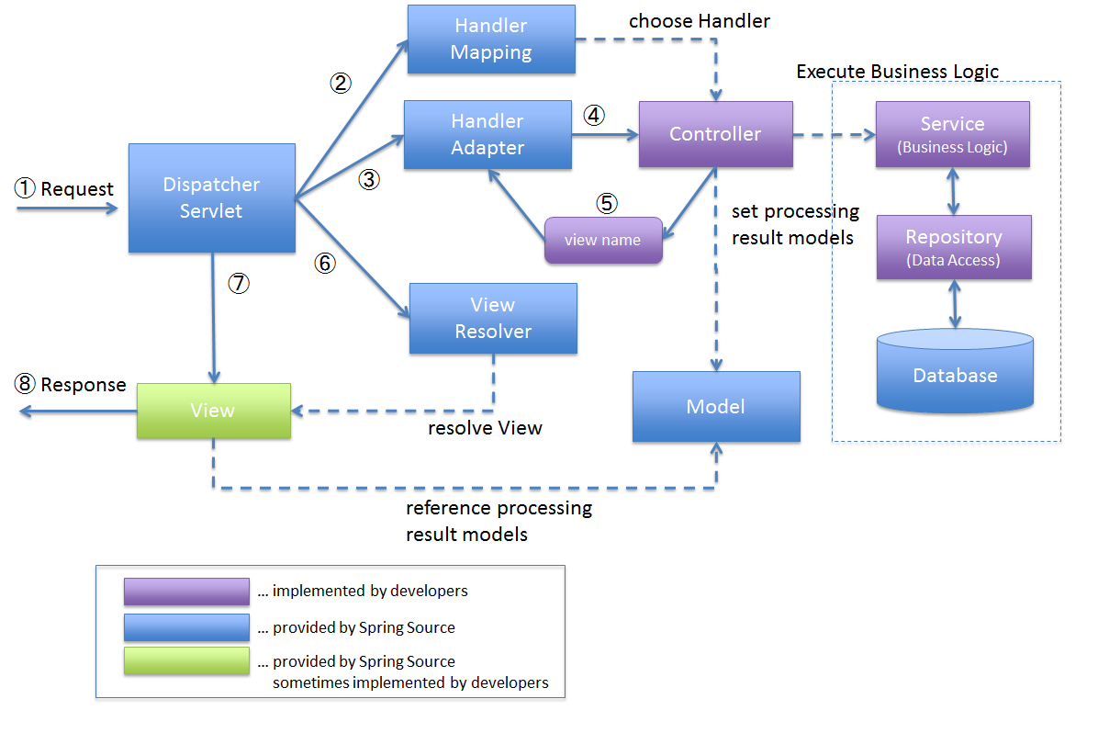

Slide 30
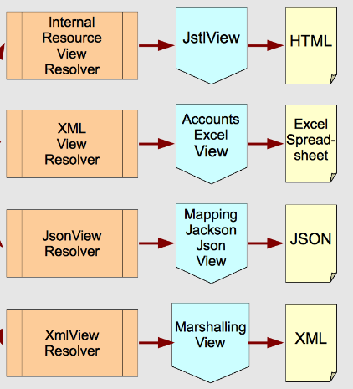

Slide 31
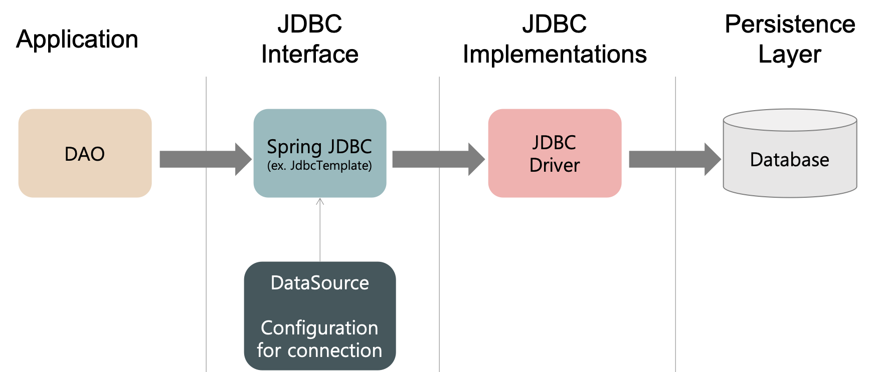
June 24 2023
Spring JDBC Template
Spring JDBC is a wrapper for JDBC

Slide 32
<bean id="<Your DAO ID here>" class="<Your DAO class name here>">
<property name=“junk" ref="jdbcTemplate" />
</bean>
<bean id="jdbcTemplate" class="org.springframework.jdbc.core.JdbcTemplate">
<constructor-arg ref="dataSource" />
</bean>
<bean id="dataSource" class="org.springframework.jdbc.datasource.DriverManagerDataSource">
<property name="driverClassName" value="com.mysql.jdbc.Driver"/>
<property name="url" value="jdbc:mysql://localhost:3306/mysql"/>
<property name="username" value=“john"/>
<property name="password" value="123456"/>
</bean>
Change the values per your application requirements
Disclaimer: This slide and following slides are just code snippets. They are not actual working code. So, use this as reference and modify the code to suit your needs.

Slide 33
DAO interface
CRUD operations
public interface CustomerDAO {
Customer selectCustomer(int customerId);
int insert(Customer c);
int deleteCustomer(int customerId);
void updateCustomer(Customer customer);
}
RowMapper is a helper class provided by Spring JDBC Framework.

Slide 34
DAO impl class
int rows = jdbcTemplate.update(
"insert into customer values(?,?,?,?,?)",
custId,
name,
address
);
public class CustomerDAOImpl implements CustomerDAO {
private JdbcTemplate jdbcTemplate;
public JdbcTemplate getJdbcTemplate() {
return jdbcTemplate;
}
public void setJdbcTemplate(JdbcTemplate jdbcTemplate) {
this.jdbcTemplate = jdbcTemplate;
}
@Override
public int insert(Customer c) {
int custId = c.getCustomerId();
String name = c.getCustomerName();
String address = c.getCustomerAddress();
int rows = jdbcTemplate.update("insert into customer values(?,?,?)", custId, name, address);
return rows;
}
@Override
public int deleteCustomer(int customerId) {
String query = "DELETE from customer where custid=?";
return jdbcTemplate.update(query, new Object[] {
Integer.valueOf(customerId)
});
}
@Override
public void updateCustomer(Customer customer) {
String query = "UPDATE customer SET custname=?,city=? WHERE custid=?";
jdbcTemplate.update(query,
new Object[] {
customer.getCustomerName(), customer.getCustomerAddress(), Integer.valueOf(customer.getCustomerId())
});
}
@Override
public Customer selectCustomer(int customerId) {
final Customer customer = new Customer();
String quer = "SELECT * FROM customer WHERE custid='" + customerId + "'";
return (Customer) jdbcTemplate.query(quer, new ResultSetExtractor <Customer>
() {
public Customer extractData(ResultSet rs) throws SQLException, DataAccessException {
if (rs.next()) {
customer.setCustomerId(rs.getInt(1));
customer.setCustomerName(rs.getString(2));
customer.setCustomerAddress(rs.getString(3));
}
return customer;
}
});
}
}
public int update(
String sql,
@Nullable Object... Args
)
public Customer extractData(ResultSet rs)
public T extractData(ResultSet rs)

