Slide 1
Linux
Kernel
Filesystem
shell
Basic commands
Memory management
Networking
storage

Slide 2
Linux is an open-source operating system that is based on the Unix operating system.

Slide 3
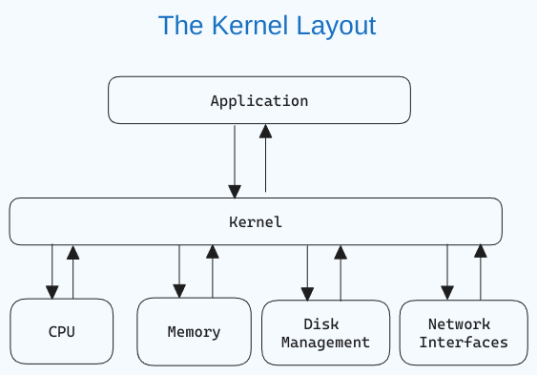
Linux Kernel
loads into memory first when an operating system starts and remains there until the system shuts down

Slide 4
Linux Distribution
Reuse kernel and create a new distribution
Popular
Ubuntu
Centos / redhat
Fedora

Slide 5
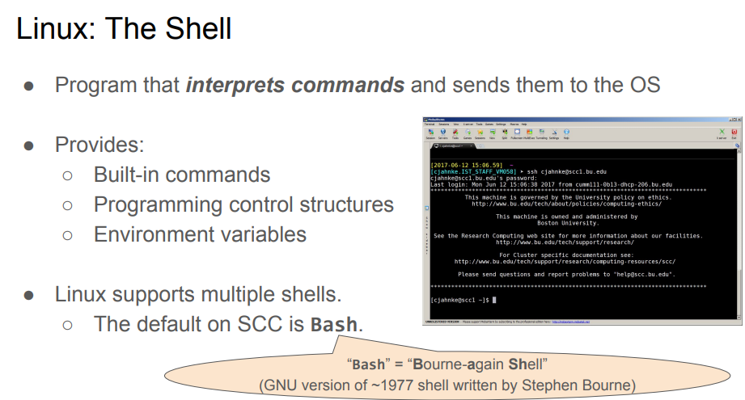
Shell

Slide 6
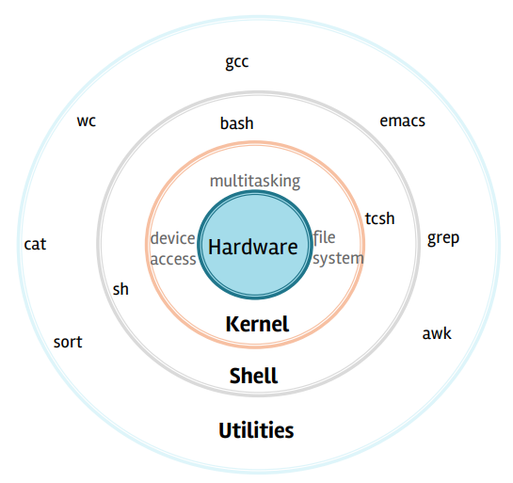
Linux FileSystem

Slide 7
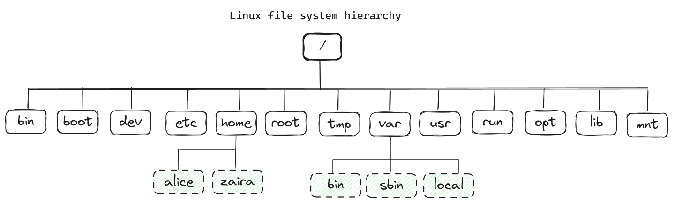
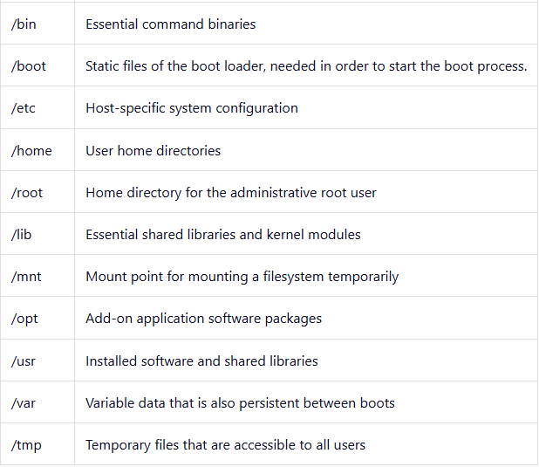
File System Hierarchy
/ Root Directory

Slide 8
Memory management

Slide 9
Memory management in linux ensures that processes and programs get the memory they need to execute while maintaining system performance and stability. It prevents one process from affecting others and efficiently uses both RAM and swap space.

Slide 10
Physical Memory (RAM)
The system’s actual hardware memory, where programs and processes are loaded and run. It is fast but limited in size.
Virtual Memory
Virtual memory allows programs to use more memory than is physically available by using part of the storage (swap) as additional memory. This gives the illusion that the system has more RAM than it physically does.
SWAP SPACE

Slide 11
What is swap space?
Swap space is a reserved area on disk (part of the hard drive or ssd) that the linux kernel uses when physical ram is full. It’s slower than RAM but serves as an extension.
When is swap used?
When the system’s physical memory (ram) is exhausted, the linux kernel moves less frequently used pages to swap space, making room for more active processes in ram.
Pros and cons of swap:
Pros: Increases system stability and allows the system to run larger workloads.
Cons: Swap is much slower than ram, so excessive swapping can degrade performance (known as "thrashing").

Slide 13
Commands
ls
pwd
tree
cd
man
touch
mkdir
cp
mv
cat
hostname
whoami
$PATH
echo
printenv
history
date
pipe
Ps -ef
redirection
find /path/ -type f -name file-to-search
find . -type f -name "*.log" ------ search log files with .log extension
find / -size +250m ------- list files greater than 250mb
find . -type d ----- find folders in current directory
wc – lines, words and character count
cat /etc/os-release
free
uptime
top

Slide 14
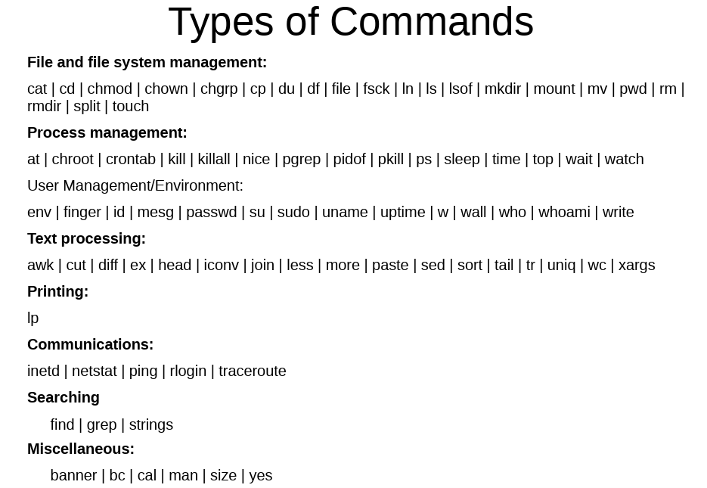

Slide 15
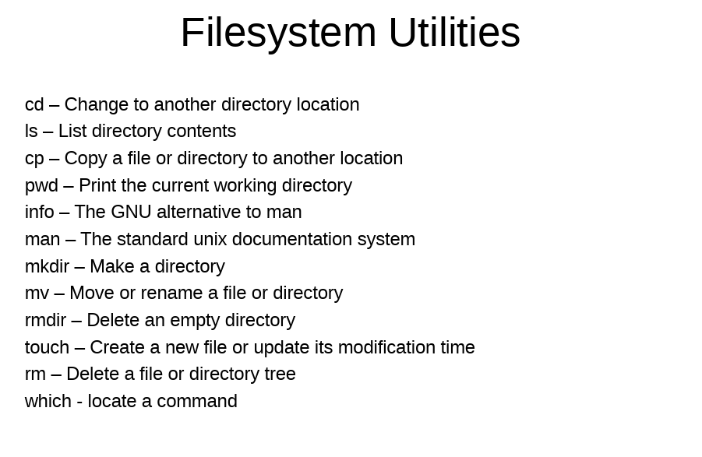

Slide 16
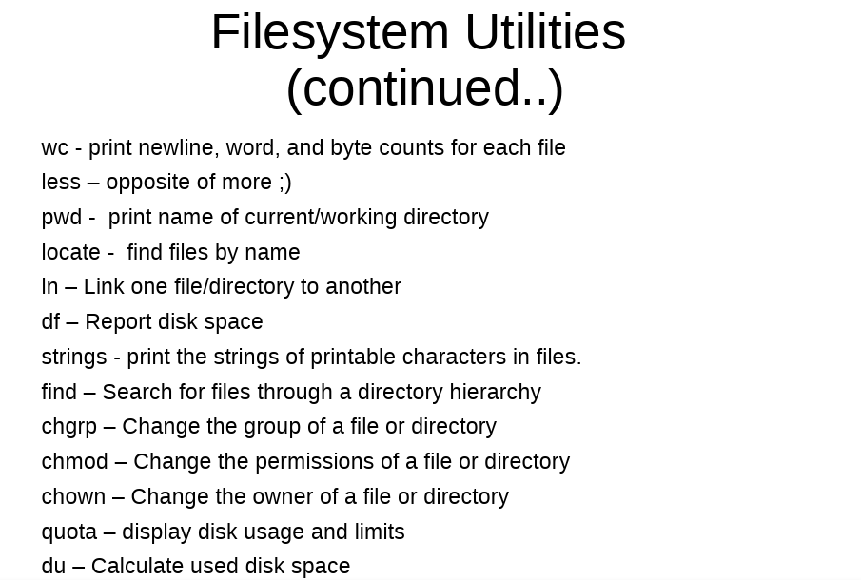

Slide 17
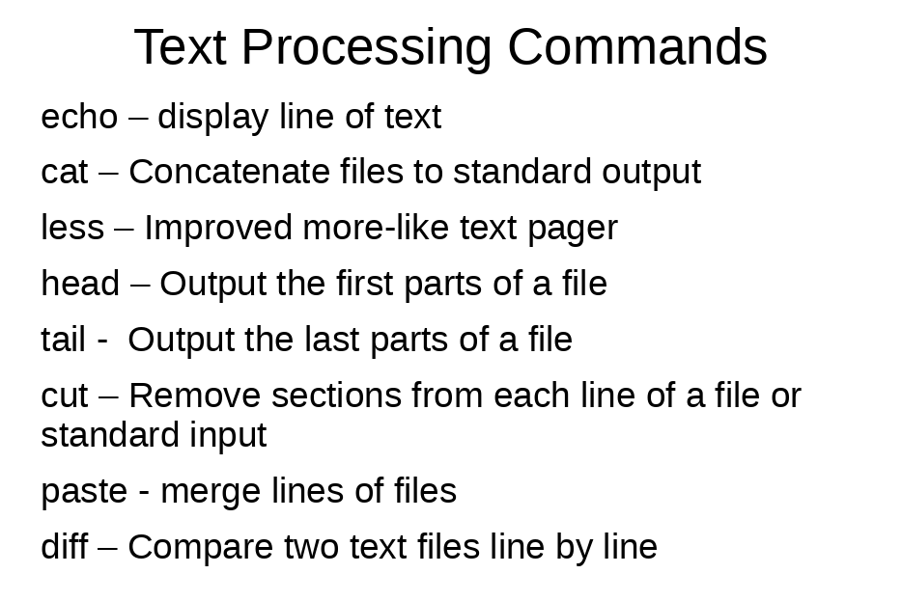

Slide 18
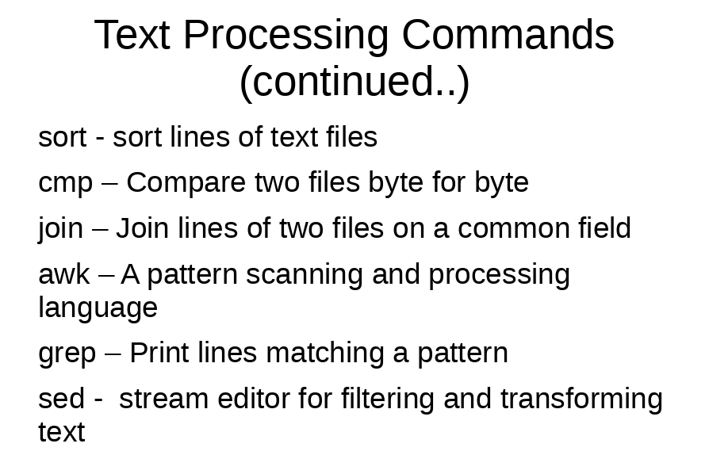

Slide 19
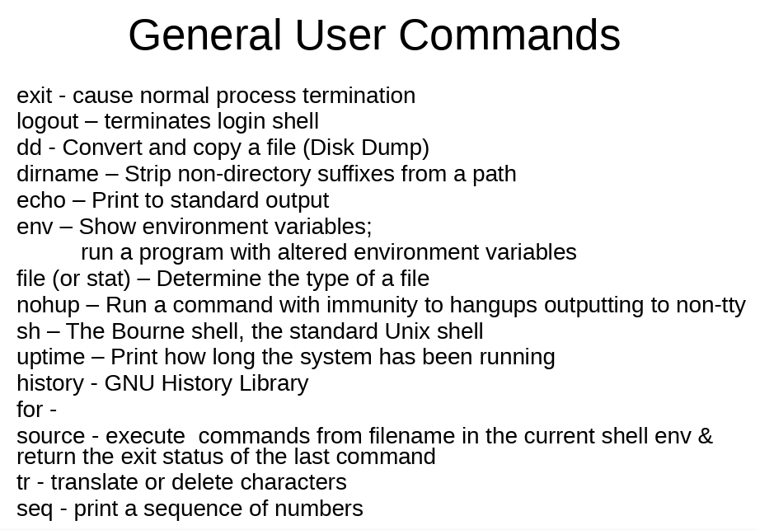

Slide 20
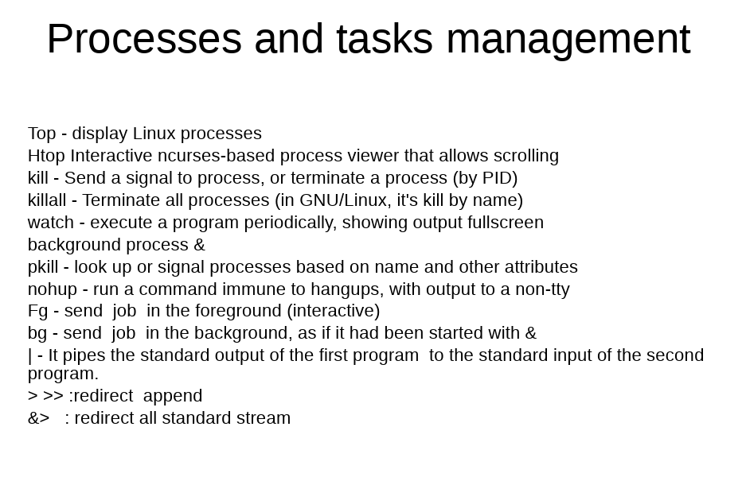

Slide 21
Exercises

Slide 22
Use the comands cd, pwd and ls to explore the filesystem.
• cd <dir> (change to dir)
• pwd (print working directory)
• ls (list files in current directory)
• ls -all (list all properties)
• cd . (change to here)
• cd .. (change one level down)
• cd ~(change to home directory)
• cd / (change to the root directory- the equivalent to ”C:” in windows)

Slide 23
List the files in your home directory.
Display detailed information about the files in your current directory.
Create a new directory and remove it
Create a new file called file.txt, Open and add contents to it. Display the contents.
Check the permissions of a file.
Change the file permissions of file.txt so that it is readable, writable, and executable by the owner.
Copy file.txt to a new file.
Move the copied file to a new directory called mydir.
Rename the copied file in the new directory.

Slide 24
Search for a file named file.txt in your home directory.
Search for the word "Linux" inside file.txt.
View the system's processes.
Check how much disk space is used on your system.
Check the available memory on your system.
Use piping to combine two commands: list all files and search for a specific file type.
Redirect the output to a file.

Slide 25
Use piping to combine two commands: list all files and search for a specific file type.
Redirect the output to a file.
List the processes running on your system.
Terminate a running process by its process ID (PID).
View the current network configuration, including IP addresses and network interfaces.
Use ip a or ifconfig (if available) to display the network interfaces and their IP addresses.

Slide 26
View the current network configuration, including IP addresses and network interfaces.
Check the network connectivity to a remote host (e.g., Google’s DNS server or a website).
Use the traceroute command to trace the route to a remote host.
View the list of active network connections and their associated processes.

